Slide 1
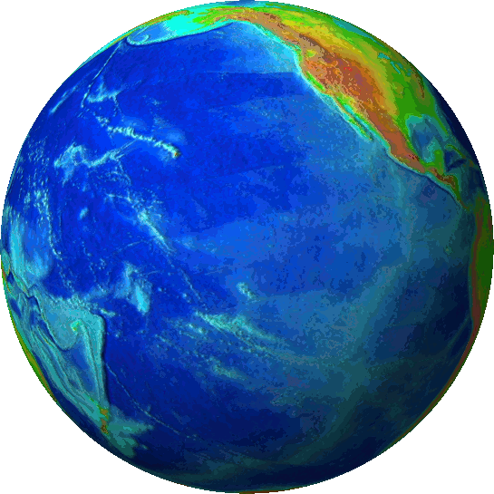
Earth Day is celebrated on April 22nd each year to raise awareness about the environmental problems of our planet and to realize how important it is to take care of the environment

Slide 2
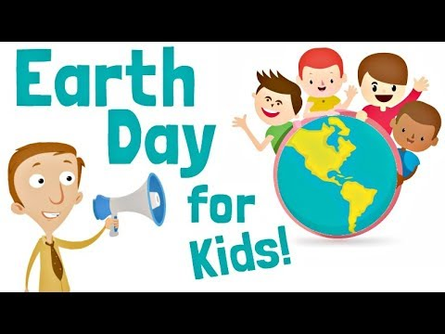
The first Earth Day was celebrated in 1970 after local protests about air and water pollution in the USA.In 1969 people were angry about a terrible oil spill in Santa Barbara,California,and the damage it caused.US Senator,Gaylord Nelson,called for a national "teach-in"bringing together students and teachers to talk about problems of pollution.
On April 22nd 1970,20.000.000 people ,joined the "teach-in"and met in streets,parks and universities to call for a healthy and clean environment.
20 years later,in 1990 Earth Day went global.More than 200.000.000 people in 141 countries took part in the event.
Today,more than 1.000.000.000 people all over the world come together each year to celebrate International mother Earth Day

Slide 3
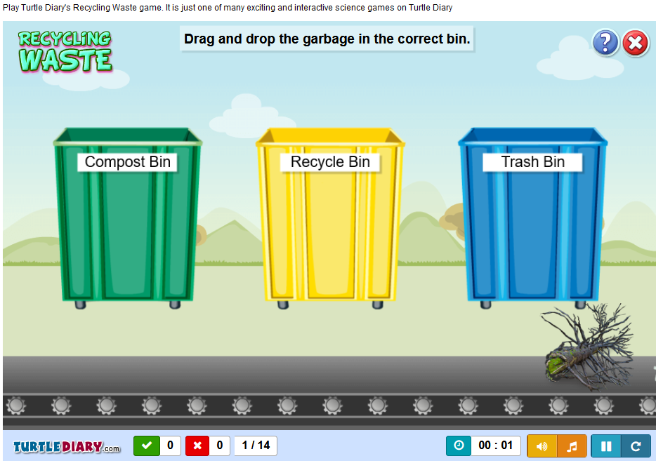
GAME: CLEAN AND GREEN
GAME: RECYCLE!

Slide 4
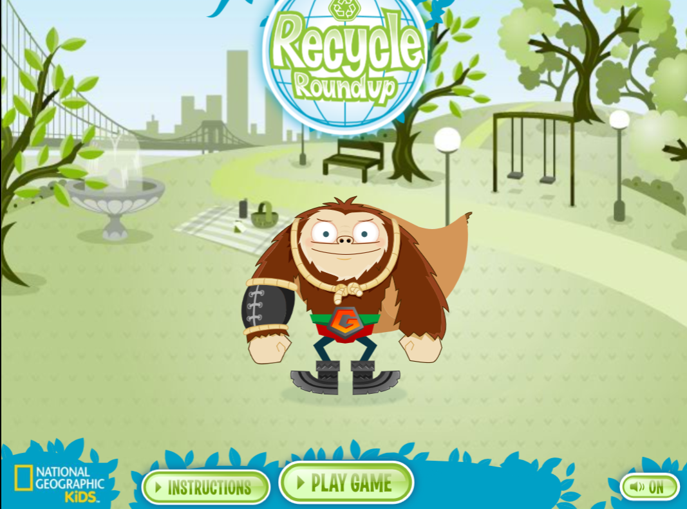
RECYCLE ROUND-UP!
Βοήθησε να καθαρίσουμε το πάρκο...βάλε τα αντικείμενα στο σωστό κάδο...

Slide 5
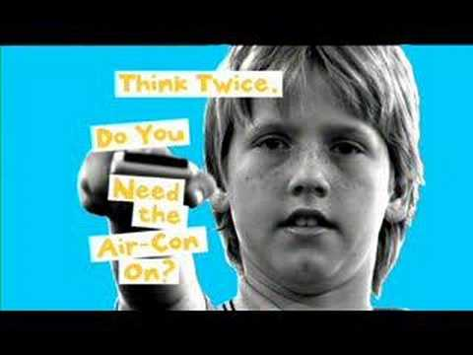
5 MINUTES TO CHANGE THE WORLD

Slide 6
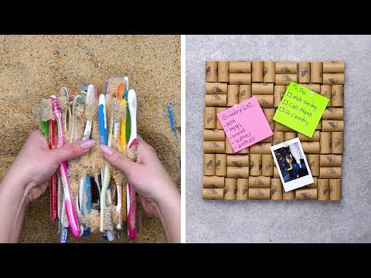
10 EASY WAYS RECYCLING-UPCYCLING HACKS

Slide 7
GAMES AND QUIZZEZ BY THE PARTNER SCHOOLS
OUR QUIZ about World Days about our Planet: (click on the days for more information)
WATER DAY -
EARTH DAY -
EARTH HOUR -
WORLD ENVIRONMENT DAY -
WORLD CAR-FREE DAY -
WORLD ANIMAL DAY -
MATCHING GAME 1 BY BERECAZZO SCHOOL
MATCHING GAME 2 BY BEREGAZZO SCHOOL
WORDSEARCH BY KARPENISI SCHOOL
HANGMAN BY 4TH PRIMARY SCHOOL OF KARPENISI

Slide 8
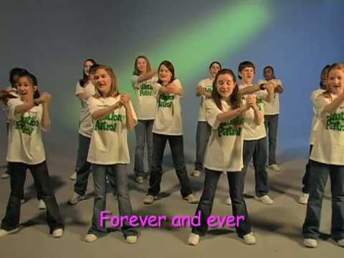
EARTH, WE’RE IN IT TOGETHER

Slide 9
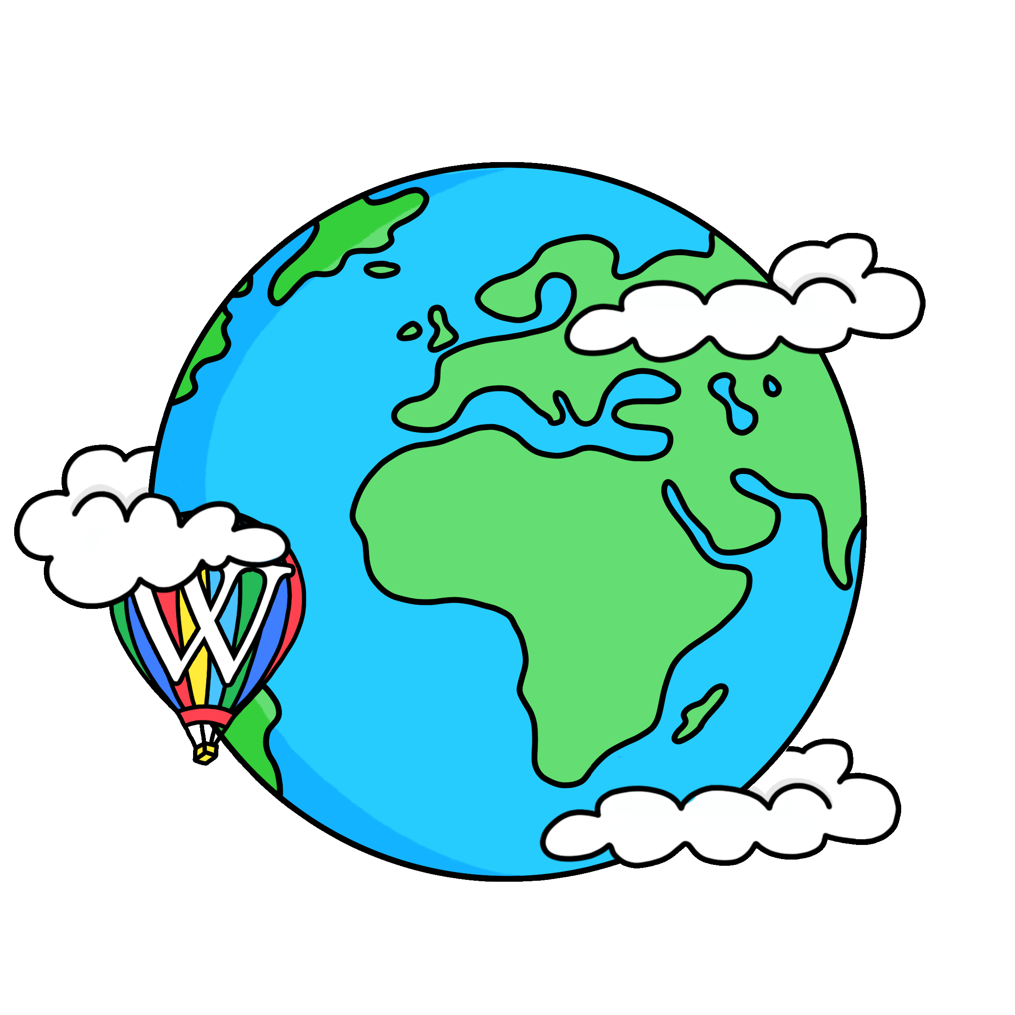
The Earth is a fine place and worth fighting for."
Ernest Hemingway

