Slide 1
Anti- covid Rules
By the students of the 4th Primary school of Karpenissi- Greece

Slide 2
Schools may be closed now in Greece, but we know how to protect ourselves from Covid-16

Slide 3
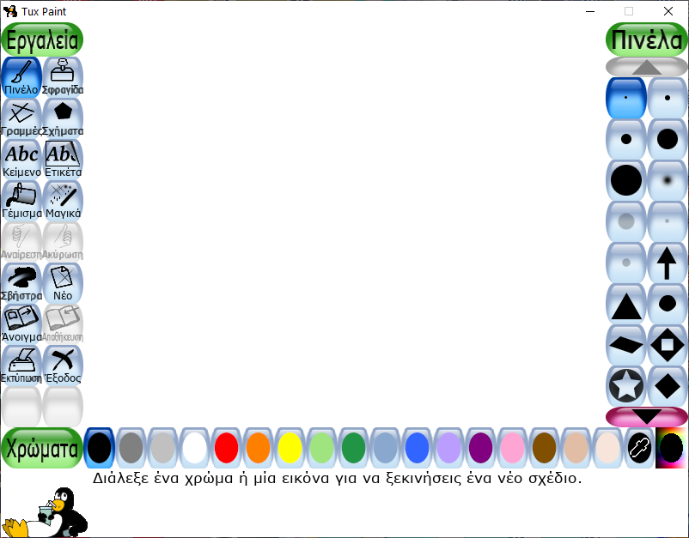
We worked in pairs in our school’s computer lab…
We like drawing with TUXPAINT!!!

Slide 4
WE Drew and wrote our rules and then we asked the students of the 5th and the 6th grade to help us translate them into French.

Slide 5
Here is our work!! We hope you like our drawings!

Slide 6
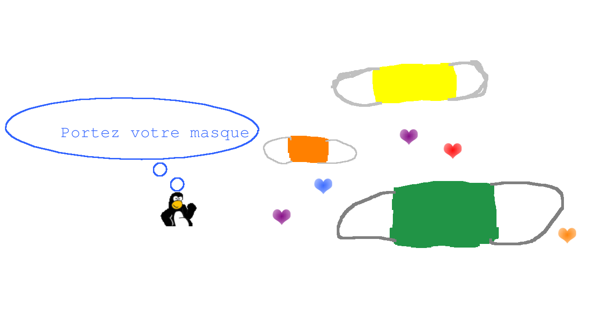
1) Wear your masks

Slide 7
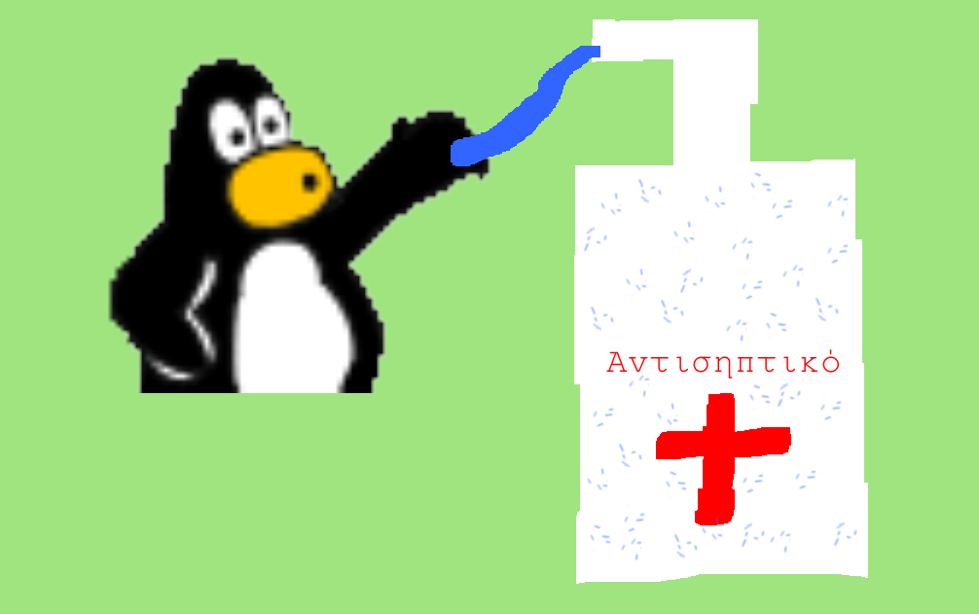
2) Use antiseptic

Slide 8
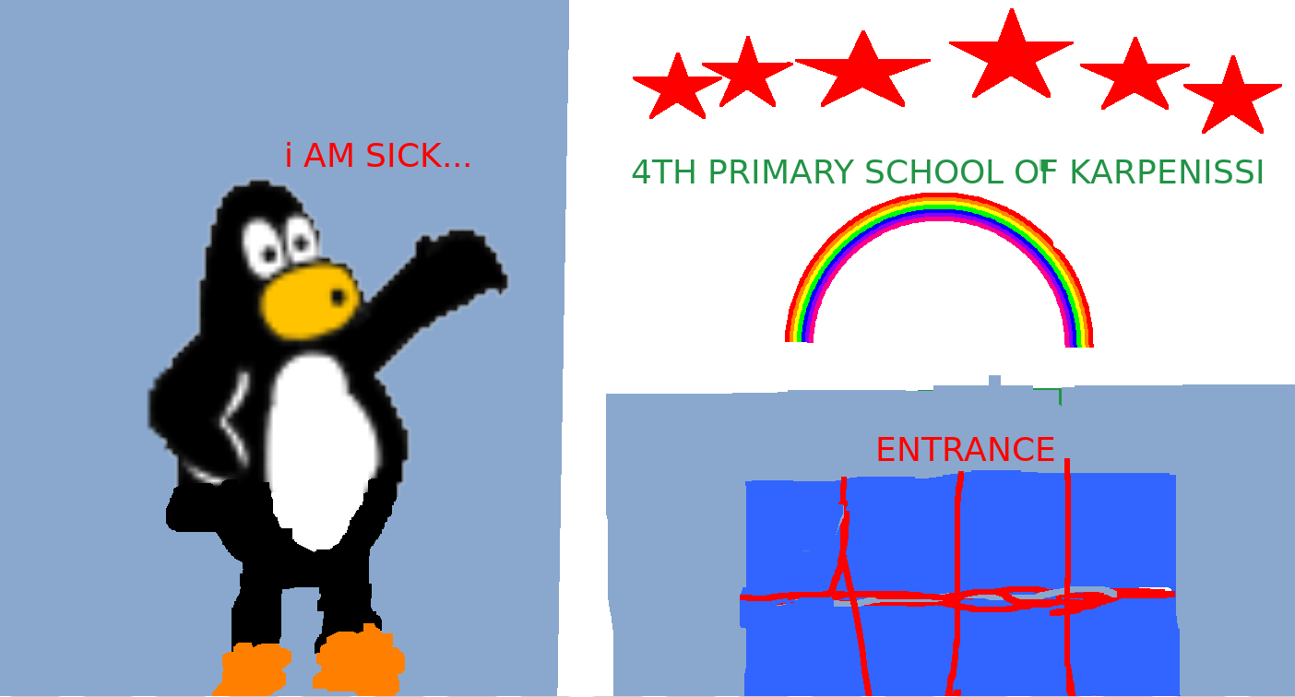
3) Don’t go to school when you are sick

Slide 9
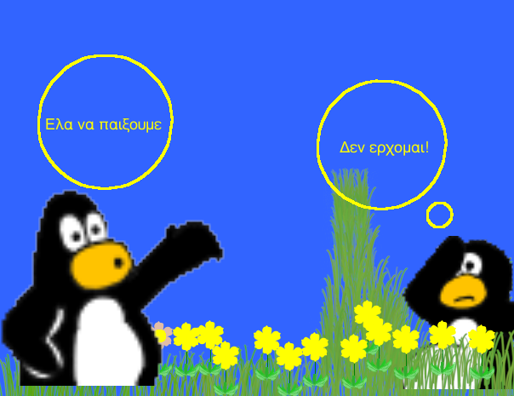
4)Keep distances
Come to play!
No, I’m not coming!

Slide 10
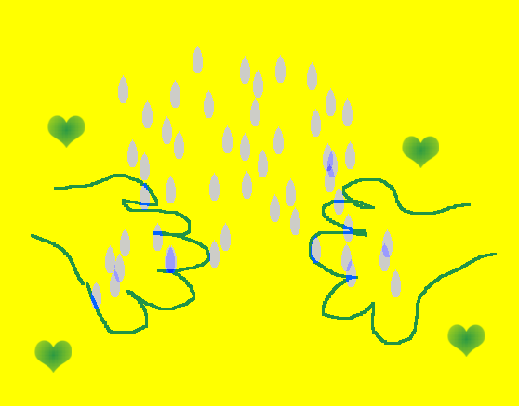
5)Wash your hands

Slide 11
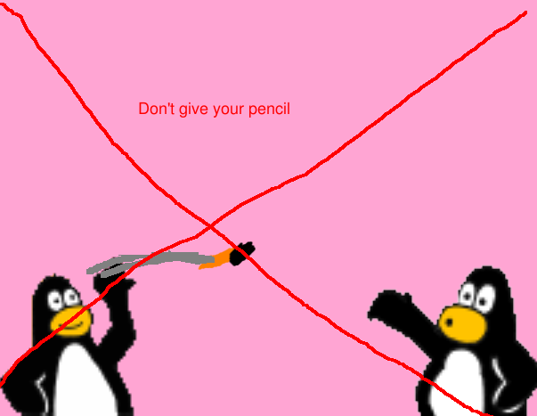
6) don’t share your things

Slide 12
Thanks for watching!!!

