Slide 1
Zagreb
city presentation

Slide 2
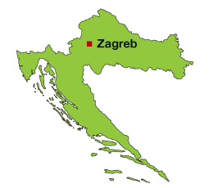
ZAgreb
Zagreb is a capital city of Croatia. About 1 million people live in Zagreb. It is my hometown. It is in the north of Croatia.

Slide 3
History of zagreb
In the past, Zagreb was first mentioned in eleventh century. It was consisting of Gradec (where the citizens lived) and Kaptol (which was under control of the bishops and priests who built their houses there).

Slide 4
Zagreb today
It is a beautiful city. It has a lot of nice shops, restaurants, museums, cinemas, hotels, theatres, squares, old streets and a lot of famous buildings from the past.

Slide 5
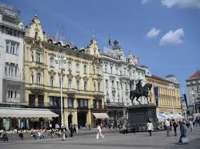
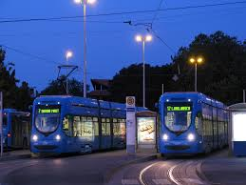
What you should visit
The main square: Ban Jelačić square
You should try a ride in our trams

Slide 6
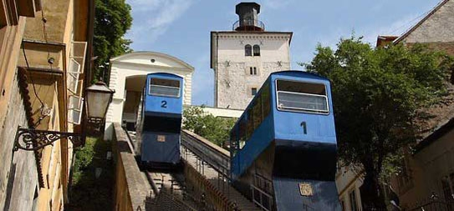
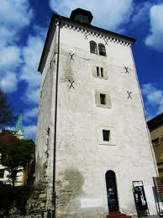
What you should visit
The amazing Upper Town
You should try a ride in our cable car
You should visit fortress Lotršćak

Slide 7
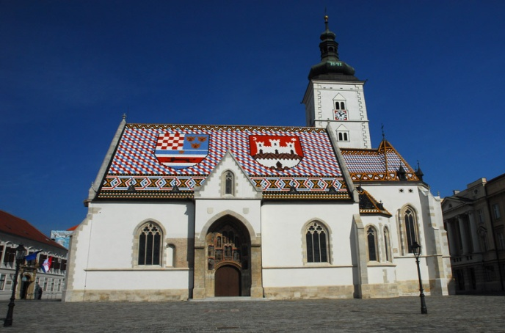
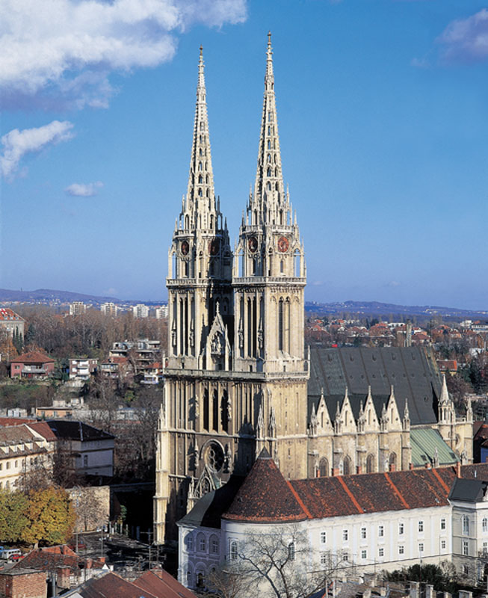
What you should visit
The church of Saint Marko
The Zagreb cathedral

Slide 8
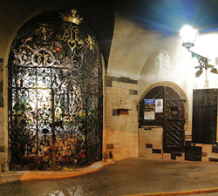
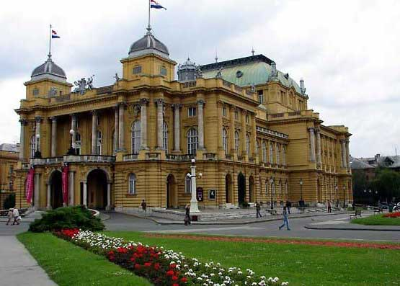
What you should visit
The amazing Stone Gate
HNK Theatre
Some of museums in Zagreb

Slide 9
Zagreb
I think that Zagreb is the heart of Croatia. I think it’s worth visiting. The people are friendly. There are good shopping malls like: Garden Mall, Avenue Mall, West Gate, City Center One East, City Center One West... As you could see there are nice places to visit and there is a good choice of hotels too. Good hotels are: Esplanade, Sheraton, International and Dubrovnik. They have five stars (Esplanade, Sheraton) and four stars (International, Dubrovnik). I think it’s a really fascinating city and it has an interesting history.

Slide 10
Zagreb
If you decide to live in Zagreb, you should pick the eastern side of the city. It’s where I live. I live in Retkovec, the part of Zagreb that is closer to the historical Upper Town. People moved in Retkovec in 1964 after the flood from the main river Sava that destroyed the part of city that is at the bottom of the old hills Gradec and Kaptol which formed Zagreb in the past. People needed a new place to live so that is how Retkovec was made. Our school (which I attend) was made in 1967. It is one of the biggest (elementary) schools in Zagreb. It has over one thousand students.

Slide 11
That would be all!
THANK YOU FOR YOUR ATTENTION!

