Slide 1
pupils with disabilities and special needs in the italian inclusive school system
Functional Diagnoses and the Flexible Learning Approach in our school

Slide 2
Look at these pictures taken in our school «Francesco Petrarca» in catania. What do you see?
ALL DIFFERENT, UNIQUE, SPECIAL AND ALL WELCOME.
CHILDREN.

Slide 3
Some disabilities and special needs are visible
Children with high needs arrive at school with their own special portfolios. They have certifications and functional diagnoses and evaluations issued by the multidisciplinary équipe (Health Board and Neuropsychiatric Departments).

Slide 4
Some children arrive alone from african countries
Girls and boys speaking their native languages and very basic French or English who arrive without their families. We welcome them with special programmes in our classrooms.

Slide 5
Some disabilities and special needs are not visible
In this class group, there is a pupil with Specific Learning Disabilities (Dysgraphia and Dyslexia), another has a mild intellectual disability and another one shows signs consistent with an attention disorder. Also, three of them are affected by sociocultural issues.

Slide 6
Inclusion is an attitude and a must. It determines how we interact with one another.
It is not just about access…
…and it’s more than just a policy.
It’s about the needs…
…knowing and understanding the needs of all pupils.
It means improving the context…
…changing the way things are organised.

Slide 7
Inclusion is a social challenge and it is everybody’s responsability.
We all have to be on the same page…
By exchanging good practices and sharing infos through a network system including…
How?
…teachers, families, schoolmates, rehab operators, assistive personnel, social and welfare service assistants, medical équipes, and so on.
…even if at different times!

Slide 8
Realising inclusion in public schools as well as in our societies is a matter of complexity
Remember… it was easier in the other equations!

Slide 9
Since the 70s when children with disabilities were first integrated in the italian public schools and the special schools for handicapped pupils were closed, a lot has been done.
Students with disability accessing their rights by Law n.104/1992 (art.3 comma1;
art.3 comma 3)
are entitled to be supported by
Some examples:
Autism
Deafness
Blindness
Mental retardation
Multiple disabilities
Hearing impairment
Developmental delay
Traumatic brain injury
Still, the cornerstone for inclusion in the italian school system is the law 104/1992, which defines the procedures to give support to disabled pupils from infant school to high secondary education.
Specialised assistants for communication and autonomy not only for autism spectrum disorders.

Slide 10
During the year, in our schools, There are regular meetings with the interdisciplinary equipes for each and every of our special children.
Support teachers assess the special students’ potentials and levels of need, together with pedagogists and psychologists (the neuropsychiatry staff), and the families.
Functional Diagnoses and Functional Disability Profiles are the starting documents leading to the Individualised Education Program which includes short and long-term objectives, tailored-activities and special practices or rehab projects.
All teachers agree on the best strategies and methods to teach their special need students and everyone cooperates in writing the IEP (assessing, testing, evaluating) while adjusting it during the years.

Slide 11
We are gradually overcoming the medical model
A disability determination tool based on the International Classification of Functioning, Disability, and Health – Children and Youth (ICF-CY) framework is being applied.
Ability/Disability determinations made using the ICF-based tool are thought to provide more information than determinations based on diagnoses alone.
The old but still applied ICDH – International Classification of Impairments, Disabilities and Handicaps
The new perspective is based on the biopsychosocial model framework
Personal factors
Body functioning and structures
Disability is defined as the consequence of an interaction between an impaired body structure and its function, limitations of activities of participation, and barriers in the environment.
The context
and it follows the recommendations of the World Health Organization (WHO)

Slide 12
Support teachers work together with all the other teachers inside the classrooms creating the best possible setting for some activities to be shared and the child’s individualised objectives to be reached.
All together students support each other. Inclusion fosters their social and emotional development.
The school can provide assistive technology (hw and sw) by requesting it to dedicated Centres.

Slide 13
Sometimes, during the day, individual learning sessions and workshops in small groups are scheduled inside more controlled environments.
Sometimes, working by myself is just fine!
Dramatisation and role-playing are perfect for improving interaction skills and learning autonomy.

Slide 14
Every activity has to be carefully organised in advance
School trips may include the participation of parents and daily care assistants.
The itinerary has to be accessible and barrier free!

Slide 15
Every activity has to be organised in advance
Every student is given his own time to adjust but eventually they all get along just fine!
We also arrange visits to other schools (higher grades) and teachers and parents can exchange infos to ensure the best support needed. Support teachers can shadow for some sessions their colleagues.

Slide 16
The Headmaster and the leading teacher, who coordinates the team of teachers for special educational needs, conduct regular surveys of the school special population and they may suggest programmes and courses to improve teachers’ formation .
It provides the outlines for an important document on the inclusion policies called
SCHOOL INCLUSION PLANNING
Schools have a dedicated Working Party to improve the inclusive dimension(GLIS)
It is summoned at least twice a year
It has to be updated every year…
Teachers, parents, social services, health board representatives, local board reps, special needs associations reps, they all can be invited
…and it also contains short and long term objectives for the next school year.

Slide 17
In our school, over a population of more than 900 students, 100 are with special needs.
By the Law
n. 170/ 2010
Regulating the Specific conditions caused by Learning Disorders (DSA) such as Dyslexia, Dysgraphia, Dyscalculia, Dyspraxia
Their levels of need are different and we, as teachers of an inclusive school, are responding to this complex situation by organising our classroom teaching strategies accordingly.
these pupils are not entitled to a support teacher but…
…use of assistive technology, a didactic by mind/concept mapping, the extensive use of visuals (pictures and videos) on tablets and IWB (Interactive Whiteboards).
…all teachers agree on Personalised Learning Programs and the…

Slide 18
In the public italian school system EVERY LEARNER HAS TO BE CARED FOR.
Students with other disorders and disabilities can get the help needed…
By the most recent government guidelines
C.M. n.8
March 6th 2013 and Law n. 66/2017
These children may have ADHD (Attention Deficit Hyperactivity Disorder) or ODD (Oppositional Defiant Disorder) or a Borderline Cognitive Functioning
Their condition may be evaluated and diagnosed by the Neuropsychiatry Staff but…
Also, the classroom team of teachers, can independently decide to prepare Personalised Learning Programs
…they are not assigned a specialised teacher.
So, Italian teachers are asked to be simply amazing, no less!

Slide 19
Disciplinary contents have to be presented to suit the students’ different learning styles.
PERSONALISATION
Cooperative learning sessions
Learning by doing
This is true and it works better for everyone!
Step-by-step procedures
Mind mapping
Adaptations and Scaffolding
Flipped Classroom
Tiered tasks and Bias tasks
Coursebooks with special needs editions and dedicated worksheets and visual materials also with online repositories and IWB versions
Mixed level teaching
Working in pairs
Peer Tutoring

Slide 20
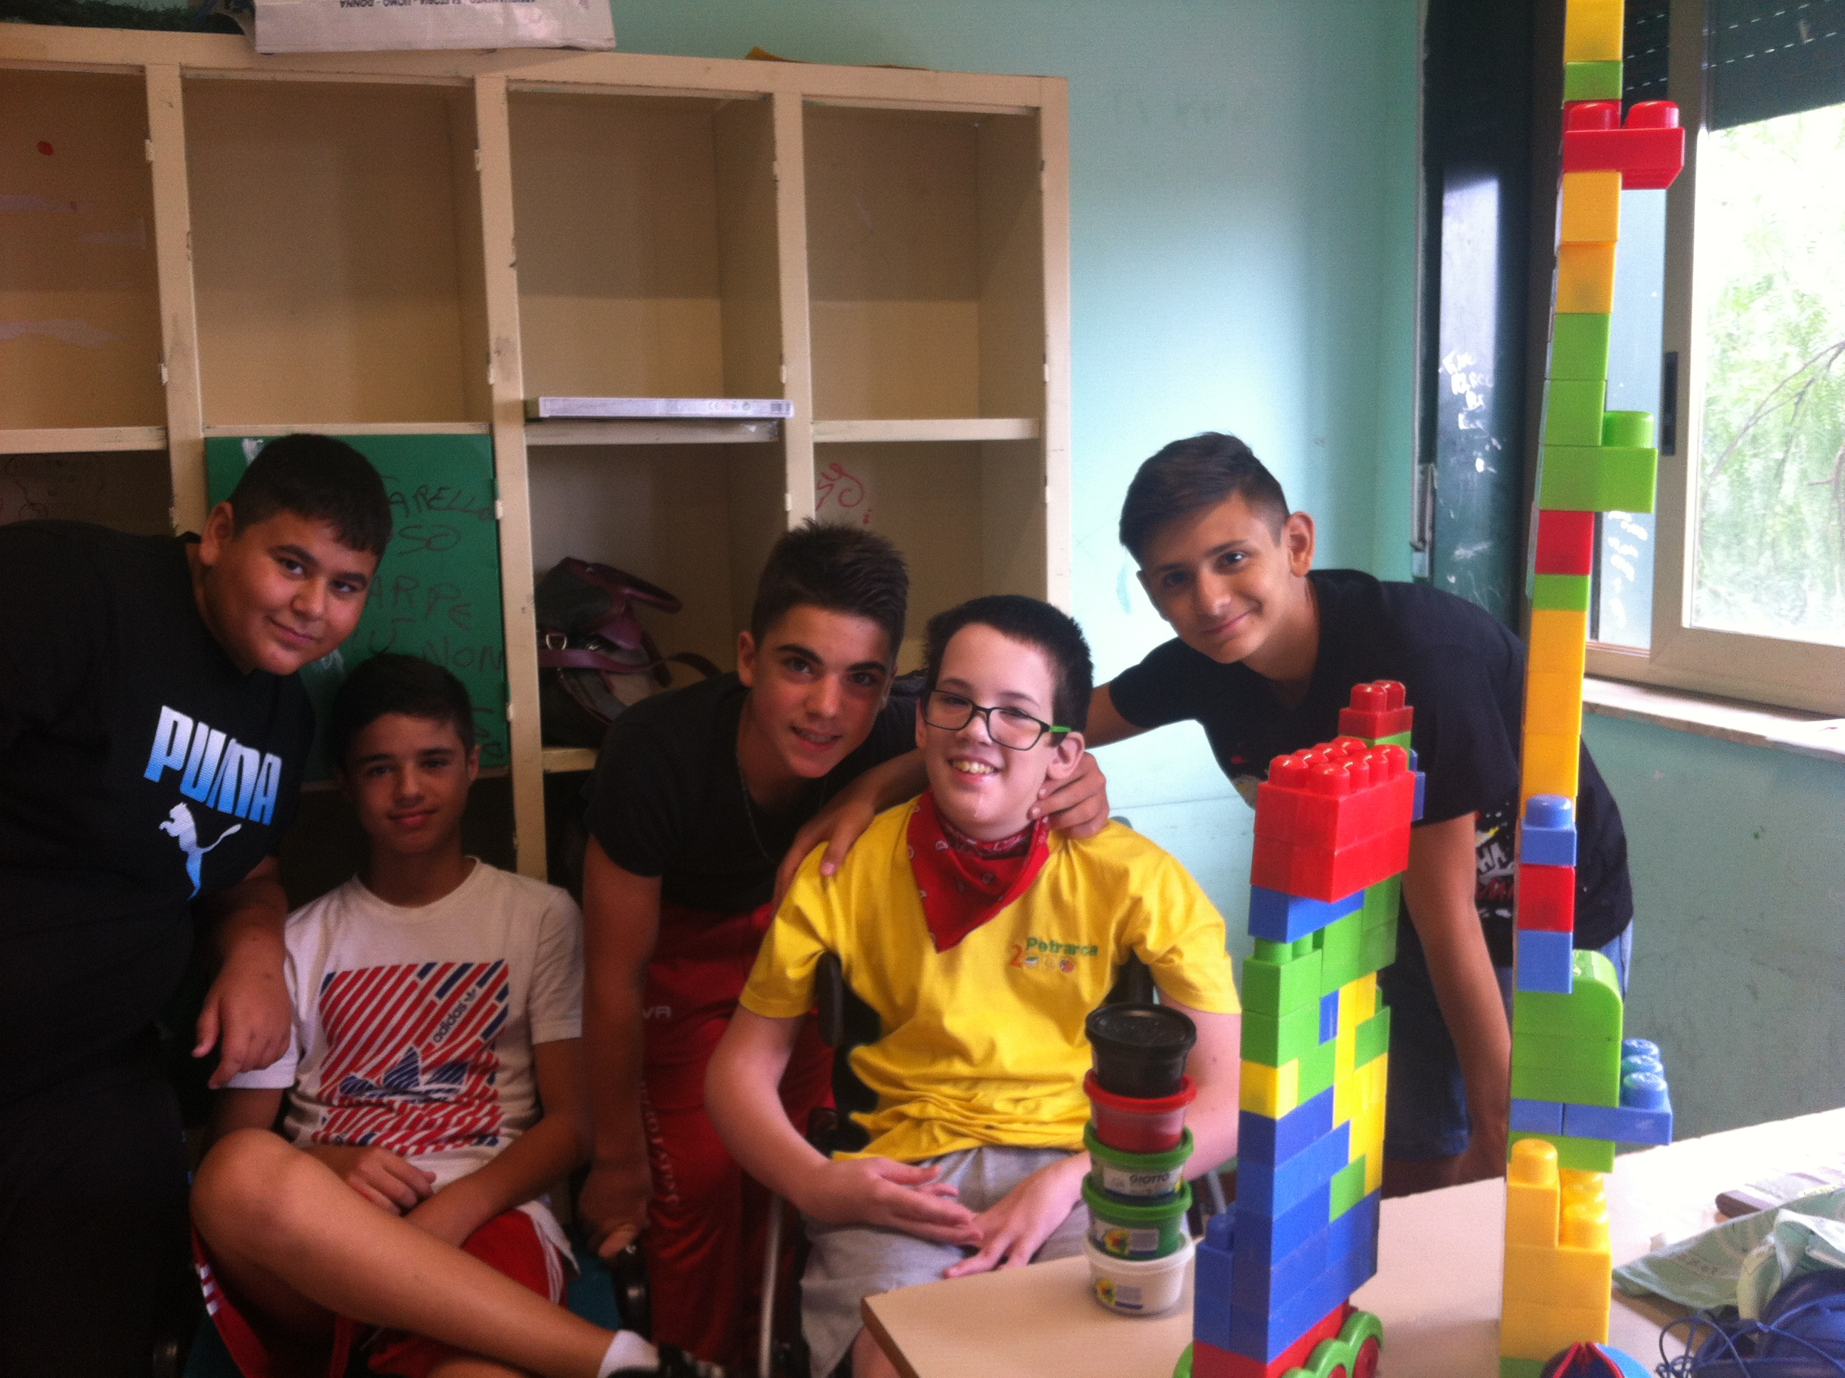
Challenging and Difficult as it is, we are doing our best, all together, to build a better, more conscious society where everyone has the right to be acknowleged
Thank you.

