Slide 1
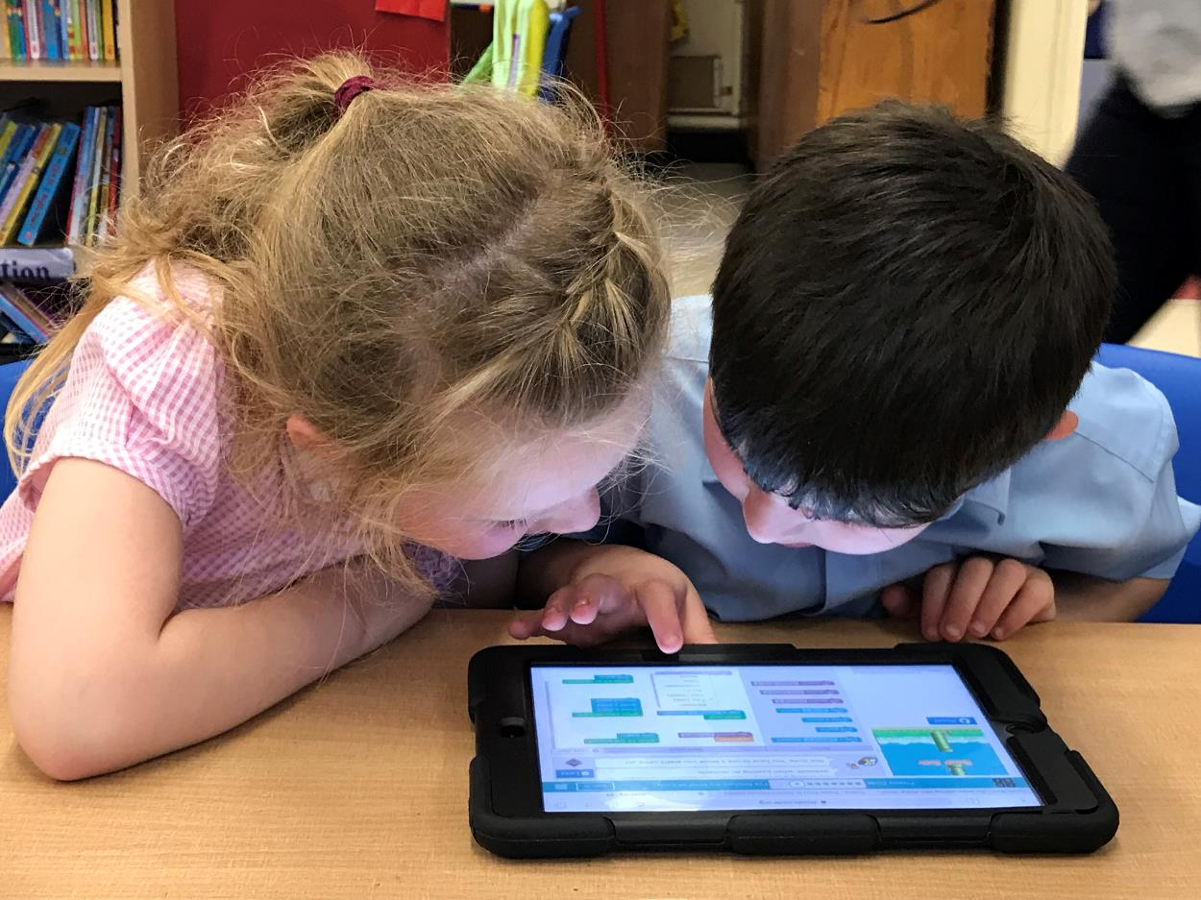
Digital Learning
at Saint Austin’s Primary School

Slide 2
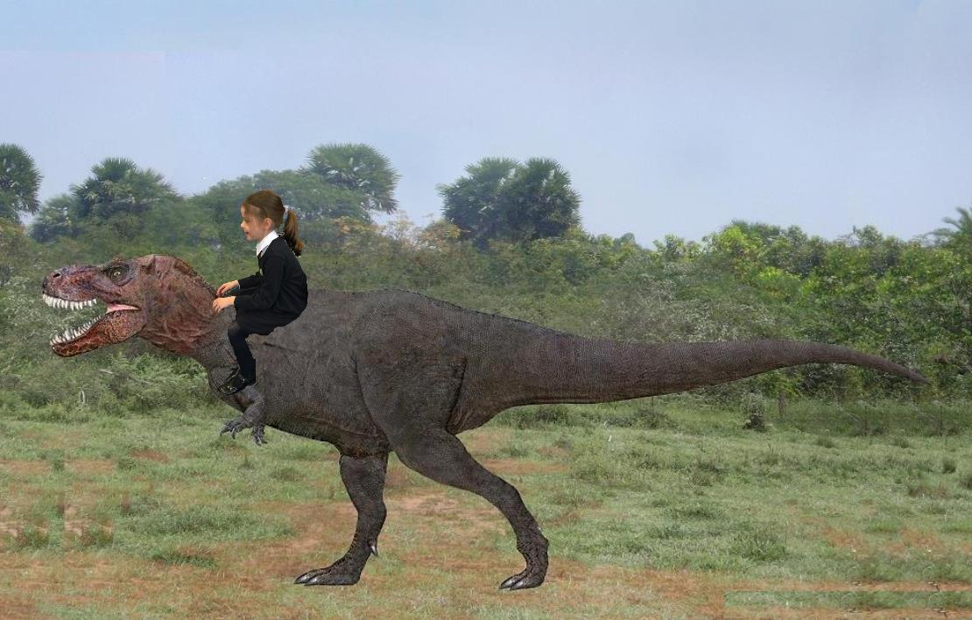
Digital images
Creating, Modifying, Editing

Slide 3
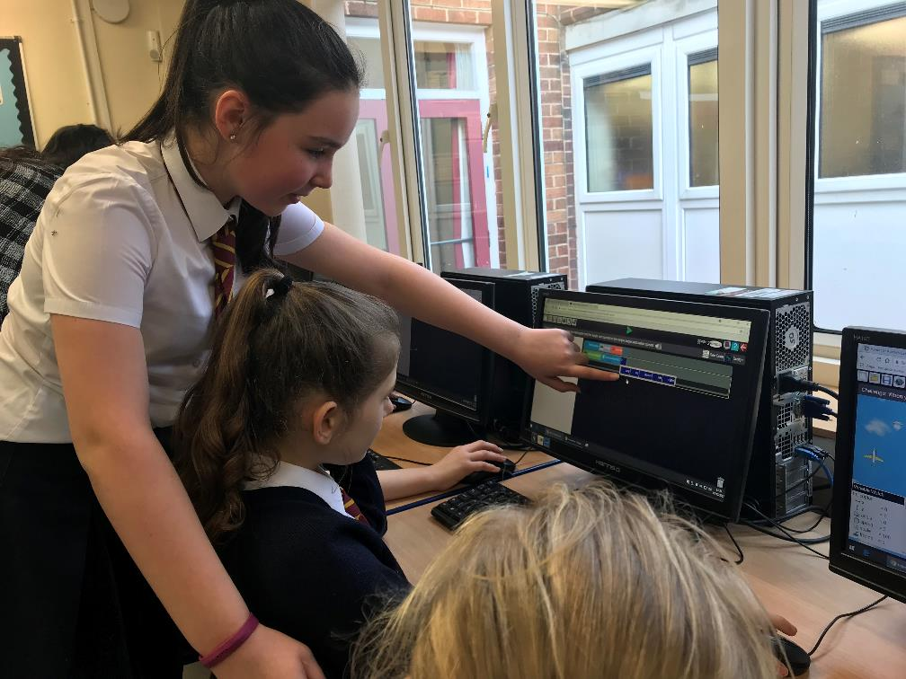
Coding
Writing code, Making games, Programming devices

Slide 4
Digital Video
Recording, Green screen, Film study

Slide 5
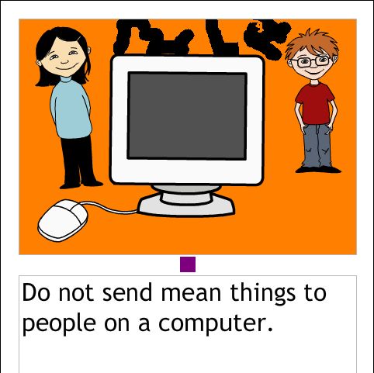
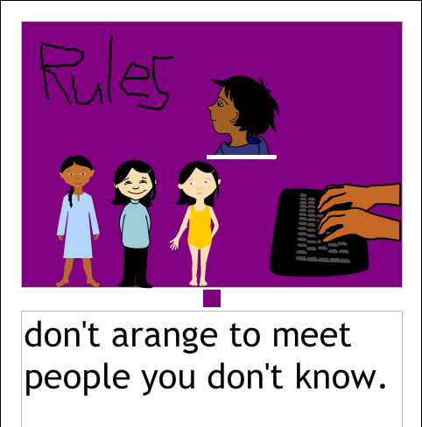
Online Safety
Staying safe, Understanding dangers, Being responsible

Slide 6
Our digital world
Understanding technology, Using devices, Ready for the future

