Slide 1
Digital media in my school
Prof. ssaAntonella Lovullo
Prof.ssa Silvia Miceli

Slide 2
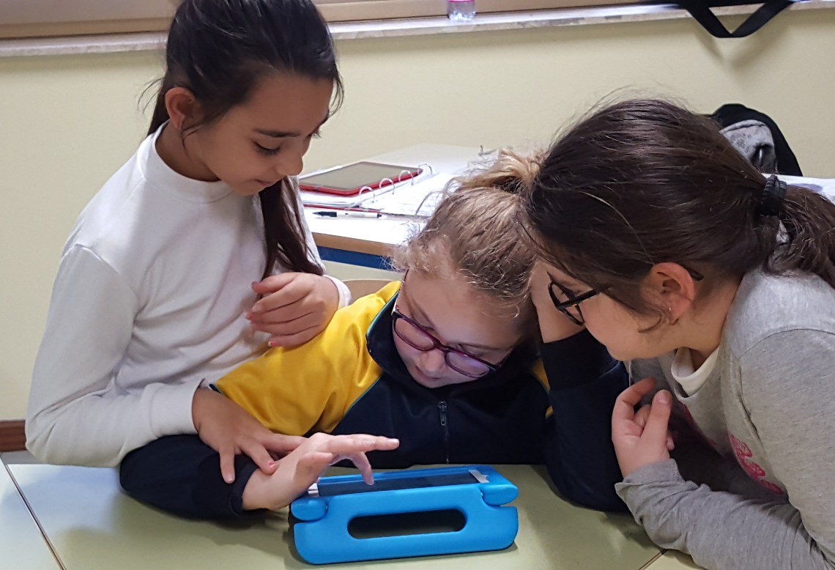
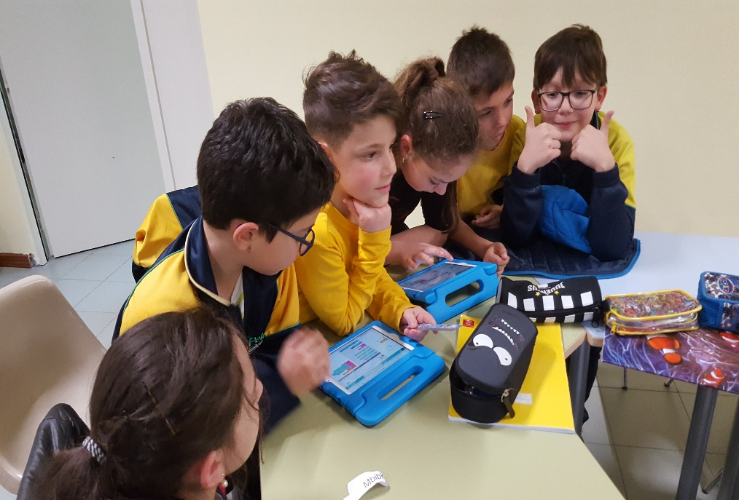
Cooperative learning ipad in THE class

Slide 3
coding

Slide 4
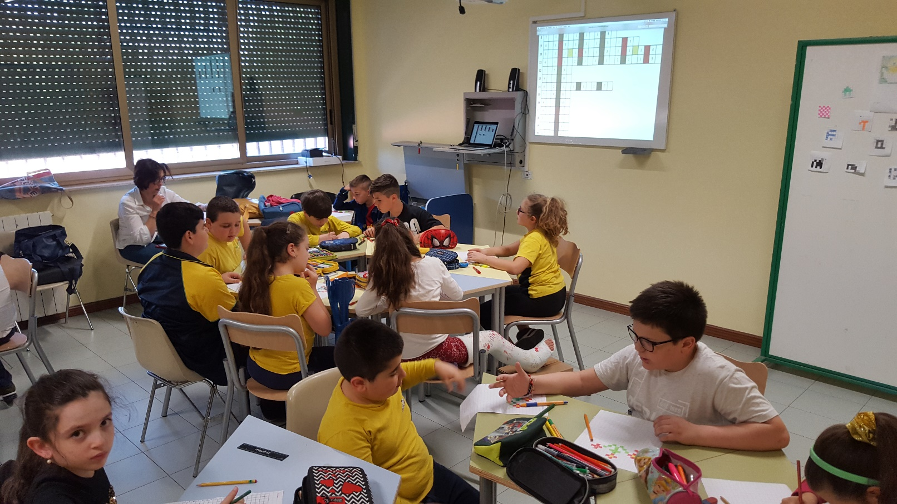
NEW LEARNING SPACE

Slide 5
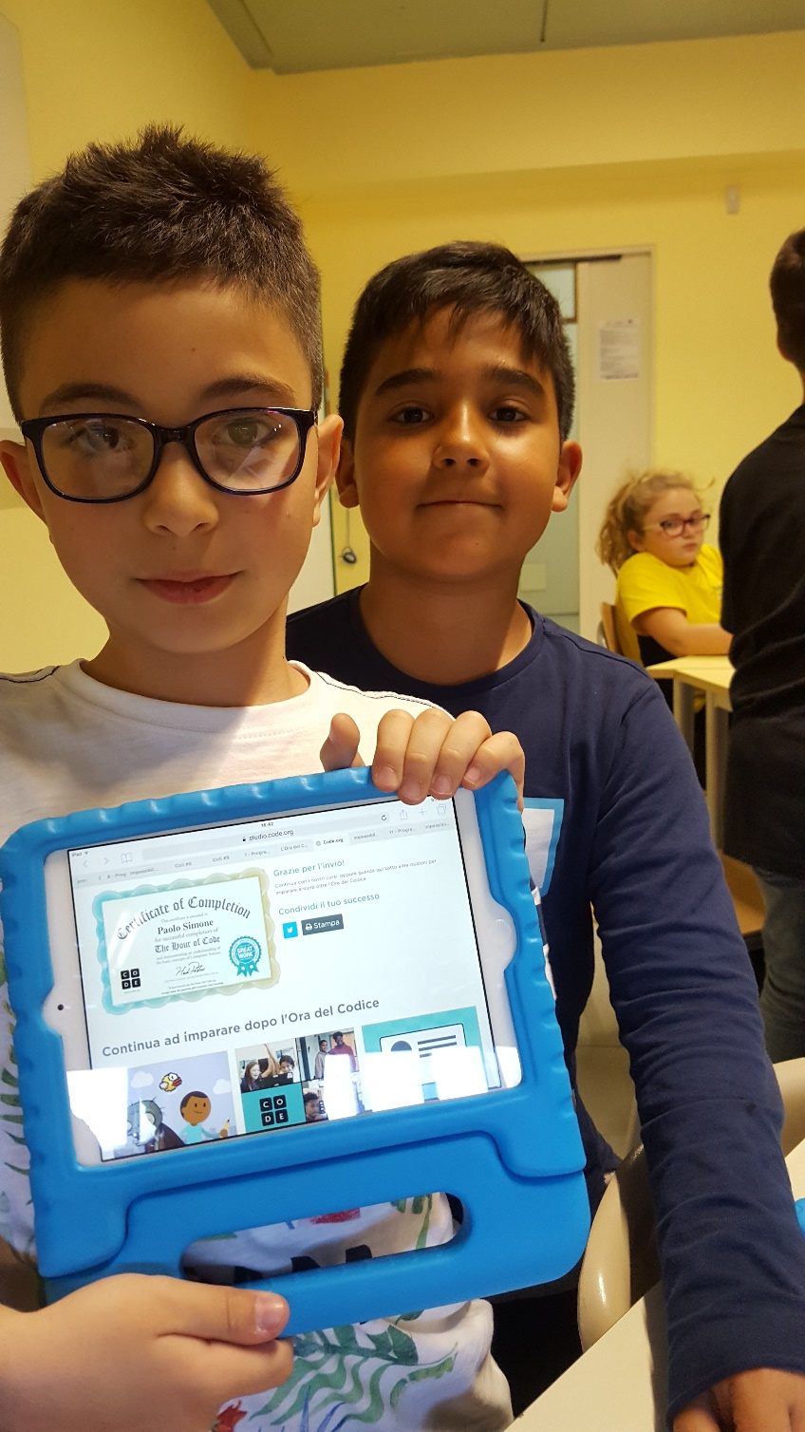
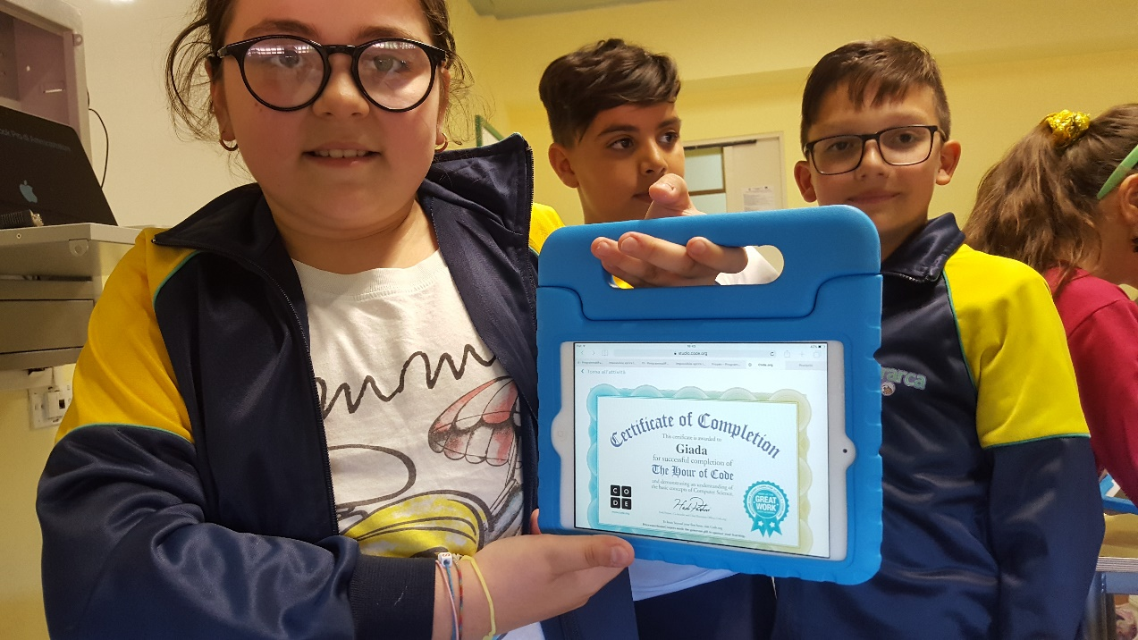
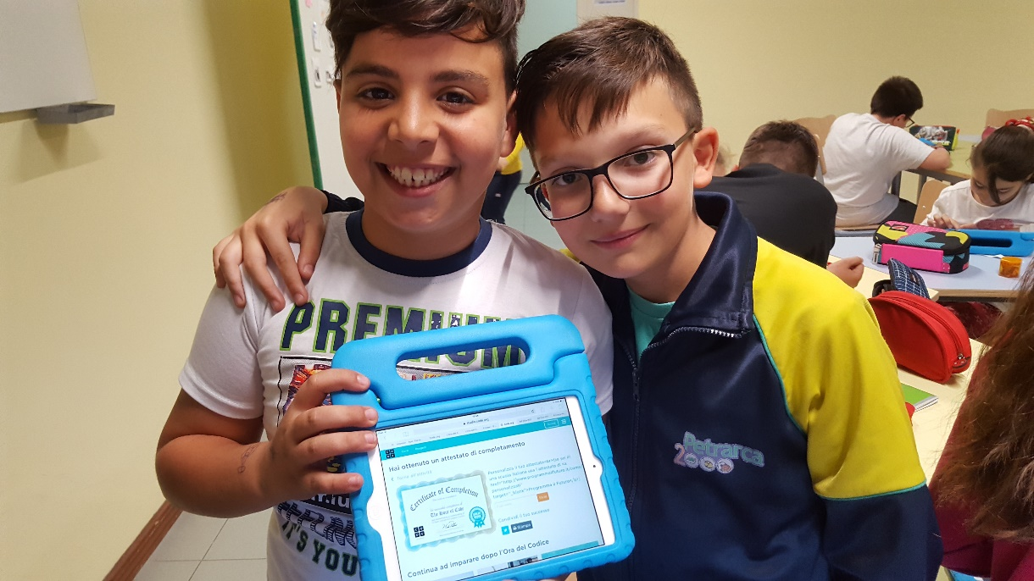
LEARNING IS FUN

Slide 6
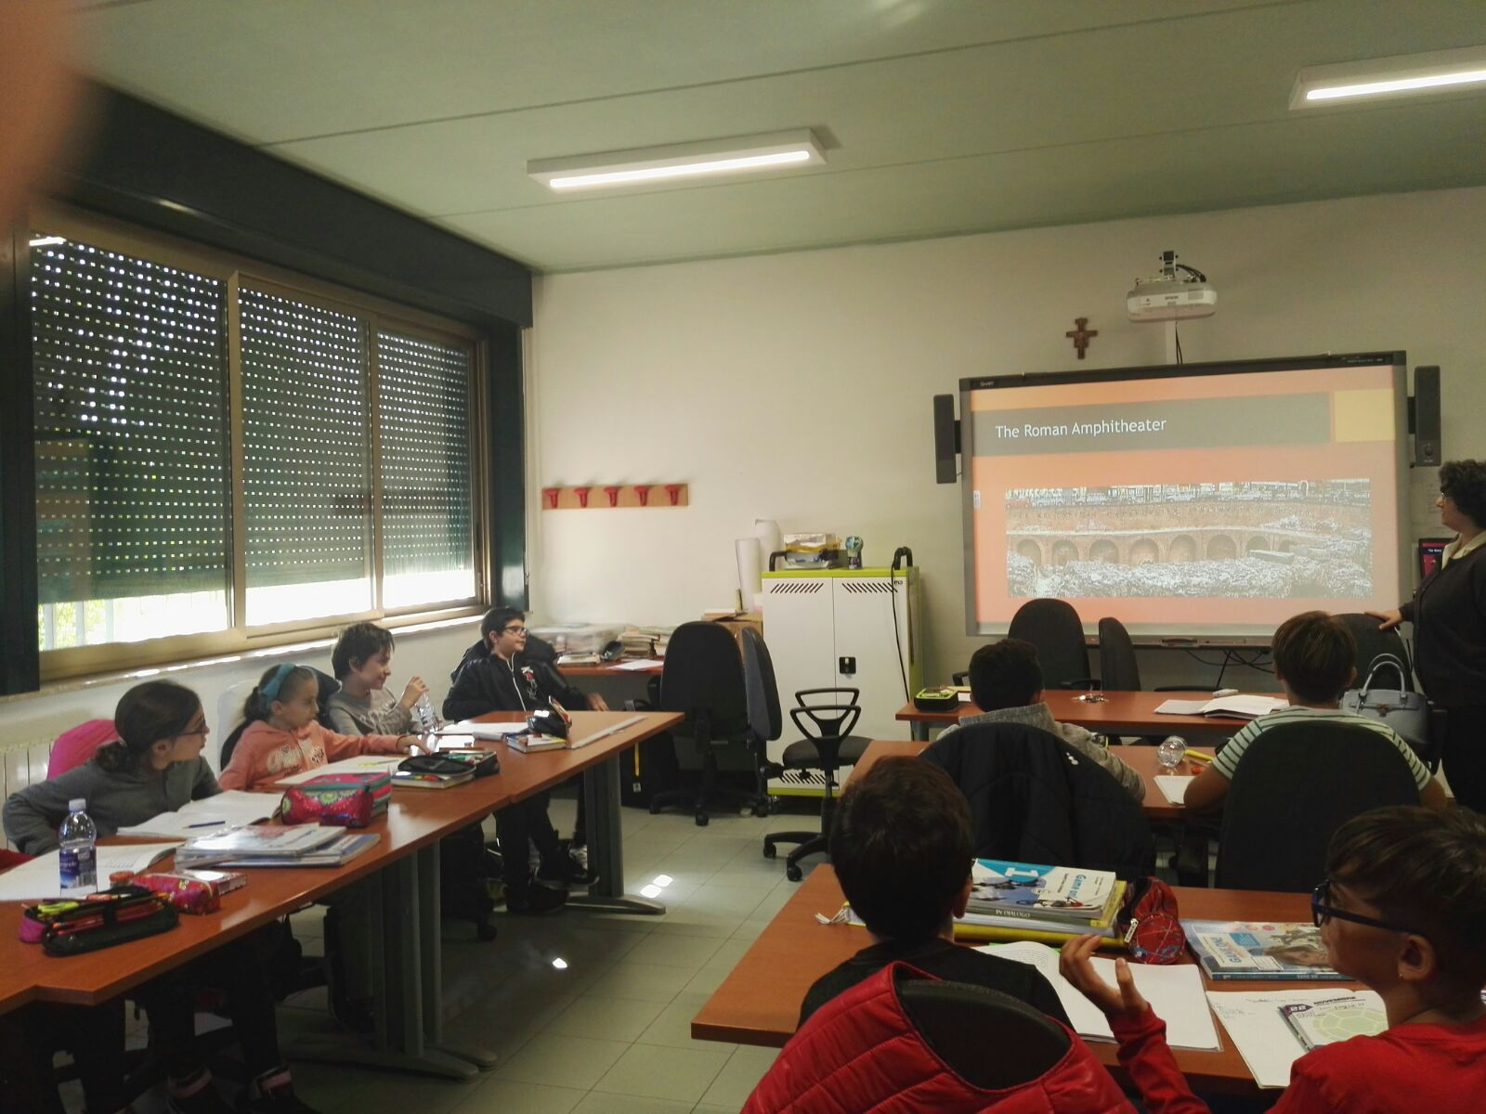
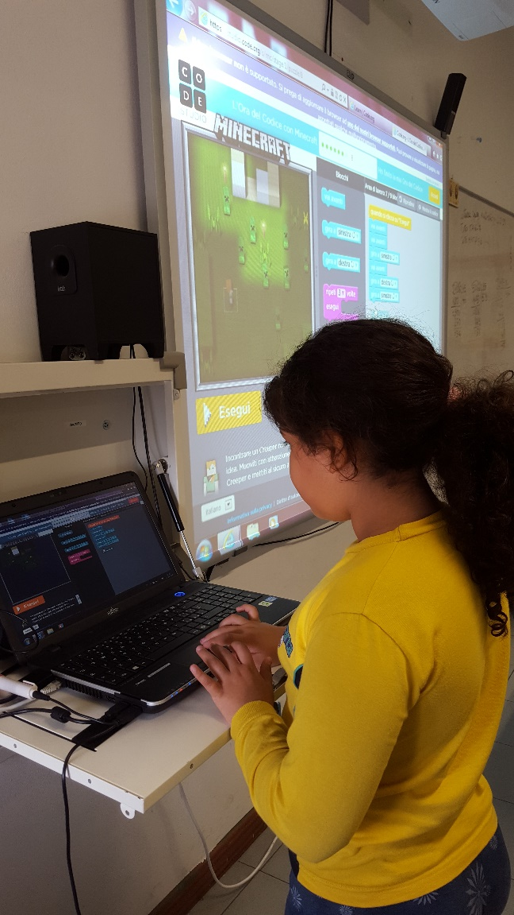
I B in ALL classES

Slide 7
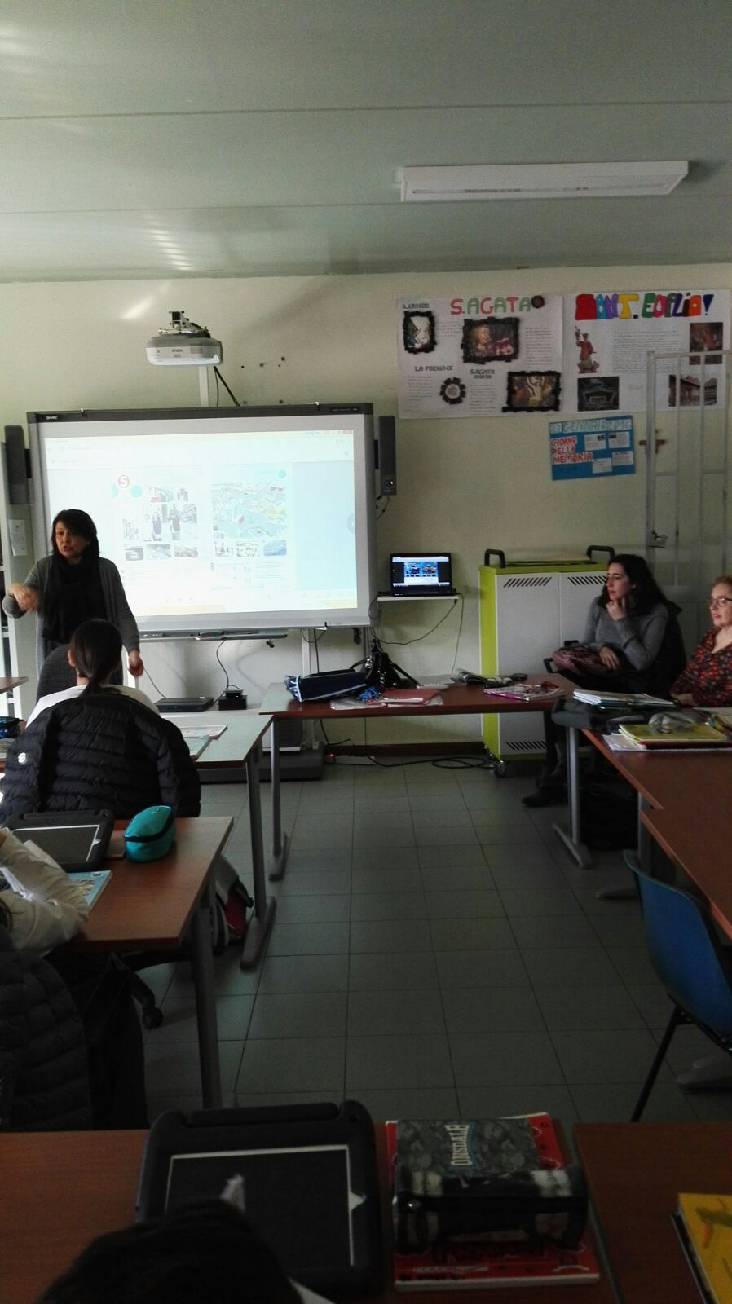
ClassES 2.0

Slide 8
ClassES 2.0

Slide 9
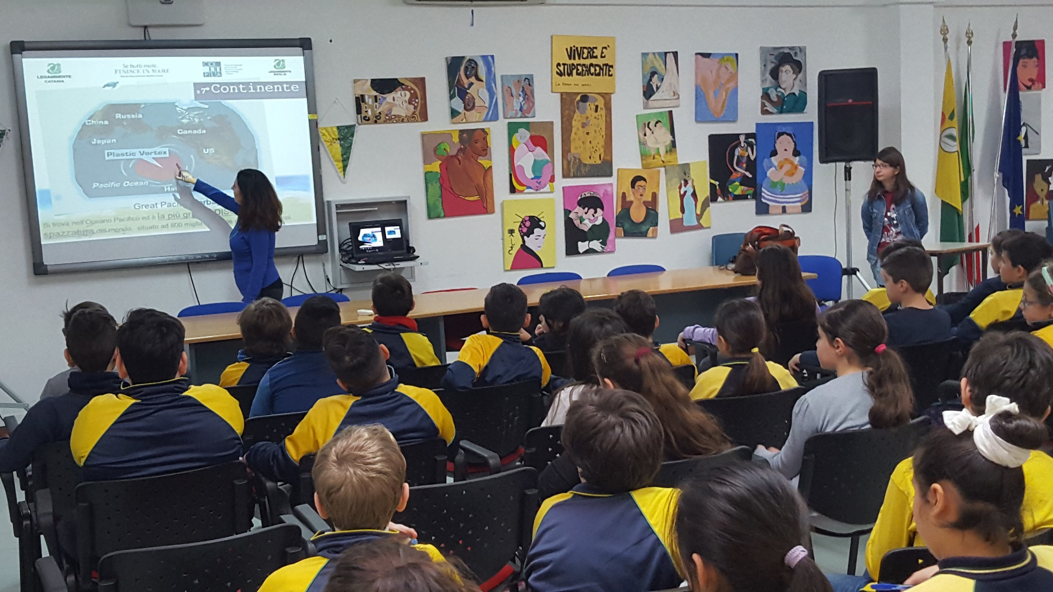
GATHERED ClassES

Slide 10
NET robotic PROJECT

Slide 11
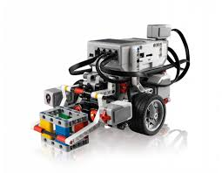
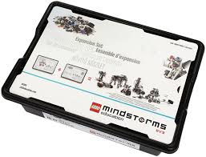
Robotic USING lego MINDstorms

