Slide 1

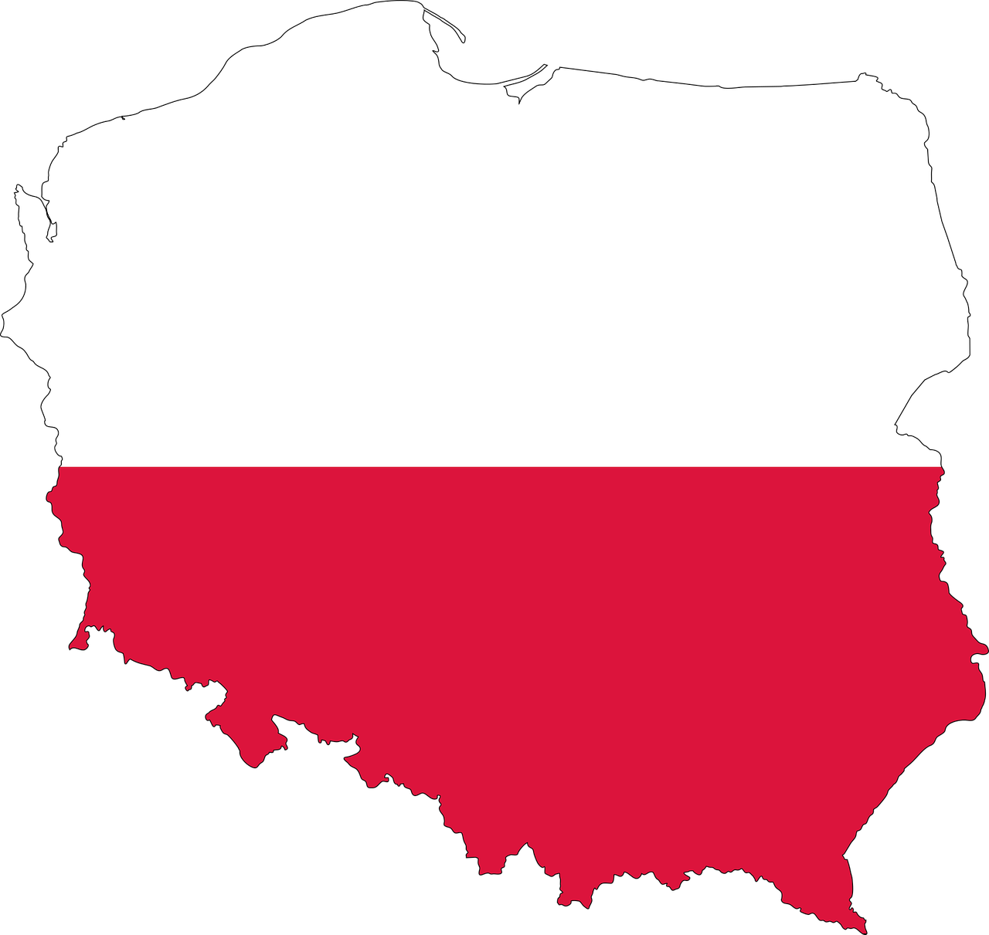

Polish Language

Slide 2
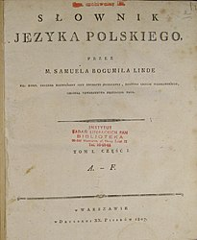
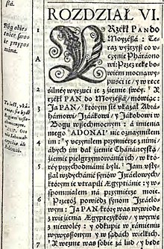
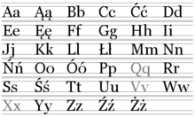
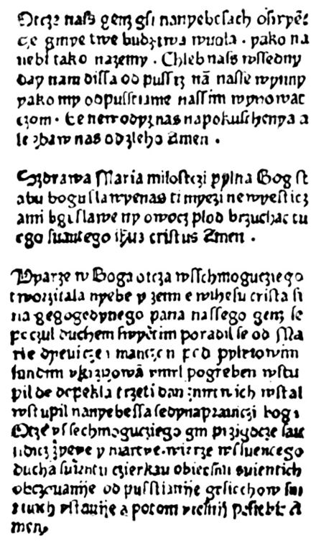

The History of Polish Language

Slide 3
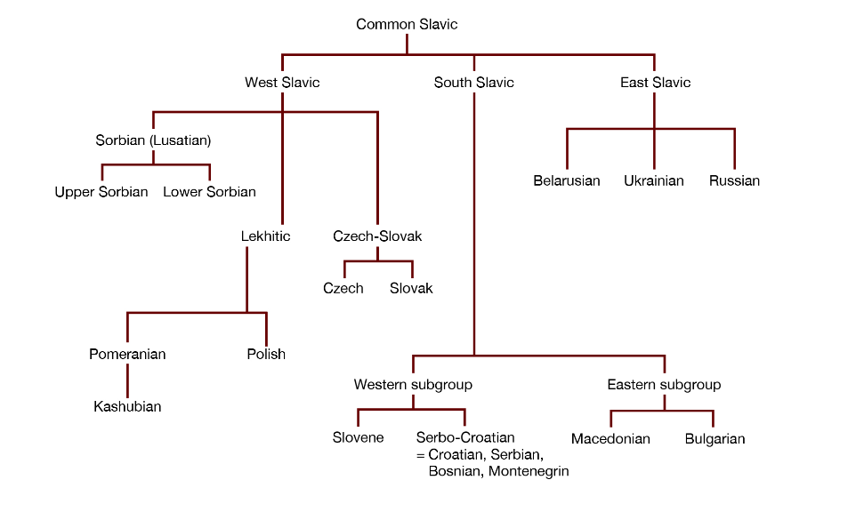

Polish belongs to a large family of Slavic languages

Slide 4

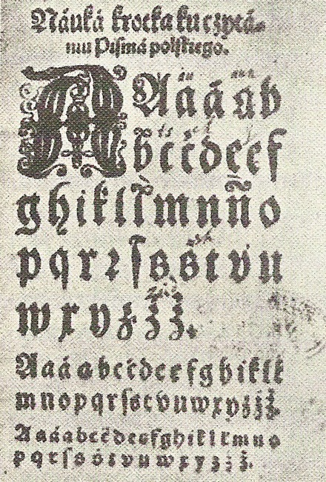
Depending on the adopted criteria, researchers specify five periods of Polish language development in total :
pre-literate - from the X century to the middle of the XII century
Old Polish - from the X or mid-XII century to the turn of the XV and XVI century
Middle Polish - from the XVI century to the end of the XVIII century
New Polish- from the end of the XVIII century to 1939
contemporary - after 1939

Slide 5
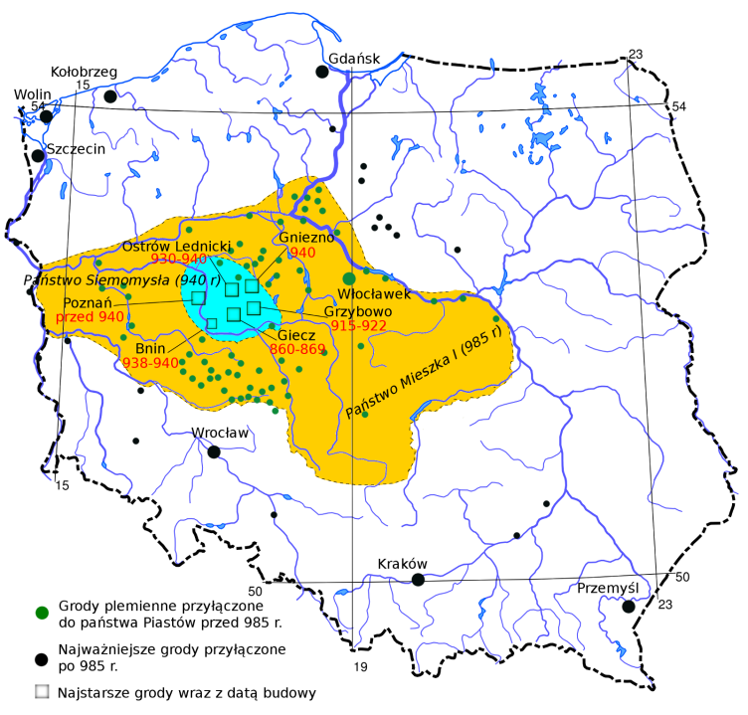
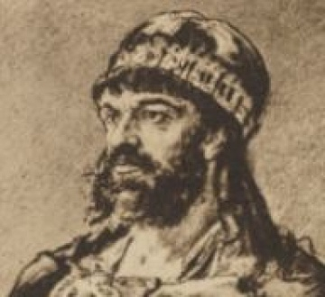
Polish began to emerge as a distinct language around the 10th century, the process largely triggered by the establishment and development of the Polish state.
Mieszko I, ruler of the Polans tribe from the Greater Poland region, united a few culturally and linguistically related tribes from the basins of the Vistula and Oder before eventually accepting Christianity in 966.
With Christianity, Poland also adopted the Latin alphabet, which made it possible to write down Polish, which until then had existed only as a spoken language.

Slide 6
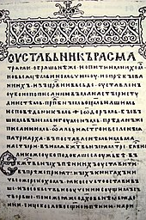
Polish was created from the Western variant of the Slavonic language and is derived from the Proto-Indo-European language.

Slide 7

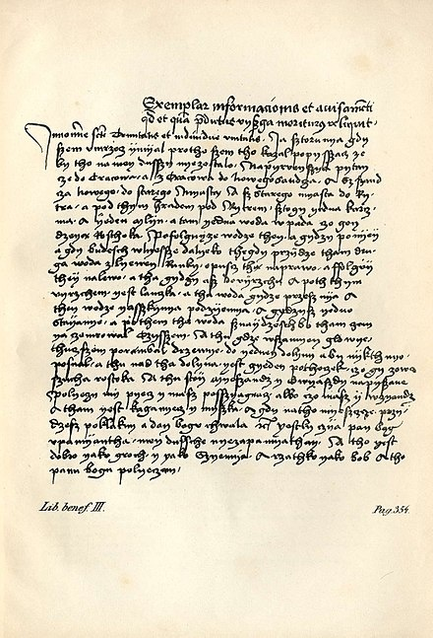
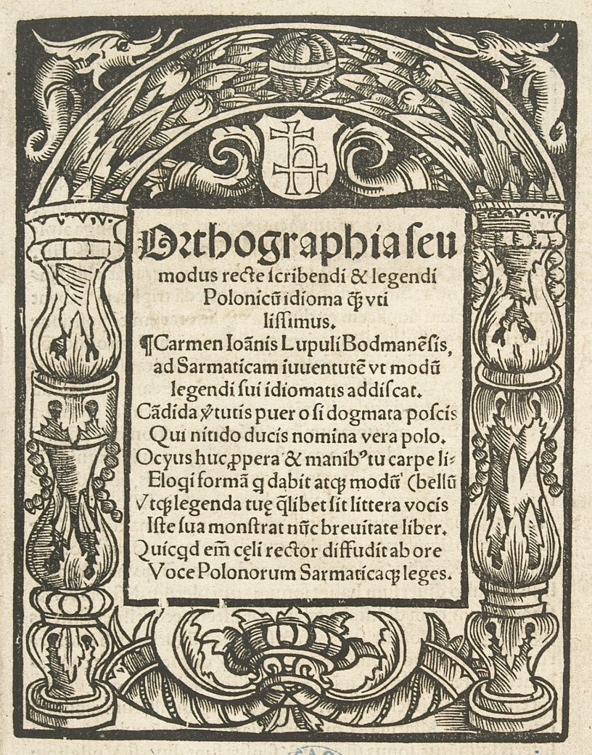
The first Polish words recorded in medieval Latin documents were names and geographical names

Slide 8
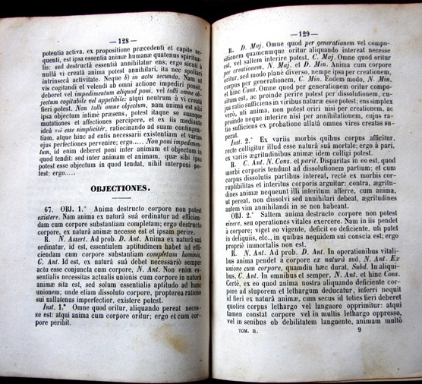
In medieval Europe, Latin was the international literary, official, diplomatic and scientific language.

Slide 9
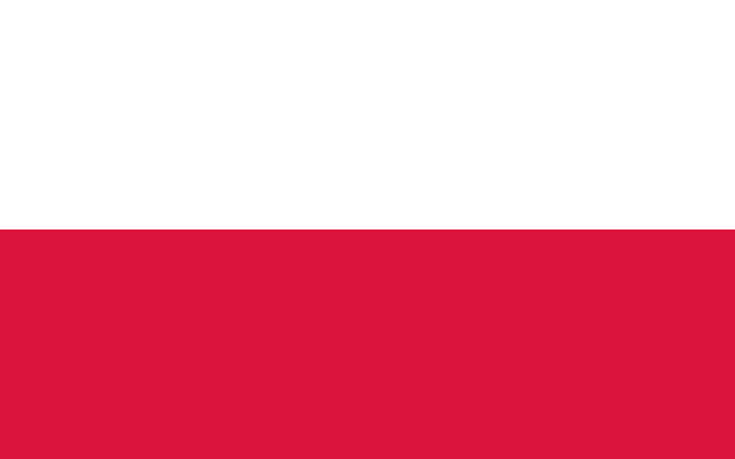
Contemporary Polish

Slide 10
Polish language today
There are over 50 million Polish-language speakers around the world and it is one of the official languages of the European Union.
It is also spoken as a second language in Northern Czech Republic and Slovakia, western parts of Belarus and Ukraine as well as in Central-Eastern Lithuania and Latvia.
Because of the emigration from Poland during different time periods, most notably after World War II, millions of Polish speakers can be found in countries such as Canada, Argentina, Brazil, Israel, Australia, the United Kingdom and the United States.

Slide 11
Polish is written with the standardized Polish alphabet, which has nine additions to the letters of the basic Latin script (ą, ć, ę, ł, ń, ó, ś, ź, ż).
Among the major languages, it is most closely related to Slovak and Czech, but differs from other Slavic varieties in terms of pronunciation and general grammar.
In addition, Polish was profoundly influenced by Germanic languages, most notably German, and Italic languages like Latin and French, which contributed to a large number of loanwords and similar grammatical structures.
Polish currently has the largest number of speakers of the West Slavic group and is also the second most widely spoken Slavic language.

Slide 12
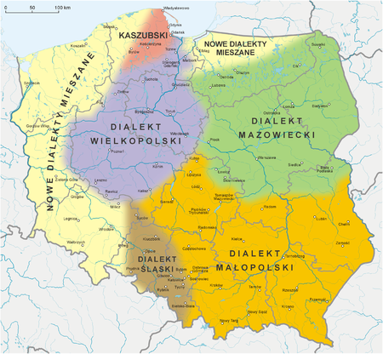
Dialects
Polish has traditionally been described as consisting of four or five main regional dialects:
Greater Polish, spoken in the west
Lesser Polish, spoken in the south and southeast
Masovian, spoken throughout the central and eastern parts of the country
Silesian, spoken in the southwest (also considered a separate language, see comment below)
Kashubian, spoken in Pomerania west of Gdańsk on the Baltic Sea, is thought of either as a fifth Polish dialect or a distinct language, depending on the criteria used

Slide 13
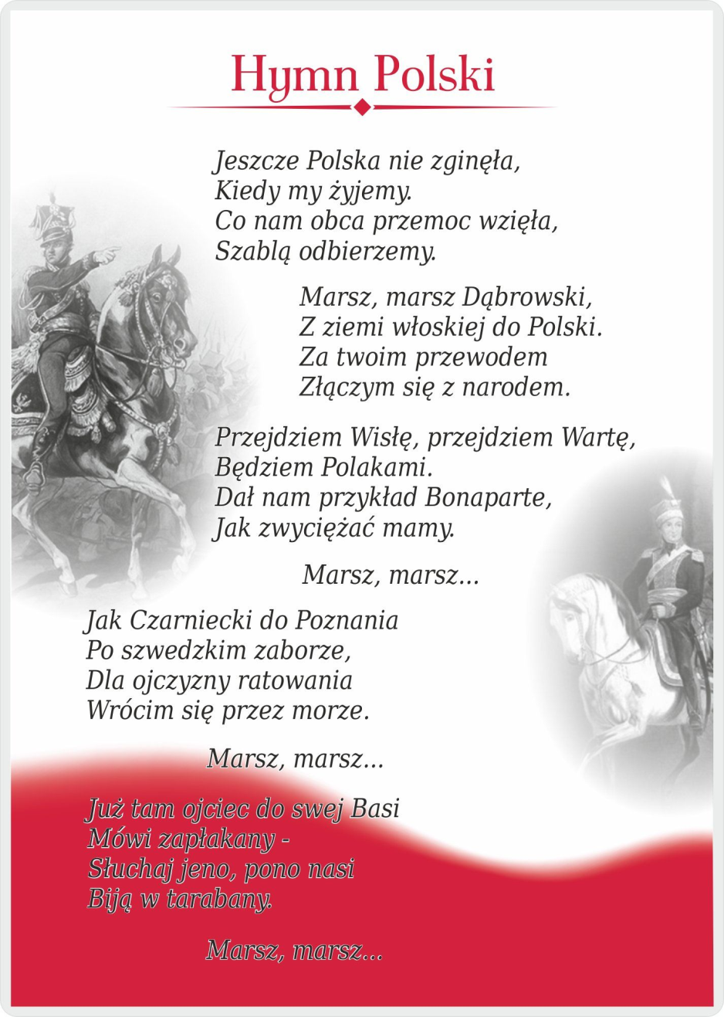
National anthem of Poland- Dąbrowski's Mazurka
The first two verses:
Poland has not yet perished,
So long as we still live.
What the alien force has taken from us,
We shall retrieve with a sabre.
March, march, Dąbrowski,
From the Italian land to Poland.
Under your command
We shall rejoin the nation.

Slide 14
Language loanwords from Spanish
parasol
tortilla
paella
korrida (corrida)
ranczo, ponczo
muleta, banderilla, banderillero; toreador;
kapeador, kapa; matador, pikador; tornado
patio
finito
embargo
bandera
albinos
macho

Slide 15


Difficult words for foreigners:
Drożdżówka – Bun
Rabarbar - Rhubarb
Pszczoła - Bee
Szczęście - Happiness
Świerszcz - Cricket
Chrząszcz - Beetle

Slide 16
Polish numbers
1- one/jeden
2- two/dwa
3- three/trzy
4- four/cztery
5- five/pięć
6- six/sześć
7- seven/siedem
8- eight/osiem
9- nine/dziewięć
10-ten/dziesięć

Slide 17
Dzień dobry-Cześć
Lets learn few polish sentences
My name is…../ Nazywam się…….
I am 13 years old. /Mam trzynaście lat.
I am from Spain/ Jestem z Hiszpanii
Nice to meet you/ Miło cię poznać.

Slide 18

Most Important
Polish Poets and Writers

Slide 19
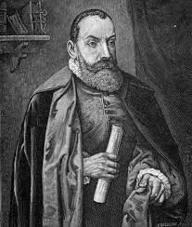
Jan Kochanowski
He is the most famous Polish poet of the Renaissance. He did a lot to develop Polish language and introduce it into the literature.
The most important words ;
„Odprawa Posłów Wiecznych” – „Briefing By Eternal Deputies”
„Psałterz Dawidów” – „Psalter of David”
„Szachy” – „Chess”
Limericks – in Polish „Fraszki”
„Na dom w Czarnolesie” – „for a house in Czarnoles”
„O doktorze hiszpanie” – „about doctor”
1530-1584

Slide 20
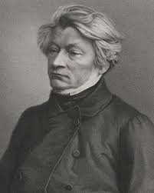
Adam Mickiewicz
Belongs to the greatest creators of Polish literature. He created lots of patriotic works. Created in Romanticism. Added added a lot to the European Romanticism and Mysticism.
The most important works;
„Dziady”
„Pan Tadeusz” – „Mr. Tadeusz”
„Oda do młodości” – „Ode to youth”
„Sonety Krymskie” – „Crimean sonnets”
„Konrad Wallenrod„
„Księgi Narodu Polskiego” – „Books of the Polish nation”
1798-1855

Slide 21
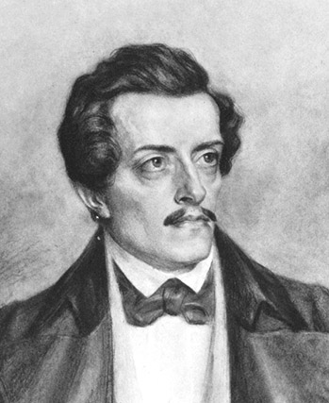
Juliusz Słowacki
Considered to be one of the most important Polish creators of literature, altogether with Adam Mickiewicz. His works were even more spiritual, mysterious and mystical.
The most important works:
Dramas:
„Balladyna”
„Kordian”
„Mazepa”
Hundreds of poems
„Do matki” – „To the mother”
„Testament mój” – „The Last Will of Mine”
„Hymn” – „The Anthem”
1809-1849

Slide 22
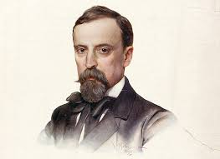
Henryk Sienkiewicz
Became famous mainly as the creator of historical novels, such as a „Trylogy”devoted to the 17th century, which in Poland was called „The Century of Wars”. He was famous for the book „Quo Vadis”, which was known all over the world, for which he was awarded the Nobel prize.
1846-1916

Slide 23
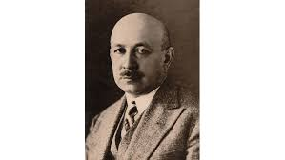
Kornel Makuszyński
Polish writer and columnist is known mainly for his works for children and youth.
The most important words;
„Szatan z siódmej klasy” – „Seventh grade devil”
„Panna z mokrą głową” – „Virgin with a wet head”
„O dwóch, którzy ukradli księżyc” – „About the two who stole the moon”
1884-1953

Slide 24
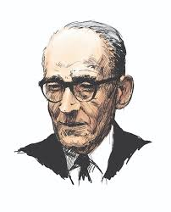
Jan Brzechwa
He devoted most of his works to children and adolescents. And they love his novels.
The most important works;
„Akademia Pana Kleksa – „Mr. Kleks' Academy”
„Kaczka Dziwaczka” – „Ducky Strange”
„Tańcowała igła z nitką” – „The needle and thread danced”
„Na wyspach Bergamutach” -on the Bergamut Islands
1898-1966

Slide 25
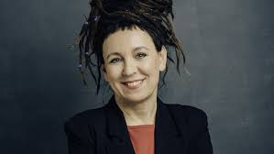
Olga Tokarczuk
Awarded with the Nobel Prize in 2018 for lifetime achievement.
The most important works ;
- "Prawiek i inne czasy" - "Prawiek and other times"
- "Dom dzienny, dom nocny" - "Living house, night house"
- "Gra na wielu bębenkach" -"Playing on many drums"
- "Bieguni" -"Bieguni"
- "Prowadź swój pług przez kości umarłych" -"Lead your plow through the bones of the dead"
1962

Slide 26
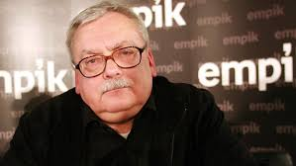
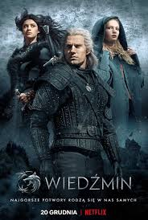
Andrzej Sapkowski
Creator of the Witcher Saga, on the basis of which the game was created very well known and liked all over the world
1948

Slide 27
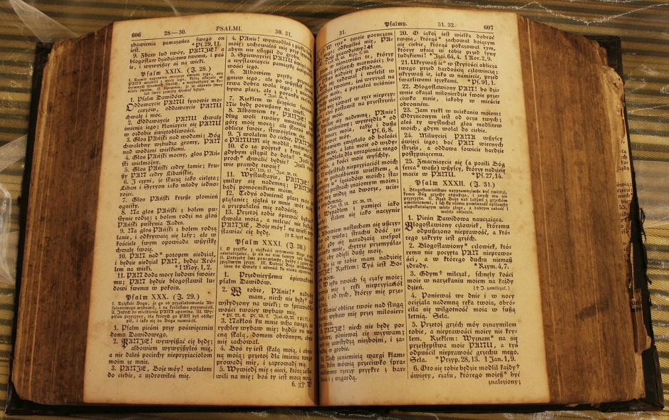
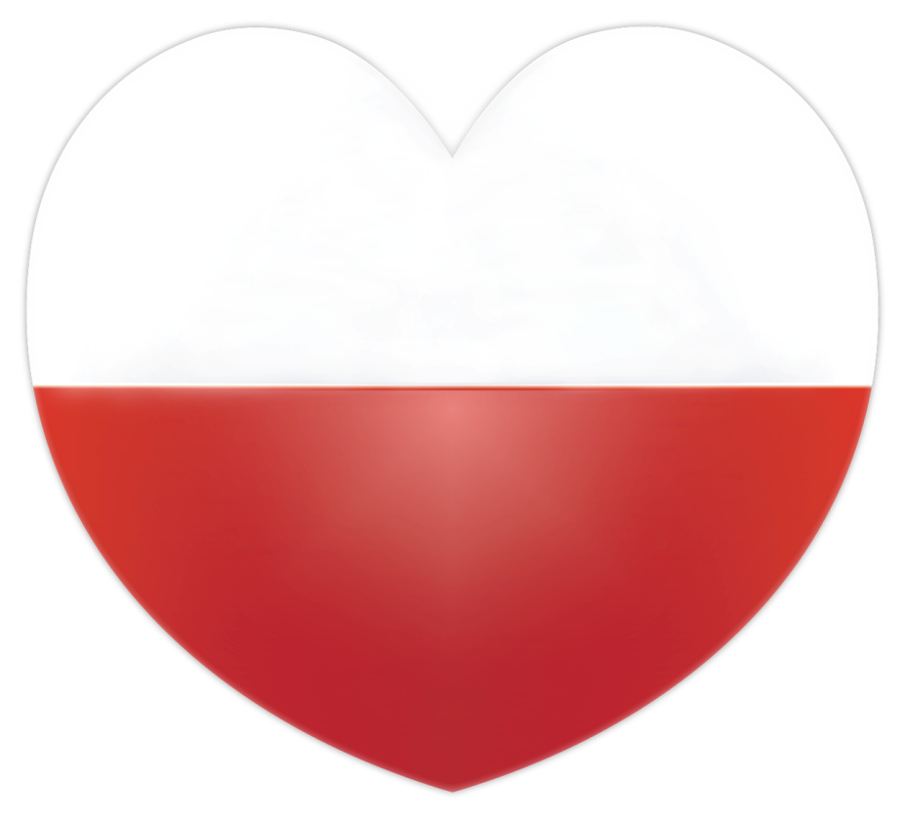
A few facts about … Polish Language

Slide 28
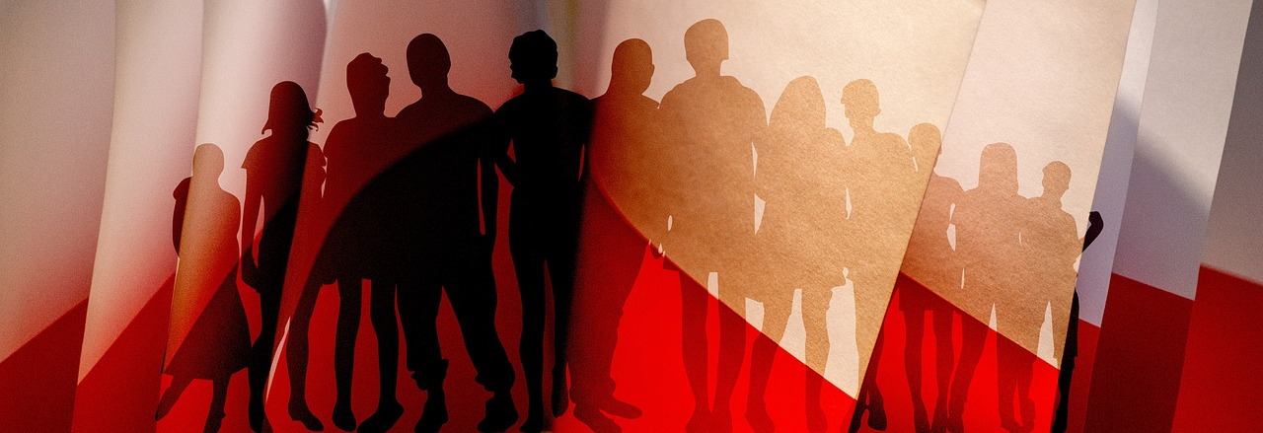
Native speakers
There are around 44 million people in the world who speak Polish on a daily basis.

Slide 29
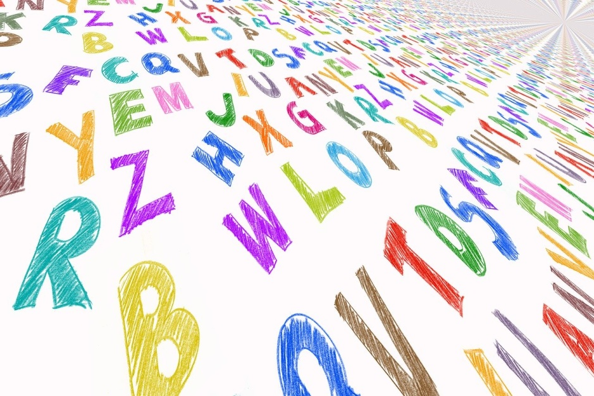
Non-native speakers
There are around 10 000 people who were taught how to speak Polish or it’s their second language. Polish is becoming more and more popular every year as a foreign language.

Slide 30
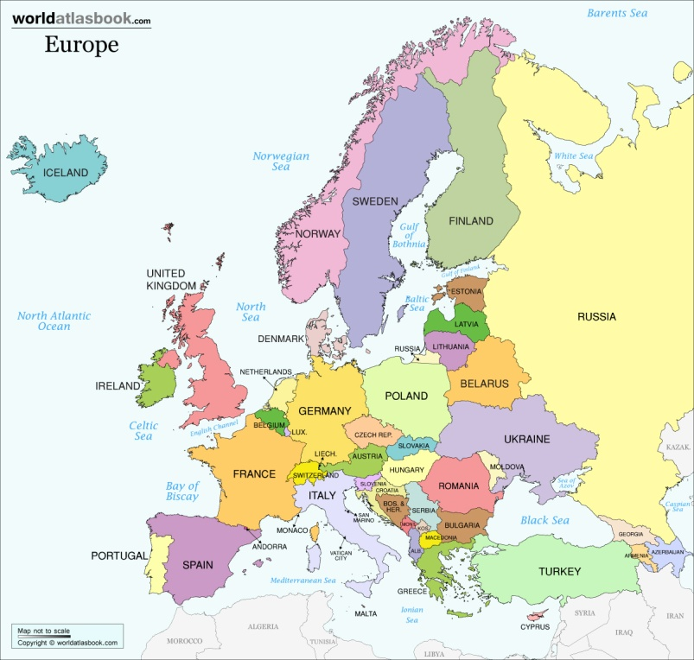
Where is it spoken?
Poland
Ukraine
Belarus
Lithuania
Slovakia
The Czech Republic

Slide 31
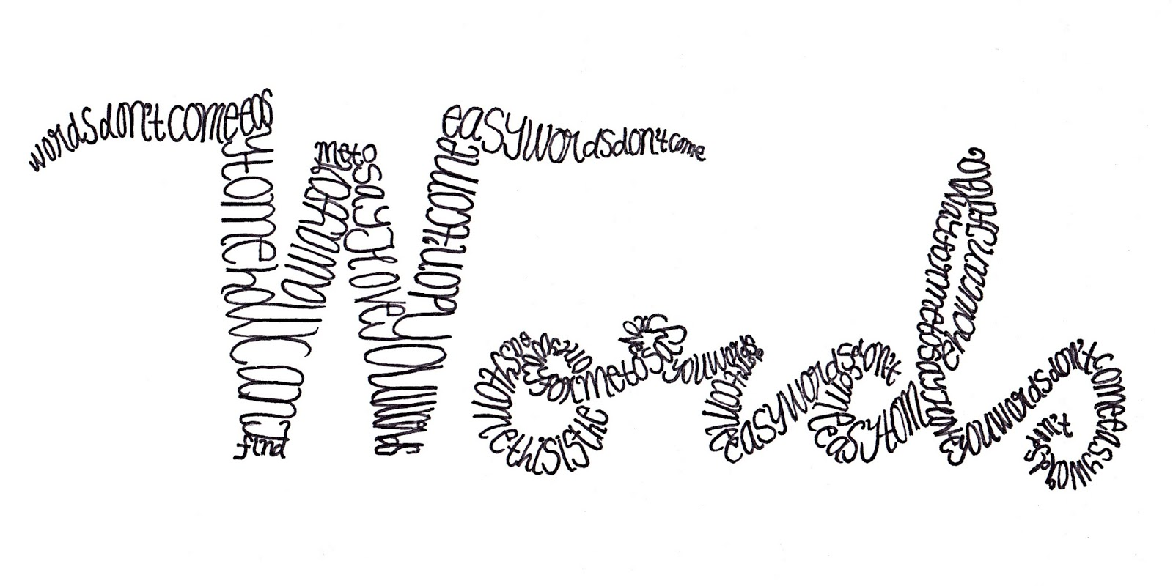
Number of words
Polish language has in it around
6000 to 10000 words.

Slide 32
Level of difficulty
Polish is considered one of the most difficult languages ​​to learn in the world, next to Chinese, Hungarian and Finnish. Polish has a limited number of characters. The alphabet currently consists of 32 letters and is based on the Latin alphabet. At present, we estimate that Polish is the native language of about 44 million people in the world.

Slide 33
Beginnings of Polish Language
The first known full sentence in Polish comes from the Henrykowski Book of 1270: "Give me a break and you do it".
In 1285 it was decided to use Polish next to Latin.
The oldest print in Polish was published in 1475 in Wrocław. There were three Catholic prayers 'Our Father', 'Hail Mary' and 'I Believe in God' published in the so-called "Elyan Statutes."

Slide 34

Curiosities
1. Interestingly, Polish has influenced such languages ​​as Ukrainian, Belarusian, Lithuanian, Russian, Yiddish, Hebrew, Czech, Romanian, and Hungarian.
2. As it turns out, our language is very plastic, and Poles love to create new words. The consequence of this are neologisms, which are no longer found only in literary works, but also in everyday speech.

Slide 35

Authors:
Maja Matusiak
Alicja Lisowska
Natalia Grobelak
Szymon Różycki
Michał Olejarz
Grades 6A and 6B.

Slide 36
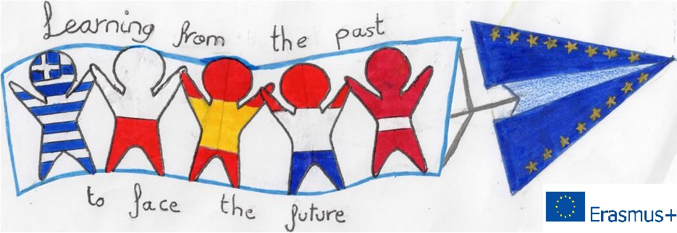
Done by the students from ZSP w Mykanowie Szkoła Podstawowa im. Stefana Okrzei for the Erasmus+ Project titled:
Learning from the Past to Face the Future: Cultural Heritage in Contrast with Modern Society.
Project number: 2018-1-PL01-KA229-051241_1

