Slide 1
European Day of Languages
ERASMUS DAYS
The students of the 5th Grade (E1) are playing the “What do you know about English speaking countries?” quiz.

Slide 2
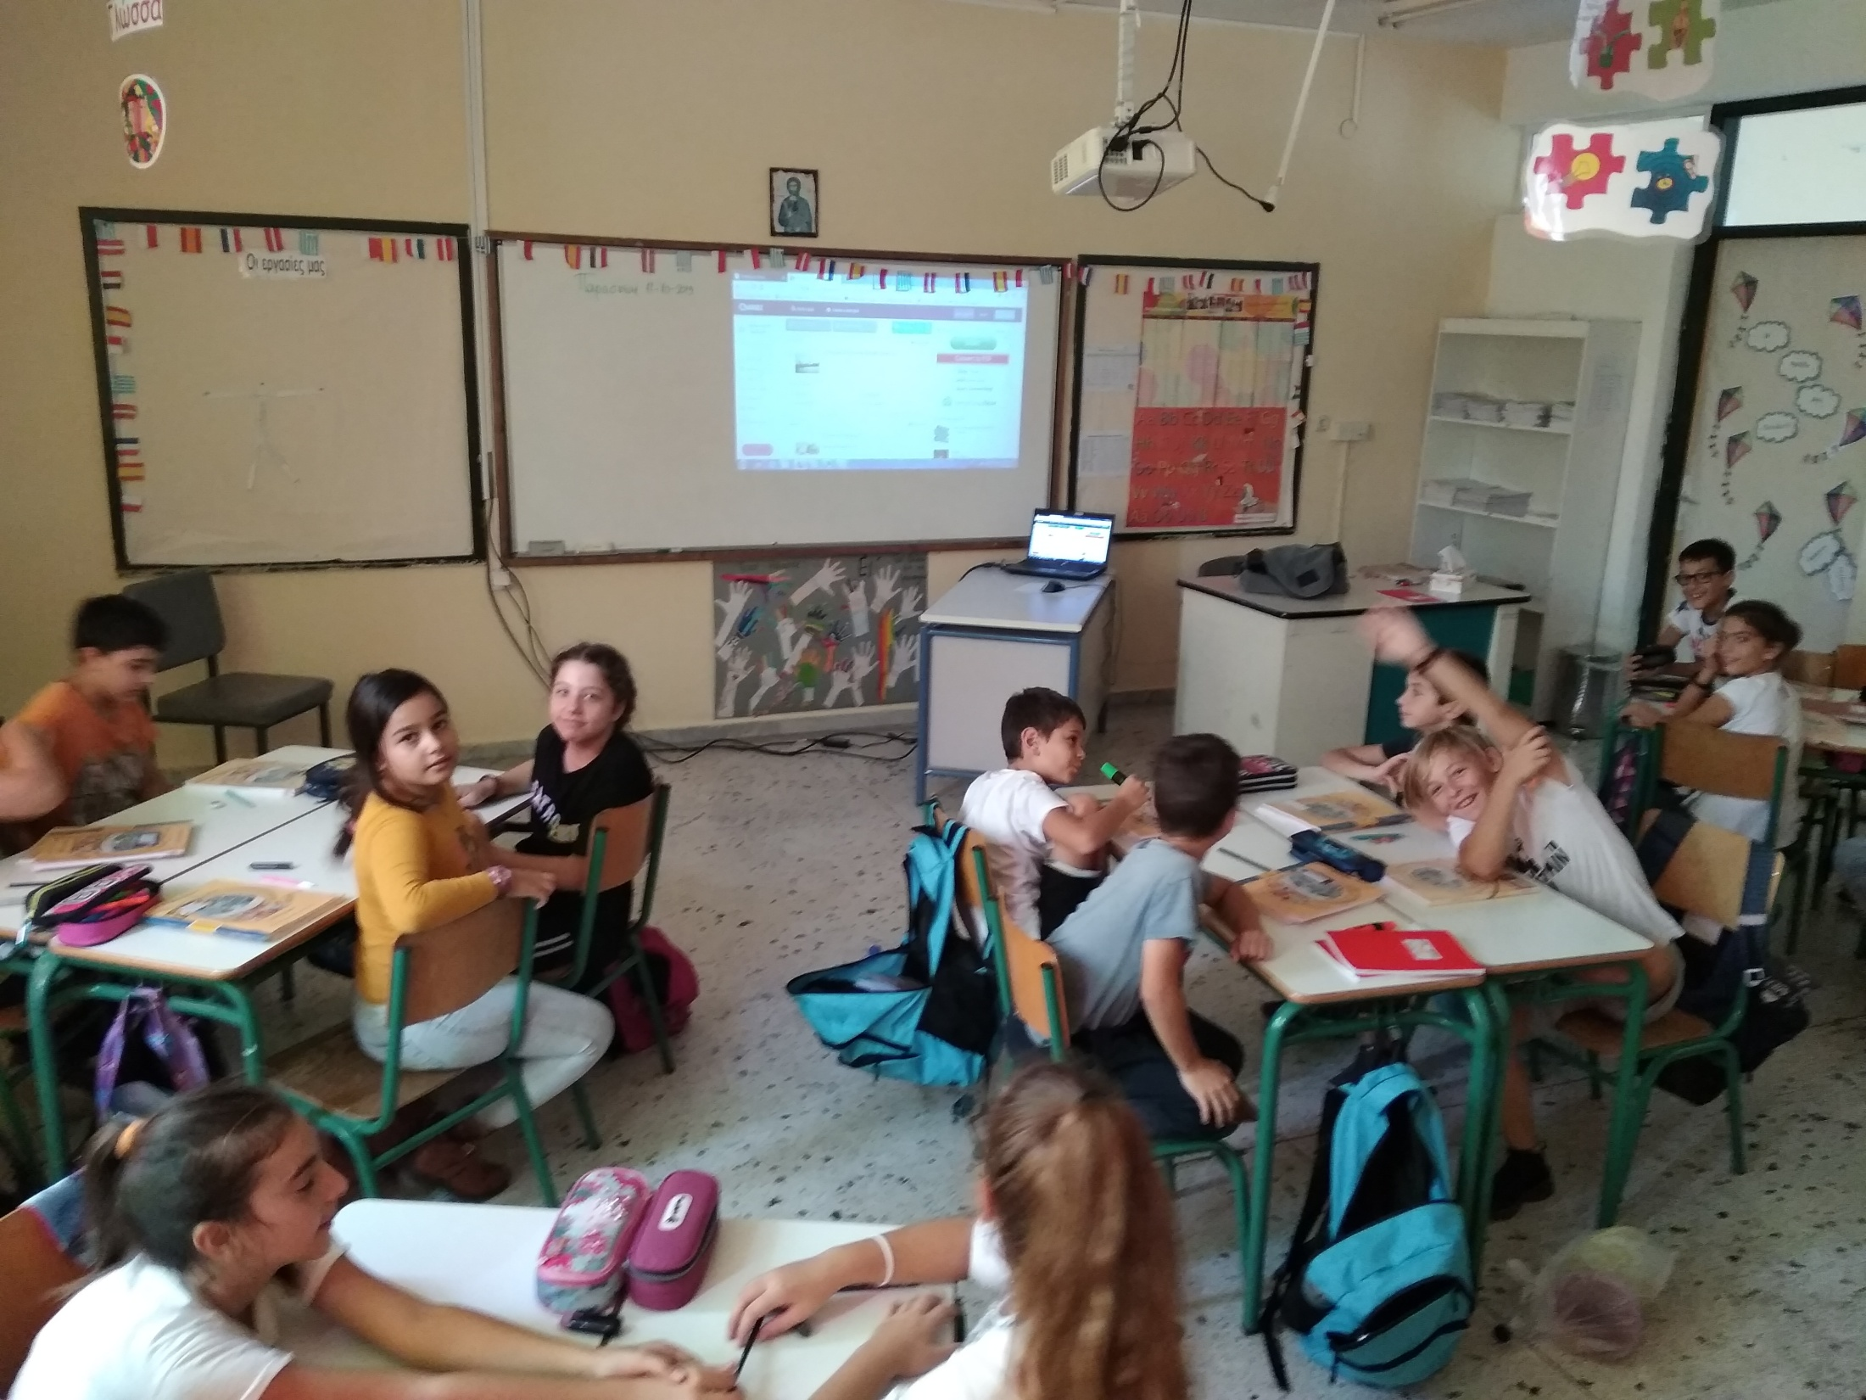

Slide 3
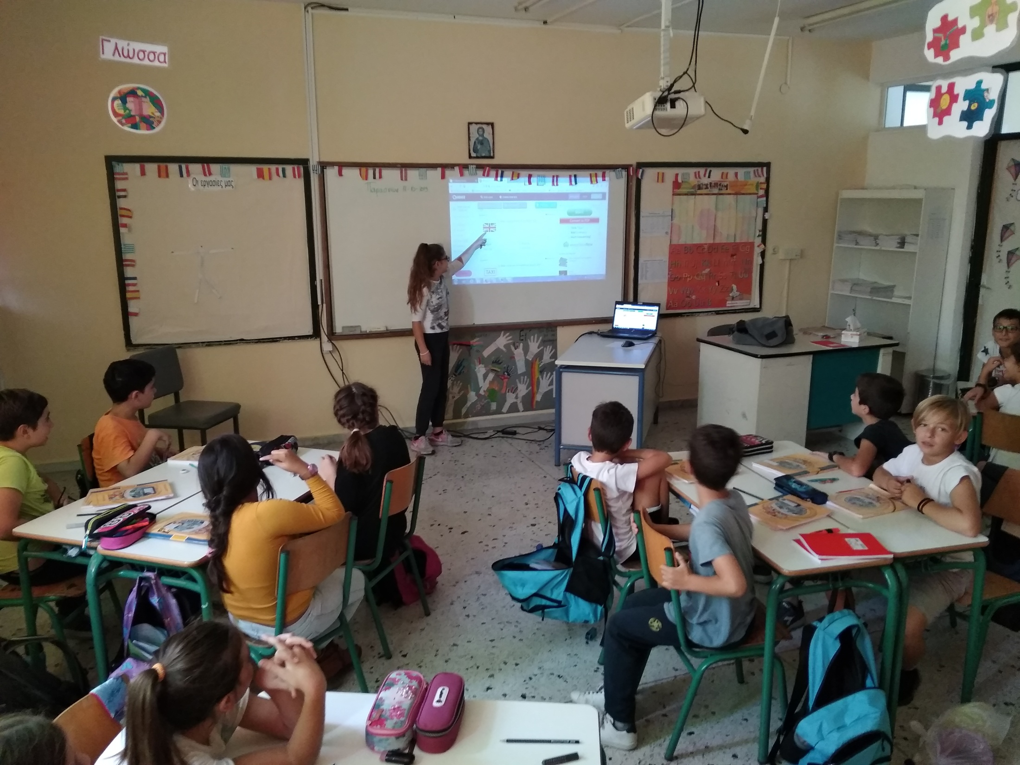

Slide 4
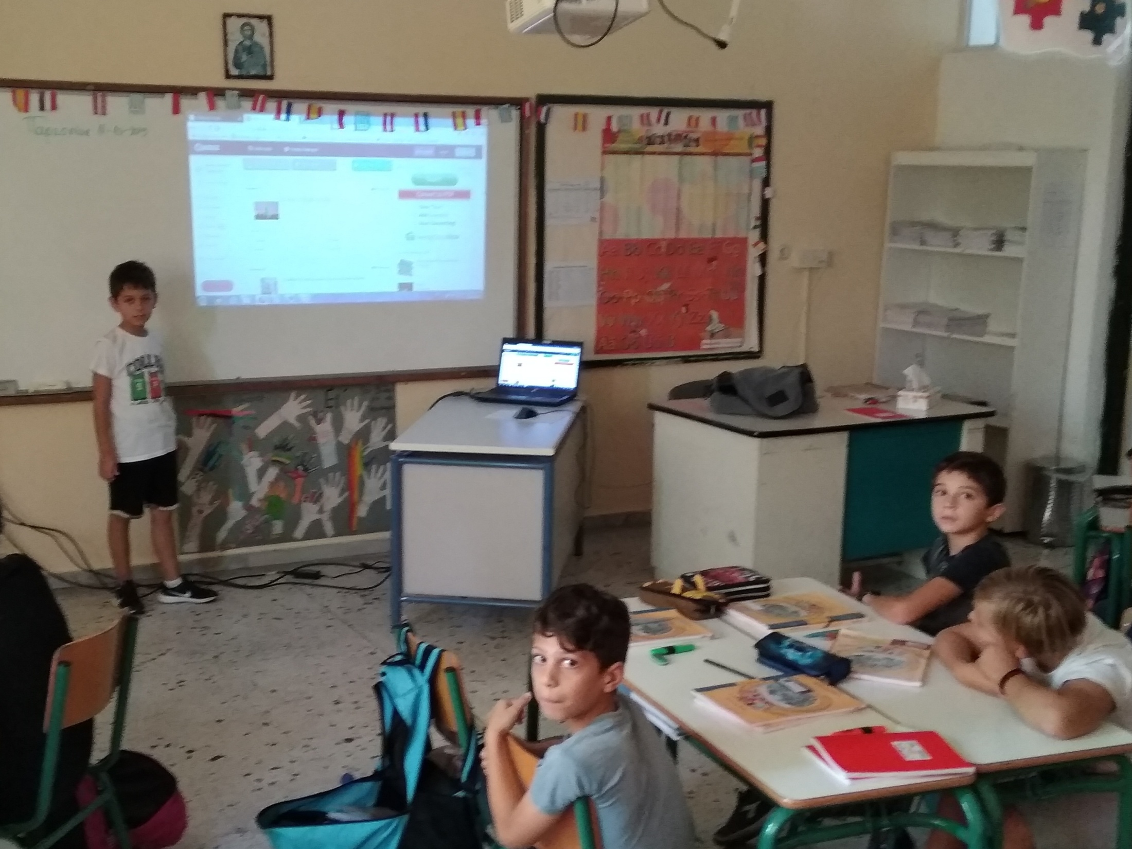

Slide 5
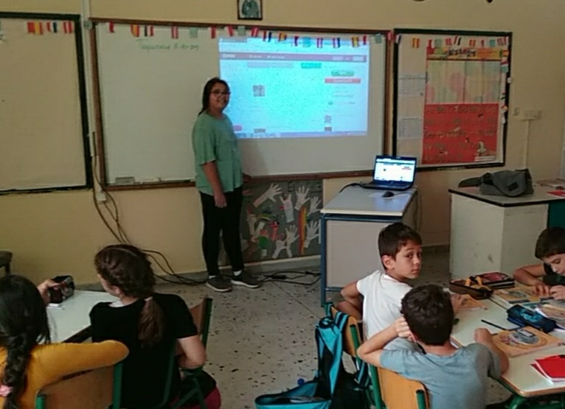

Slide 6
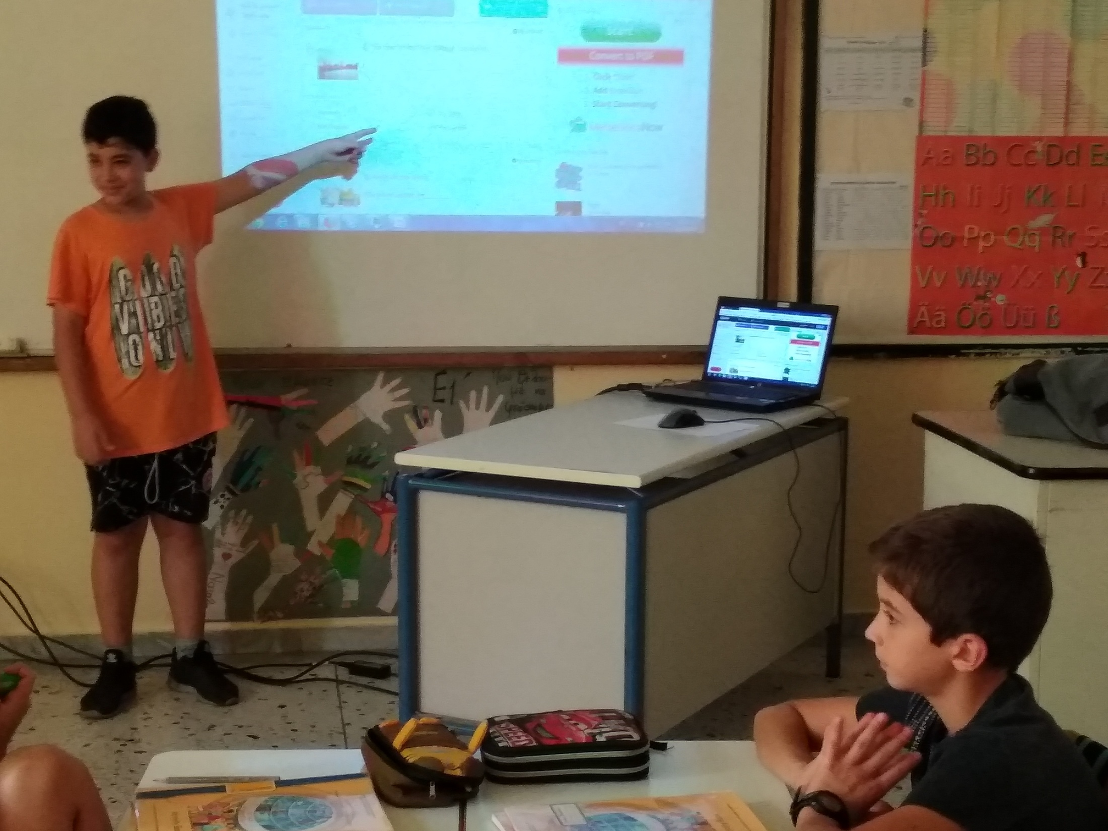

Slide 7
