Slide 1
The Spanish Language

Slide 2
History of the language
Spanish is a romance language. It comes from Latin.
Romans brought the language to Spain.
It also has influence from Germanic languages and Arabic.
4 official languages in Spain: Spanish, Galician, Basque and Catalan.

Slide 3
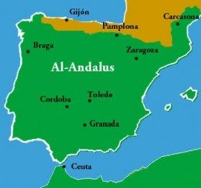
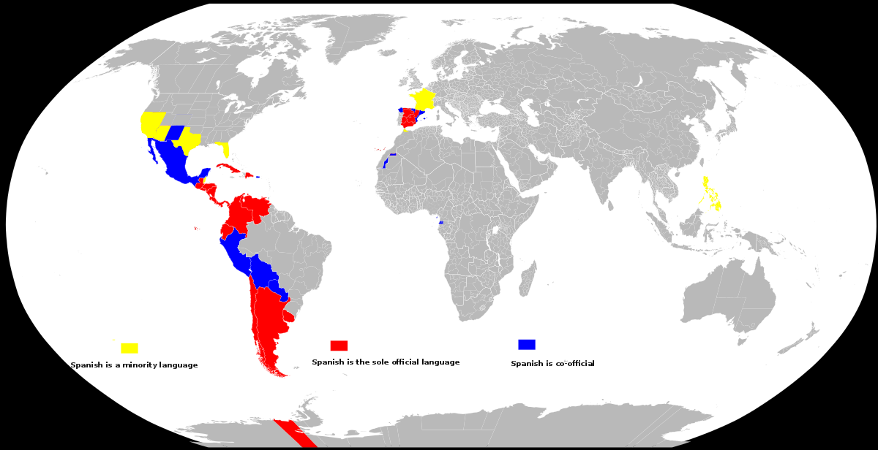
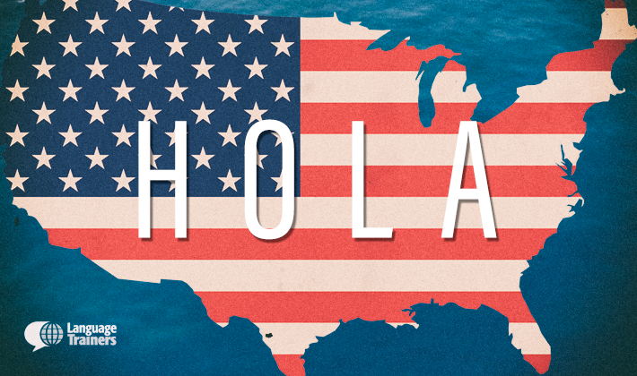
Facts
Over 400 millions of native speakers of Spanish.
Official language in more than 20 countries.
Strongly influenced by Arabic.
The Royal Spanish Academy supervises the language.
Over 50 million people who speak Spanish in the USA. More people than in Spain.

Slide 4
Most important words and phrases
English | Spanish
Hello | Hola
Good morning | Buenos días
Good afternoon/Good evening | Buenas tardes
Good night | Buenas noches
How are you? I’m fine, thanks | ¿Qué tal? Estoy bien, gracias
Thank you | Gracias
Sorry | Lo siento
Please | Por favor
Cheers | Salud
Bye | Adiós

Slide 5
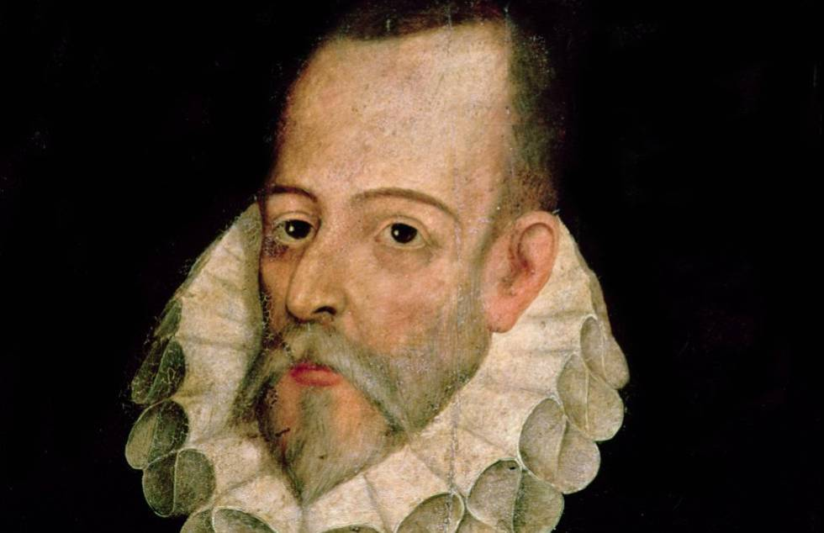
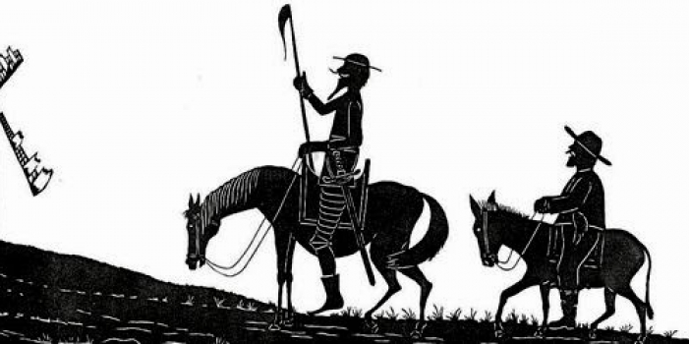
Most relevant books or writers Miguel de Cervantes “Don Quijote de la Mancha”
5 Spanish Nobel Prizes for Literature
José de Echegaray
Jacinto Benavente
Juan Ramón Jiménez
Vicente Aleixandre
Camilo José Cela

Slide 6
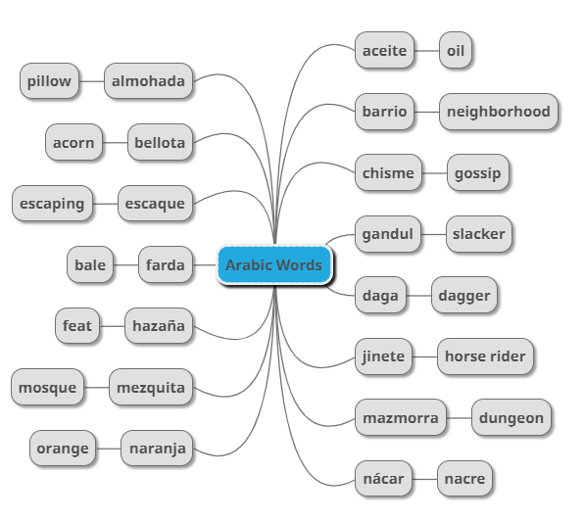
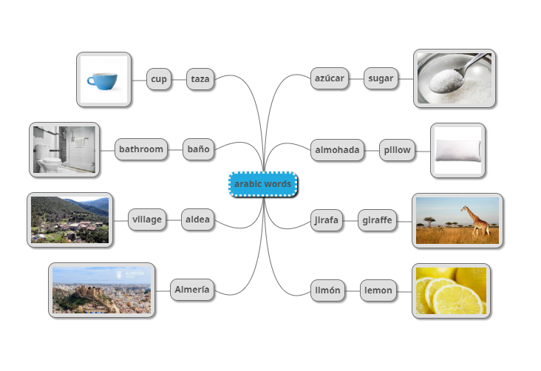
Spanish words of Arabic influence

Slide 7
Proverbs
The early bird catches the worm
No pain, no gain
Never look a gift horse in the mouth
Better late than never
Where there’s a will, there’s a way

