Slide 1
FactS about Swedish lANGUAGE
Dana Laizane

Slide 2
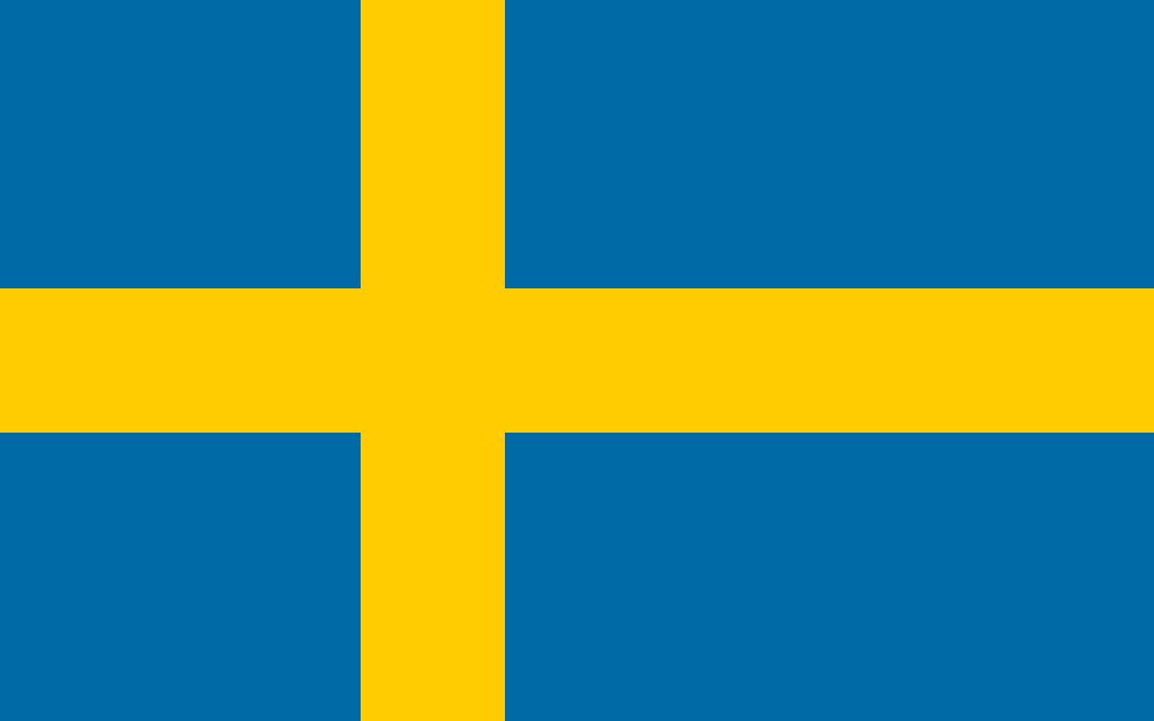
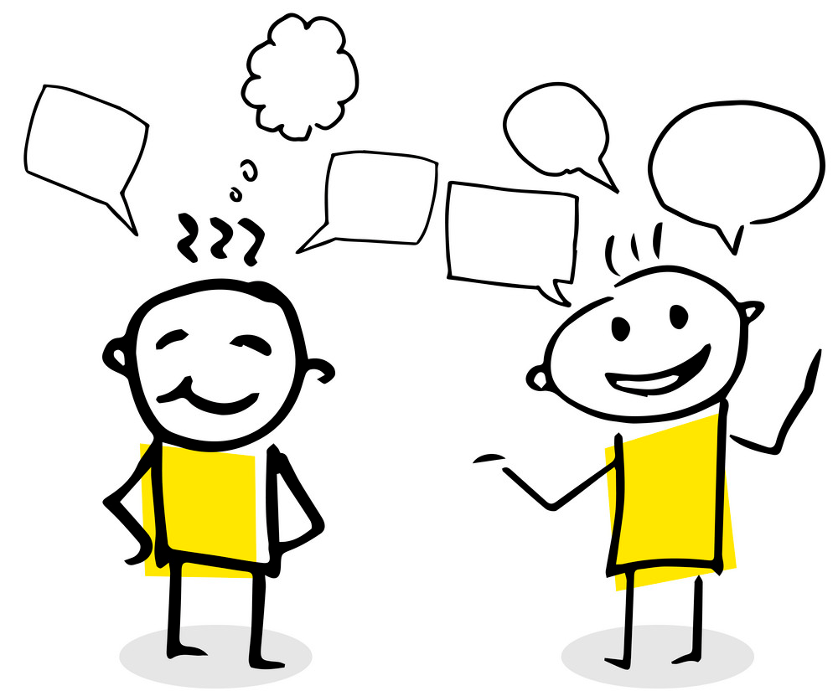
Fact 1
There are around 9 million native Swedish speakers across the world.
Swedish is mainly spoken in Sweden, where it is an official language, and in some coastal parts of Finland. In addition to this, it is estimated that around 40,000 students are learning Swedish as a second language outside Sweden and Finland.

Slide 3
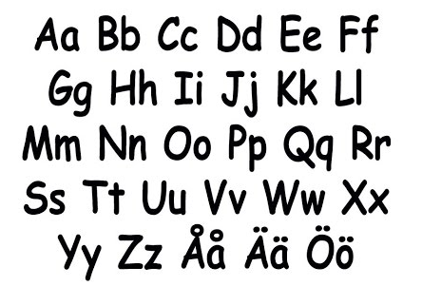
Fact 2 Alphabet
The longest Swedish word contains 28 letters
According to the Swedish Academy, Swedish’s longest word is realisationsvinstbeskattning. It stands for “capital gains tax”.
The Swedish alphabet is a basic element of the Latin writing system used for the Swedish language. The 29 letters of this alphabet are the modern 26-letter basic Latin alphabet.

Slide 4
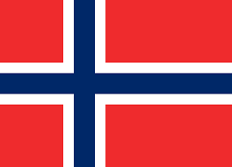
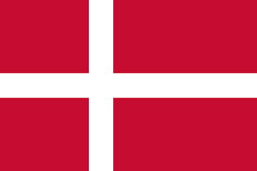
Fact 3
If you speak Swedish, you can also understand Danish and Norwegian.
Sweden, Denmark, and Norwegian are close geographically, and their languages are similar, as well. Because of this, Swedish speakers are able to understand both Danish and Norwegian – so speaking Swedish is like getting three languages for the price of one!

Slide 5
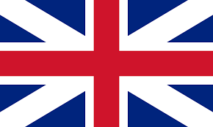
Fact 4
Several Swedish words made it into the English language
Examples of Swedish loanwords include gravlax (a Nordic dish served as a starter), moped (formed of motor” and “pedal”, this word refers to a small motorcycle), ombudsman (a public advocate), orienteering (sports using navigational skills), rutabaga (a root vegetable), tungsten (translating directly as “heavy stone”, it refers to a chemical element

Slide 6
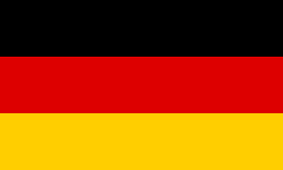
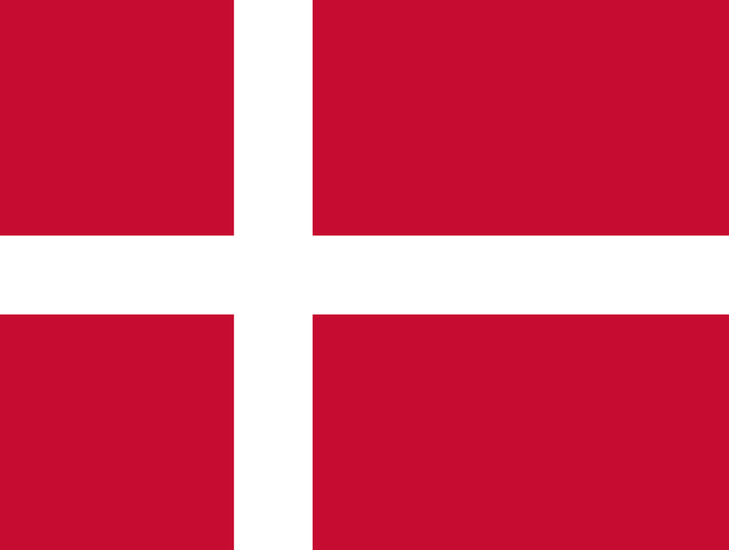
Fact 5
Swedish is a North Germanic language derived from Old Norse
Swedish differentiated itself from Danish in the Middle Ages. Swedish has been heavily influenced by other Germanic languages, especially Danish, throughout its history. In the 18th century, Swedish also borrowed a large number of words from French. While Swedish has many dialects, Standard Swedish became the standardised form of Swedish spoken nationally in Sweden during the 19th and 20th century.

