Slide 1
Mobility in Greece
Booklets

Slide 5
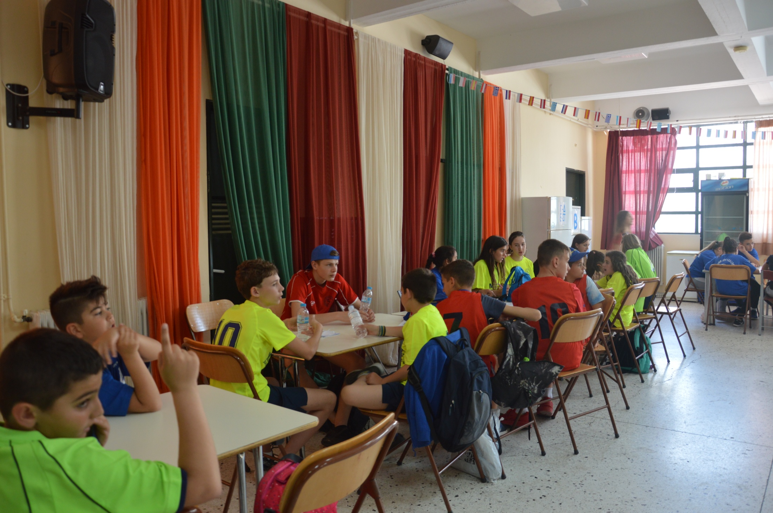

Slide 12
