Slide 1
Basic words and phrases English – Swedish

Slide 2
Basic structures
Hello! - Hej!
Good morning! – God morgon!
Good afternoon! – God eftermiddag!
Good evening! – God kväll!
Good night! - Godnatt!
Good bye! – Adjö
How are you? I’m fine. – Hur mår du? Jag mår bra.
Thank you! – Tack!
Sorry. – Förlåt.
Please. – Snälla du.
Cheers! – Skål.
Bye! – Hejdå!

Slide 3
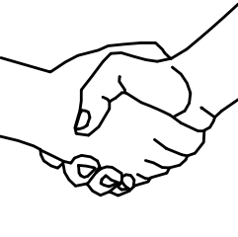
Greetings
Hello! - Hej!
Good morning! – God morgon!
Good afternoon! – God eftermiddag!
Good evening! – God kväll!

Slide 4
Farewells
Good night! - Godnatt!
Good bye! – Adjö
Bye! – Hejdå!

Slide 5
Starting a conversation
How are you? I’m fine.
– Hur mår du? Jag mår bra.

Slide 6
Being polite
Thank you! – Tack!
Sorry. – Förlåt.
Please. – Snälla du.

Slide 7
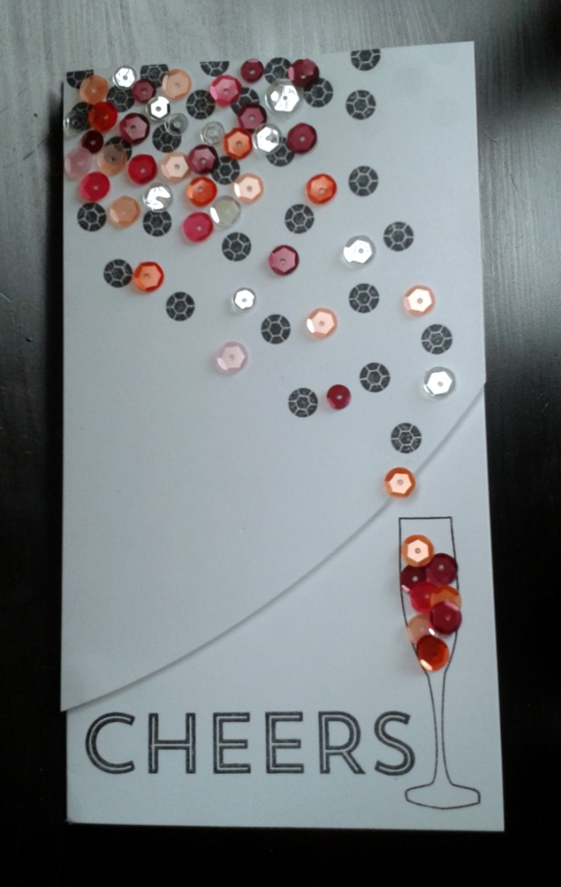
And on the party…
Cheers! – Skål!

Slide 8
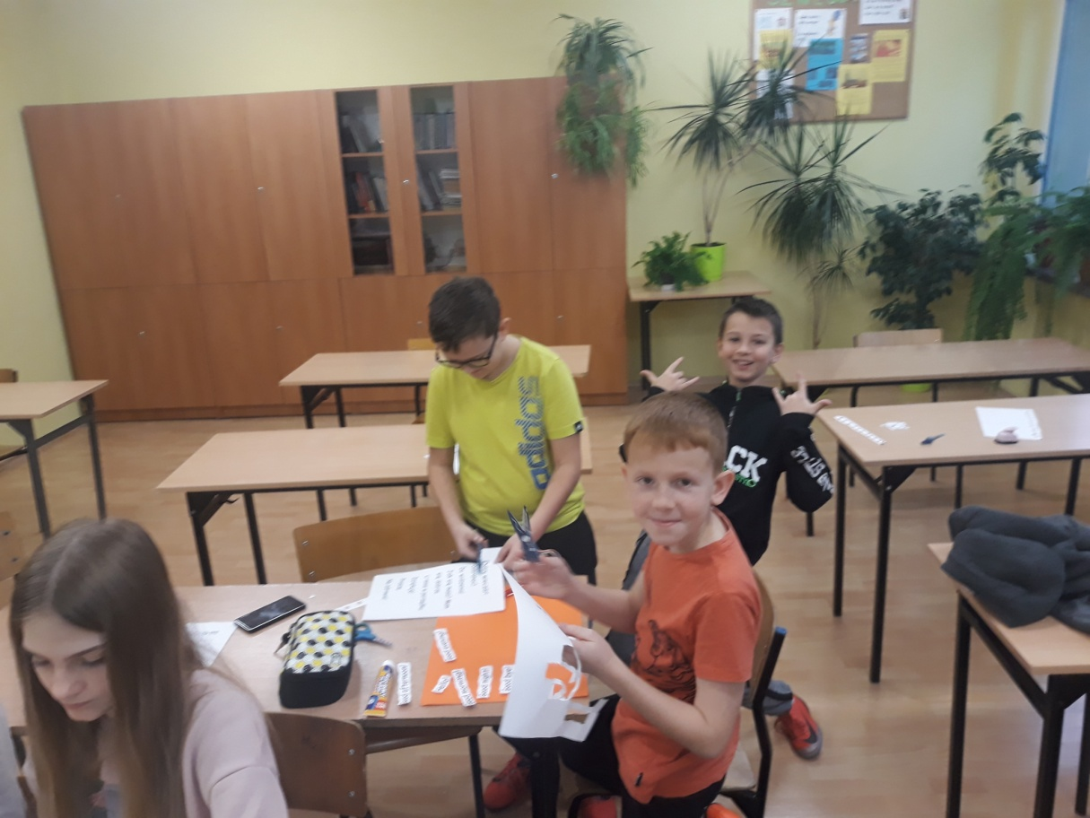
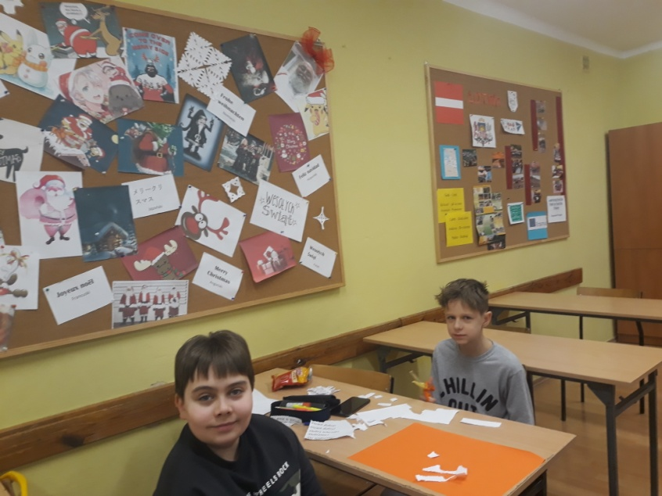
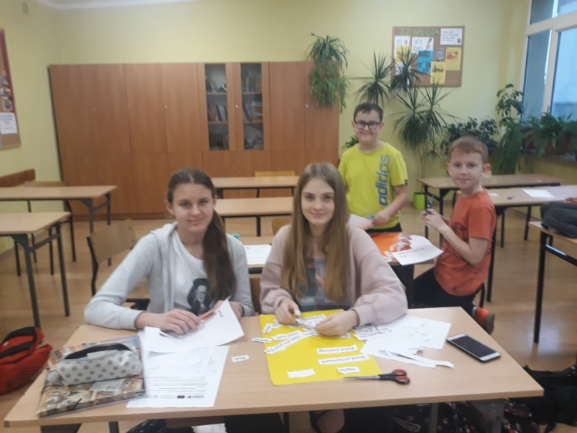
Preparation time

Slide 9
Authors:
Maja Matusiak
Alicja Lisowska
Natalia Grobelak
Szymon Różycki
Michał Olejarz
Grades 6A and 6B.

Slide 10
Done by the students from ZSP w Mykanowie Szkoła Podstawowa im. Stefana Okrzei for the Erasmus+ project titled:
Learning from the Past to Face the Future: Cultural Heritage in Contrast with Modern Society.
Project number: 2018-1-PL01-KA229-051241_1

