Slide 1
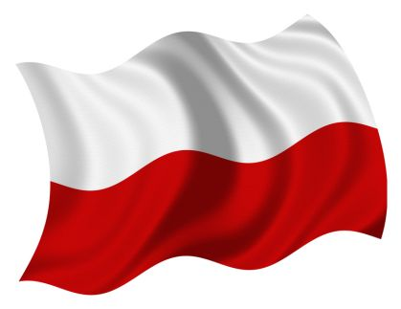
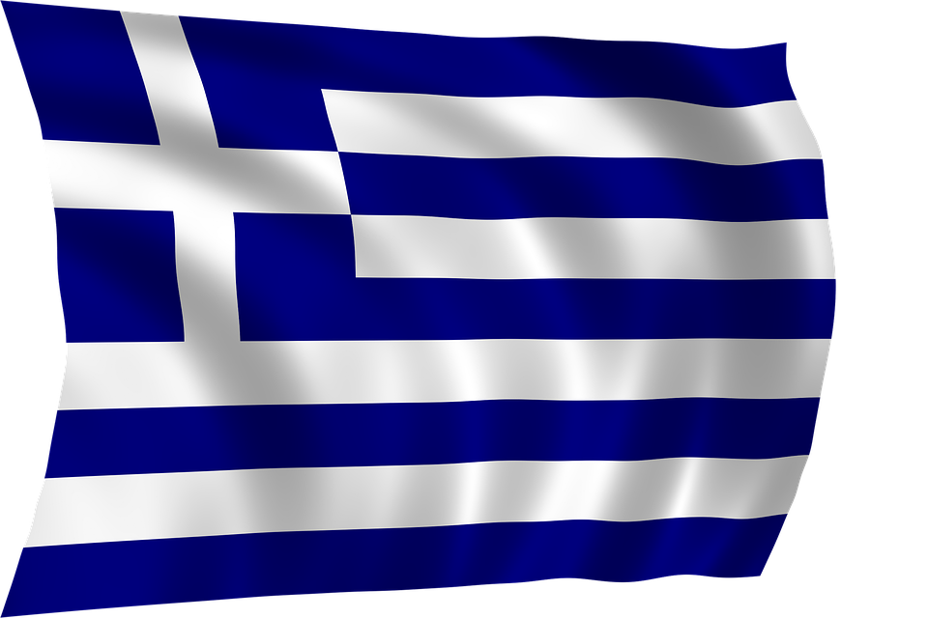

Slide 2
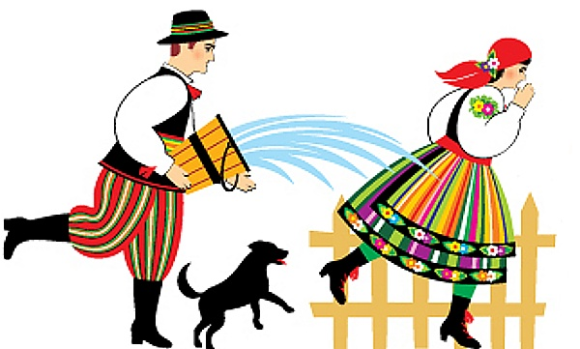
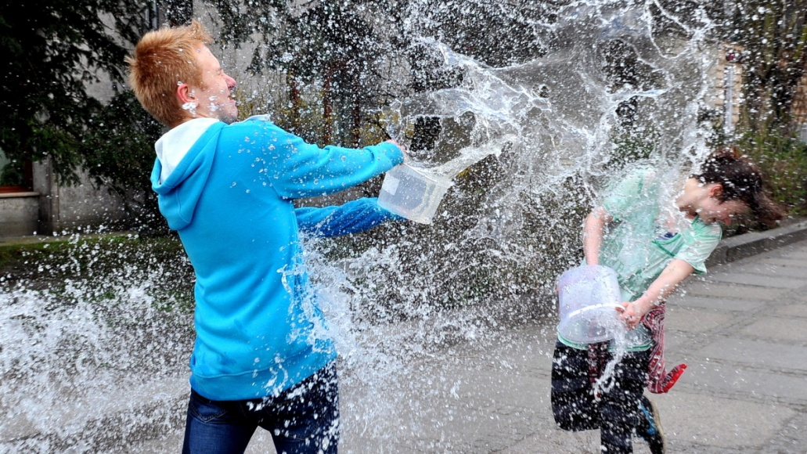
Wet monday
Did you know that Poland has a “soaking people with water” day? Or more correctly, Poland has a “Wet Monday,” known locally as “Smigus Dyngus.”

Slide 3
What is Wet Monday?
Wet Monday takes place annually on Easter Monday in Poland where people get water thrown on them. Traditionally guys soak girls on Monday, and Tuesday is time for revenge, with girls soaking the guys. It is said that if you don’t wake up early on Wet Monday, you will be awoken by having water poured on you. This happens all over the country in family homes, universities and flats.

Slide 4
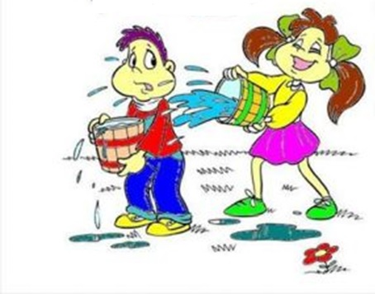

Slide 5
Who celebrates Wet Monday?
Depending on your outlook on being soaked with water, it may be more of a day to avoid, than one to celebrate. Many Polish girls want to hide away that day for fear of being soaked and embarrassed in public. But generally it is a day that is well-known and celebrated all over Poland and in Polish communities overseas. Similar traditions also exist in Thailand (with Songkran), Lithuania and Slovakia.

Slide 7
Fat Thursday
Fat Thursday is a traditional Christian feast marking the last Thursday before Lent and is associated with the celebration of Carnival. Because Lent is a time of fasting, the days leading up to Ash Wednesday provide the last opportunity for feasting until Laetare Sunday, and after that not until Easter. Traditionally it is a day dedicated to eating, when people meet in their homes or cafés with their friends and relatives and eat large quantities of sweets, cakes and other meals usually not eaten during Lent. Among the most popular all-national dishes served on that day are donuts (pol. pączki) in Poland. Laetare Sunday is the fourth Sunday in the season of Lent.

Slide 8
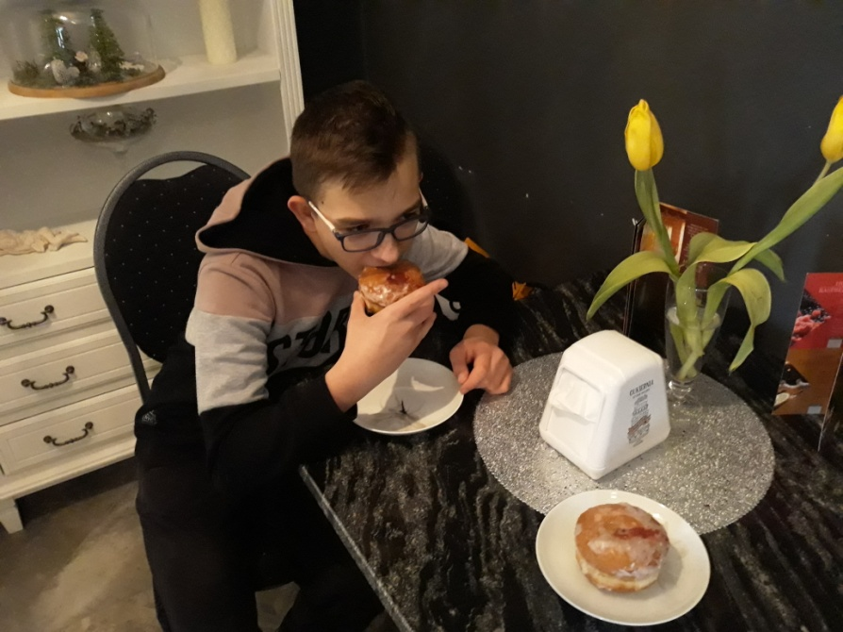
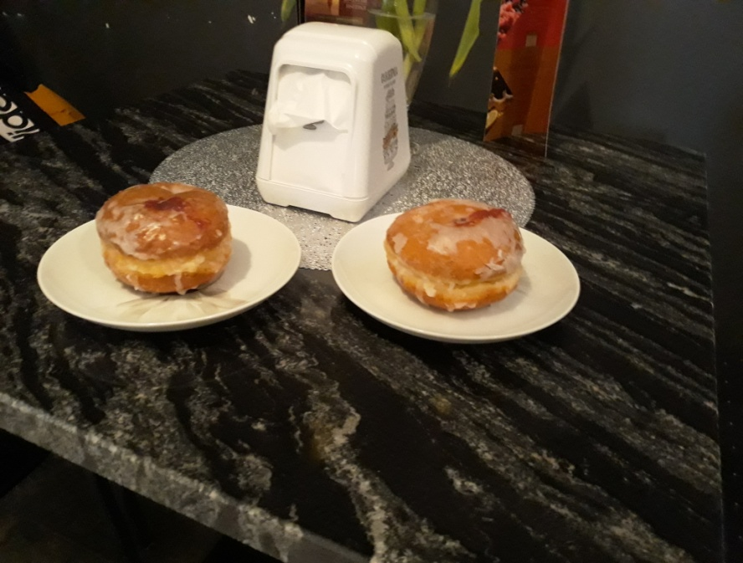

Slide 9
Thanks for watching
Łukasz Jankowski
Wiktor Matusiak

Slide 10
