Slide 1
Actors:
Martyna Kielan,
Kinga Brewczyńska,
Paweł Kielan
Wiktor Wierus,

Slide 2


Slide 3
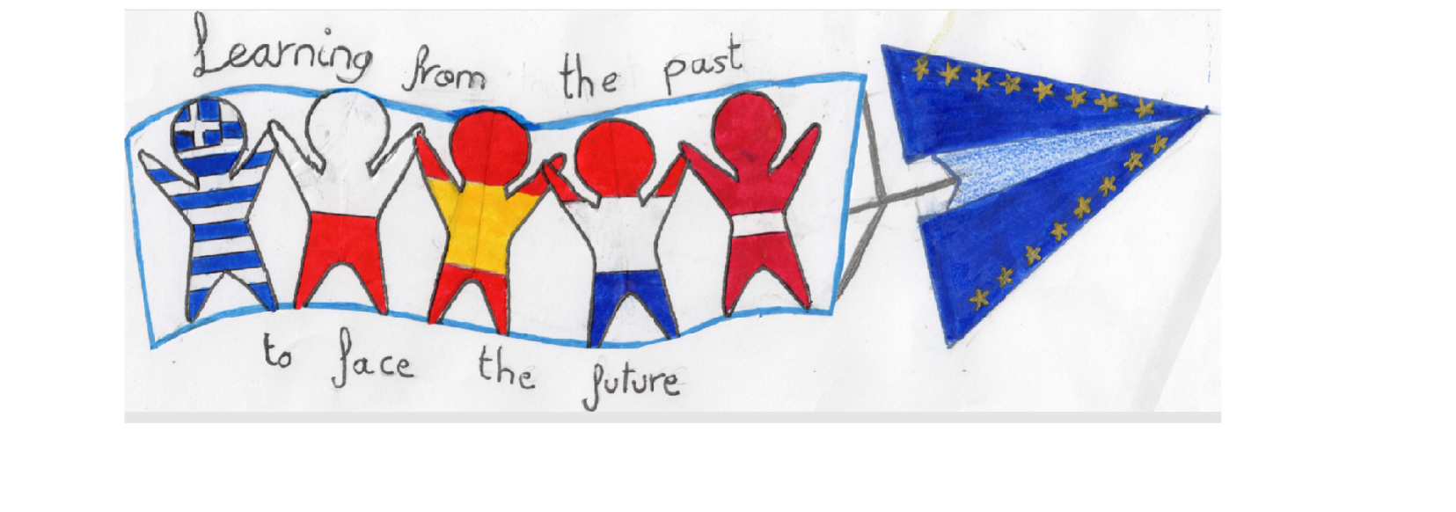

Learning from the past to face the future:
Cultural Heritage in Contrast with Modern Society

