Slide 1
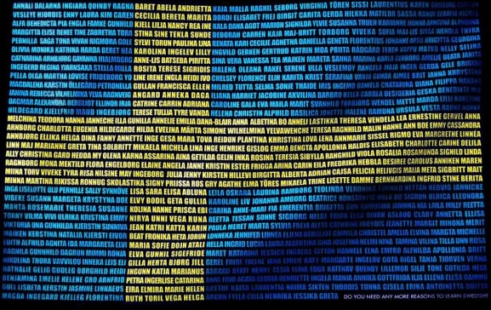
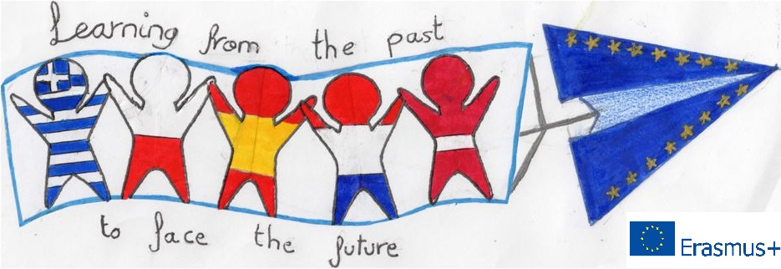
The history of the
Swedish language
5th Primary School of Korydallos, Greece

Slide 2
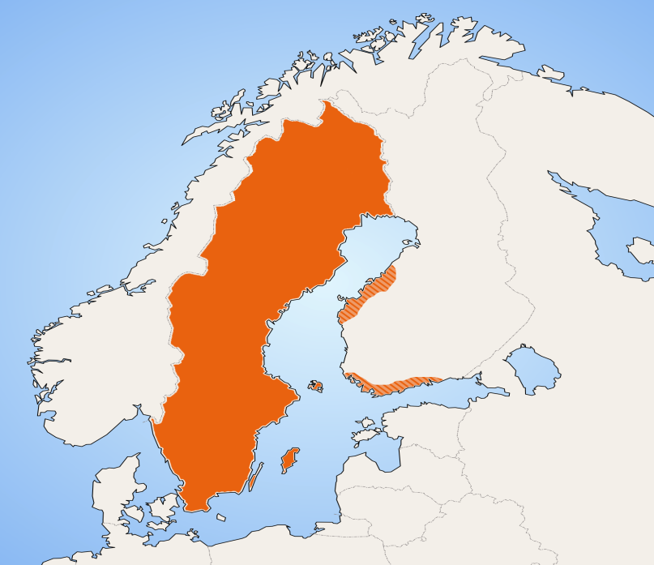
The Swedish language belongs to the North German language family, which also includes Danish, Norwegian, Icelandic and the Ferro language.

Slide 3
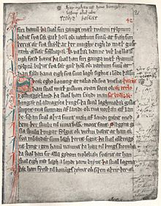
Ancient Scandinavian (400 B.C. – 800 A.D.)
Ancient Scandinavian is the most ancient language in Scandinavia.
There are not many scripts from the ancient Scandinavian era – only about two hundred. Those found, are engraved on stones, on mountain slopes and on charms.

Slide 4
Rune Swedish (800 A.D. – 1225 A.D.)
The Runic Swedish script replaced ancient Scandinavian around 800 A.D.
This dialect had only 16 letters. About 3.000 Runic inscriptions have been found in Sweden only.

Slide 5
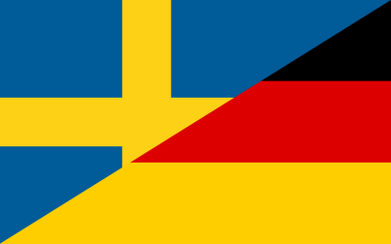
Classic old Swedish
The era of the classic old Swedish began in the 12th century.
The Christianization of the country and the entry of Latin through religion influenced the spoken and written language.
However, the greatest influence came from German. German missionaries, businessmen and craftsmen came and settled in Sweden, changing the Swedish language substantially.

Slide 6
New Swedish
The date considered to be the starting point of the contemporary Swedish language is 1879.
The language which influences Swedish, especially after the Second World War, is English, since through the cinema and music a lot of English words are adopted in Swedish.

