Slide 1
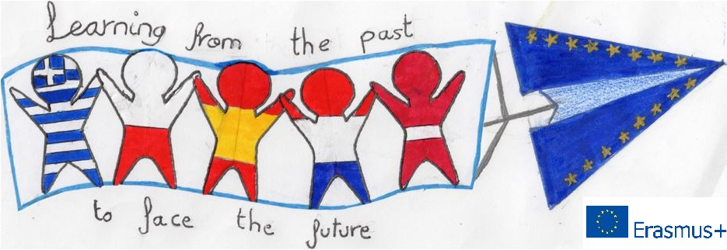
Learning from the Past to Face the Future: Cultural Heritage in Contrast with Modern Society Moments from the Greek students’ booklets

