Slide 1
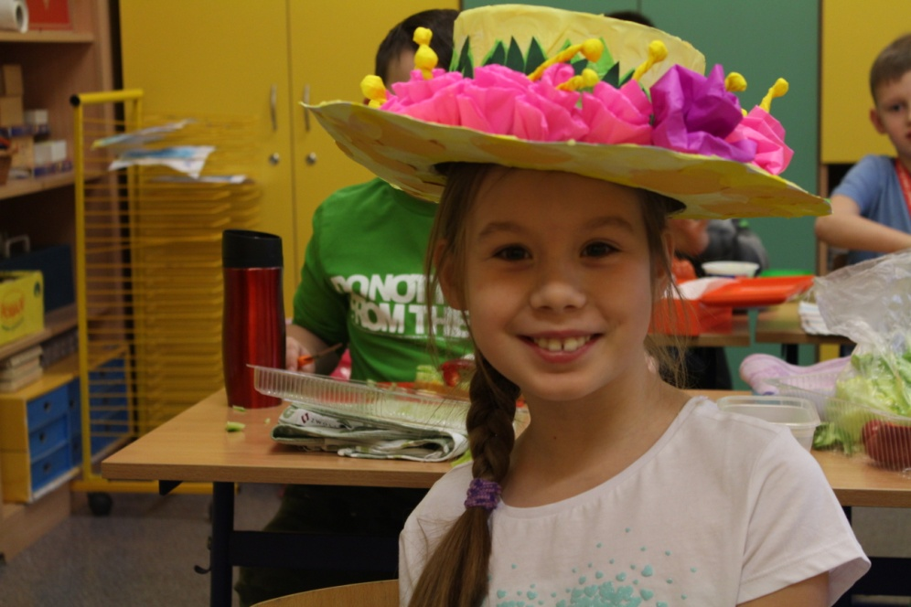
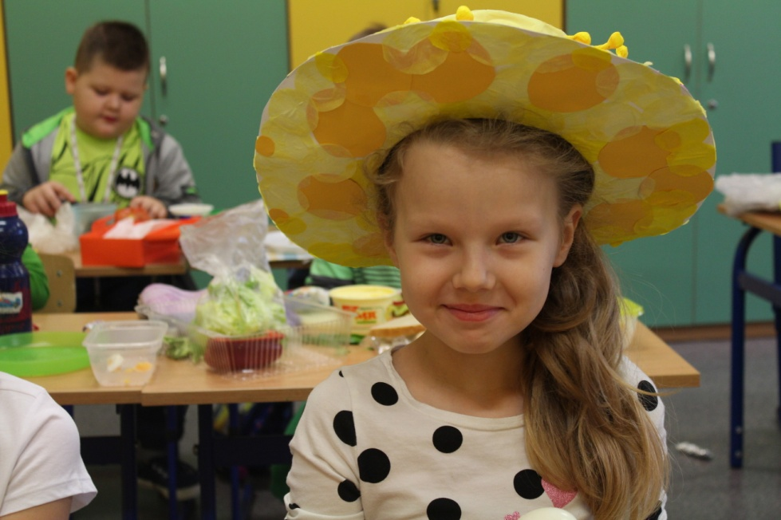
The First Day of Spring! 21st March.
Traditions of welcoming spring of our school.

Slide 2
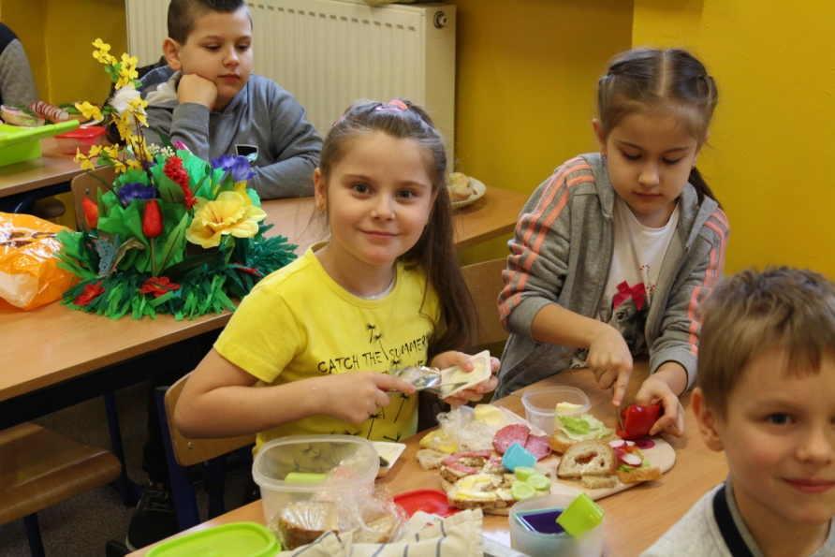
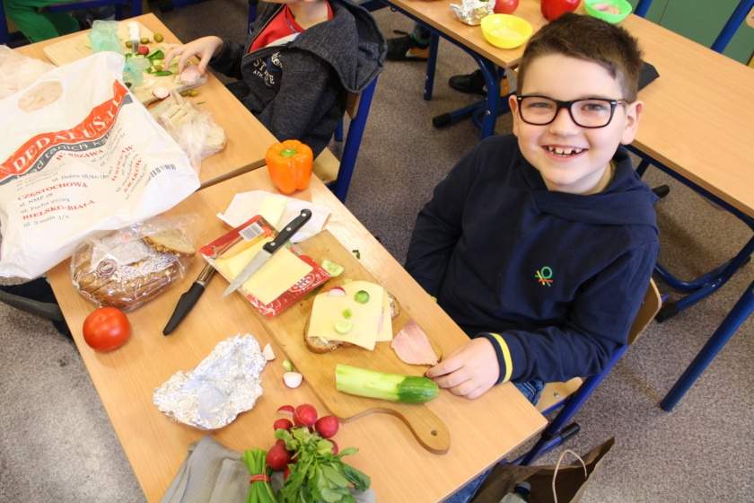
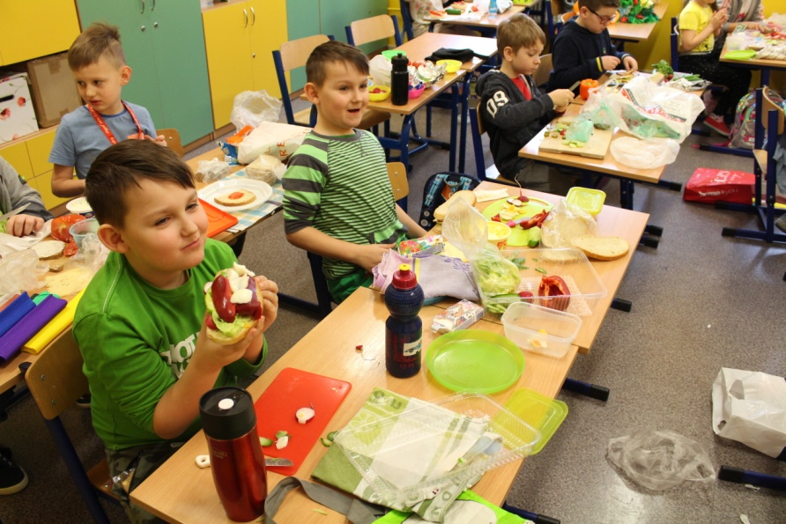
Healthy Spring Breakfast!
The youngest students from grade 1st prepared tasty and healthy sandwiches with assistance and supervision of their class teacher.

Slide 3
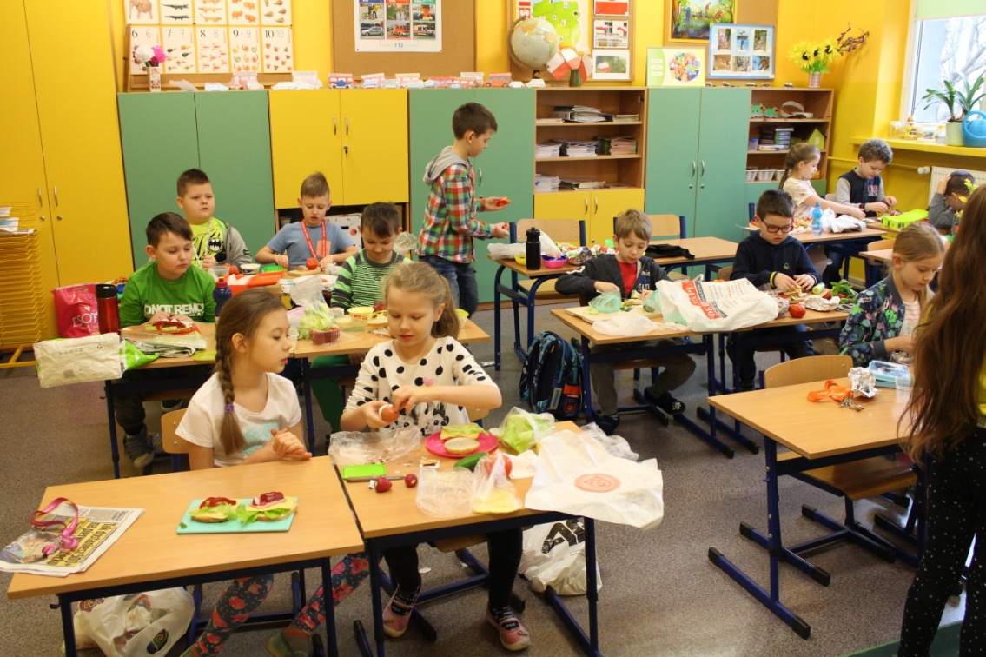
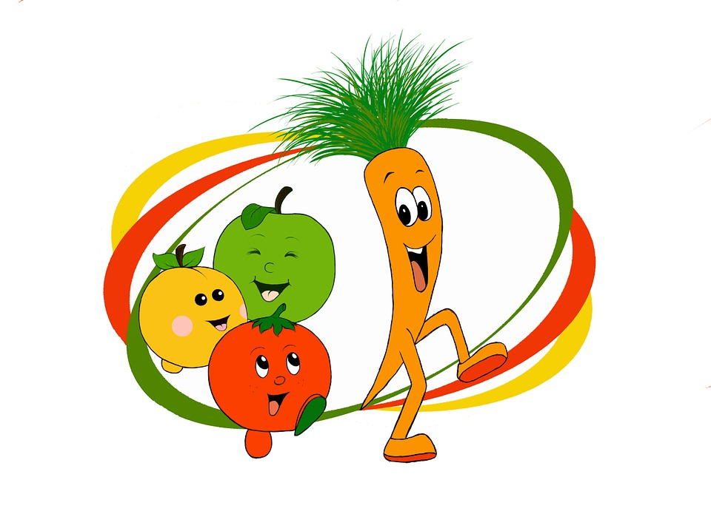
Healthy Spring Breakfast!
It is one of our traditions to teach children how to eat healthy and keep the balanced diet. They are aware of the fact that fruit and vegetables and take the most important part in our daily menu.

Slide 4
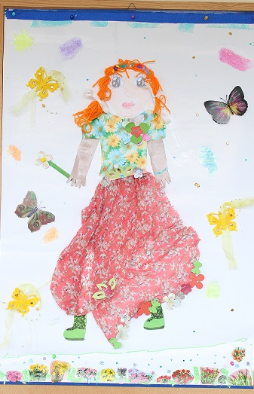
Tradition of „Marzanna”
Kids in Poland traditionally prepare a scary puppet made from straw, paper and rags. „Marzanna” symbolises cruel, ugly winter. It was either burnt or drown in the water in order to banish winter for good!

Slide 5
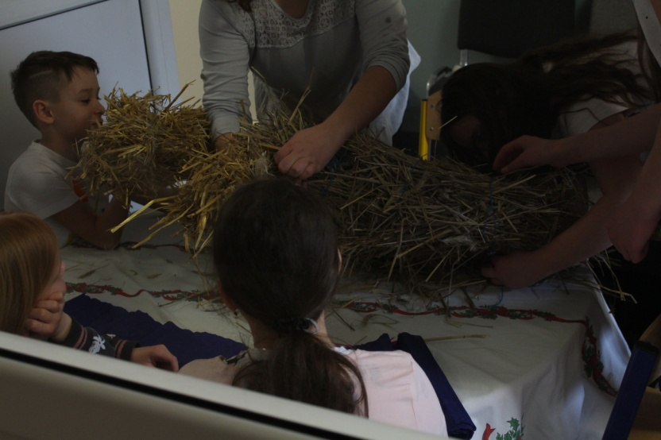
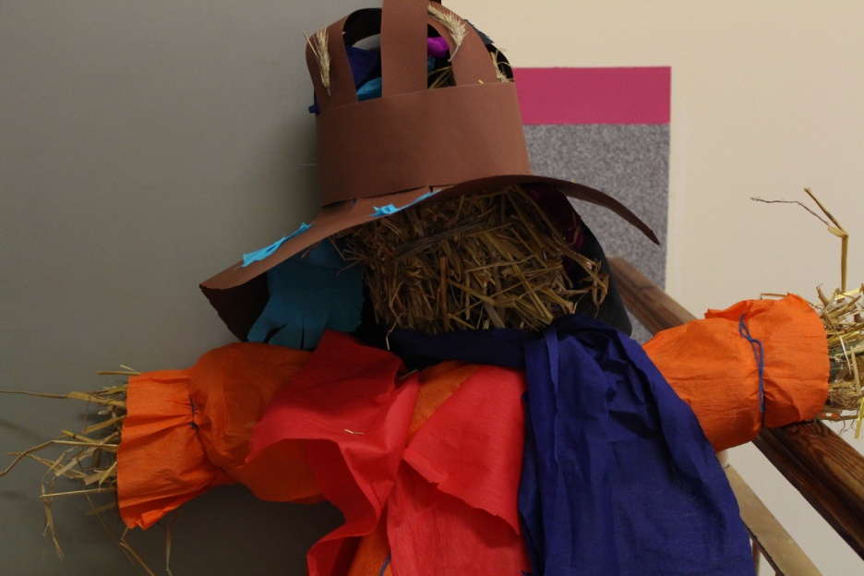
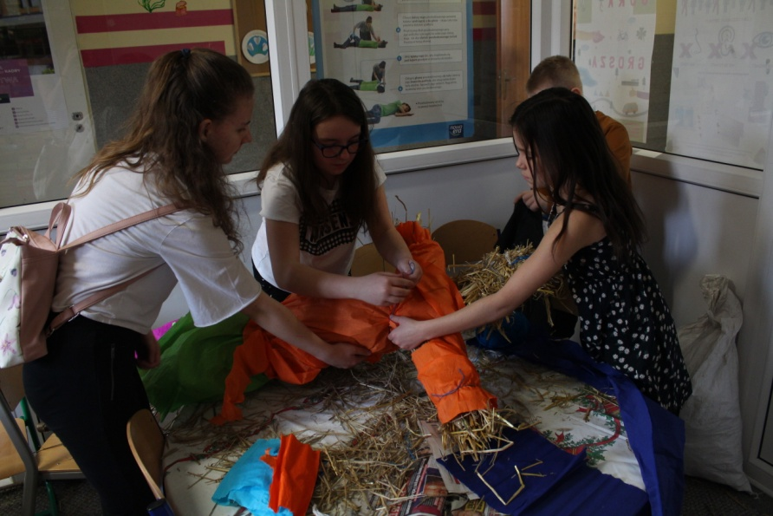
Preparing „Marzanna”
Our younger kids under the guidance of their teachers prepared their version of „Marzanna”.

Slide 6
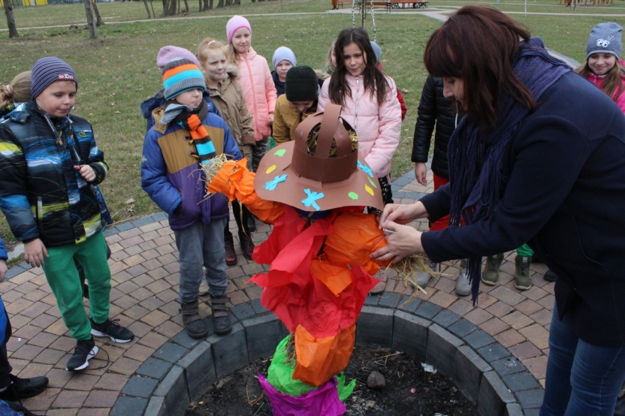
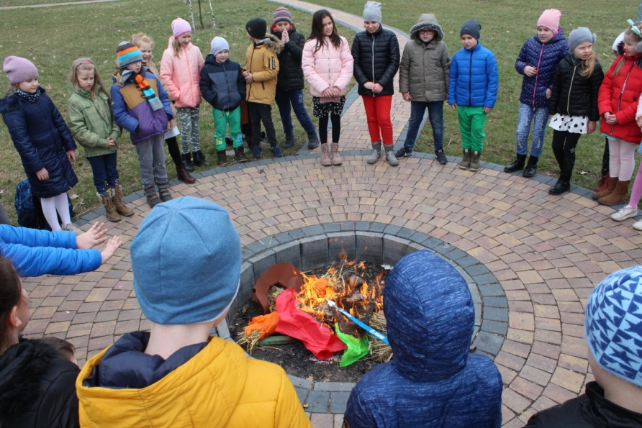
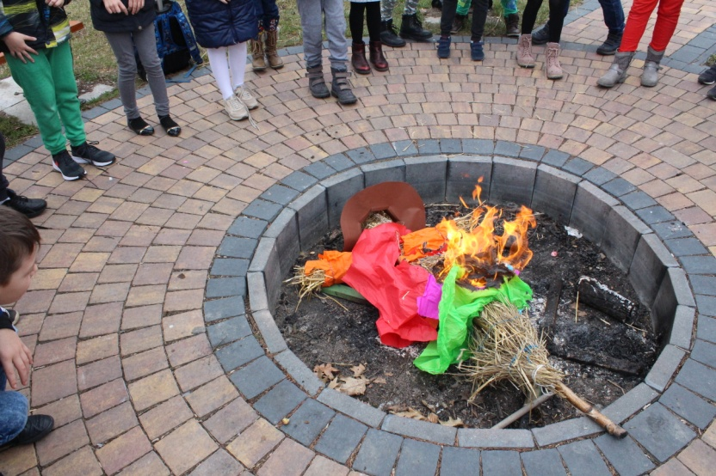
Traditional burning of „Marzanna”
Later on it was burnt in the bonfire in order to banish winter for good!

Slide 7
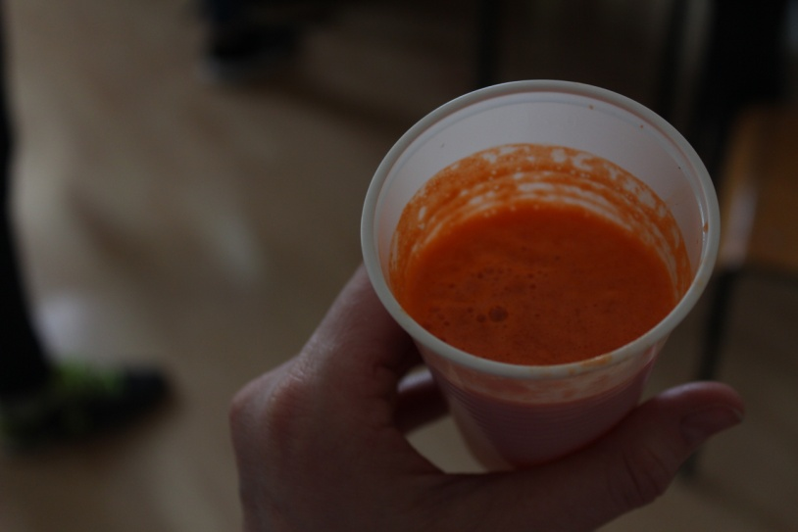
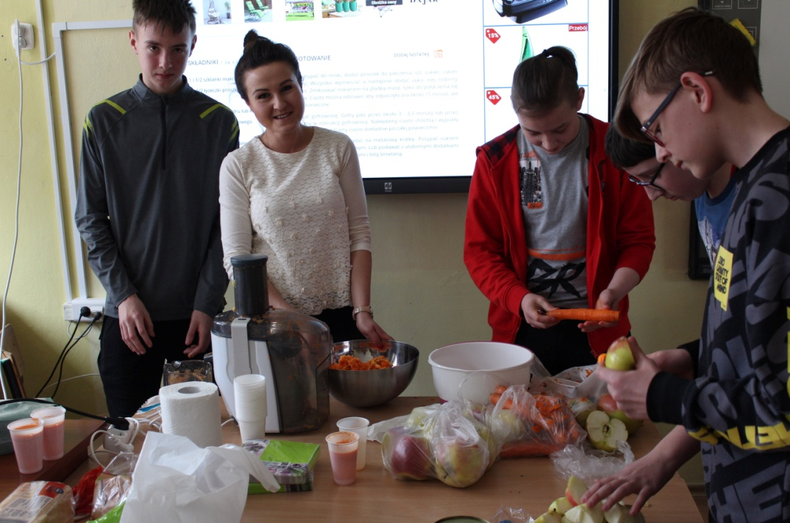
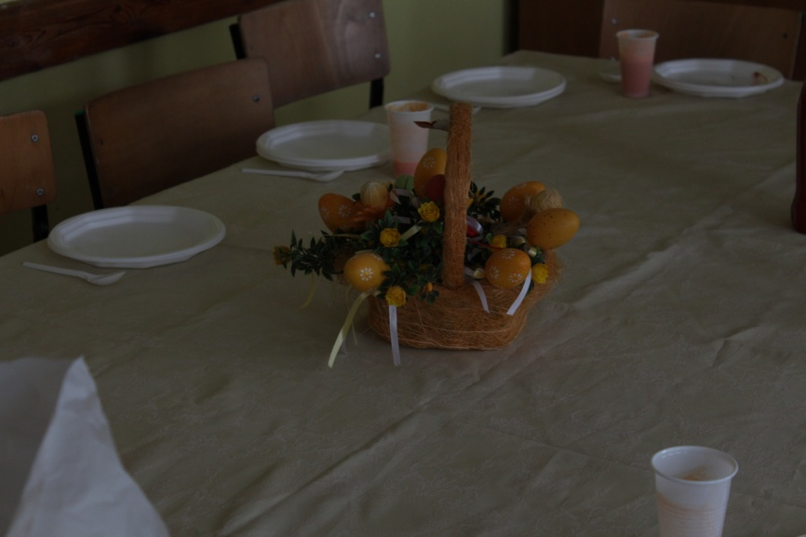
Healthy drinks and snacks!
Students from grade 7th began a new tradition of preparing healthy smoothies, salads and juices.

Slide 8
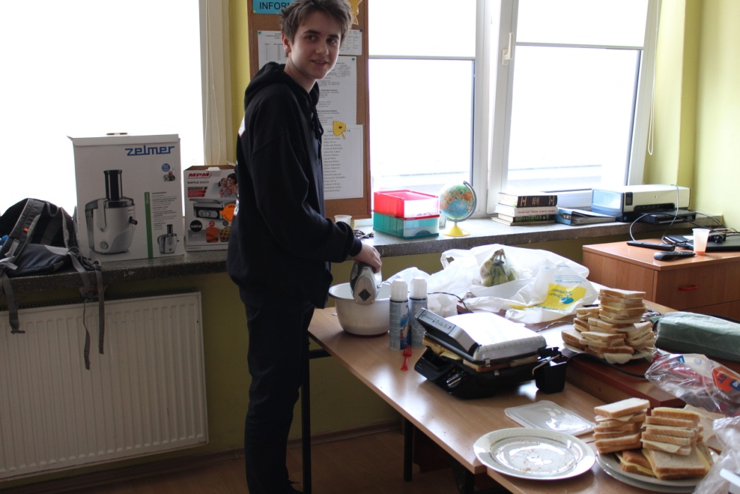
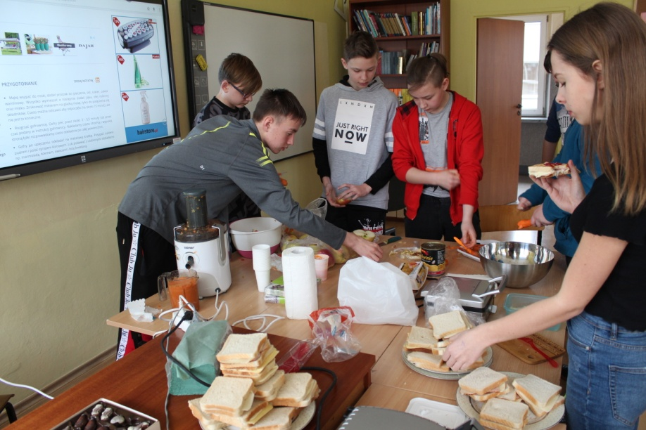
Second breakfast.

Slide 9
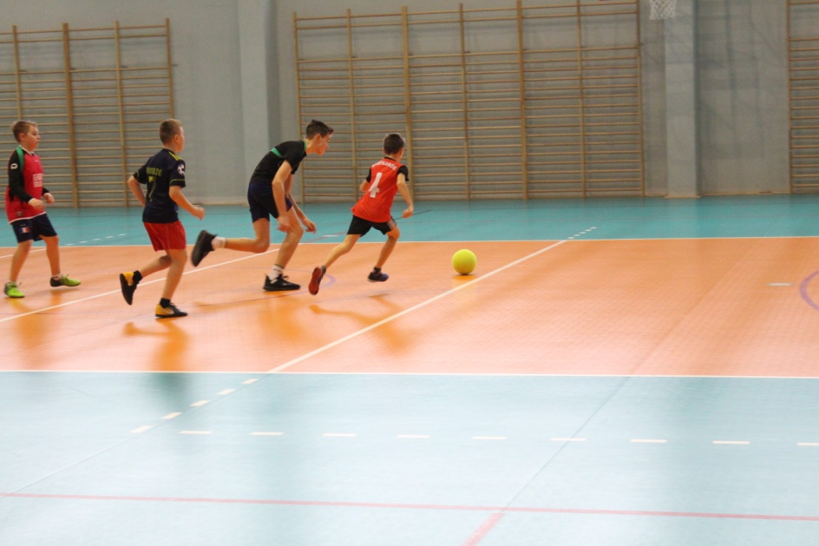
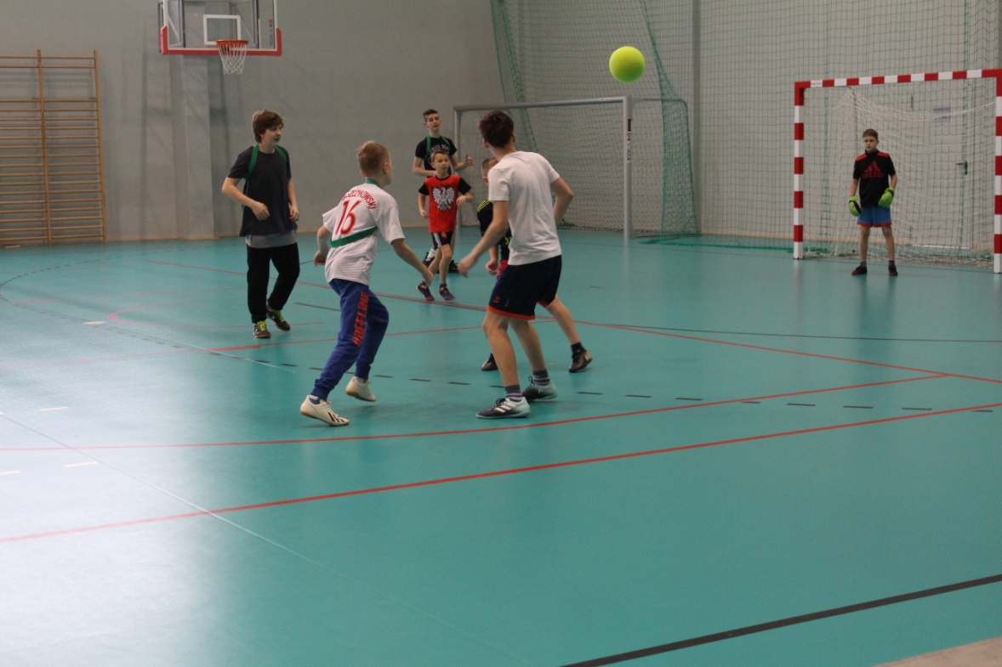
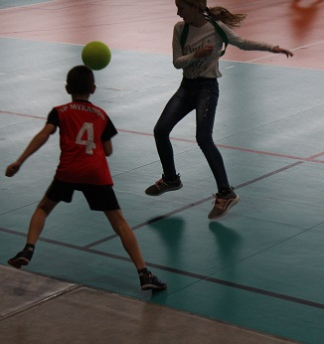
Sports competitions!
Spending the first day of spring in a sporty way is a long tradition at our school.

Slide 10
Spring is here!

