Slide 1
Who speaks Dutch?

Slide 2
Dutch speaking countries/places
Netherlands
Dutch Antilles
(Caribbean)
Dutch
Aruba
Flanders
(northern provinces of Belgium)
Suriname
(South America)

Slide 3
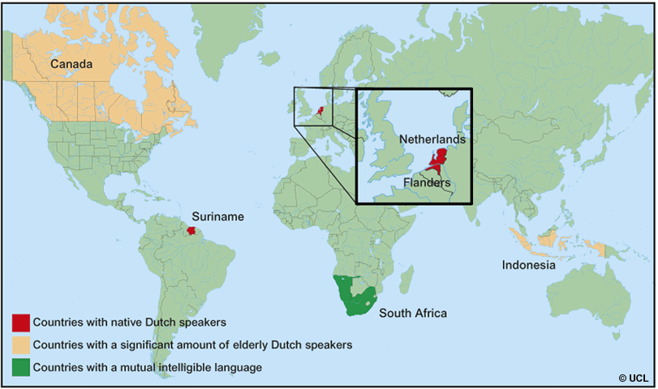
Dutch speaking places on Map

Slide 4
In total Dutch has 23 million mother tongue speakers.

Slide 5
Non Native speakers There are also 4 million people worldwide who speak Dutch as a second or foreign language.

Slide 6
History of the Dutch language
In 700 AD there were three major language areas in Europe: Latin, Celtic and Germanic. The Latin language has changed to the Romance languages. Varieties of Celtic are only spoken in some places in Britain and Ireland.
English, German, Dutch and the Scandinavian languages ​​developed from the Germanic language group.
The languages ​​were only spoken at that time (no writing).
A standard language/Dutch did not appear until the 16th century. Before that you had no such thing as "Dutch", just dialects. Speakers often did not even understand each other.
Since then, the way we have to write Dutch words has changed quite often. The last big change was in 1995.

Slide 7
Number of words in Dutch

Slide 8
Number of words in Dutch
There are at least almost 400,000 words in the Dutch language.
The Dictionary of the Dutch language contains between 350,000 to 400,000 entries.
These are words from between 1500 to 1921, which were registered in this dictionary.

Slide 9
Alphabets in Dutch

Slide 10
The modern Dutch alphabet consists of the 26 letters. Five (or six) letters are vowels and 21 (or 20) letters are consonants. The letter E is the most frequently used letter in the Dutch alphabet. The least frequently used letters are Q and X. the digraph IJ behaves as a single letter.

Slide 11
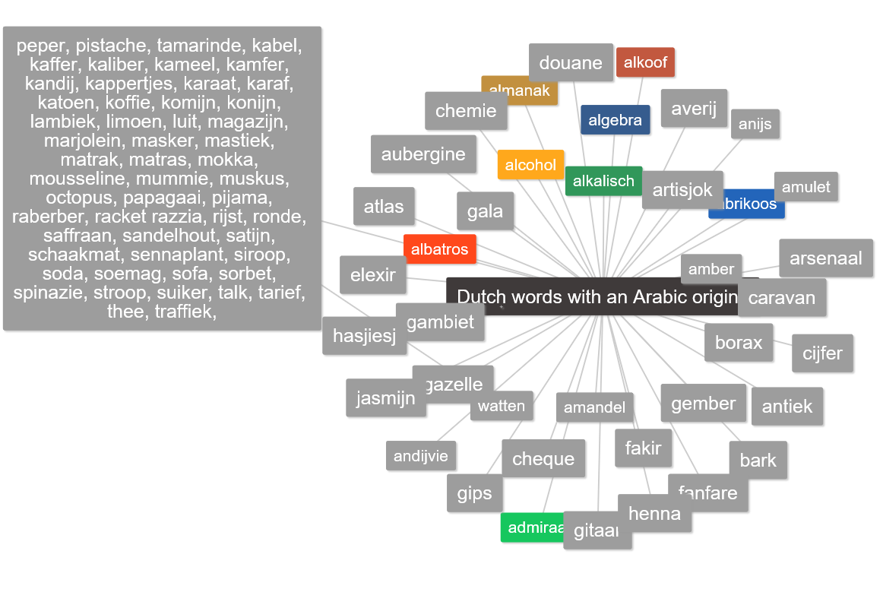
Arabic words in Dutch language

