Slide 1
The Greek Language
5th Primary School of Korydallos, Greece

Slide 2
History

Slide 3
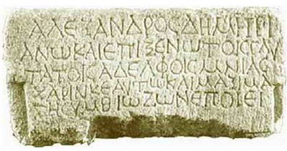
Ancient Greek
There are written texts in Greek dating back in the 16th century B.C.
The main characteristic of the spoken language was its musicality.
The first 2 forms of the ancient Greek language have not been encrypted…

Slide 4
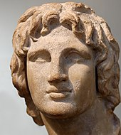
Ancient Greek
The most important dialect in Ancient Greece was the Attic, the one spoken in Attica, the area of Athens.
King Philip of Macedonia and his son, Alexander the Great, established the Attic dialect as the single language of the whole Greece.

Slide 5
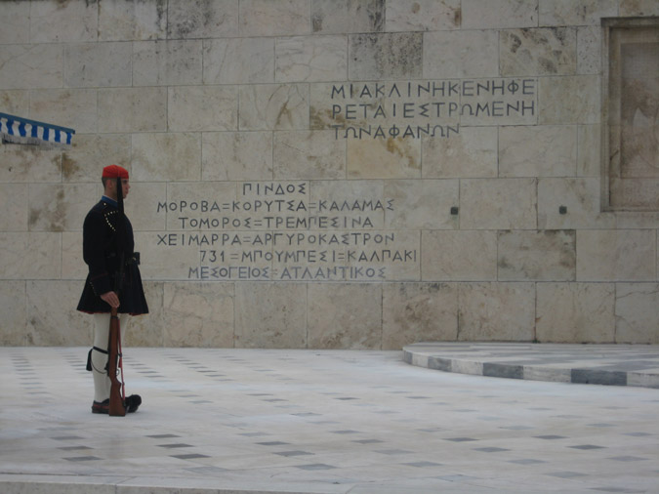
Modern Greek
The language started shaping its modern form during the Byzantine era.
Nowadays, it still uses the same alphabet, but it is written in a simpler way.

Slide 6
Facts

Slide 7
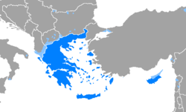
Number of speakers
The Greek language is spoken by 13 million people in Greece and Cyprus.
Also, it is officially recognised as a minority language in parts of Italy, Albania, Armenia, Romania, and Ukraine.

Slide 8
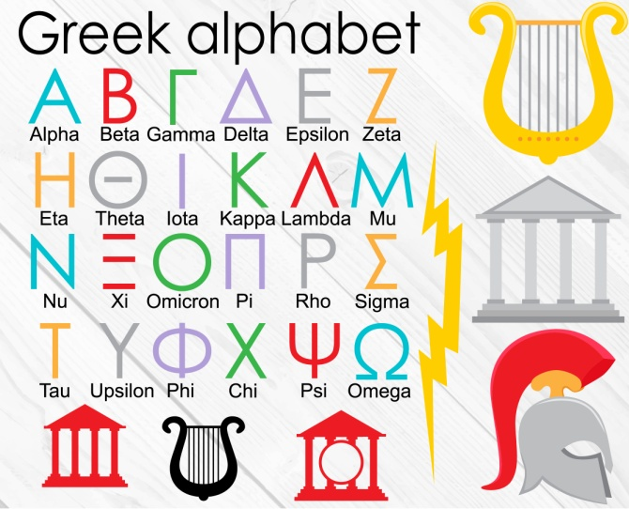
Alphabet and Words
The Ancient Greek alphabet had capital letters only, but the writers’ need to write more letters in the same space and in a quicker way led to the appearance of the small letters.

Slide 9
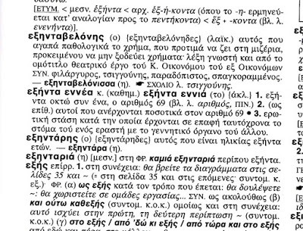
Alphabet and Words
There are 24 letters in the Greek alphabet.
The modern Greek language, along with its dialects, contains about half a million words.

Slide 10
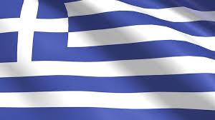
Greek words in Spanish
Gramatica
Lexico
Alfabeto
Dialogo
Historia
Drama
Musica
Museo
Academia
Logica
Problema
Aeroplano
Helicoptero
Telefono
Monasterio
Biologia
Fisica
Astronomia
Dialogo
Metafora
Perimetro
Television

Slide 11
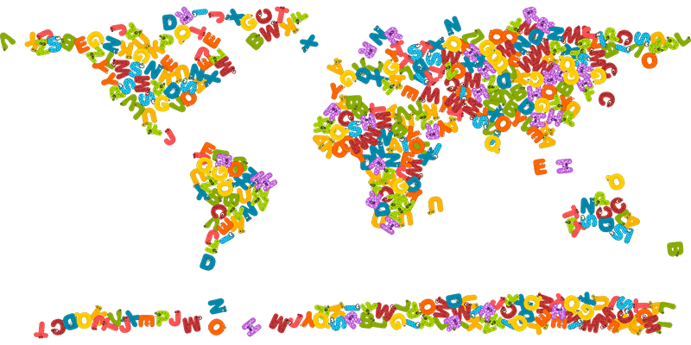
Words in Greek, borrowed from other languages
French | English | Turkish | Italian
Αεροπλάνο | Βεράντα | Γιαούρτι | Βεντάλια
Βαγόνι | Βόλεϊ | Τεμπέλης | Διαμάντι
Βιτρίνα | Γκολ | Ταβάνι | Ταράτσα
Φοβία |  |  | Τακούνι
 |  |  | Ταμπέλα
 |  |  | Φασαρία

Slide 12
Mini-glossary

Slide 13
Mini-glossary
Hello
Good morning
Good afternoon
Good evening
Good night
How are you?
Γεια
Καλημέρα
Καλό απόγευμα
Καλησπέρα
Καληνύχτα
Πώς είσαι;

Slide 14
Mini-glossary
I’m fine
Thank you
Sorry
Please
Cheers
Bye
Είμαι καλά
Ευχαριστώ
Συγνώμη
Παρακαλώ
Στην υγειά μας
Αντίο

Slide 15
Literature

Slide 16
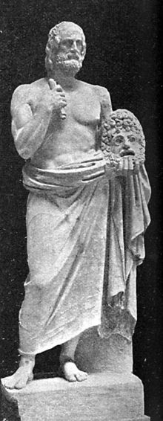
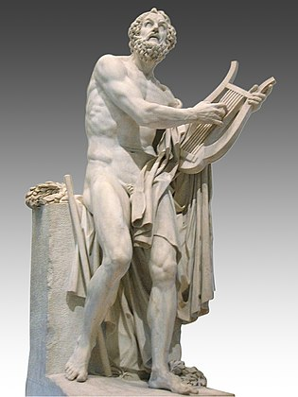
Ancient Greek writers
Theatrical writers
Euripides
Aeschylus
Sophocles
Aristophanes
Homer
The legendary author of the Iliad and the Odyssey

Slide 17
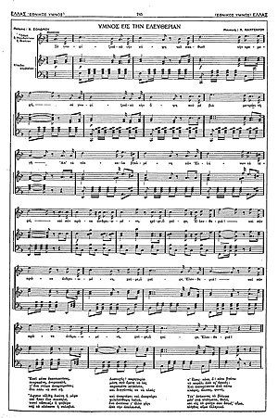
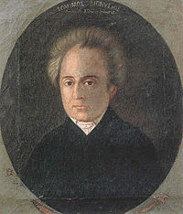
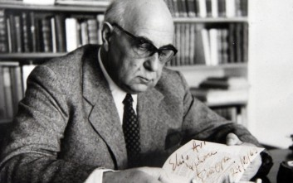
Greek writers
Writers awarded the Nobel Prize in Literature
Odysseas Elytis
Giorgos Seferis
Dionysios Solomos
Writer of the poem “The Hymn to Liberty” that became the National Anthem of Greece

Slide 18
Proverbs

Slide 19
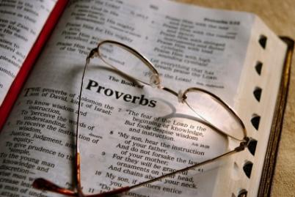
English | Greek
No pain, no gain! | Τα αγαθά κόποις κτώνται.
The early bird catches the worm. | Των φρονίμων τα παιδιά πριν πεινάσουν μαγειρεύουν.
When there’s a will, there’s a way. | Όπου υπάρχει θέληση, υπάρχει τρόπος.
Never look a gift horse in the mouth. | Του χάριζαν γάιδαρο και τον κοίταζε στα δόντια.
Better late than never. | Κάλλιο αργά παρά ποτέ.

Slide 20
No pain, no gain
It means that good things must be earned!
Phrases with similar meaning can be found in the writings of Euripides.
In Greek the phrase “Τα αγαθά κόποις κτώνται” is used, with a similar meaning.
A literal translation in English would be “Good things come after works”.

Slide 21
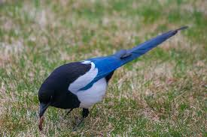
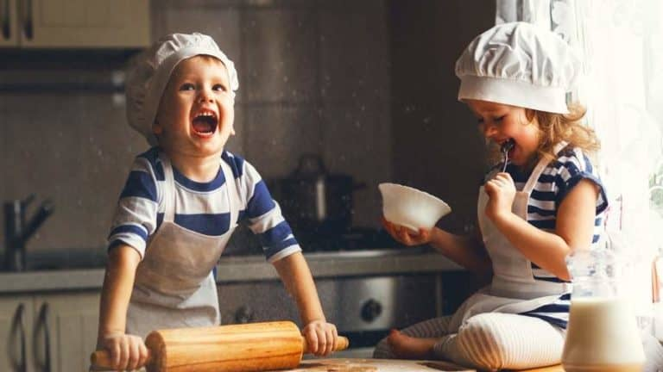
The early bird catches the worm
It means that we should start our day early!
In Greek the phrase “Των φρονίμων τα παιδιά πριν πεινάσουν μαγειρεύουν” is used, with a similar meaning.
A literal translation in English would be “Wise people’s children cook before they get hungry”.

Slide 22
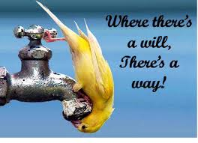
Where there’s a will, there’s a way
It means we should try hard to succeed.
In Greek the phrase “Όπου υπάρχει θέληση, υπάρχει τρόπος” is used, with the same meaning.
The Greek phrase is a literal translation of the English one!
A similar phrase was published for the first time in 1640 by George Herbert. Up to the 1820’s, the phrase had changed to “where there’s a will, there’s a way”.

Slide 23
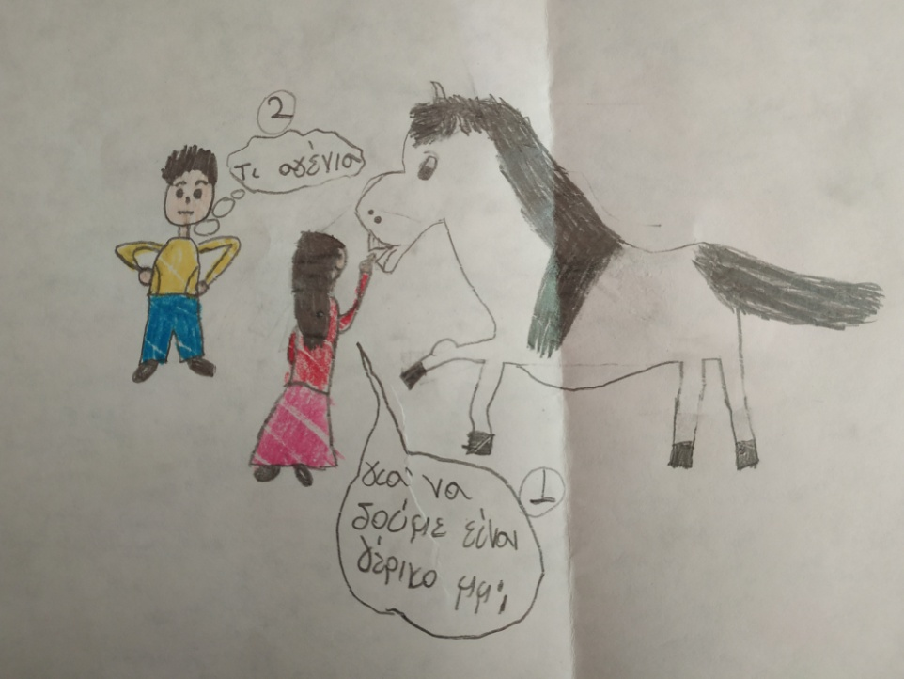
Never look a gift horse in the mouth
It is an advice to be grateful for a present, instead of trying to find something better.
In Greek the phrase “ Του χάριζαν γάιδαρο και τον κοίταζε στα δόντια” is used, with the same meaning.
A literal translation in English would be “Someone was given a donkey and he stared at its teeth”.
How rude!
Let’s see… is it old?

Slide 24
Better late than never
It means that it is better to do something late than not do it at all.
In Greek the phrase “Κάλλιο αργά παρά ποτέ” is used, with the same meaning.
The Greek phrase is a literal translation of the English one!

Slide 25
Arabic words

Slide 26
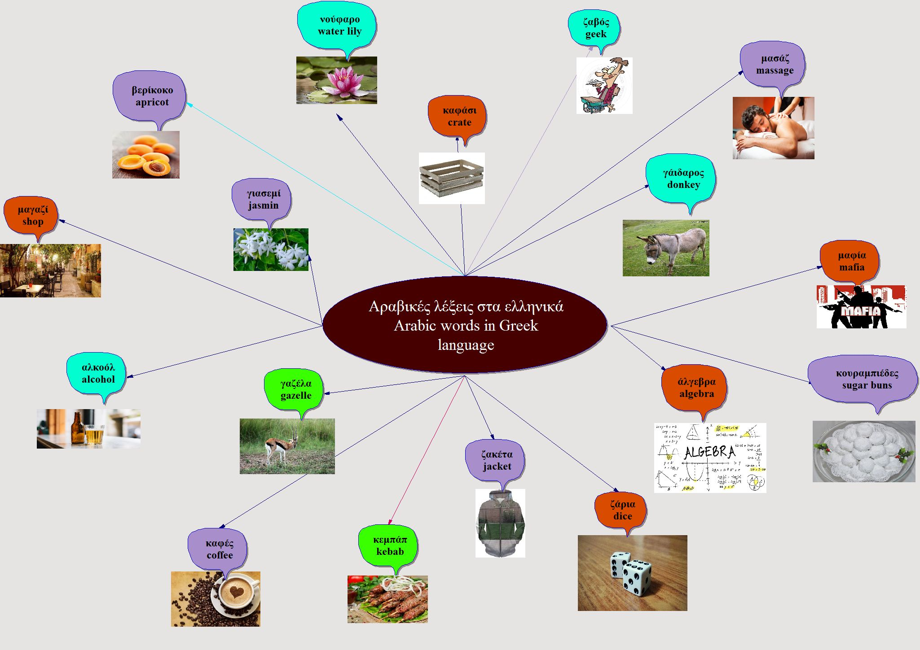

Slide 27
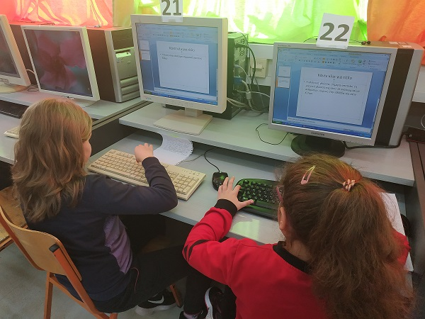
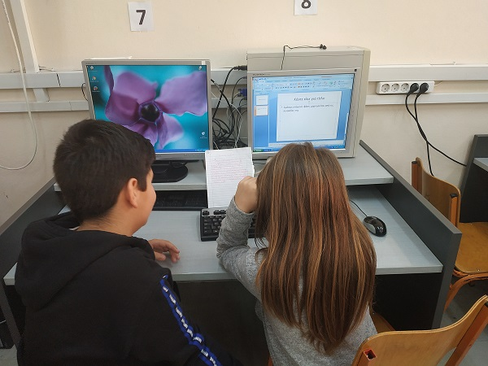
Thank you!
The students of the 4th, 5th and 6th grades

