Slide 1
Project about latvia

Slide 2
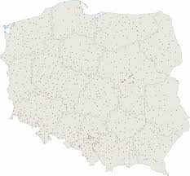
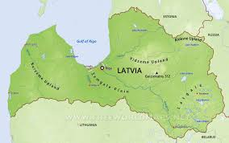
Area in square kilometers
Latvia
ABOUT 64 THOUSAND SQUARE KILOMETERS
Poland
ABOUT 312 THOUSAND SQUARE KILOMETERS

Slide 3
POPULATION
LATVIA
ABOUT 2 MILION
POLAND
ABOUT 33 MILION

Slide 4
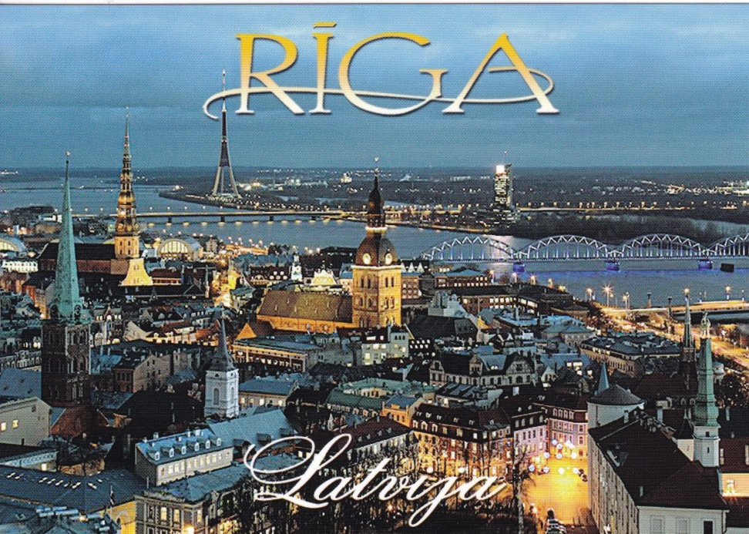
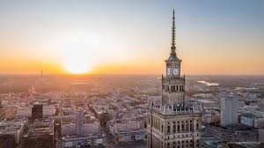
CAPITALS AREA IN SQUARE KILOMETERS
RIGA
ABOUT 300 SQUARE KILOMETERS
WARSAW
ABOUT 515 SQUARE KILOMETERS

Slide 5
POPULATION IN CAPITALS
ABOUT 635 THOUSAND
ABOUT 1,7 MILION

Slide 6
Three brothers
In Riga we knew buildings called three brothers.
The three brothers are a complex of three medieval residdential houses in Riga.

Slide 7
Ventspils Castle
Ventspils castle is located in Latvia .
It is one of the oldest and best preserved castle in the Inflant Order
It was used as a fortress,
mansion, Garrison,school,military base and prison.

Slide 8
Riga
Riga is the capital and largest city of Latvia .
The city is located on the Daugave River near the Baltic sea in the Gulf of Riga .
It is the main economie, industrial and communication.

Slide 9
Old town
The oldest part of Riga lying on the night bank of the Daugava river.
The old town is know for its temples and historical buildings.

Slide 10
communication
Riga operates the airport, the seaport and latvia's largest railway station.
Public transport is operated by both trams and trolleybuses.

Slide 11
Museum IN lATVIA
-Latvian Ethnographic Museum
-Museum of Occupation in Riga
-Riga Automotive Museum
-Latvian National Museum of Art

Slide 12
Universities
-University of Latvia
-University of Stradiņša in Riga
-Riga Technical University
-Stockholm School of Economics in Riga
-Latvian Academy of Arts

Slide 13
Done by
-Maja Rygał
-Agata Migoń
-Paweł Kielan

