Slide 1
Arabic roots in Latvian

Slide 2
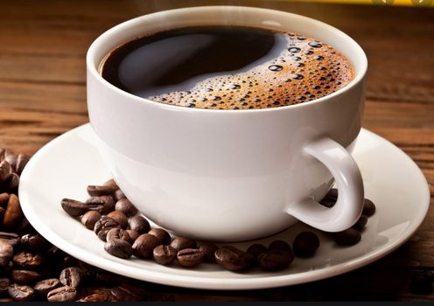
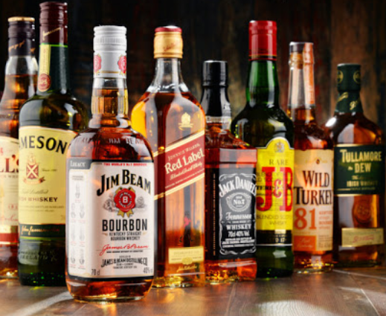
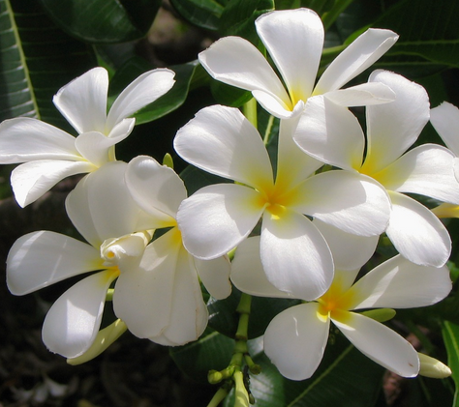
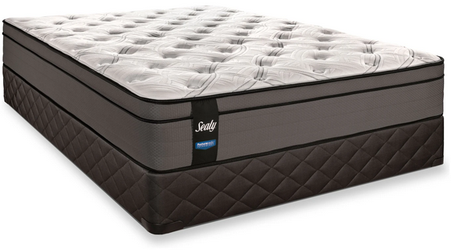
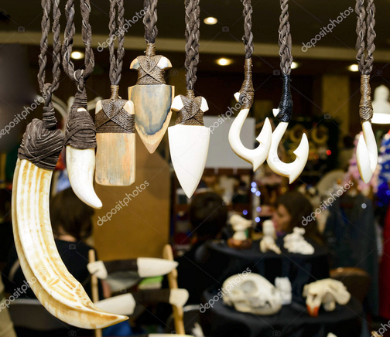
Jasmīns
[yas-meens]
Jasmin
Kafija
[ka-fee-ya]
Coffee
Alkohols
[ul-ko-hols]
Alcohol
Various words
Matracis
[mu-tru-cis]
mattress
Cipars
[ci-pu-rs]
number
Šahs
[sha-hs]
Chess
Talismans
[ta-lees-muns]
mascot

Slide 3
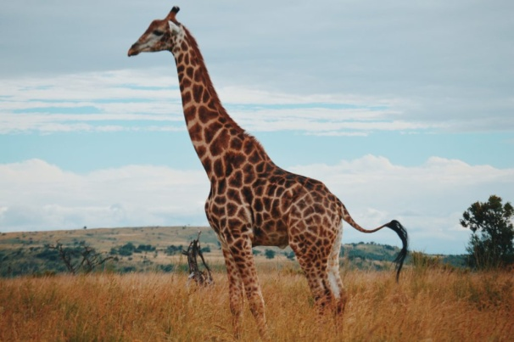
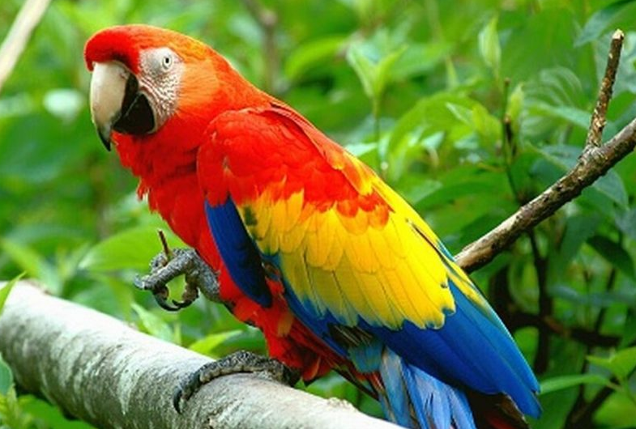
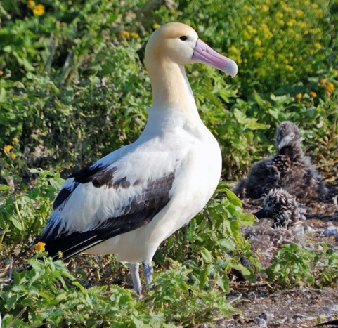
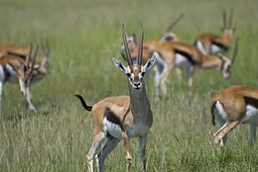
žirafe
Papagailis
|dʒɪˈrɑːfe|
|papagaɪˈlɪs|
Animals
Albatross
Gazele
|ˈalbətros|
|ɡəˈzele|

Slide 4
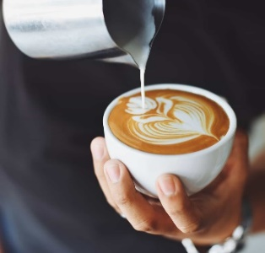
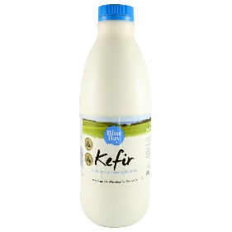
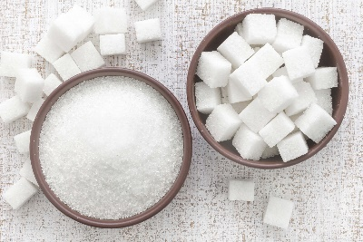
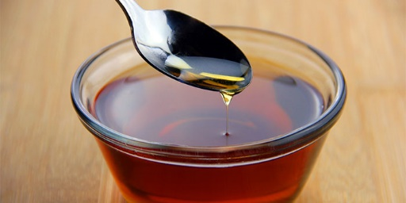
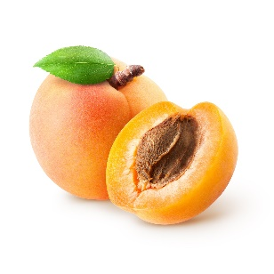
Coffee
Kefir
Kafija
Kefirs
Sugar
Cukurs
Arabic words
Srīups
Syrup
Aprikoze
Apricot

