Slide 1
Latvian language

Slide 2
The Latvian language is "a mirror of the wonderful story of our nation", says a linguistics professor at the University of Latvia.

Slide 3
A bit of History

Slide 4
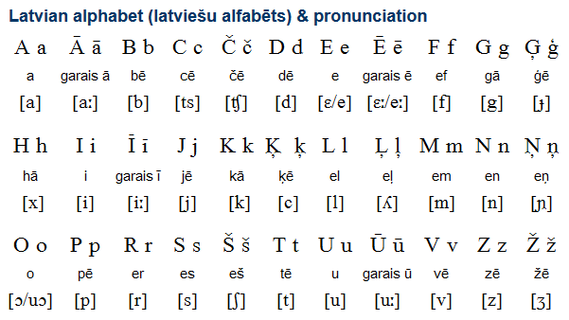
Latvian, rooted in Sanskrit, belongs to the Baltic branch of the Indo-European language family. There are only two alive Baltic languages in nowadays - the Latvian and the Lithuanian language.
Latvian language formed until 16th century.

Slide 5
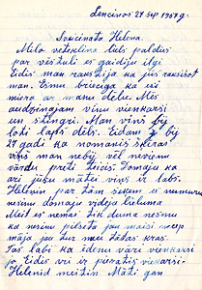
Latvian in Latin script was first based upon the German alphabet, while the alphabet of the Latgalian dialect was based on the Polish alphabet.
A modified Latin alphabet was adopted in 1922.

Slide 6
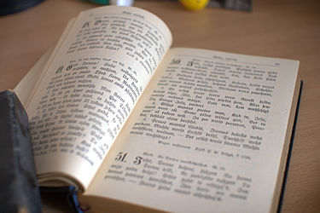
The first Latvian dictionary, Lettus, was compiled by Georg Mancelius in 1638.

Slide 7
Some facts

Slide 8
Structure
The structure of words is diffrent of other Europe languages.
For example:
(other languages) milk, latte, lait, milch,moloko (молоко)- (Latvian) piens.
(other languages) river, riviere, fleuve, fiume, reka (река)- (Latvian) upe.
So we can say that Latvian language is unique and really unusual.

Slide 9
Letters
Latvian employs modified Roman script including 33 letters.
Every phoneme has its own letter, so you can always guess how to pronounce a word when you read it.
The stress with some exceptions is on the first syllable.
There are about 1.3 million native Latvian speakers in Latvia and 100,000 abroad.

Slide 10
Garumzīme
The ‘garumzīme’ is one of the most important aspects in the Latvian language this symbol can change the meaning of the word.
But lets start with letters:
It makes letters like a,e,u and i longer. For example:
Ā=AA Ē=EE Ū=UU Ī=II
So when we know words we can read words, but it is not so simple as it looks. When you put one of this 4 letters with garumzīme in the end of word it will mean that you are inside of something:
Māja- a house Mājā- in a house ; skola- a school skolā- in a school
It’s interesting that garumzimes is only in Latvian language!

Slide 11
An interesting fact
The longest word in Latvian is «pretpulksteņrādītājvirziens».

Slide 12
Literature

Slide 13
Three of the most influencing writers in Latvia

Slide 14
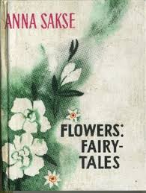
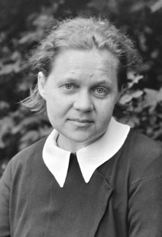
Anna Sakse
Anna Sakse was a Latvian writer and translator. She lived in the 20th century. She has written a lot of fairytales, but the most popular were about flowers («Flowers – fairytales»). Almost every child in Latvia has heard at least some of them – e.g. «Pionies», «Lily», «Hiacinth».
Her fairytales are special, because the main heroes are people with the flower names. They introduce the readers to the wide range of feelings and emotions, from happiness and hopefulness to sadness and despair, and each story leaves a strong impact on the readers.

Slide 15
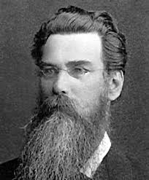
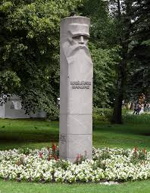
Krisjanis Barons
Krišjānis Barons was a collector of dainas (Daina is a Latvian folk song) and is known as the father of dainas. He has gathered and systematized an impressive collection of beautiful dainas and nowadays Latvian people still sing some of them. He has brought together around 7 millions dainas about everything that surrounds people - from the description of a bug to thoughts about the world's creation.
This is a huge legacy for Latvia and people abroad, because these folk songs teach us history about how people lived, worked, loved and thought in the past.

Slide 16
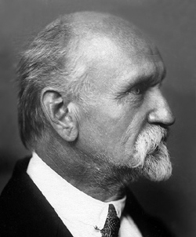
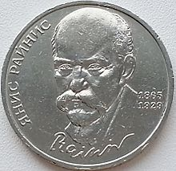
Rainis (Jān Pliekšans)
Rainis was Latvian poet, playwright, linguist and politician. He was born on September 11, 1865 and died at age 64 on September 12, 1929. He is often considered as a Latvian Shaekspeare. He wrote a lot of masterpieces – plays and poetry, such as the classic ‘Fire and Night’ and ‘The Golden Horse’, and as well as highly regarded translation of Goethe's Faust.
He is an eminent figure for Latvians because of his literature talent, political enthusiasm and being a candidate for a Nobel Prize.
Quote: „Everybody must help, to make a big work together“

Slide 17
Thanks for your attention

