Slide 1
Sweden – Festivals and Traditions

Slide 2
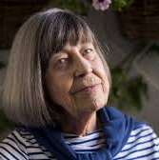
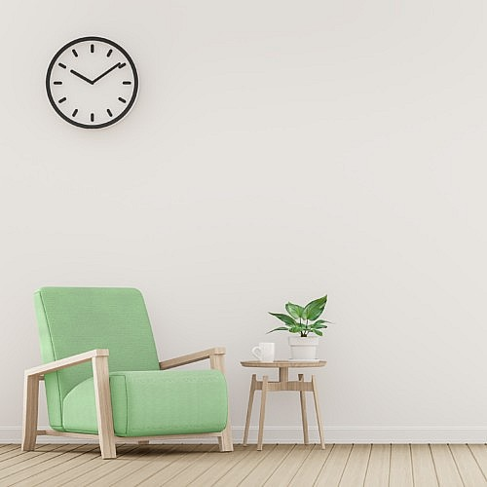
DÖSTÄDNING
Death Cleaning
It’s a process which consists of getting rid of all the unnecesary stuff for your happiness, so that you only keep those things that make you happy.
It’s creator, Margaretta Magnusson, recommends that everyone should begin death cleaning after 50 years old; nevertheless, anyone can do it.
It, should be a slow process given that you can’t get rid of all your unwanted things in a day, neither in a week.
As you’re giving your items away, you ought to give them to any other person who might want them.
By Jaime Corbella

Slide 3
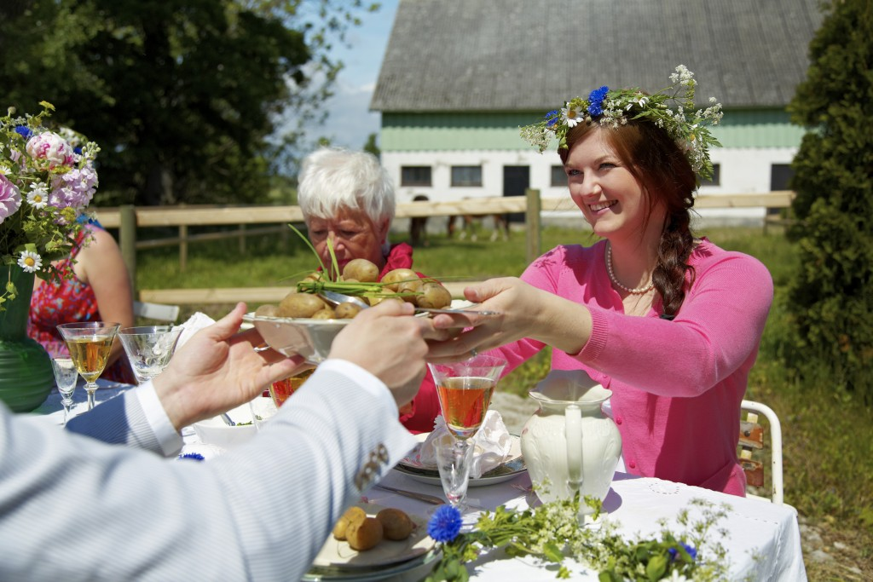
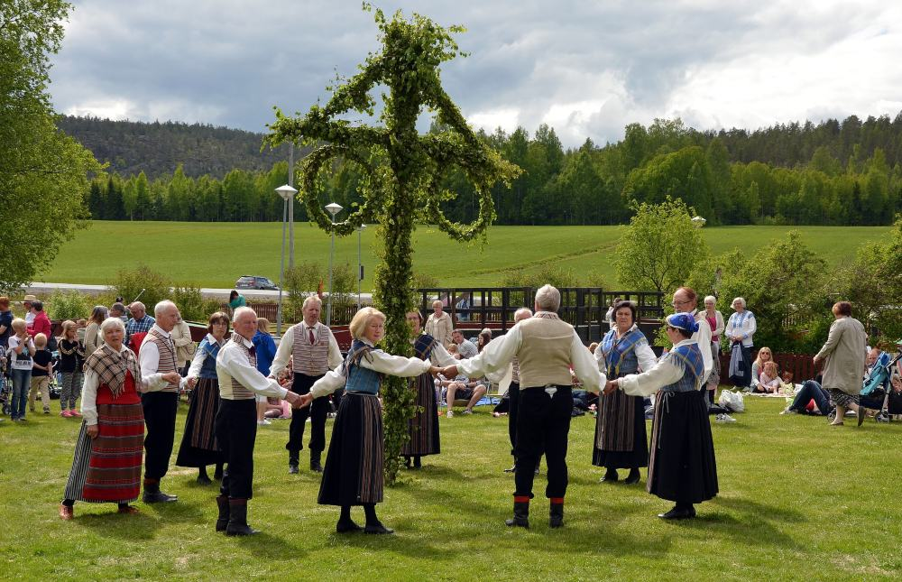
MIDSOMMAR (SWITHERLAND)
Midsommar eve is the 25 of june and it is usually celebrated in public parks, gardens or in summer cottages.
In the successful midsommar lunch party people wear flowers in their hair, dance around a dessert and sing songs while they drink schnapps. They also eat a whole load of pickled herring served with delicious new potatoes, chives and sour cream. All in all, a big day out.

Slide 4
Waffle day
It's celebrated on March 25. This tradition comes from the Christian celebration of the Annunciation's Day.
Nowadays the Waffle Day has recently begun to be celebrated in other countries

Slide 5
Cinnamon Bun Day
The day was created to celebrate Sweden's rich tradition of bullar, and now it has become a tradition held every year on October 4.
The purpose of the celebration is to increase attention on Swedish baking traditions.

