Slide 1
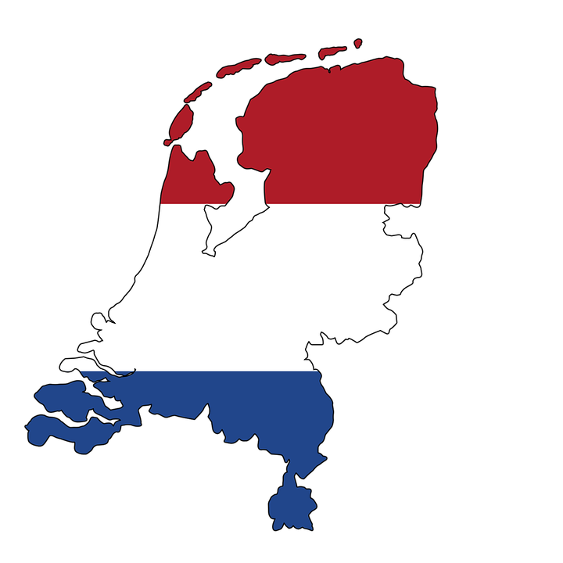
Holland

Slide 3
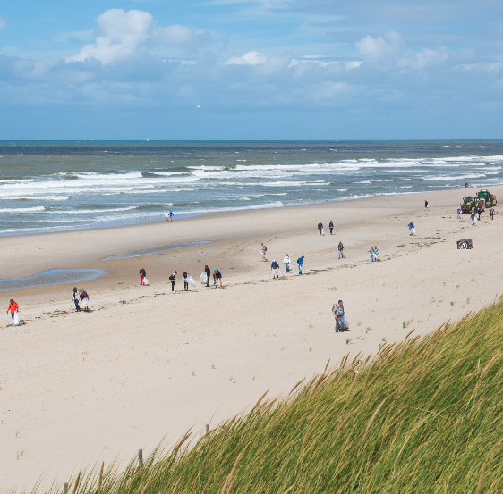
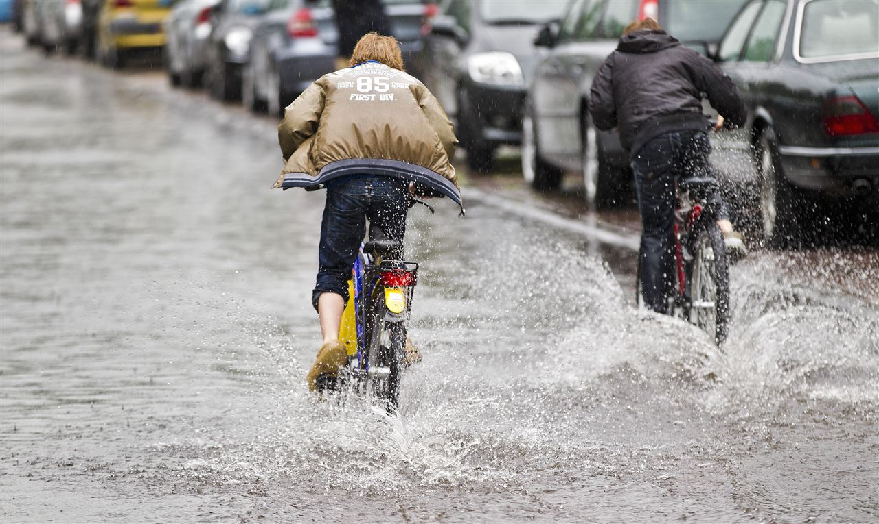

Slide 4
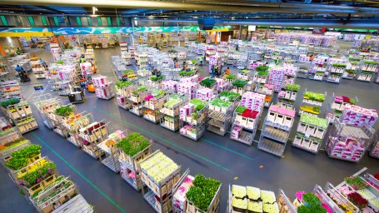

Slide 5
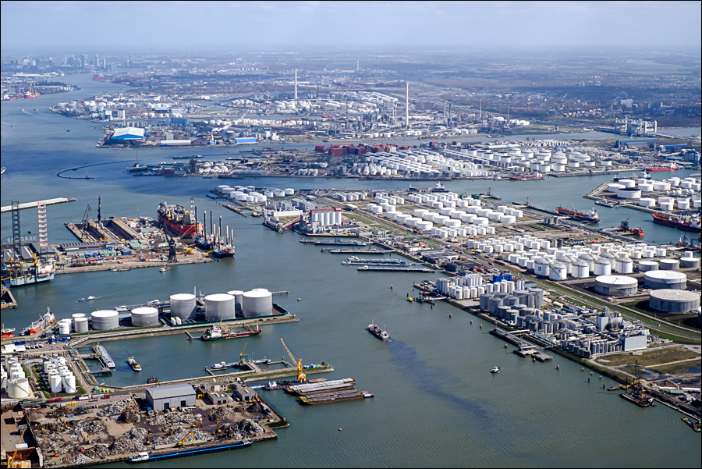
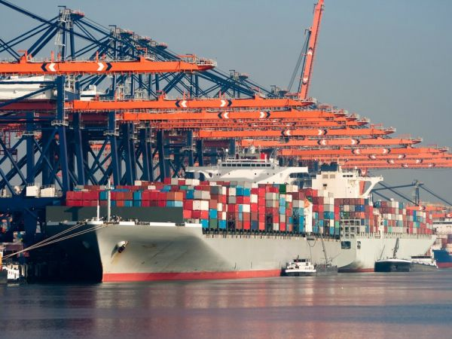
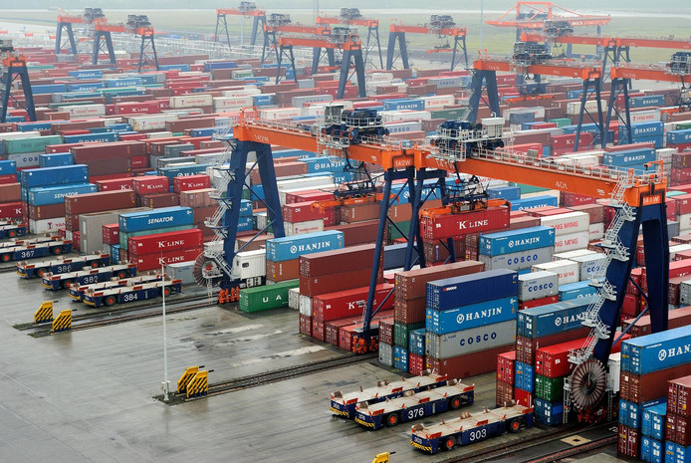

Slide 6
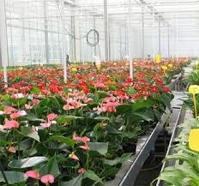
what they grow all in the Netherlands

Slide 7
here 2 more videos about the Netherlands
https://www.youtube.com/watch?v=vnjCAEMcQOc
https://www.youtube.com/watch?v=H6p86gG3Fm4

