Slide 1
Erasmus+
made by Maja Rygał

Slide 2
Travel by plane
The flight to Latvia took place without any surprises. Thanks to the beautiful views, I forgot how high we are. I also forgot about the time we were flying. During the flight, I was afraid of staying with the girl I was supposed to be with, but I was hopeful because it was nice to write with her.

Slide 3
We landed!
After the flight, we all met the people we were supposed to spend time with. In my case it was supposed to be Violetta. She turned out to be a nice, kind, honest and friendly person. We enjoyed talking because we had the same sense of humor. Throughout our stay in Latvia, we got on very well.

Slide 4
landscape of Latvia
Before my stay in Latvia I did not expect anything special, but when I was there, I noticed that it is just as beautiful there as in Poland. Amazing monuments, castles and beautiful nature.

Slide 5
school
The school in Latvia differs from the school in Poland in Mykanów:
- size
- number of students
- number of teachers
- there are some other subjects
- the language they speak

Slide 6
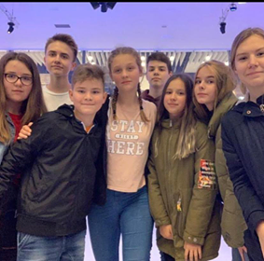
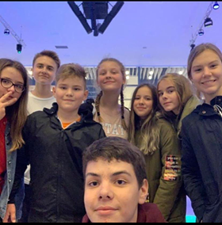
Afternoon with the family
When I first arrived, we brought all my things to the apartment, then we went to the gallery with an ice rink in the middle and we rode it together with other people from the exchange. In the following days we were bowling, laser paint ball.

Slide 7
what have I gained
Thanks to my stay in Latvia, I made many new friends from Greece, the Netherlands, Spain and Latvia. I was improving my English skills all the time. I tried new things, e.g. their regional dishes. I learned teamwork and most importantly had a lot of fun.

