Slide 1
Welcome to Poland!

Slide 2
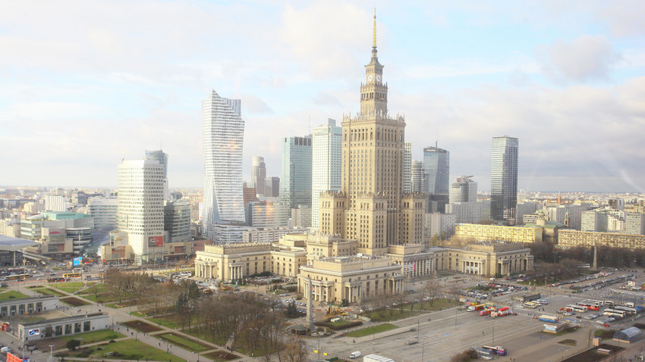
Our country Poland is a medium size country. In Poland lives 38 mln people. The capital city of Poland is Warsaw. There are many interesting places in our country.

Slide 3
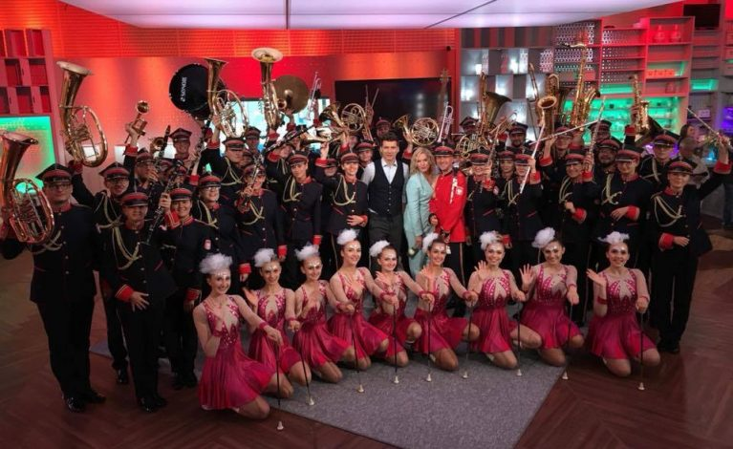
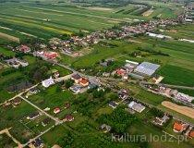
Mykanów
Mykanów is a village.
In Mykanów there are organised plenty of festivals.
Lots of people like walking and watching nature
We are proud of orchestra and vocal studio, which are very successful.

Slide 4
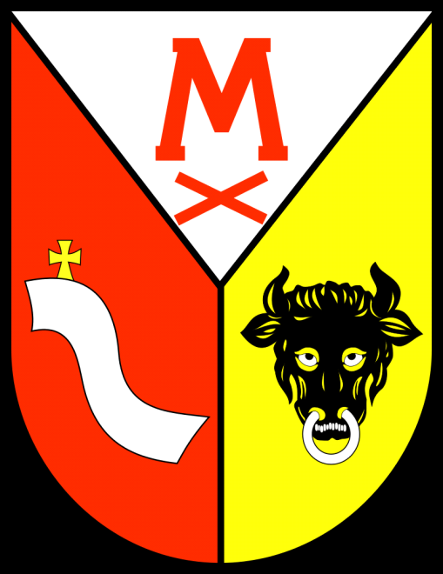
Our village and also the province is called Mykanów. It's a small and quiet community in the south of Poland, in Silesian Region. Mykanów is located near Częstochowa. This is one of the bigger cities in this region of Poland. Location of Mykanów is good because of the beautiful nature around. There are small lakes, rivers, picturesque fields and meadows. Still, the centre of Częstochowa is about 20 km far from here.

Slide 5
Our School
Our school participates in various projects and also in many competitions. Students are willing to attend sports tournaments, music festivals and subject competitions.

Slide 6
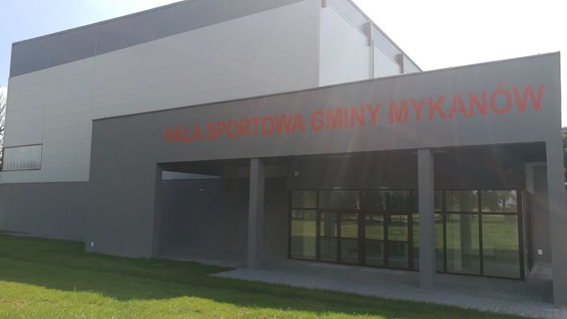
Primary School from Poland is in Słoneczna Street 114, Mykanów. There are about 250 students .They are from 4 to 16 years old, because in one building there are three schools. There are a kindergarten a primary school, and a middle school which people in Poland call “Gimnazjum”. There are news walls in every corridor and classroom. There are two teachers’ rooms, a gym, a sports hall an a small library. The sports hall is very big and modern.

Slide 7
Students are happy to organize fairs and take part in performances.
The school organizes various additional activities to develop your passions and interests

Slide 8
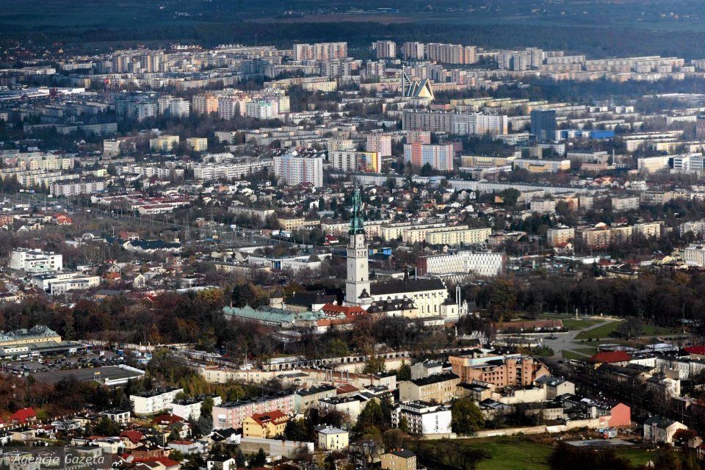
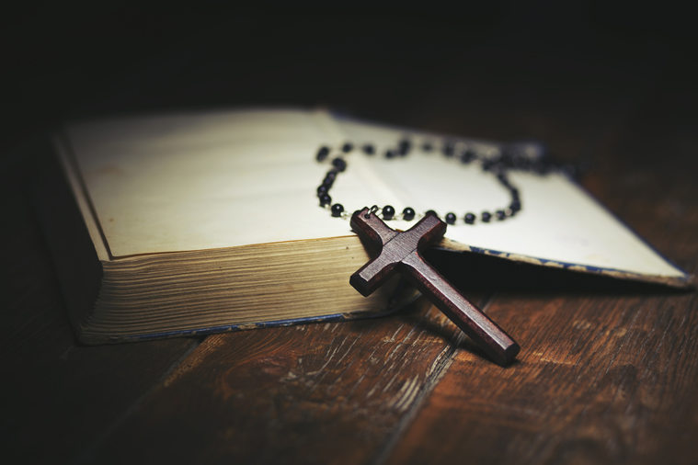
Częstochowa is not only the largest pilgrimage center in Poland but also one of the most important centers of this type in the Christian world.

Slide 9
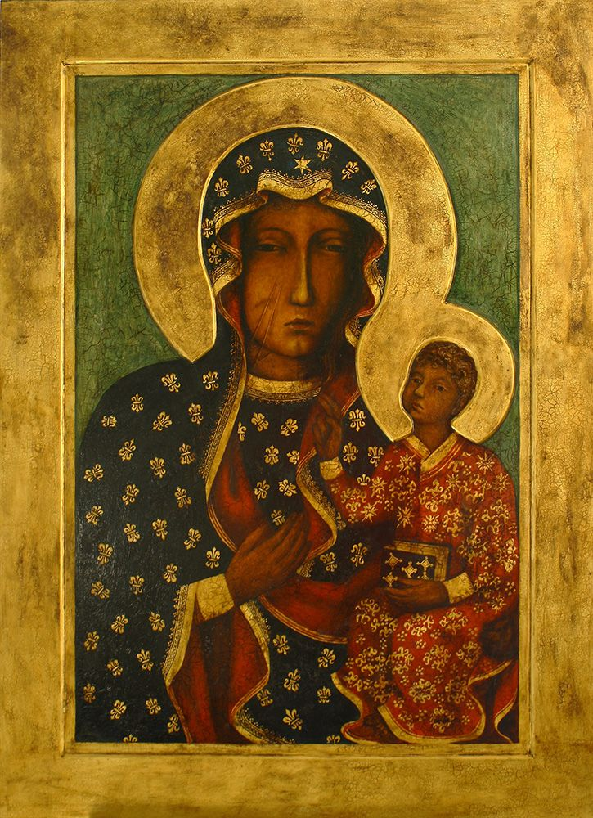
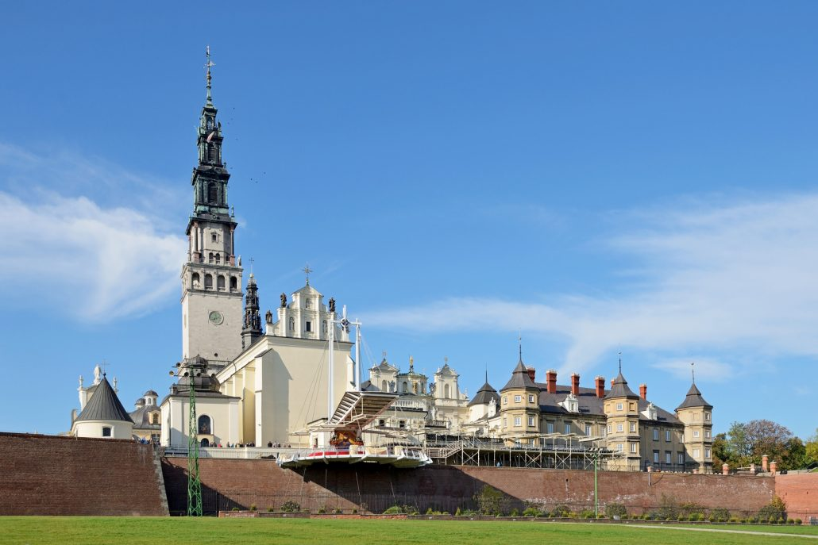
All thanks to Pauline monastery at Jasna Góra, whose walls hide the icon of the,,Black Madonna” - the image of Our Lady of Czestochowa. Every year, Częstochowa is visited by a few millions of pilgrims from around the world.

Slide 10
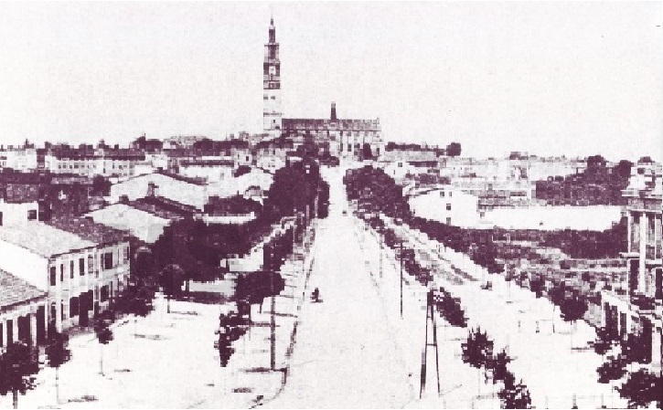
Częstochowa history begins in the XIII century when it was built connecting the city of Old Częstochowa and Częstochówka. Today, situated by the Warta River town has more than 200.000 residents, covers an area of 170 km² and is an important cultural, service and marketing in the region.

Slide 11
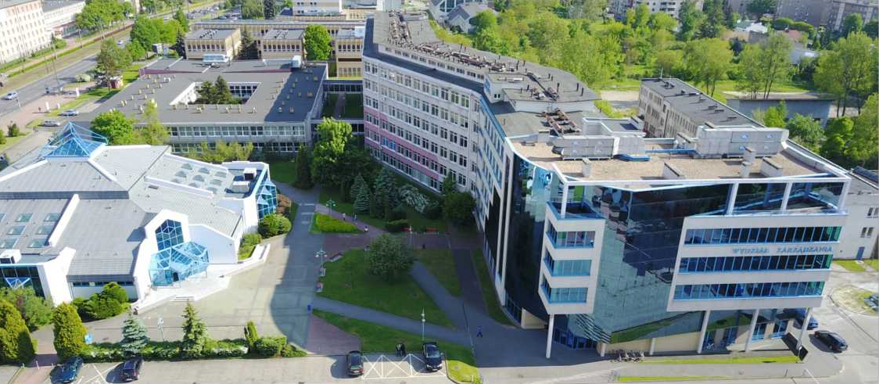
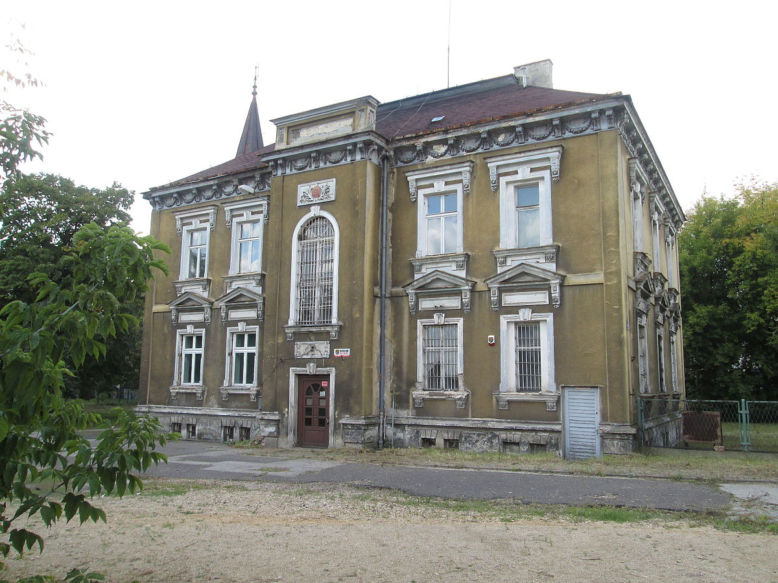
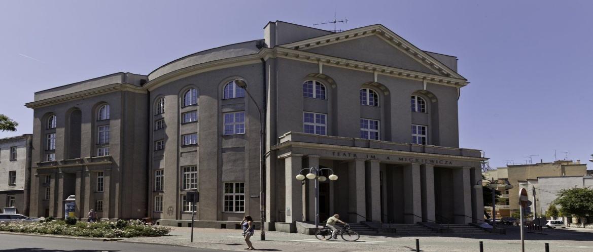
Having up to 8 universities it is also a major academic center. There is well-developed infrastructure and numerous monuments. Besides, the most important Monastery of Jasna Gora, Czestochowa offers numerous museums, architectural monuments, galleries, theaters, etc.

Slide 12
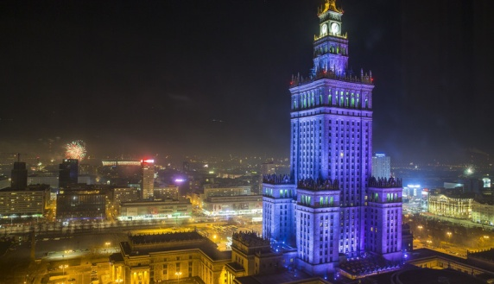
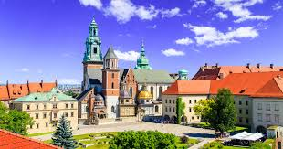
Famous Places in Poland
Palace of Culture and Science is a notable high-rise building in Warsaw, Poland.
The Jasna Góra is the sanctuary with an image of Black Madonna of Częstochowa.
The Wawel Castle is a castle residency of former kings located in central Kraków.

Slide 13
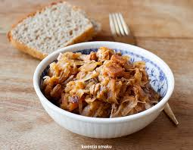
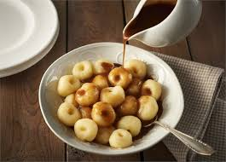
Regional Food
Pierogi is a traditional dish served as one of twelve dishes in Christmas. It is made off dough with various fillings such as: mushrooms, cheese, meat or fruit.
Bigos is a stewed dish consisting of cabbage and sausage. It has to be cooked for a few days before serving to be delicious.
These are noodles from southern Poland with a characteristic hole in the middle. They are very often served for Sunday dinner with a thick sauce.

Slide 14
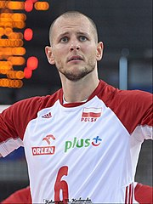
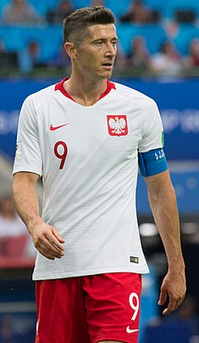
Famous Sports People
Kamil Stoch is a Polish ski jumper. He is one of the most successful ski jumpers from Poland.
Bartosz Kurek is a Polish volleyball player, a member of Poland men's national volleyball team.
Robert Lewandowski is a Polish professional footballer who plays as a striker for Bayern Munich and is the captain of the Poland national team.

Slide 15
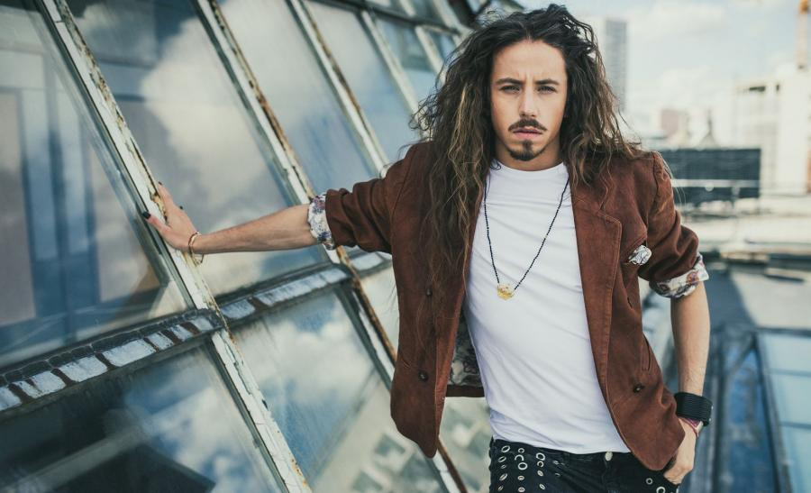
Famous artists
Edyta Górniak is a Polish singer. She won second place in Eurovision in 1994.
Michał Szpak is a Polish singer who found fame on the first series of the Polish X Factor in 2011.

Slide 16
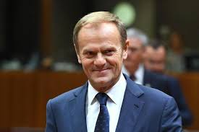
Famous people from the present
Jurek Owsiak became famous for charity campaigns and fundraising for those in need.
Donald Tusk is Polish politician, a chairman of the European Council

Slide 17
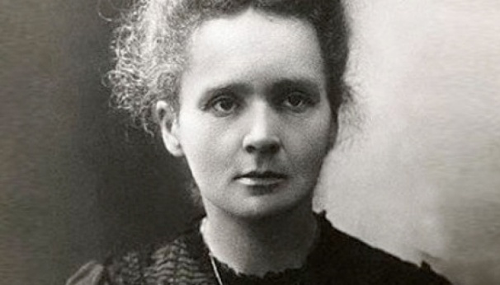
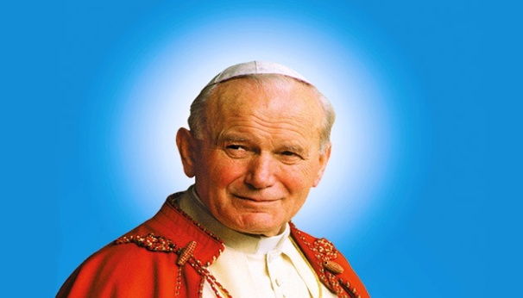
Famous people from the past
Marie Skłodowska Curie was a Polish and naturalized-French physicist and chemist who conducted pioneering research on radioactivity.
Nicolaus Copernicus was a Renaissance-era mathematician and astronomer who formulated a model of the universe that placed the Sun rather than the Earth at the center of the universe
Pope John Paul II was the head of the Catholic Church and sovereign of the Vatican City State from 1978 to 2005.

Slide 18
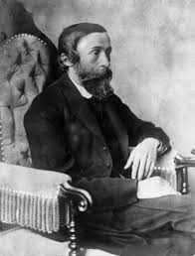
Famous inventors
Maria and Piotr Curie invented the polonium and radium elements.
Maria was Polish chemists. in 1903 she received the Nobel Prize.
Ignacy Łukasiewiczwas was a Polish pharmacist, engineer, businessman, inventor, and chemist. He was a pioneer who in 1856 built the world's first modern oil refinery.

Slide 19
Thanks for watching!
By Oliwia, Laura and Oliwier from Poland.

