Slide 1
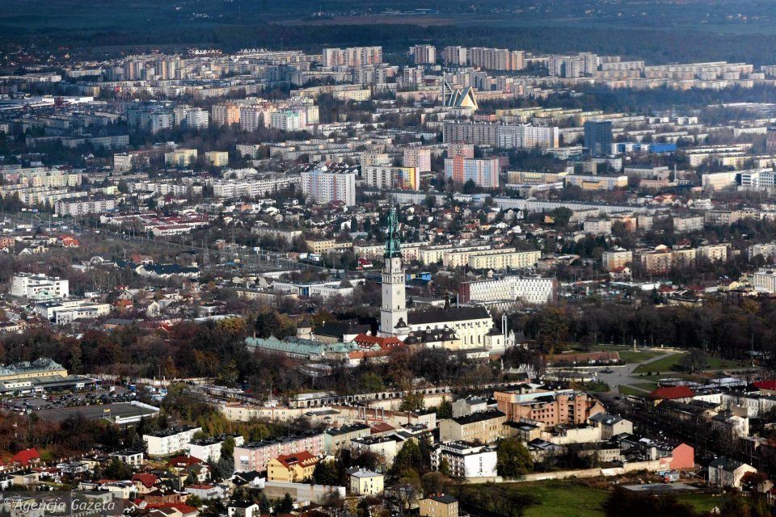
Częstochowa is not only the largest pilgrimage center in Poland but also one of the most important centers of this type in the Christian world.

Slide 2
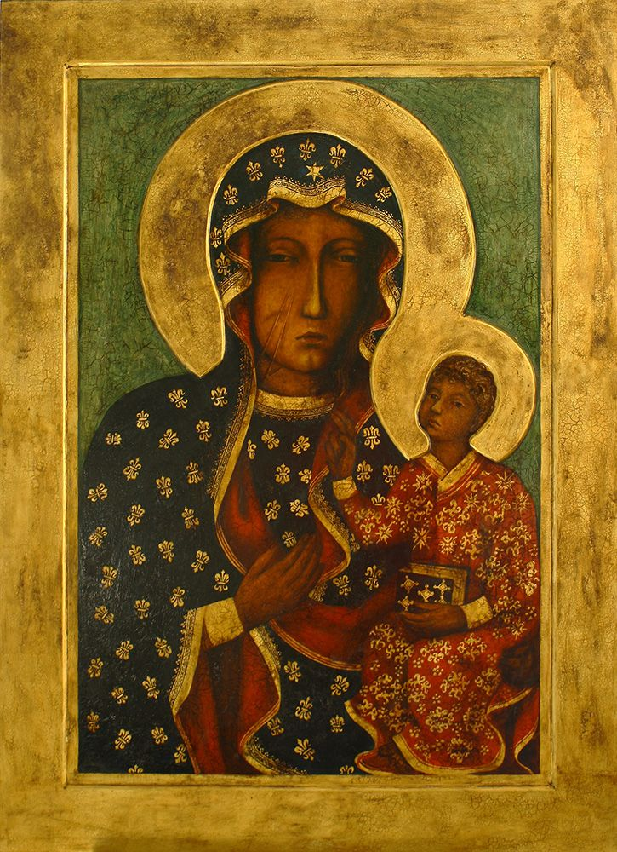
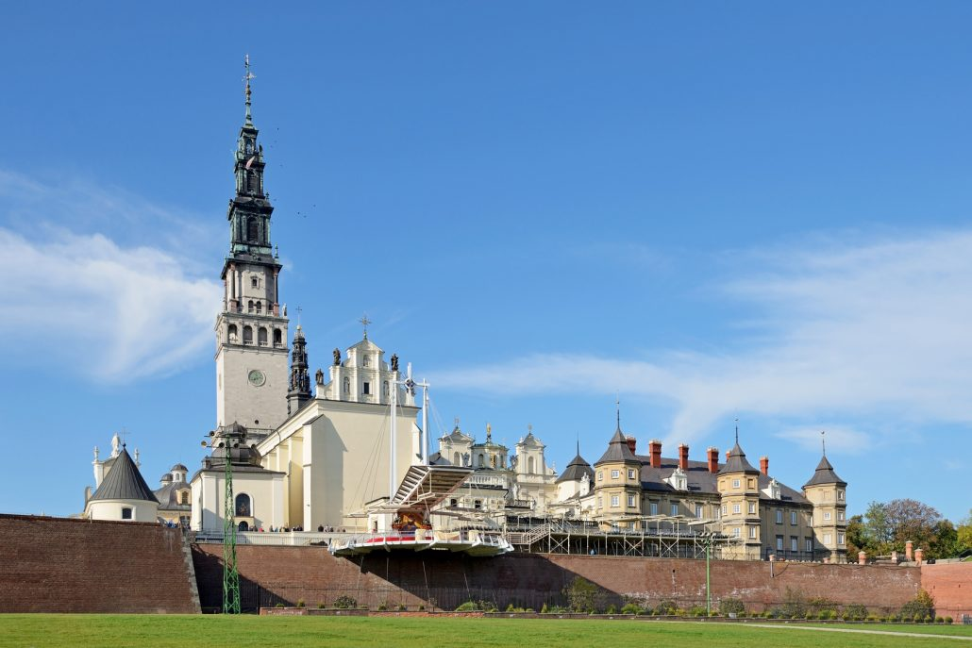
All thanks to Pauline monastery at Jasna Góra, whose walls hide the icon of the,,Black Madonna” - the image of Our Lady of Czestochowa. Every year, Częstochowa is visited by a few million of pilgrims from around the world.

Slide 3
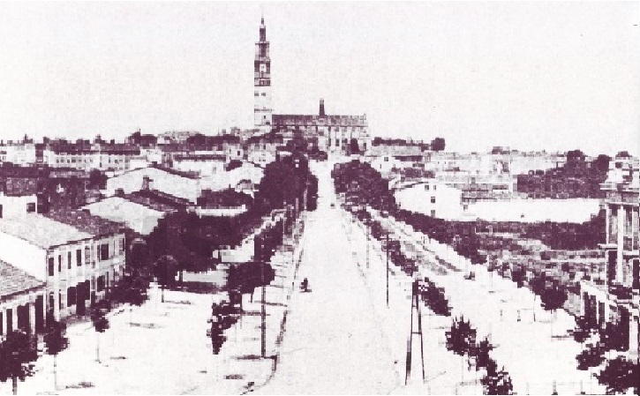
Częstochowa history begins in the XIII century when it was built connecting the city of Old Częstochowa and Częstochówka. Today, situated on the Warta River town has more than 200.000 residents, covers an area of 170 km² and is an important cultural, service and marketing in the region.

Slide 4
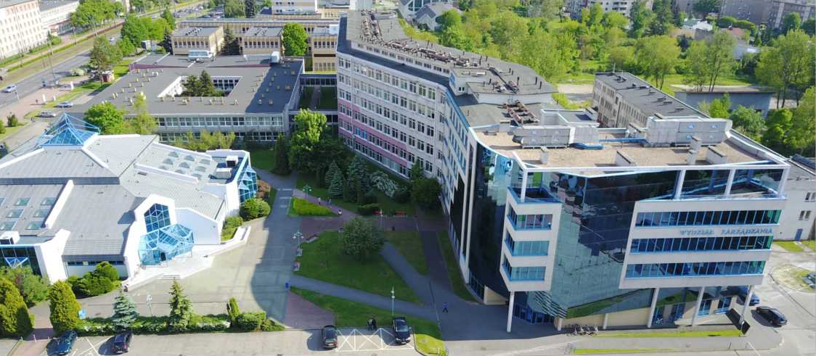
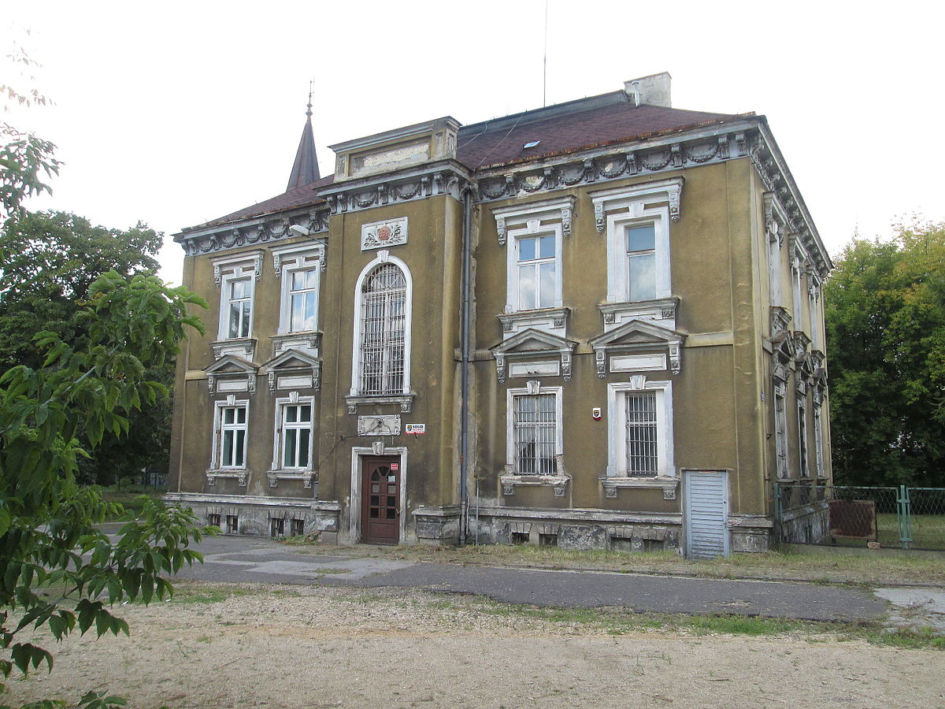
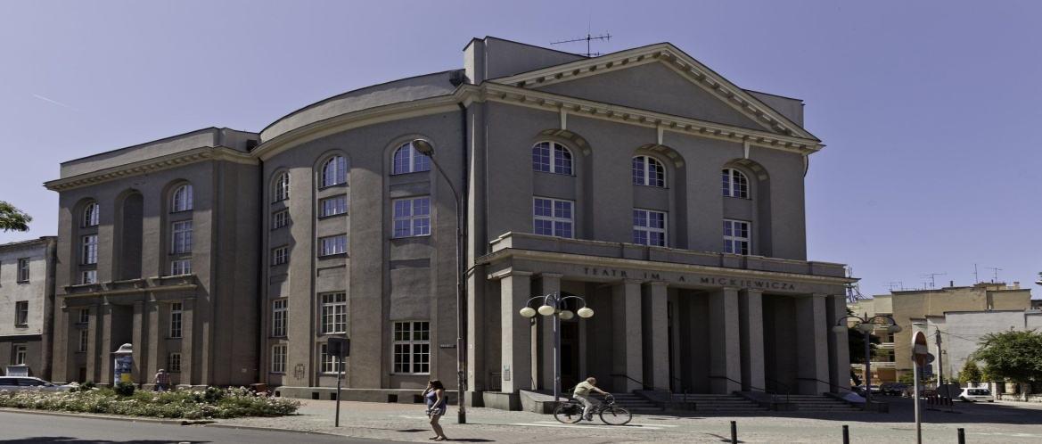
Having up to 8 universities it is also a major academic center. There is well-developed infrastructure and numerous monuments. Besides, the most important Monastery of Jasna Gora, Czestochowa offers numerous museums, architectural monuments, galleries, theaters, etc.

