Slide 1
It’s proverbs’ time!
5th Primary School of Korydallos – 5th Grade

Slide 2
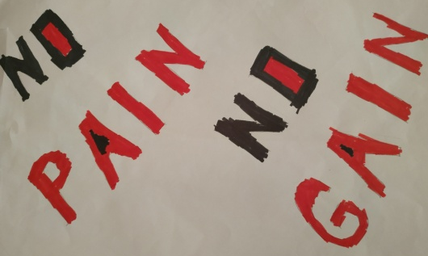
No pain, no gain!
It means that good things must me earned!!
Phrases with similar meaning can be found in the writings of Euripides.
In Greek the phrase “Τα αγαθά κόποις κτώνται” is used, with a similar meaning.
A literal translation in English would be “Good things come after works”.

Slide 3
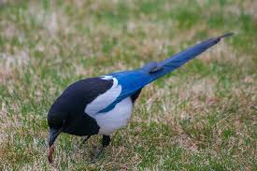
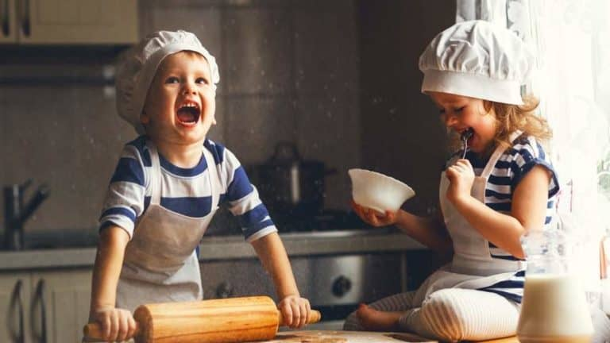
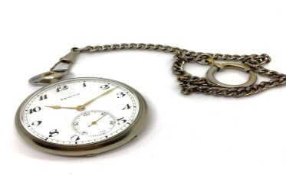
The early bird catches the worm
It means that we should start our day early!
In Greek the phrase “Των φρονίμων τα παιδιά πριν πεινάσουν μαγειρεύουν” is used, with a similar meaning.
A literal translation in English would be “Wise people’s children cook before they get hungry”.

Slide 4
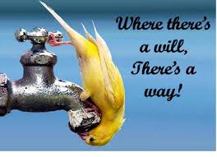
Where there's a will, there's a way
It means we should try hard to succeed.
In Greek the phrase “Όπου υπάρχει θέληση, υπάρχει τρόπος” is used, with the same meaning.
The Greek phrase is a literal translation of the English one!
A similar phrase was published for the first time in 1640 in “Jacula Prudentusm” by George Herbert. Up to the 1820’s, the phrase had changed to “where there’s a will, there’s a way”.

Slide 5
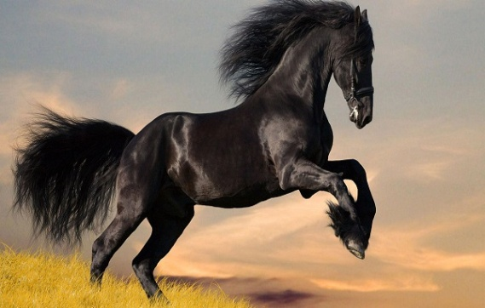
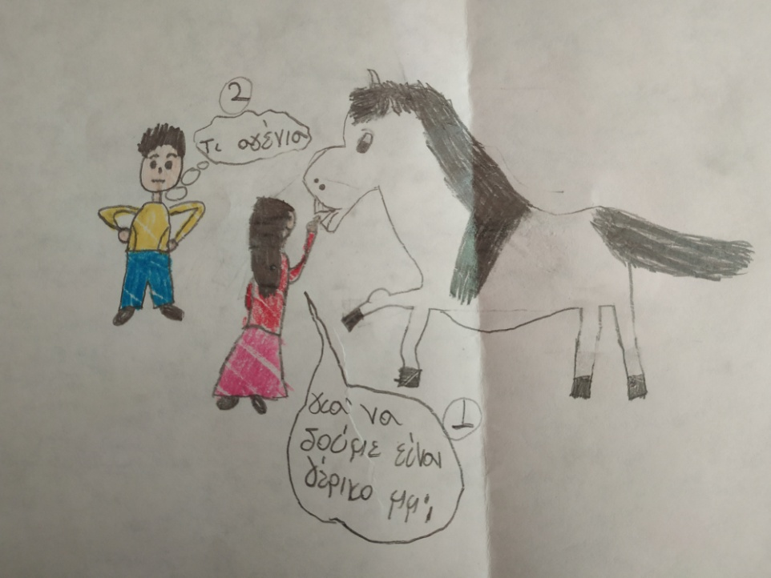
Never look a gift horse in the mouth
It means that when we are given a gift, we shouldn’t look at its value, but receive it and say thank you.
It is an advice to be grateful for a present, instead of trying to find something better.
In Greek the phrase “ Του χάριζαν γάιδαρο και τον κοίταζε στα δόντια” is used, with the same meaning.
A literal translation in English would be “SOMEONE WAS GIVEN A DONKEY AND HE stared AT ITS TEETH”.
How rude!
Let’s see… is it old?

Slide 6
Better late than never
It means that it is better to do something late than not do it at all.
In Greek the phrase “Κάλλιο αργά παρά ποτέ” is used, with the same meaning.
The Greek phrase is a literal translation of the English one!

Slide 7
English | Greek
No pain, no gain! | Τα αγαθά κόποις κτώνται.
The early bird catches the worm. | Των φρονίμων τα παιδιά πριν πεινάσουν μαγειρεύουν.
When there’s a will, there’s a way. | Όπου υπάρχει θέληση, υπάρχει τρόπος.
Never look a gift horse in the mouth. | Του χάριζαν γάιδαρο και τον κοίταζε στα δόντια.
Better late than never. | Κάλλιο αργά παρά ποτέ.
5th Primary School of Korydallos

