Slide 1
STUDENT EXCHANGE 2019

Slide 2
May 2019
In may 2019 me, my friends and teachers were in Greece for student exchange. We’ve spent there 7 magical days with greek students and their families. Also we were on the Acropolis and a lot of diffrent trips! Theese are fotos from my best school trip in my life!

Slide 3
We arrived to Greece
6.05.2019

Slide 4
Beautifull Acropolis and the museum of the Acropolis

Slide 5
Beautifull seaport

Slide 6
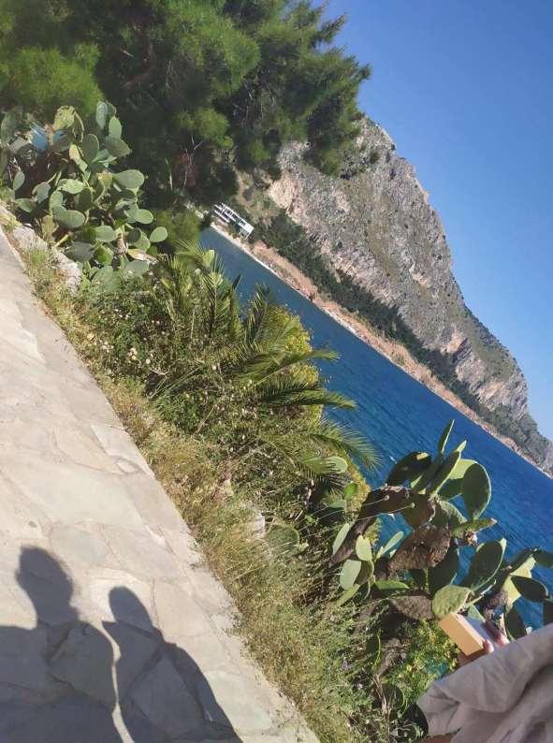
And my favourite – Magical seaside

Slide 7
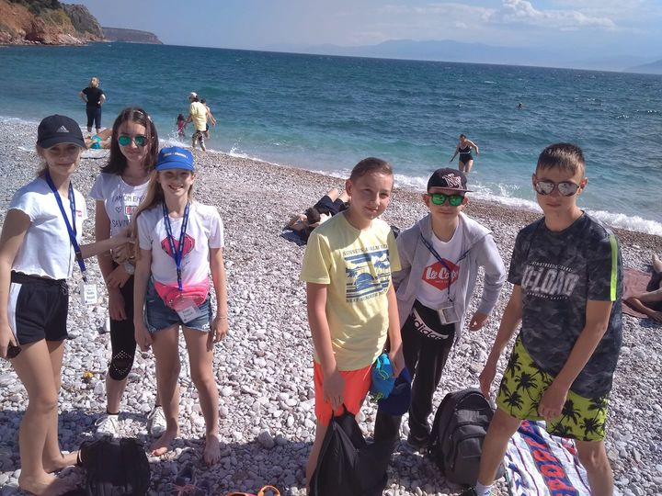
We were swimming

Slide 8
Greek Theater

Slide 9
And some views from the airplane

Slide 10
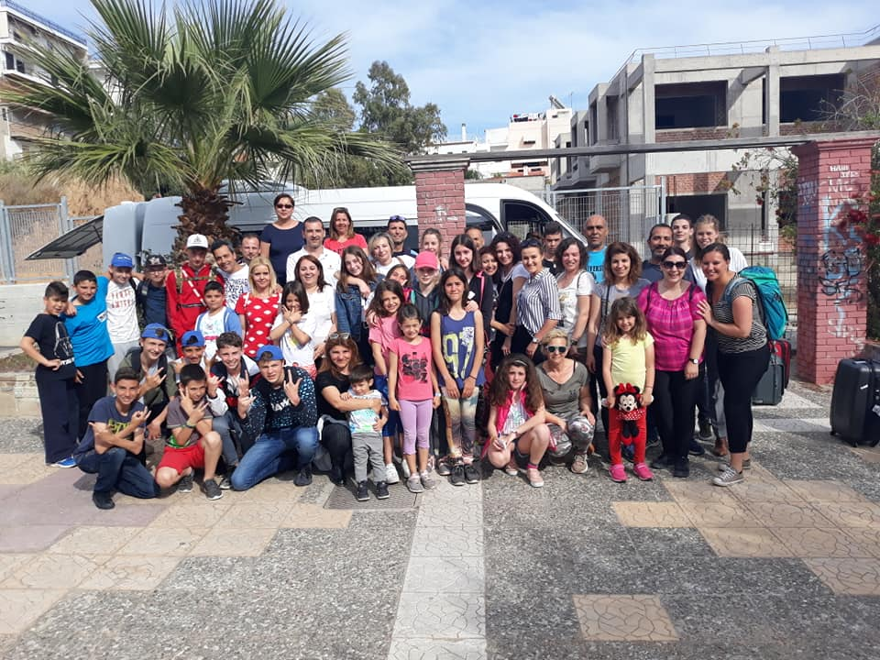
Thanks for watching !

