Slide 1
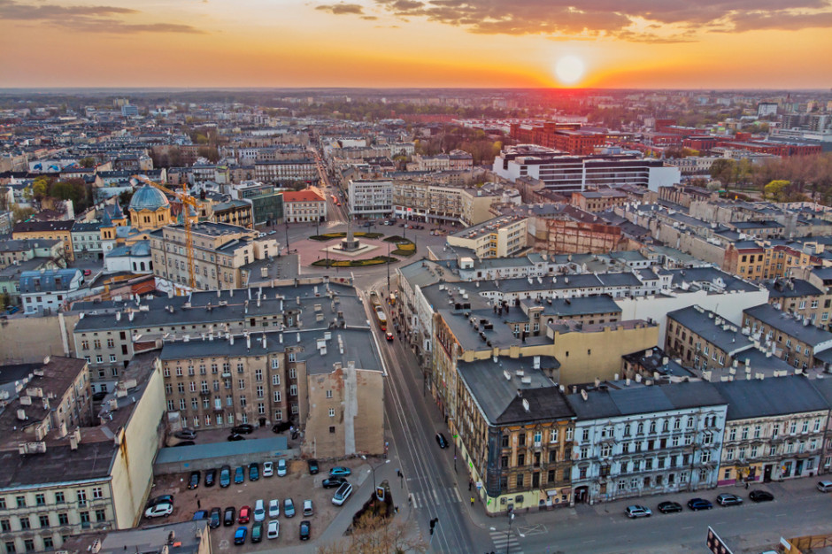
ŁÓDŹ

Slide 2
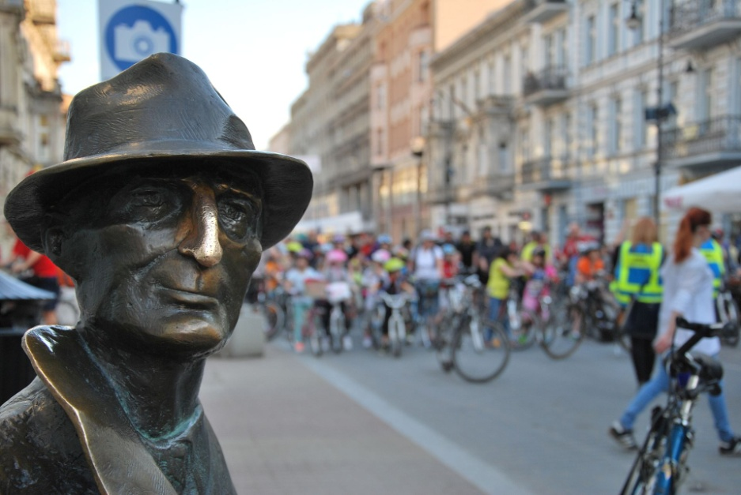
Łódź is the third-largest city in Poland and a former industrial centre (fabric industry).

Slide 3
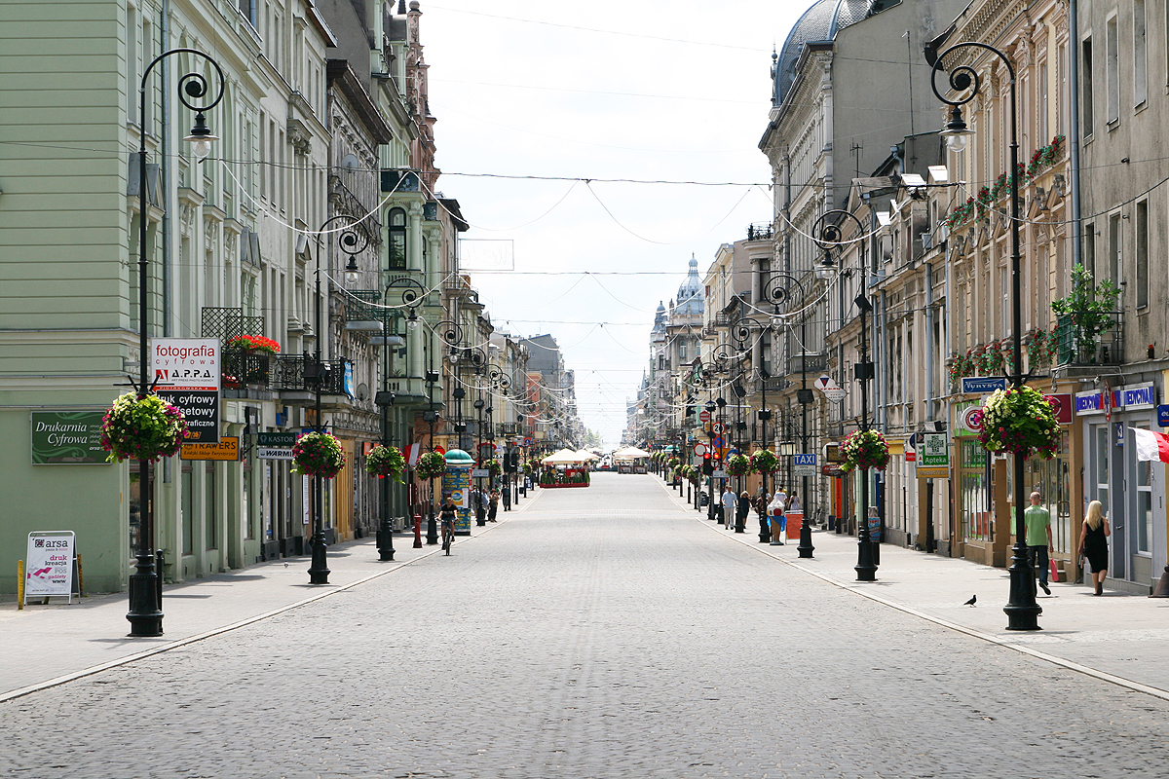
Located in the central part of the country, it has a population of 682,679 inhabitants.

Slide 4
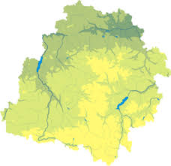
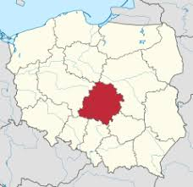
Location of Łódź on the map of Poland
The city is located in the central part of the country.
It is the capital of Łódź Voivodeship, and is located approximately 120 km south-west of Warsaw.

Slide 5
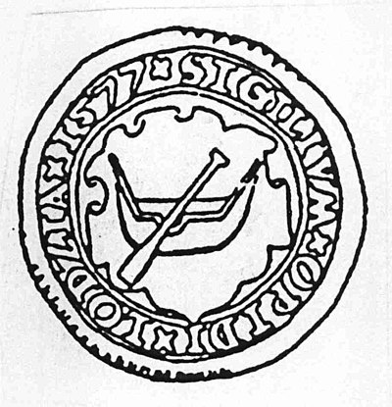
The city's coat of arms is an example of canting, as it depicts a boat (łódź in Polish).
1577
2020

Slide 6
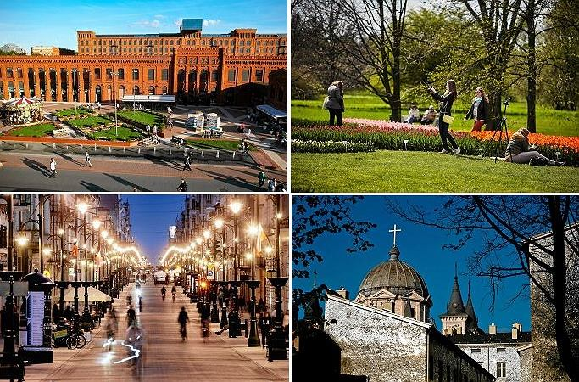
The most important places in Łódź

Slide 7
During your stay you should visit these places:
- Manufaktura Shopping Center - Museum of Art. In Łódź - Księży Młyn - English: Priest’s Mill
Piotrkowska Street - Palm House in Łódź - Monument of the Piano of Rubinstein - Modern Science and Technology center EC1 - Archcathedral Basilica of St. Stanislaus Kostka - City Hall of Łódź
Izrael Poznański’s Palace
Łódź Hills Landscape Park
Many other interesting monuments

Slide 8
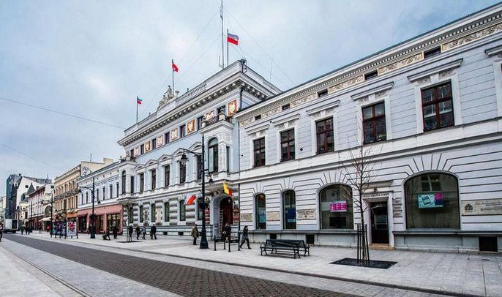
City Hall of Łodź.
The seat
of local
authorities.

Slide 9
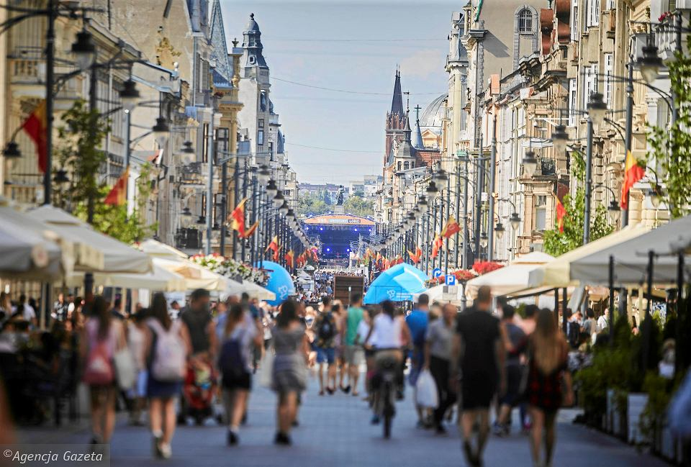
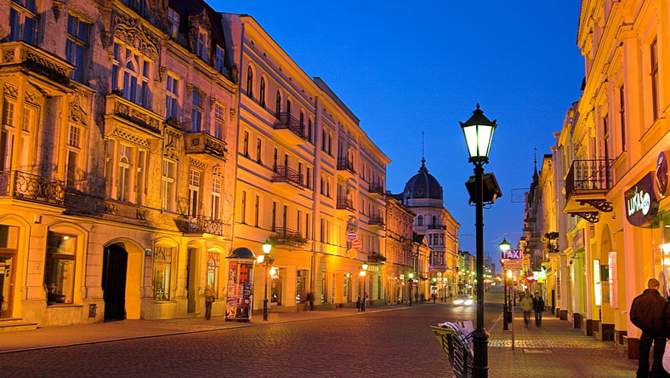
Piotrkowska Street

Slide 10
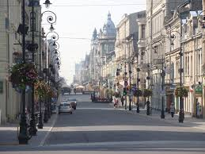
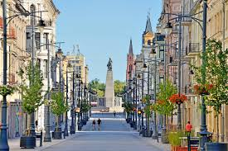
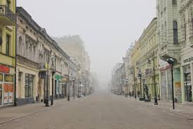
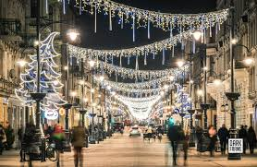
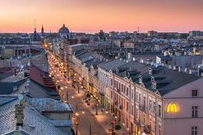
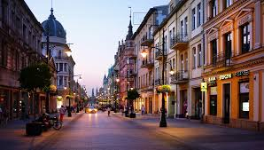
Piotrkowska Street
Representative street of Łódź, one of the longest shopping streets in Europe, about 4.2 km long, running in a straight line.

Slide 11
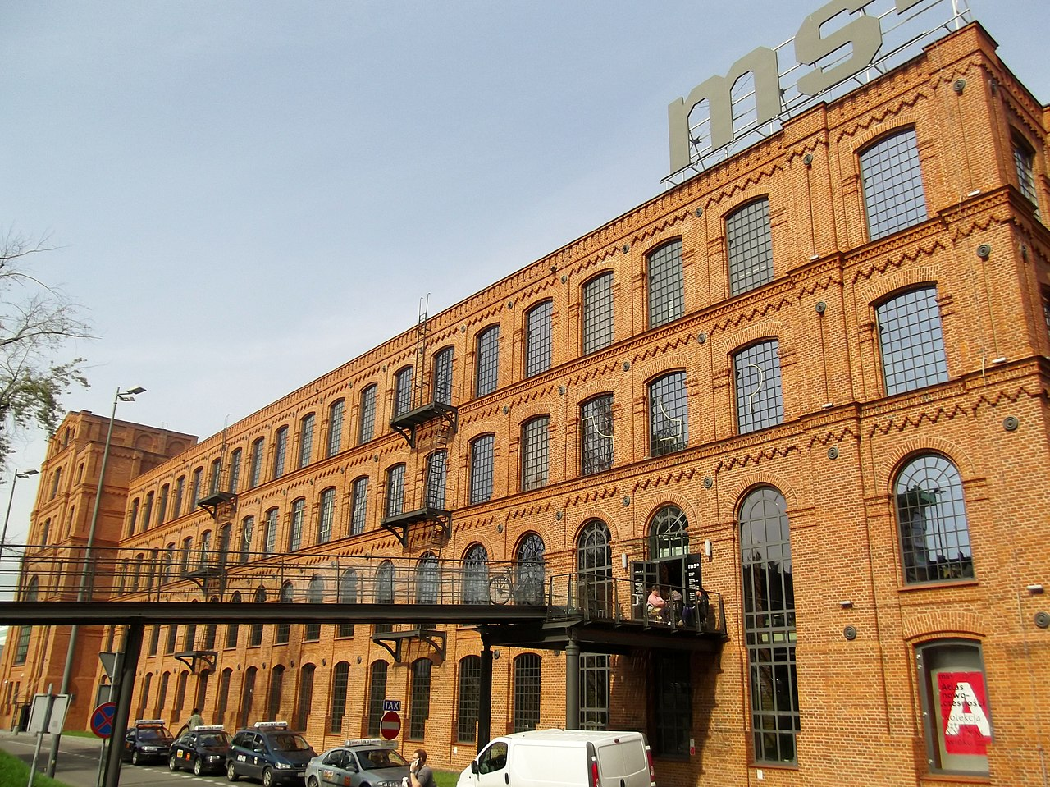
Museum of Art in Łódź

Slide 12
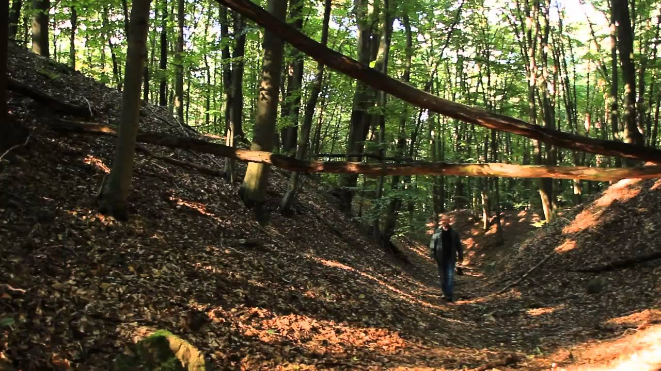
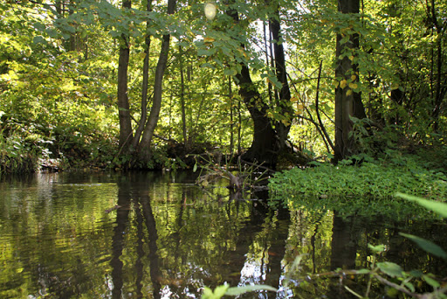
Łódź Hills Landscape Park

Slide 13
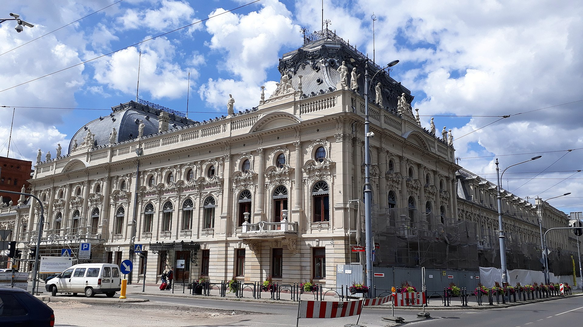
Izrael Poznański's Palace

Slide 14
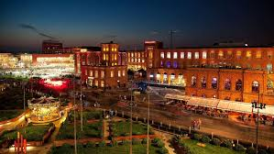
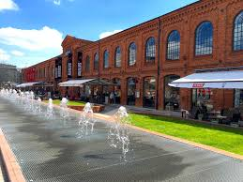
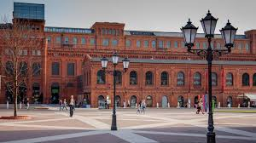
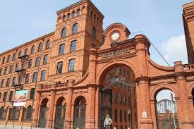
Manufaktura Shopping Center

Slide 15
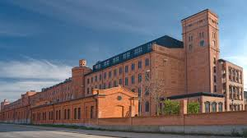
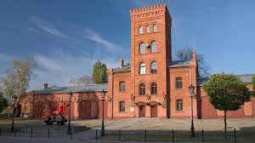
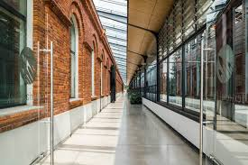
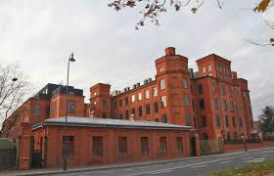
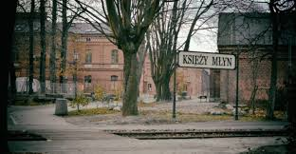
Księży Młyn (English: Priest’s Mill)
A group of textile factories (mainly cotton spinning mills) and associated facilities, have been built in Łódź since 1824.

Slide 16
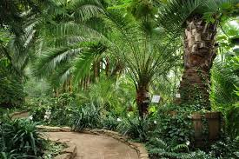
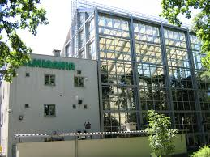
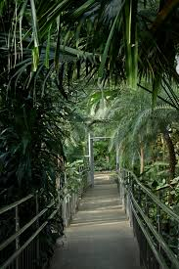
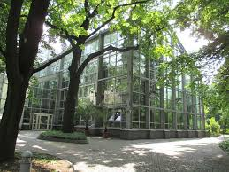
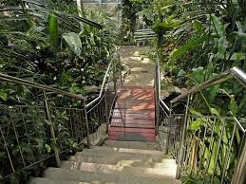
Palm House in Łódź

Slide 17
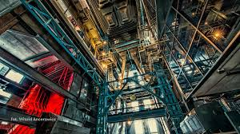
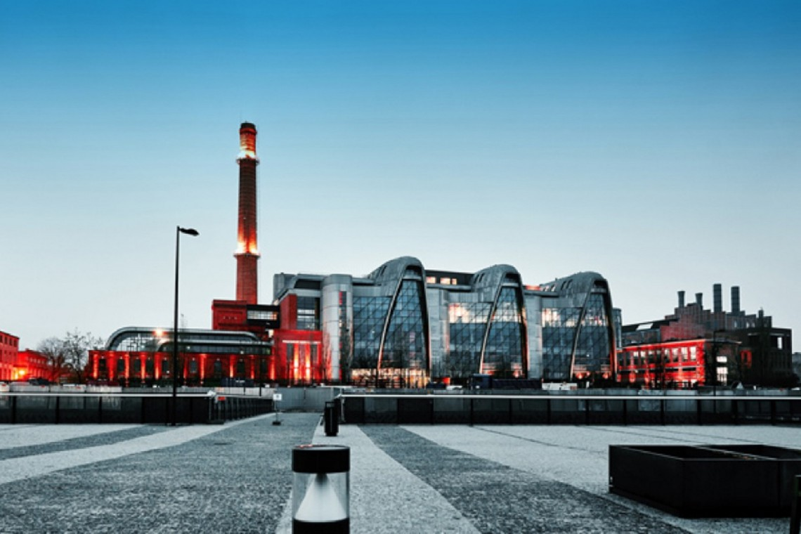
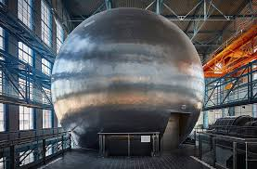
Science and Technology Center

Slide 18
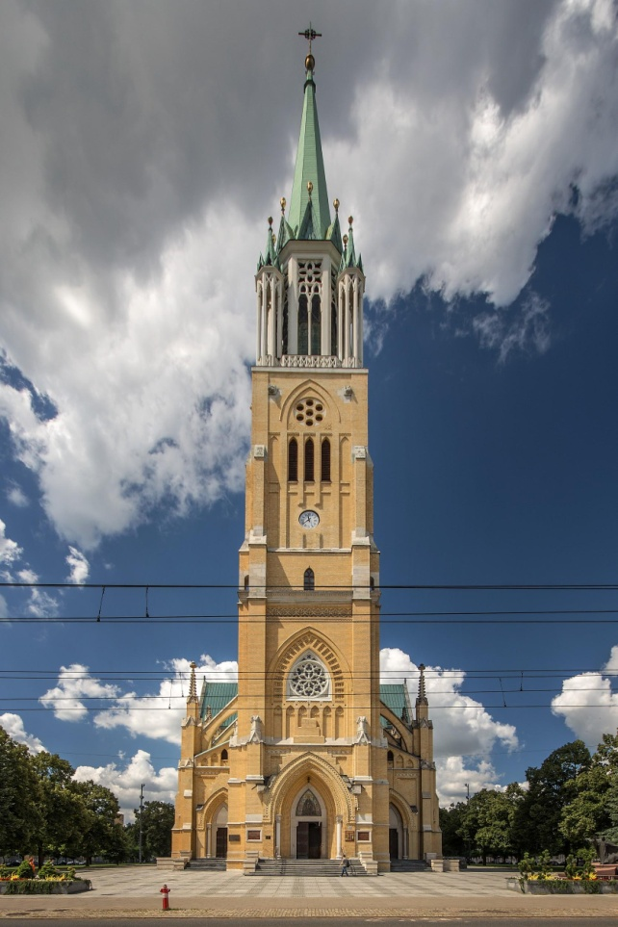
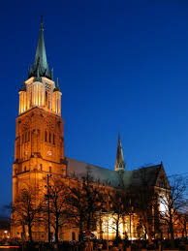
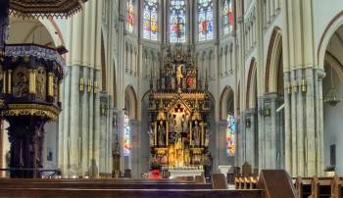
Archcathedral Basilica of St. Stanislaus Kostka
A monumental Roman Catholic parish church built in 1901–1912, located at Piotrkowska Street in Łódź.

Slide 19
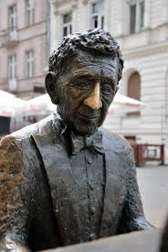
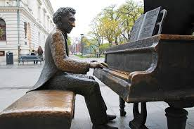
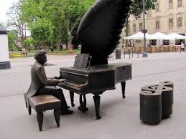
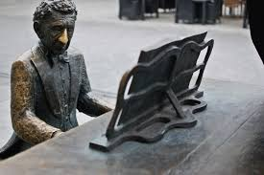
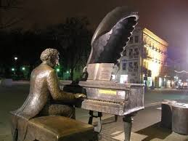
Piano of Rubinstein

Slide 20
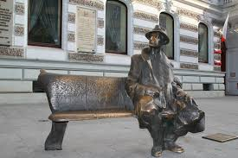
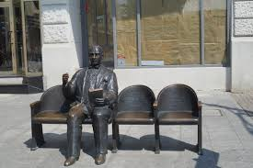
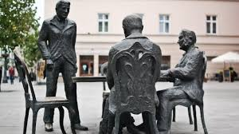
There are many other monuments in Łódź.
Julian Tuwim “bench”.
Jarcz’s armchair.
Manufacturers.

Slide 21
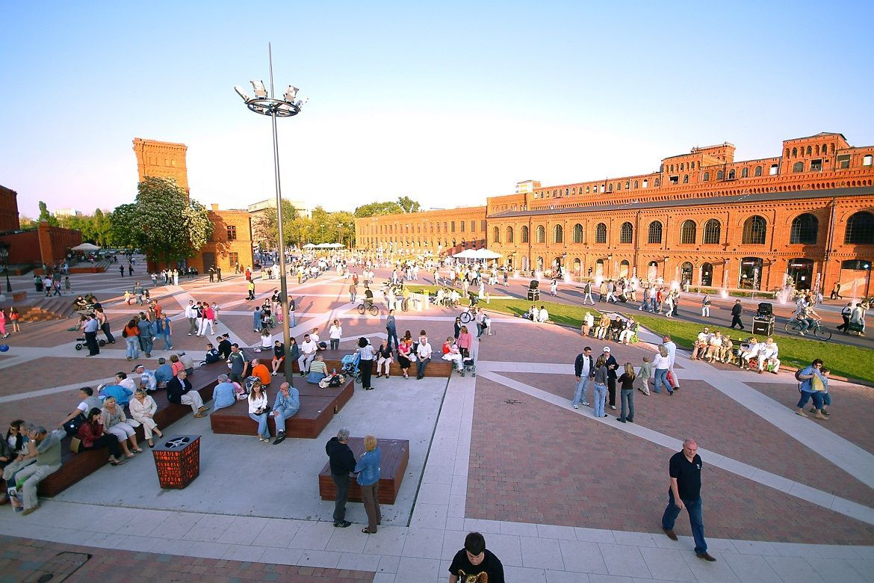
Famous people from Łódź

Slide 22
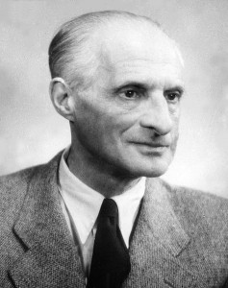
Julian Tuwim Poet

Slide 23
Marcin Gortat Basketball player

Slide 24
Michał Wiśniewski Singer

Slide 25
Jerzy Janowicz
Tennis player

Slide 26
Jerzy Skolimowski
– a famous screenwriter

Slide 27
Thank you for your attention! Pictures available from the following sites: -Google Grafika/Photos -Wikipedia Multimedia presentation was made by Wiktor Lacek and Oliwier Urbański

