Slide 1
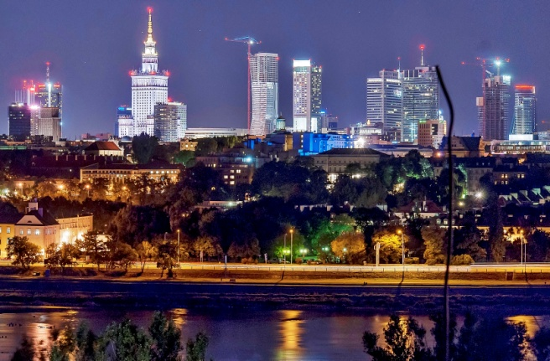
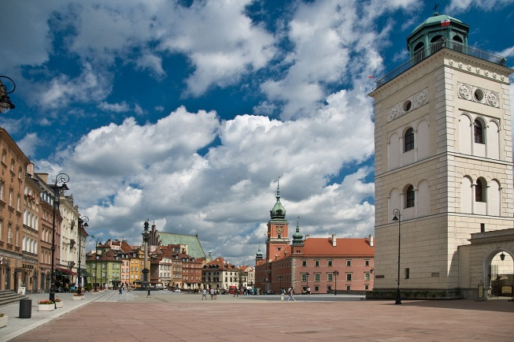
Best places in Warsaw
Locations that combine past and present of our capital city.

Slide 2
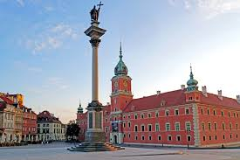
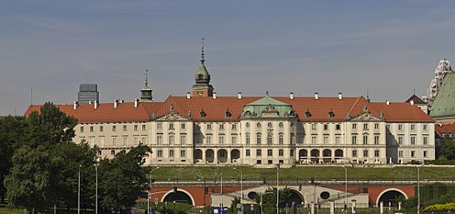
Royal Castle in Warsaw
The Royal Castle in Warsaw is a castle residency that formerly served throughout the centuries as the official residence of the Polish monarchs. It is located in the Castle Square, at the entrance to the Warsaw Old Town.

Slide 3
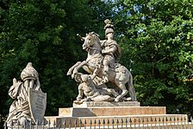
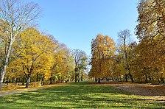
Royal Baths Park
Łazienki Park or Royal Baths Park is the largest park in Warsaw, Poland, occupying 76 hectares of the city center. It is filled with beautiful monuments, museums and nature wonders.

Slide 4
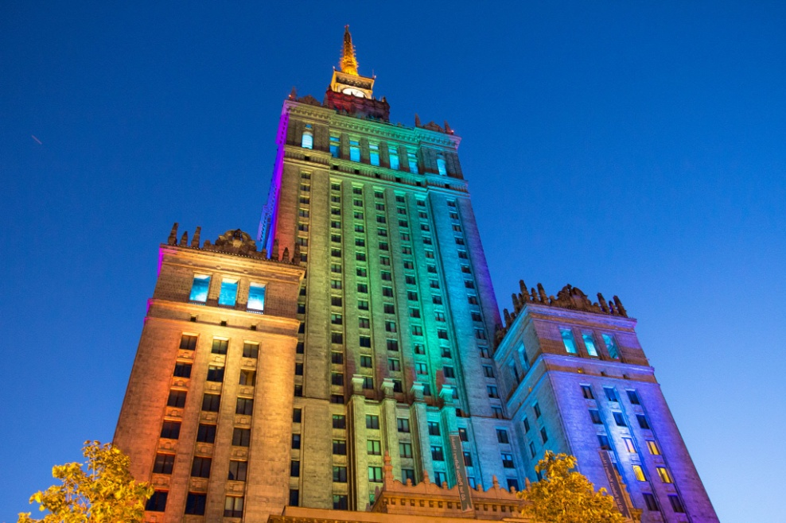
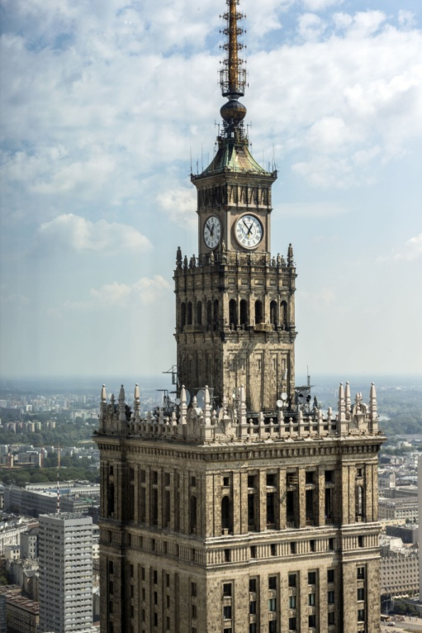
Palace of Culture and Science
Palace of Culture and Science is a notable high-rise building in central Warsaw, Poland. With a total height of 237 metres (778 ft) it is the tallest building in Poland, the 5th-tallest building in the European Union (including its spire) and one of the tallest on the European continent.

Slide 5
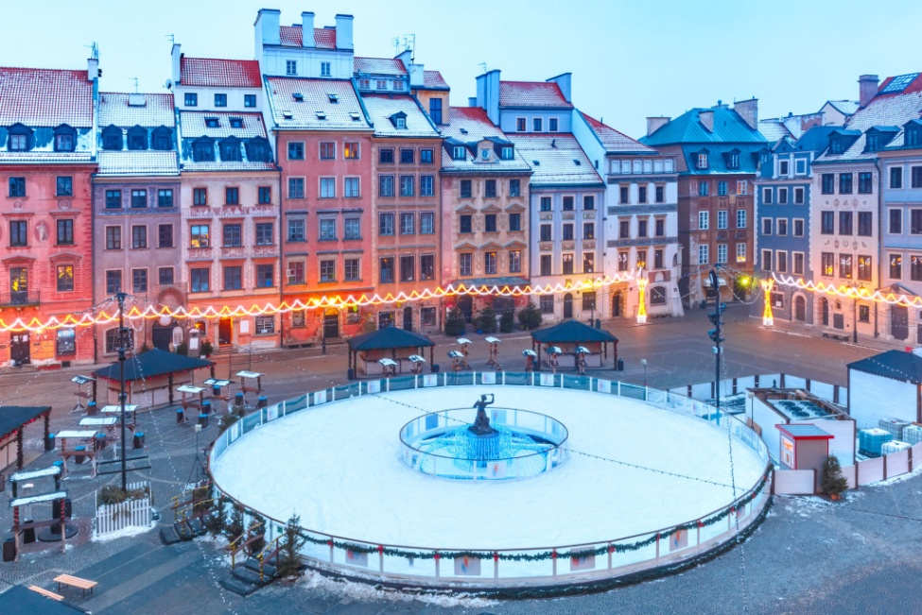
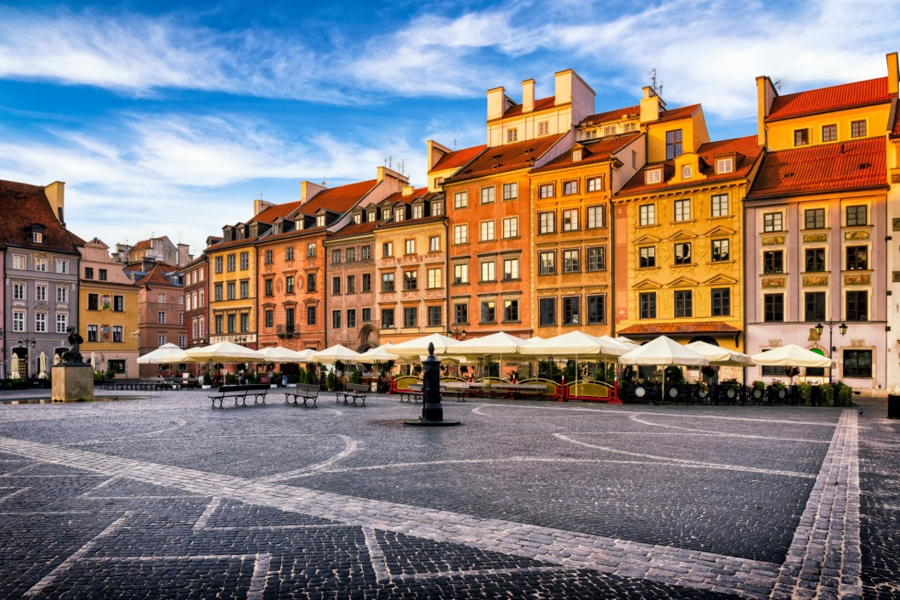
Old Town Market Square Warsaw
Warsaw's Old Town Market Place is the center and oldest part of the Old Town of Warsaw, capital of Poland. Immediately after the Warsaw Uprising, it was systematically blown up by the German Army. After World War II, the Old Town Market Place was restored to its prewar appearance

Slide 6
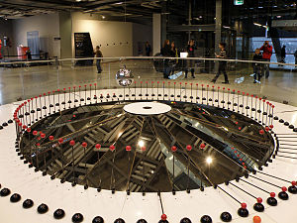
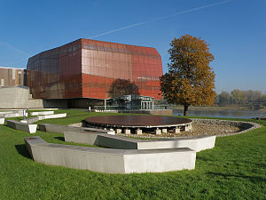
Copernicus Science Centre
Copernicus Science Centre is a science museum standing on the bank of the Vistula River in Warsaw, Poland. It contains over 450 interactive exhibits that enable visitors to single-handedly carry out experiments and discover the laws of science for themselves.

Slide 7
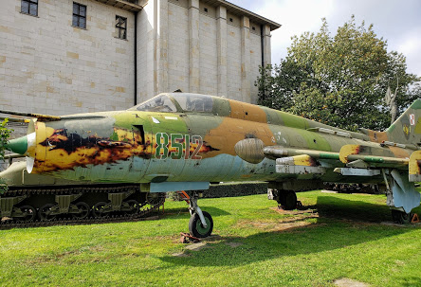
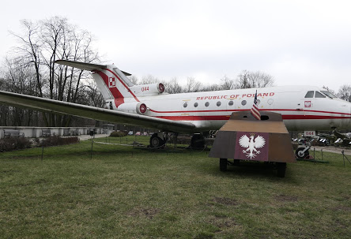
The Museum of Polish Army
Museum of the Polish Army is a museum in Warsaw documenting the military aspects of the history of Poland. Created in 1920, it occupies a wing of the building of the Polish National Museum as well as several branches in Poland.

Slide 8
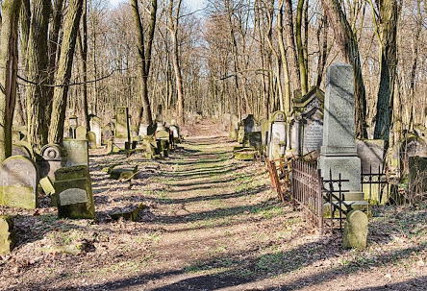
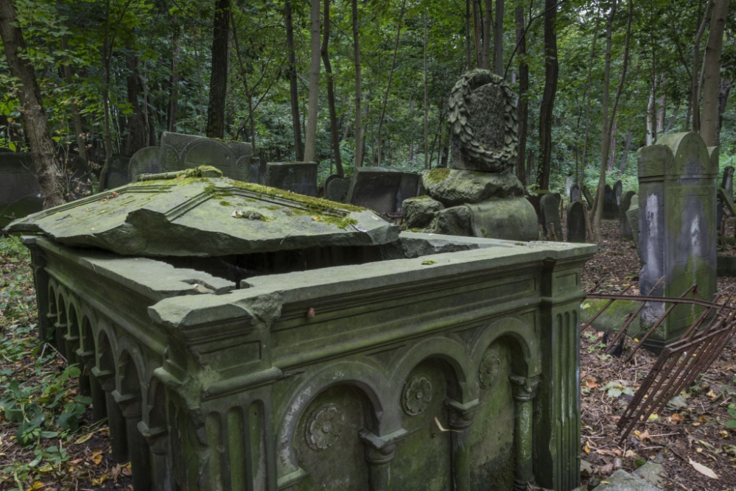
Jewish Cemetery
Okopowa Street Jewish Cemetery is one of the largest Jewish cemeteries in Europe. Located in Okopowa street and bordering with the Powazki Cemetery, the Jewish Cemetery was established in 1806 and occupies 33 hectares (83 acres) of land.

Slide 9
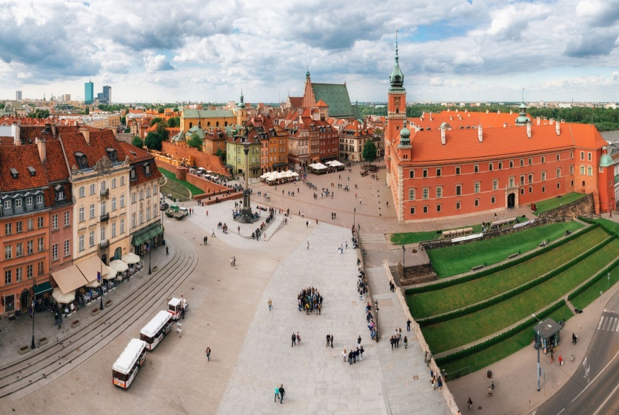
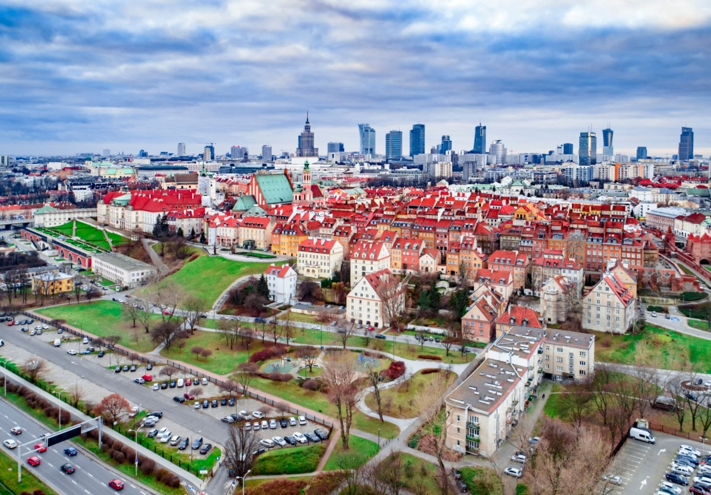
Warsaw Old Town
Warsaw Old Town is the oldest part of Warsaw, the capital city of Poland. It is bounded by the Wybrzeże Gdańskie (Gdańsk Boulevards), along with the bank of the Vistula river, Grodzka, Mostowa and Podwale Streets.

Slide 10
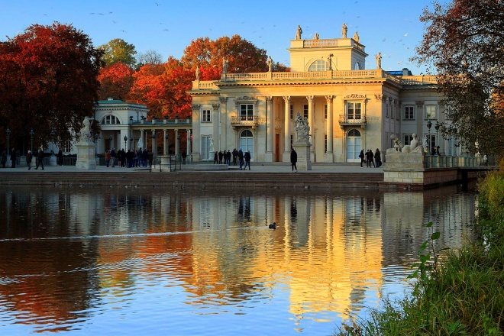
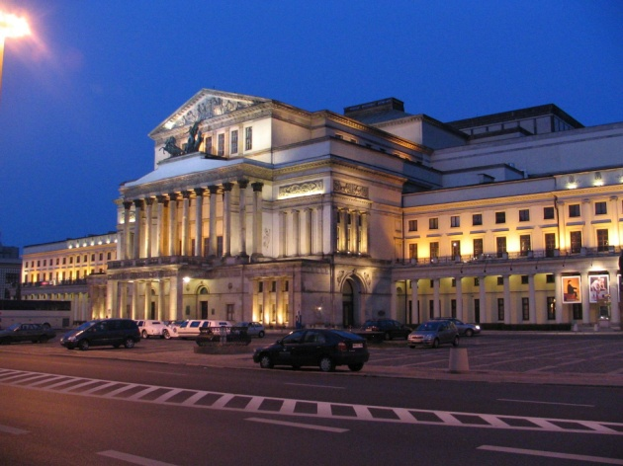
Sources:
- wikipedia.org
google.com
Made by:
Mateusz Koćwin ,grade 8th

