Slide 1
Cracow now and in the past
Oliwia Świąć

Slide 2
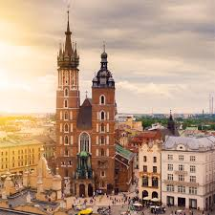
Cracow
is the second largest city in Poland and until 1795 it was the capital of our country.

Slide 3
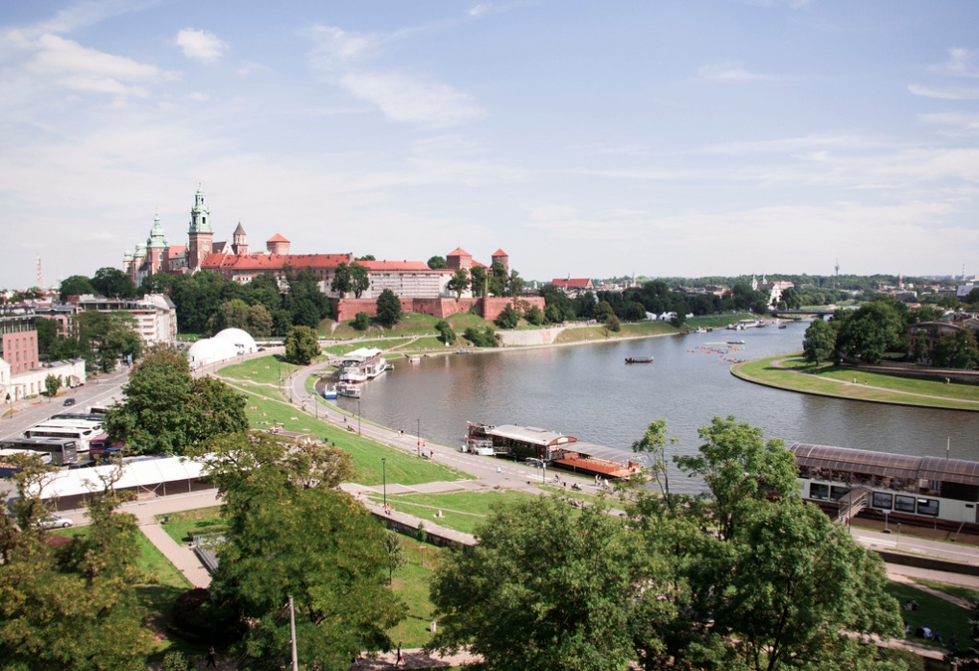
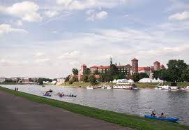
Vistula
Cracow is located on the bank on the Vistula River, the longest river in Poland.

Slide 4
The most beautiful place in Kraków is Wawel Castle. Legend says that a dragon once lived there. Now there is a fire-breathing monument there.

Slide 5
Cracow Market Square
Cracow Market Square is the largest medieval market square in all of Europe. It is here that numerous celebrations and important national events take place.

Slide 6
Mariacka Tower
One of the most famous places in Cracow is MariackaTower where every hour a special anthem is played with the trumpet. Legend says that when the Tatars attacked Cracow, the trumpeter started to play to warn the inhabitants he was by the enemy’s arrow.

Slide 7
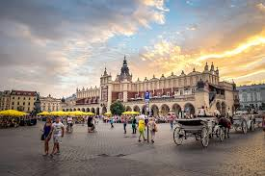
Sukiennice
"Sukiennice" is a building where we can buy many beautiful hand-made materials, souvenirs and sweets.

Slide 8
There is an Underground Museum underneath the Cracow Market Square, where we can go back in time and admire the old Cracow.

Slide 9
Museum in Cracow
In the National Museum in Cracow there is a painting by Leonardo da Vinci "Lady with an Ermine".

Slide 10
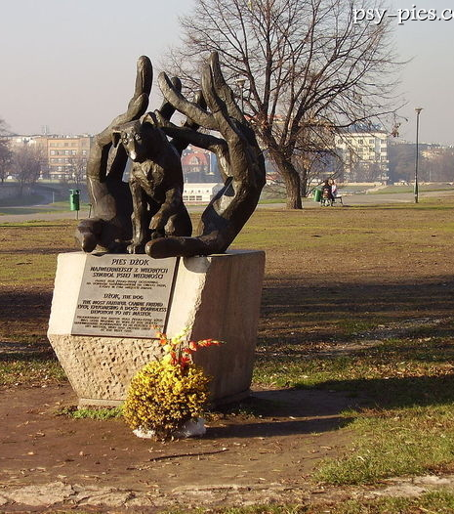
Dżok dog monument
Not far from Wawel Castle there is a monument to a dog named Dżok. His owner died of a heart attack in the center of Cracow, and the faithful dog waited for him a year in the same place.

Slide 11
Cracow specialities
The Cracow delicacy is "Kremówka Papieska", which in childhood was the favourite dessert of Pope John Paul II.

Slide 12
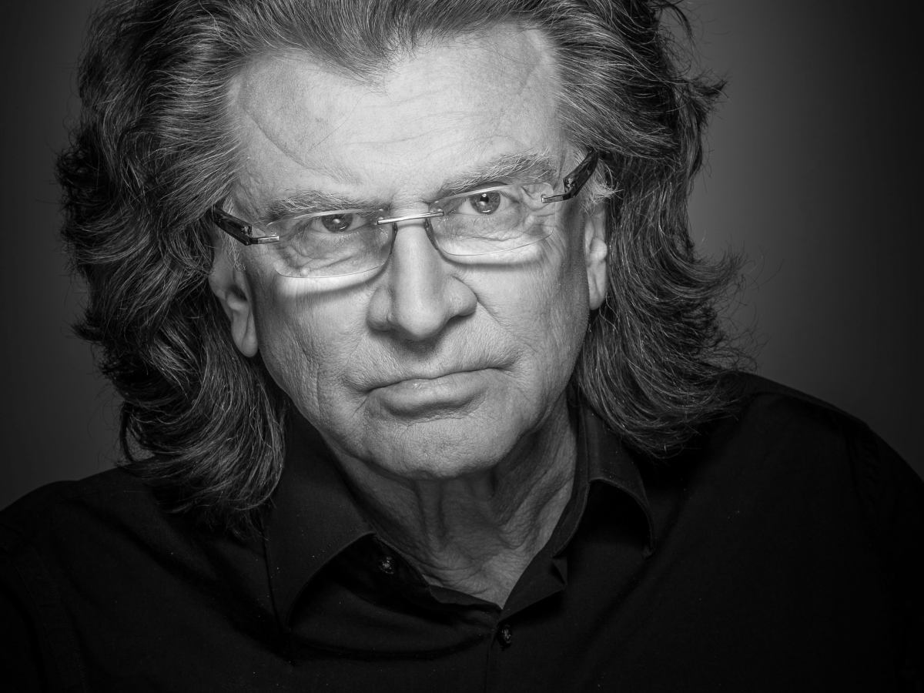
Famous people from Cracow Many famous Polish musicians were born in Cracow , such as Zbigniew Wodecki, Kora and Ewa Demarczyk.

Slide 13
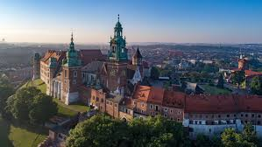
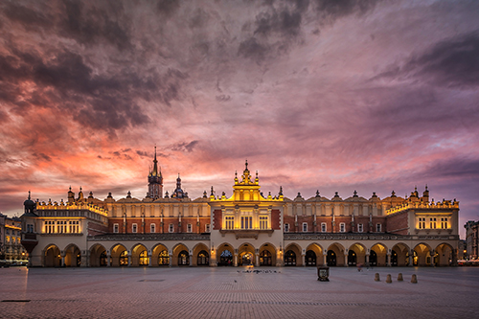
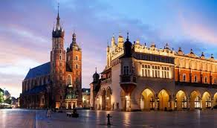
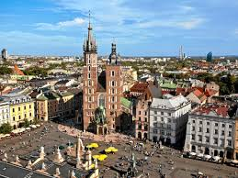
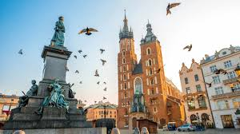
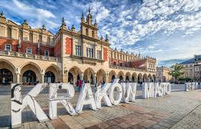
Cracow
the most
beautiful
city in Poland

Slide 14
tHanks for watching!
Oliwia Świąć

