Slide 1
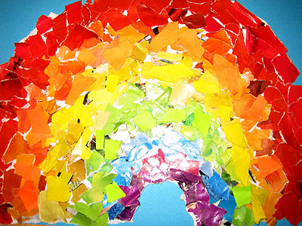
BIFROST IN SWEDISH IS RAINBOW

Slide 2
What does this mean?
The work of the school runs in all the colours of the rainbow to combine emotions, knowledge and fantasy
The work of the children should be colourful
The goal is for the children to evolve into individuals who have both knowledge and reflect over it and have the courage to be engaged in a dynamic and creative way
The children should get the best from us and each other

Slide 3
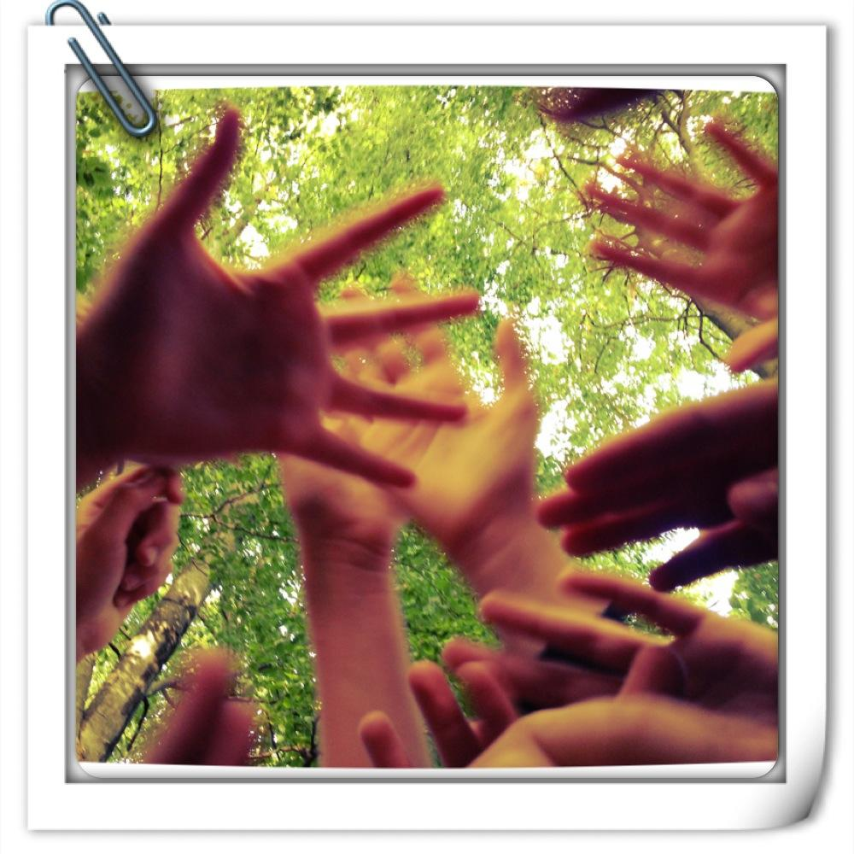
We want to hear the rainbow dance
The content of the education is an important source for the development of the childrens:
Knowledge
Thoughts
Envisions
Feelings
Interests
Skills and approaches

Slide 4
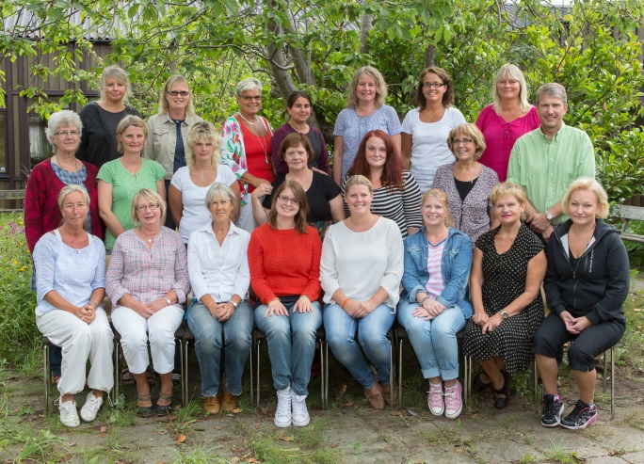
The theme’s workflow for the educators
The educators deside on a theme
All educators meet to write down the goals and purpose, roughtly plan the first experience, think broadly about content within the theme.
An inspirational day for the educators with some new input or further training
Experience day (first day of school)
After the students brainstorm, workshops, courses and goals are planned.
Work implementation planning are done in each work team.
Theme endning in May/June
Evaluation of the theme.
Continuing documentation in GAFE

Slide 5
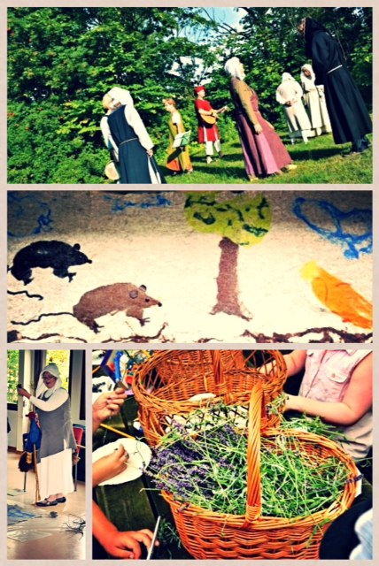
Workflow for the students
Experience day
Discussions( brainstorm
Courses.
The theme is integrated in most subjects in some way.
Workshops
Presentations
Theme endning
Continuing evaluation and documentation

Slide 6
Work shops
This way of working increases the cooperation between teachers
Reduces the sizes of the student groups
Gives the educators a chance to organise the work so the students can get a broader understanding of a subject, an overview in a wider context
Give the students an influence over their work and make them feel more involved in and take responsability for their education.

Slide 7
Experience day
Joint asssembly - first day of school after summer holiday
We often start with some kind of play
Walk around at different stations that will reflect the theme in different ways
Joint conclusion when we reveal the theme name for the first time

Slide 8
Work shops
180 min/week (3 x 60 min)
From Swedish, natural- and social science. art, craft and technology
Studio: art, craft (textiles, woodwork and metalwork)
Reading and writing: Different ways of gathering data and the producing a written work (essay, facts, artcle, news item… )
Laboratory: natural science in different ways, programming

Slide 9
Organisation
Mixed ages
Six and seven-year-olds
Eight and nine-year-olds
Ten, eleven and twelve-year-olds
12-17 students and one educator

Slide 10
Some of the themes over the years 2002 - 2017
Fair Play
Year of Light
Nobel
Circus
Around the World in 80 days
Heaven´s on fire
Hello China - Ni Hao
Thousand and one night
From fire (in Swedish ELD) to LED
Back to the Middle Ages
H.C Andersen - the king of fairy tales

Slide 11
Roadtrip 2017-2018 We are going for a virtual roadtrip to our ten countries in this project
Gift and mission for the summer:
Pack a bag with five important things for a trip (pictures and photos of the things)
A passport to fill in
A ticket to bring to the Experience Day
Make them curious and wondering what the new theme is going to be about

