Slide 1
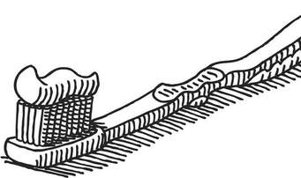
William Addis 1734 - 1808
Producer of the first mass produced toothbrush.

Slide 2
In 1770, Addis was jailed for causing a riot. While in prison, and observing the use of a broom to sweep the floor, he decided that the prevalent method used to clean teeth at the time – crushed shell or soot – was effective and could be improved. He used small animal bone, left over from the meal he had eaten the previous night and drilled small holes into it. He then obtained some bristles from one of his guards, which he tied in tufts that he then passed through the holes in the bone, and which he finally sealed with glue.
After his release, he started a business that would manufacture the toothbrushes he had built, and he soon became very rich.

Slide 3
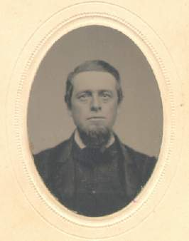
He died in 1808, and left the business to his eldest son, also called William, and it stayed in family ownership until 1996.
Under the name Wisdom Toothbrushes, the company now manufactures 70 million toothbrushes per year in the UK.

