Slide 1
122nd Primary school ““Nikolay Liliev“
STEAM training, application and more

Slide 2
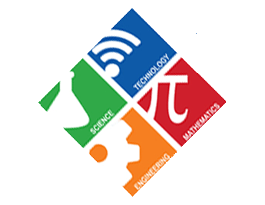
Content
What is е STEAM? Benefits.
Our school.
Application of STEAM at school.
Future plans.

Slide 3
What is STEAM? Benefits.
STEM /Science, Technology, Engineering, Math/.
However, the STEM approach is much more than "sticking" the concepts together. It is a philosophy of education that encompasses teaching skills and subjects in a way that resembles real life.
A variant of STEM is STEAM, which includes A / Arts / - Arts, Design. Artistic Design and Arts are important part of STEM-based education.

Slide 4
What is STEAM? Benefits. (2)
Through integrating STEM activities into children's learning areas, opportunities are provided to develop the skills needed to adapt to a dynamic pragmatic and technological environment.
The skills developed through STEM provide them a solid foundation for success, both in school and in real life. Students develop key skills such as:
Creative thinking;
critical analysis;
Team work;
Initiative;
Communication;
Mathematical Literacy.

Slide 5
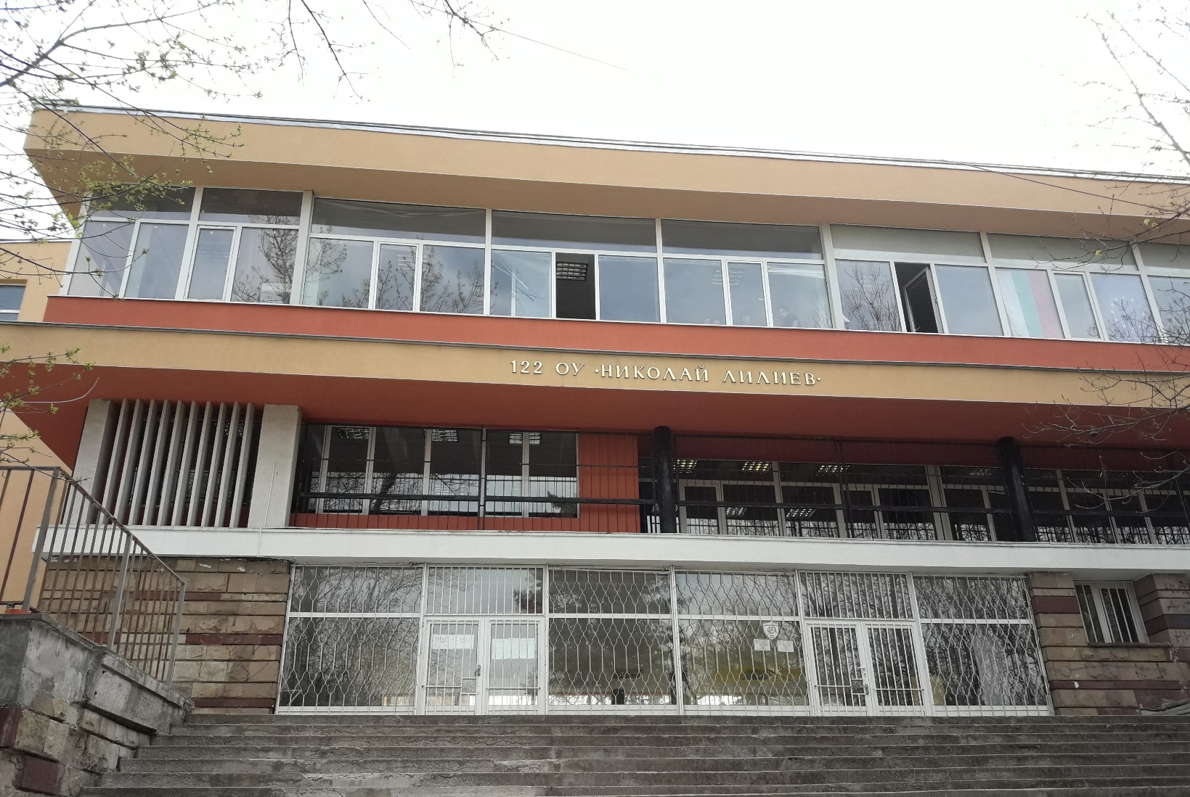
Our school
On September 1st, 1962, the school received the status of primary school number 122.
The school year 1963/1964 begins in the new sunny building.
Today our school headmistress is Mrs.Iveta Germanova. The school has acquired the status of Innovative School in Robotics and Applied Programming. The school uses modern teaching methods and has STEM lessons in the classroom. During these lessons are used virtual reality goggles, Mozabook (creating easy and convenient tutorial content), electronic notebooks and more to look at.

Slide 6
STEAM application at school
At our school, we strive to use STEAM whenever and wherever we can. First of all, STEAM is applied in the compulsory classes of children in different ways / For example, in Geography class, students go around Antarctica using VR glasses and special software to simulate the environment /.
Most of the classrooms in our school have an electronic board equipped with Mozabook software, through which students create electronic notebooks and receive them in a user-friendly format, and teachers create interesting and interactive exercises.

Slide 7
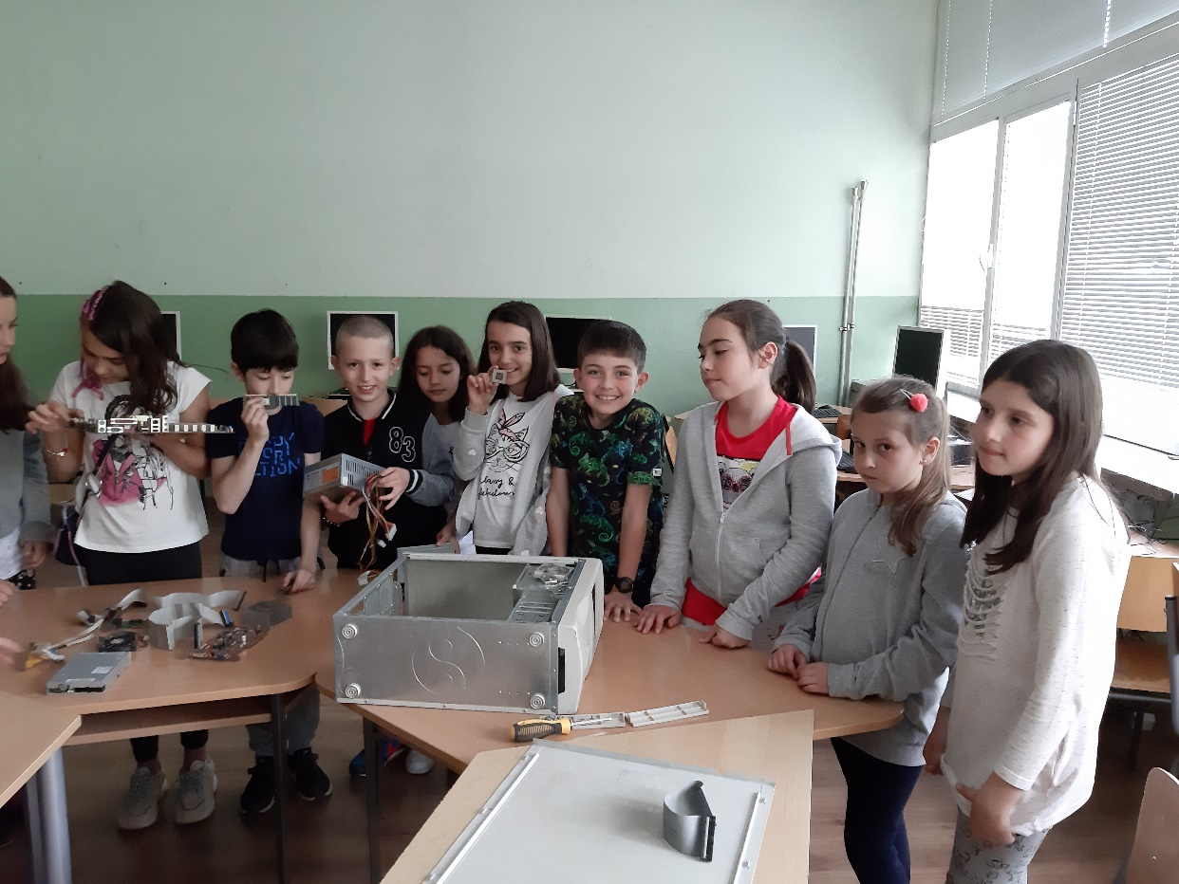
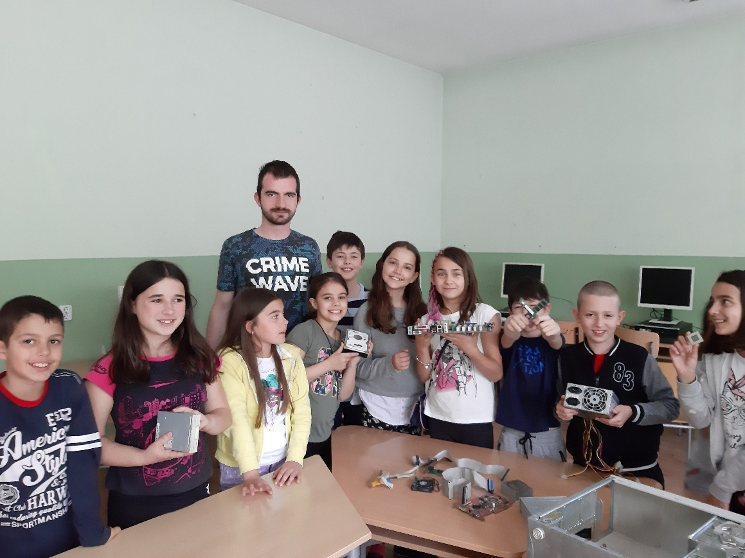
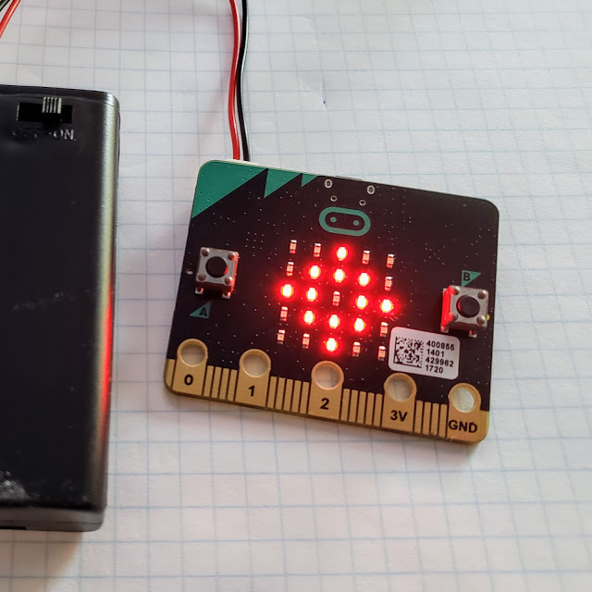
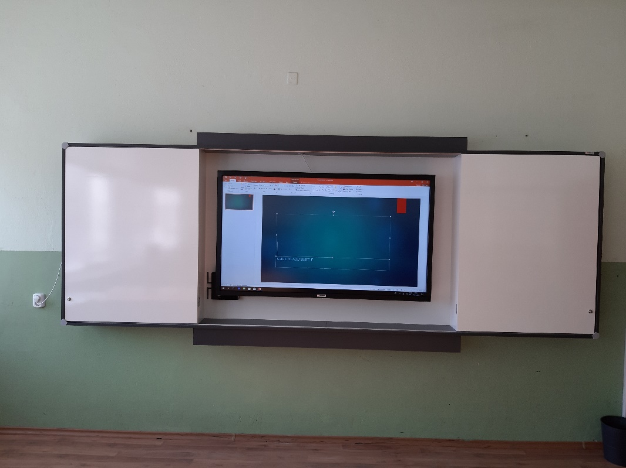
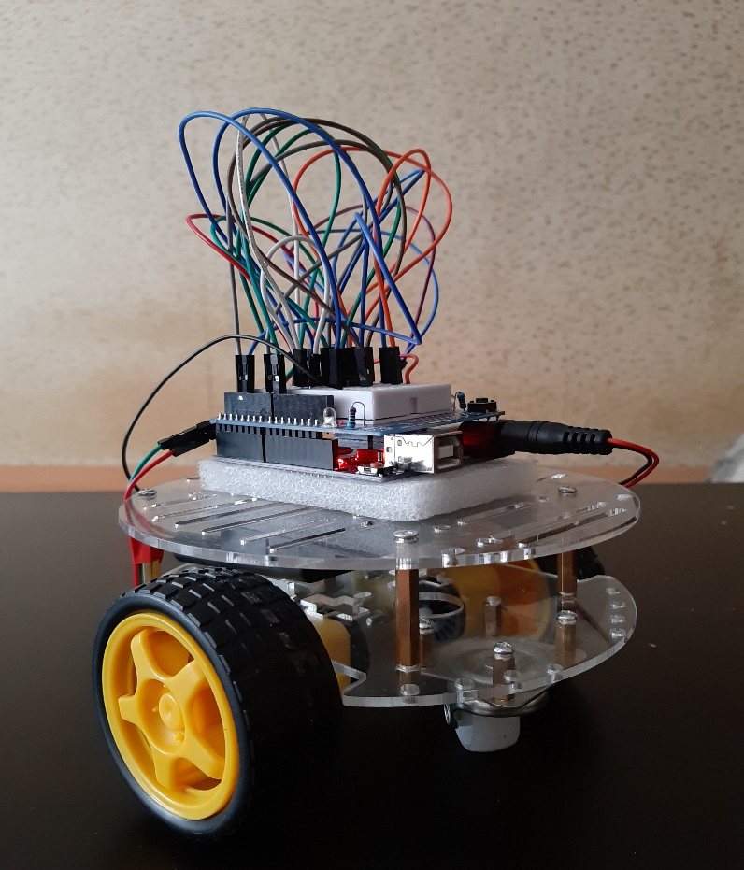
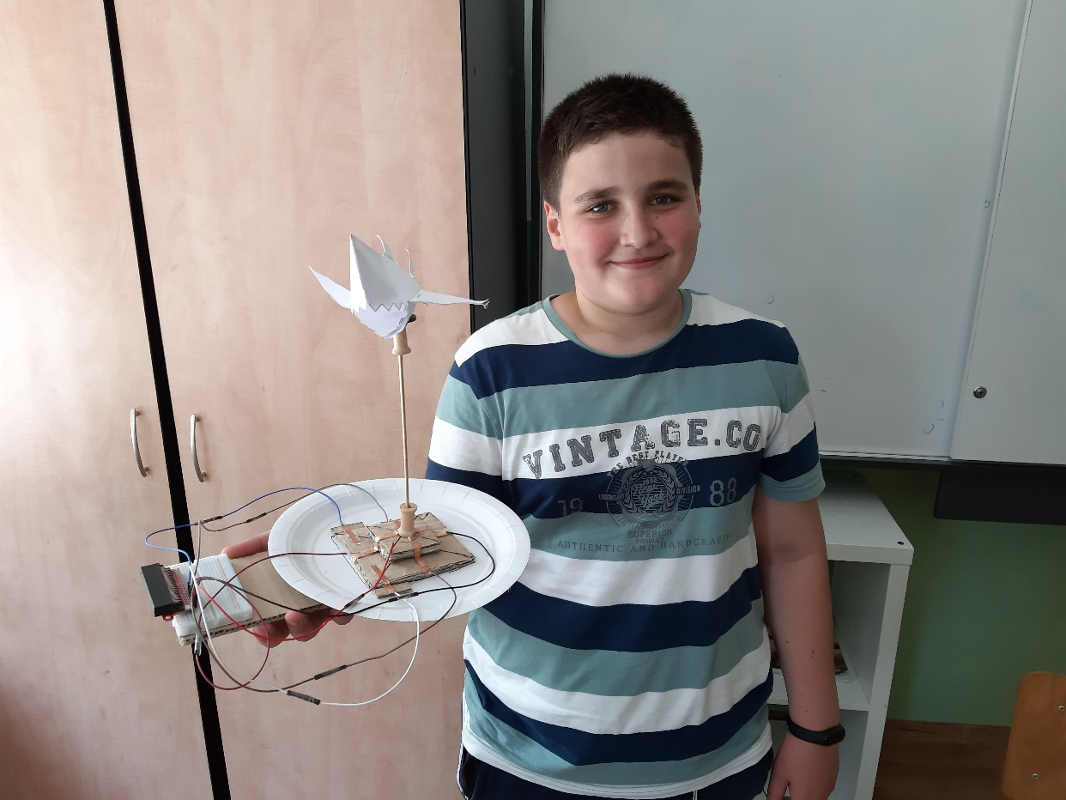

Slide 8
STEAM application at school (2)
Robotics and Applied Programming Club, with students from grades 5 to 7 participating. Micro:bit microcontrollers are used, and there are dozens of projects created by students with them /e.g. compass, thermometer, games - sea chess, snake, etc.
Participation in STEAM school-related events such as #MicrosoftEDU, Tech4Kids, HackingSTEM.
Khan Academy lessons connected with programming.
Thanks to Microsoft, students use STEAM kits to learn about life of sharks or how human brain works.

Slide 9
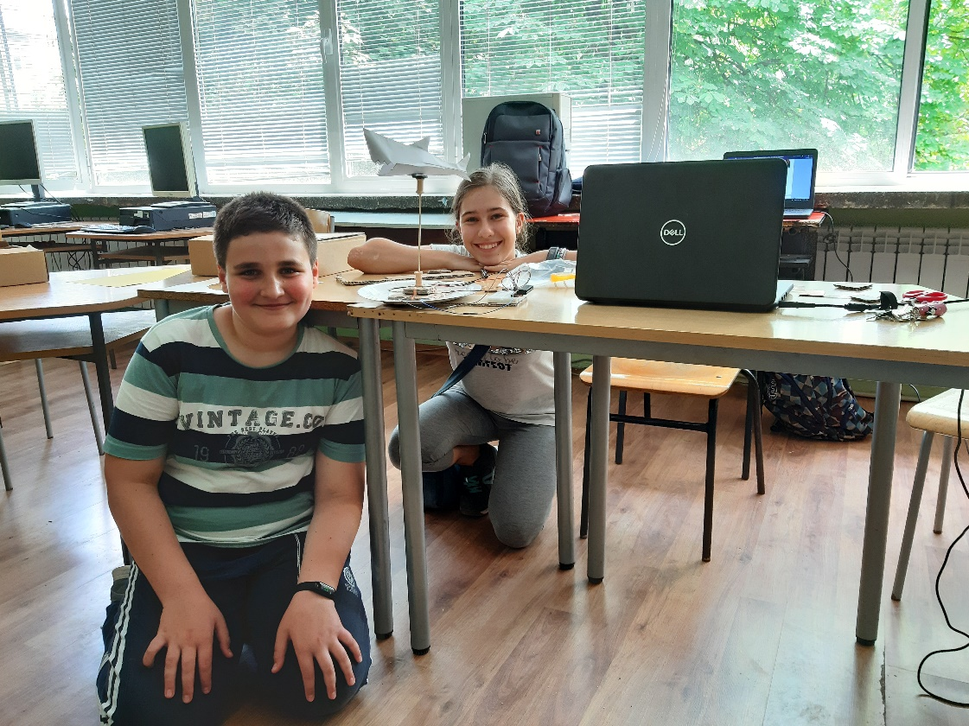
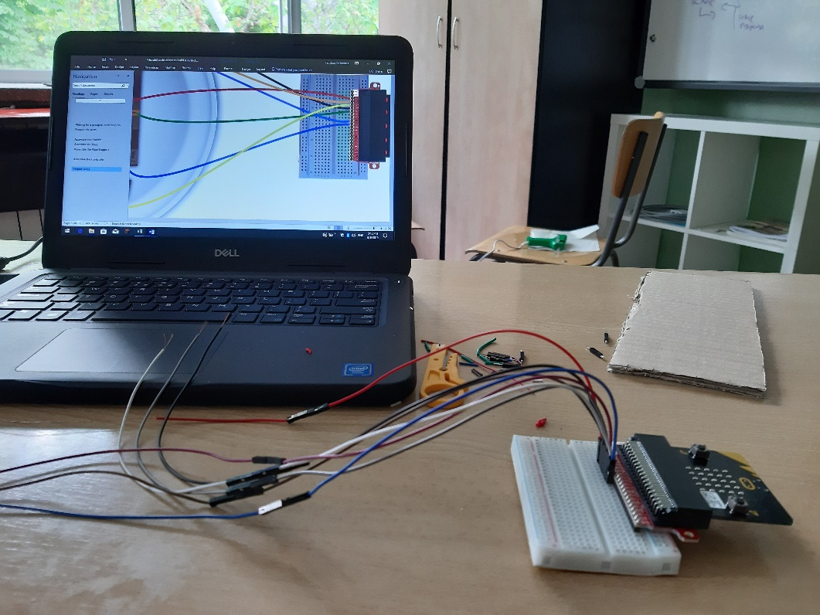
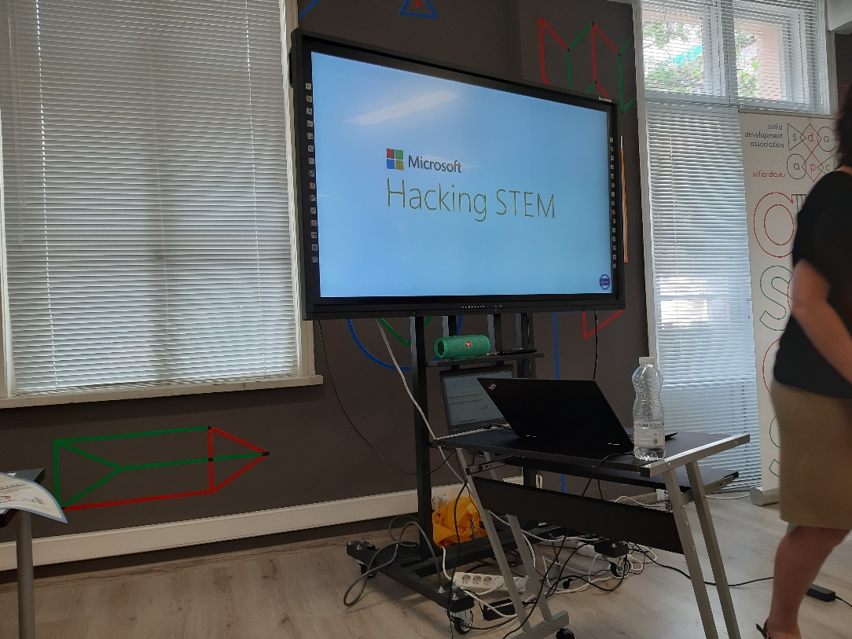
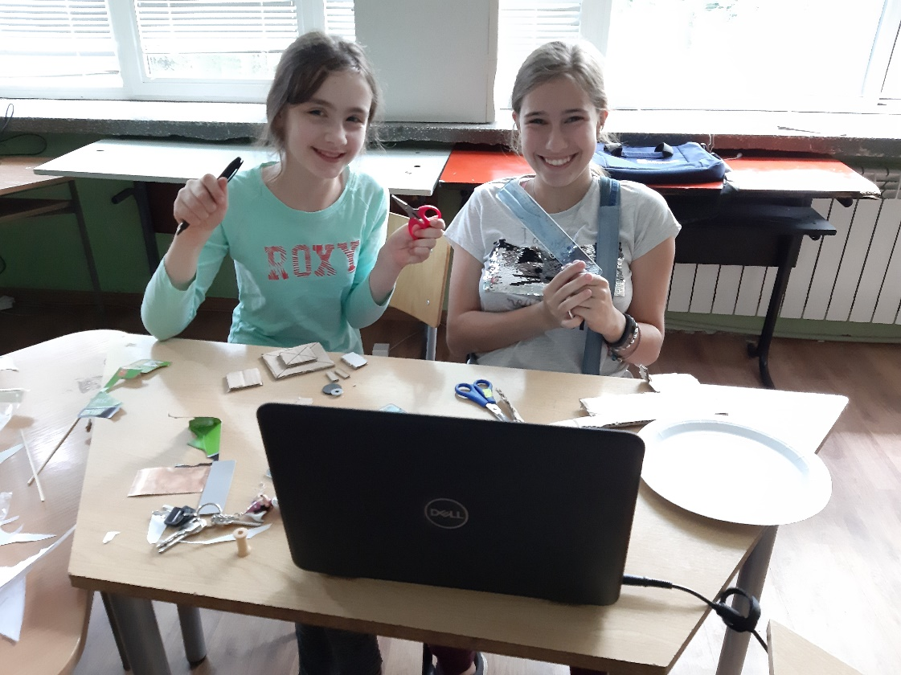
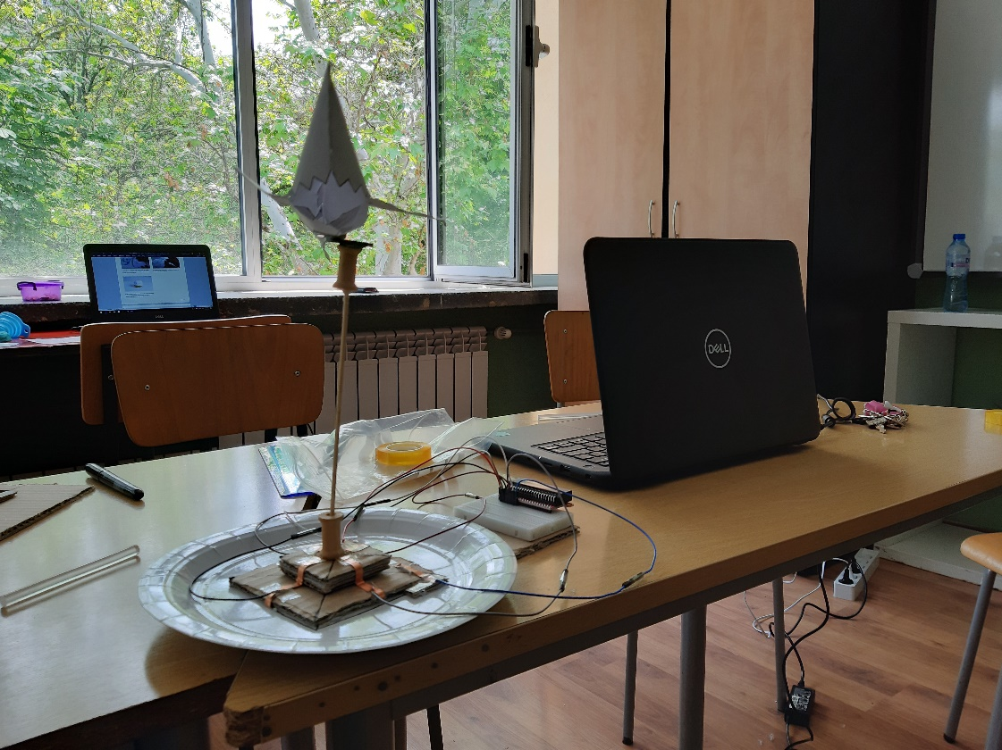

Slide 10
Бъдещи планове
Иновацията на училището е свързана с Роботиката и приложното програмиране, като учениците от 2. клас имат предмет Роботика и приложно програмиране, където 2 часа в седмицата работят с млади иновативни учители и тепърва изграждат и развиват своите познания в тази област.
Целта е да се увеличи иновативният екип на училището и всяко едно дете да има възможност да се потопи в света на STEAM.
Посещения на повече събития и споделяне на добри практики.
Внедряване на 3D моделиране и печат в училище, където децата сами ще създават свои 3D модели, след което ще се разпечатат на 3D принтер.

