Slide 1
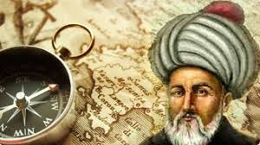
PİRİ REİS

Slide 2
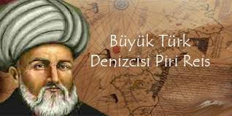
WHO IS HE?
He is known as a big Turkish mariner, an admiral and a geographer scientist.

Slide 3
Ahmed Muhiddin Piri, more famous as Piri Reis, was a senior naval officer of the Ottoman Empire. He was also a geographer and cartographer.

Slide 4
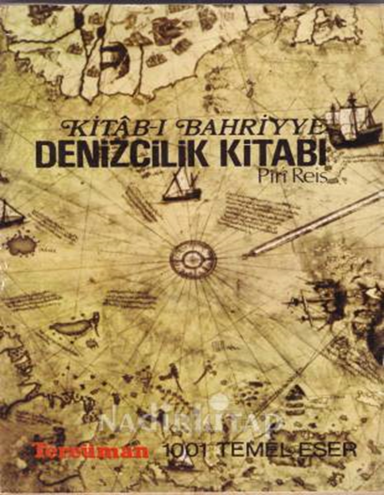
The present world knows him mainly for his charts and maps that find place in his masterpiece ‘Kitab-ı Bahriye’ (Book of Navigation).
It comprise of comprehensive data on navigation as also precise charts of those times elucidating major cities and ports of the Mediterranean Sea.

Slide 5
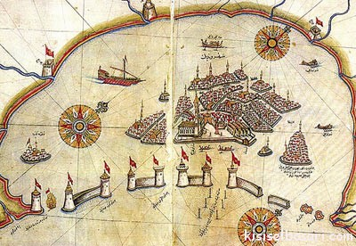
HIS MOST FAMOUS DRAWING

Slide 6
First World Map
He compiled his first world map in 1513, around one-third of which survives.

Slide 7
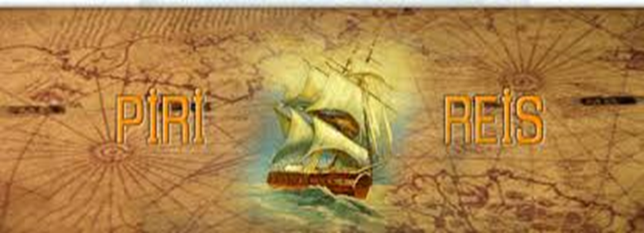
1st World Map: Drawn by Piri Reis.
2nd World Map: It was drawn and reached till now.

Slide 8
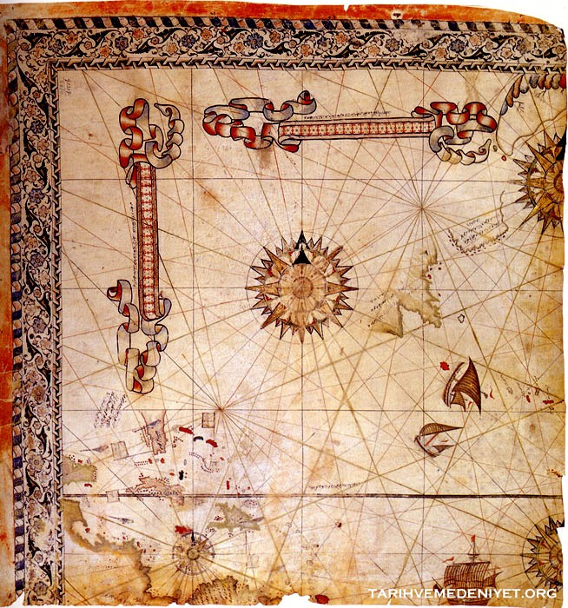
2nd World Map
So far, it is known to be the oldest Turkish atlas of the New World and is counted among the oldest ones of America that still exists. His second world map, compiled in 1528, only a small portion of which could be retrieved, displays sections of Central America, North America and Greenland.

Slide 9
Map of Cyprus

Slide 10
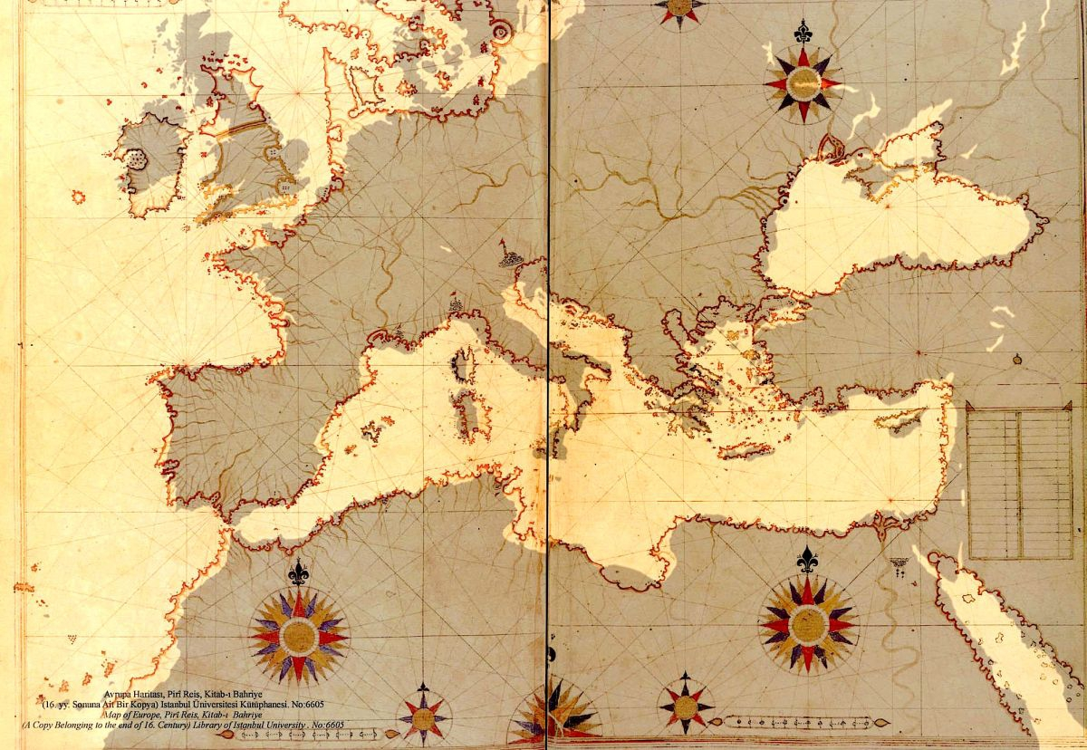
Map of Europe

Slide 11
