Slide 1
My country Lithuania
Project by Magda Vainiūtė

Slide 2
Lithuania
Lithuania is a very beautiful country. There are many very beautiful cities.

Slide 3
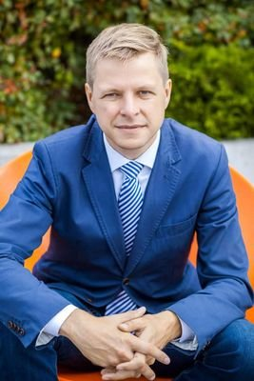
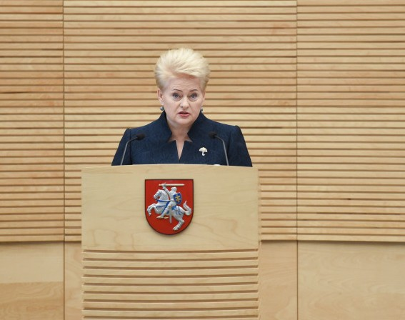
Lithuanian president and mayor OF VILNIUS
Lithuanian president is Dalia Grybauskaite.
The Mayor of Vilnius is Remigijus Šimašius.

Slide 4
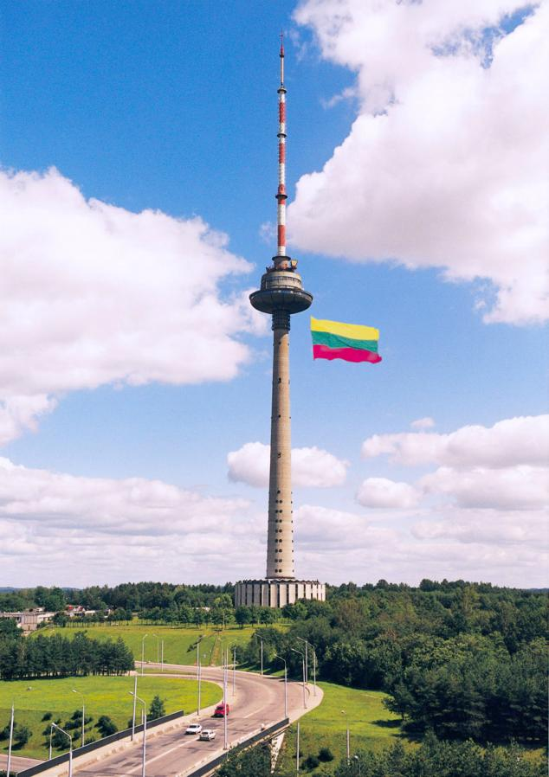
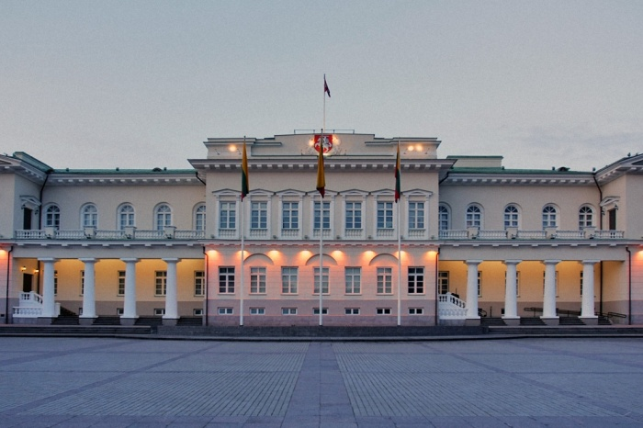
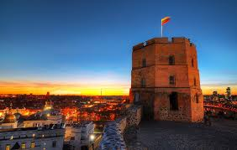
Lithuanian sights
In Lithuania you can see the buildings of old times: Gediminas‘s castle, Classicism medium presidential, TV tower and more interesting buildings, towers and castles.

Slide 5
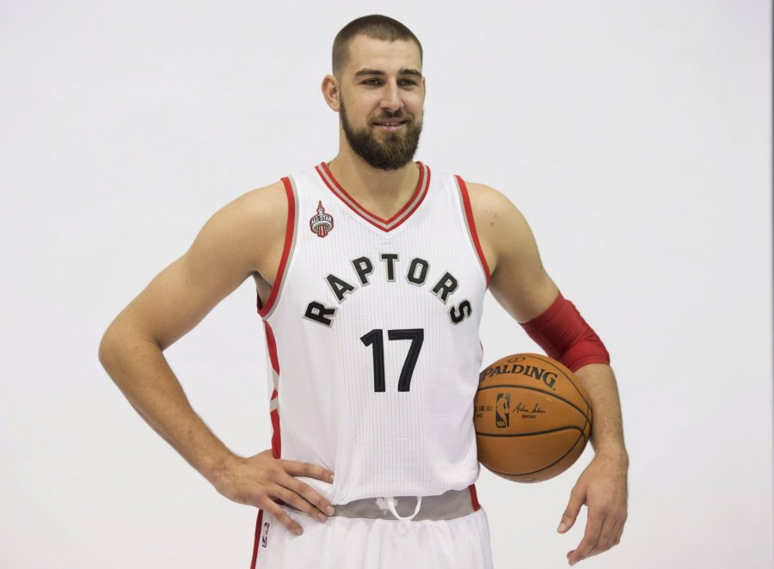
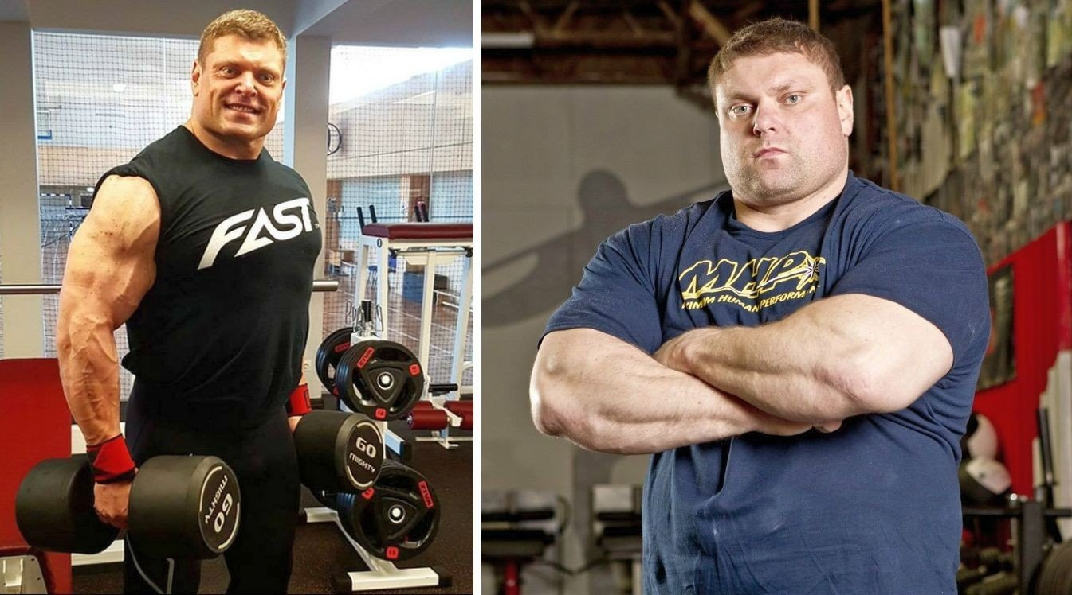
Lithuanian athletes
Lithuania has got a lot of athletes: Rūta Meilutytė, Žydrūnas Savickas and Jonas Valančiūnas.

Slide 6
I LOVE LITHUANIA!!!

