Slide 1
The Audio-lingual Method

Slide 2
What is it?
The Audio-lingual method (ALM) is an oral based approach to teaching foreign language in order to drill students in the use of grammatical sentence pattern.
It emphasizes teaching listening and speaking before readning and writing.

Slide 3
What does it mean?
Audio
Lingual
is to listen
is to repeat (drill)

Slide 4
It is also called
The Army Method =
New Key

Slide 5
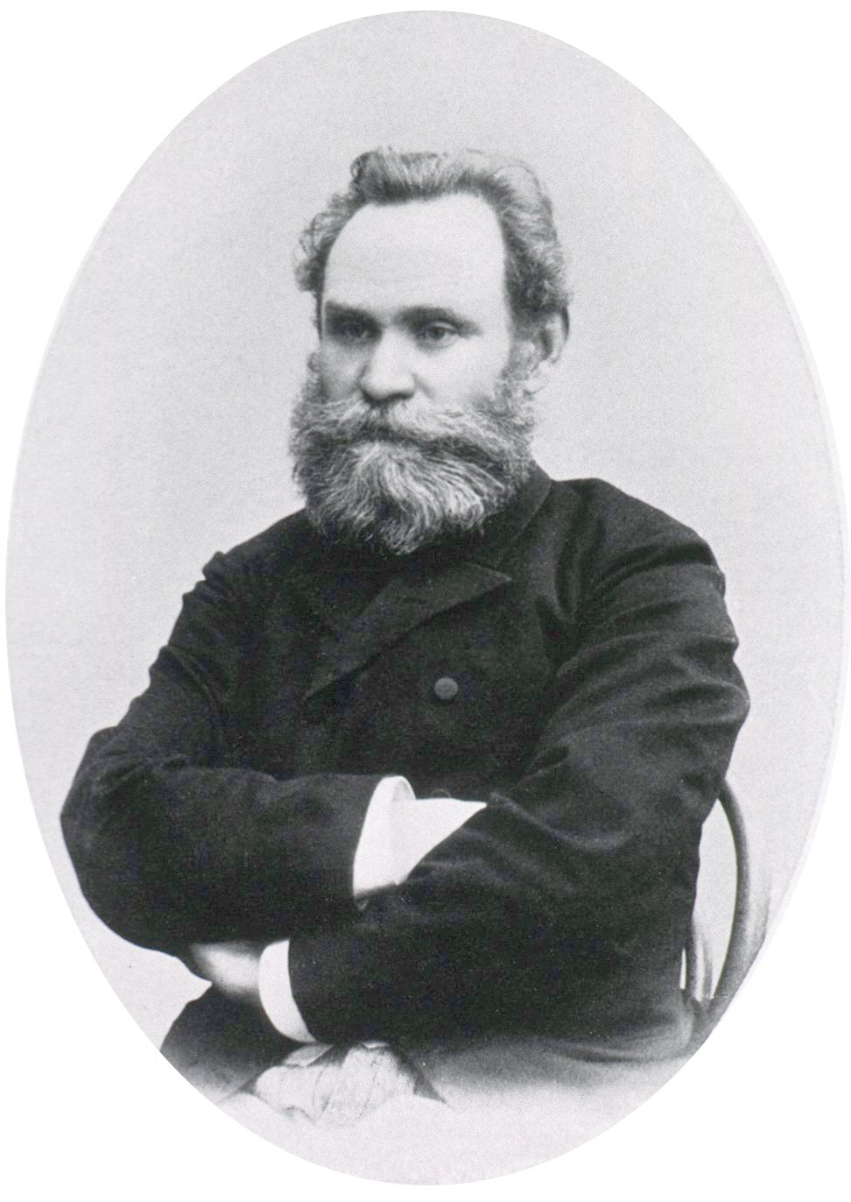
Background
It comes from behaviourism.
Most experiments were made by Ivan Petrovich Pavlov.
He showed that most animals undergo stimulus – response mechanism.
It was put into an actual teaching methodology.
https://www.google.com/url?sa=i&url=https%3A%2F%2Fpl.wikipedia.org%2Fwiki%2FIwan_Paw%25C5%2582ow&psig=AOvVaw2rnXc5ibEtQtlZgaKfrb_O&ust=1588253353231000&source=images&cd=vfe&ved=0CAkQjhxqFwoTCLCekfnejekCFQAAAAAdAAAAABAE

Slide 6
Characteristics of ALM
New material in a dialogue form.
Mimicry, memorization of set phrase.
Structures are sequenced by meanings.
Structures are taught once at a time.

Slide 7
Characteristics of ALM
5. Using repetitive drills.
6. Little or no grammatical explanation.
7. Strictly limited vocabulary.
8. Use of CDs, language labs and visual aid.

Slide 8
Characteristic of ALM
9. Emphasis on pronunciation.
10. Using only target language.
11. Successful responses are reinforced.
12. The language usage turns into a habit.

Slide 9
The gole of teacher
Students produce utternance with accurate pronunciation and grammar.
Students are suposed to form new habits in the target language and respond quickly and accurately like native speakers.
Students are able to use the target language communicatively.

Slide 10
The role of teacher and students
Students = imitators
Teacher = Orchestra leader
to follow the teachers’ directions
to respond as precisely and promptly as possible
to direct and control the whole language learning program
to monitor and correct students’ performance
to vary drills and tasks

Slide 11
Characteristics of learning process
DIALOGUES
LEARNING
THROUH
IMITATION
LEARNING
THROUH
REPETITION

Slide 12
ALM techniques
1. Repetition drill | Students repeat out loud with the teacher
1. Repetition drill | Students repeat out loud with the teacher
2. Backward build-up expansion drill | It is used when students encounter the long lines. The teacher divide the line into several parts. Students repeat a part of the sentence. Students expand what they repeated part by part until they are able to reapeat entire line.

Slide 13
ALM techniques
3. Chain drill | To make students ask and answer questions with each other
1. Repetition drill | Students repeat out loud with the teacher
4. Dialogue memorization | Students take the role of one person in the dialogue and the theacher the other. Switch roles and memorize the other person’s part.

Slide 14
ALM techniques
5. Single-slot substitution drill | The teacher gives students a line from a conversation, then substitutes with the given word into the sentence in the correct place.
1. Repetition drill | Students repeat out loud with the teacher
6. Multiple-slot substitution drills | That is similar to a single-slot substitution drill, however more words are fitted into different slots in the dialogue.

Slide 15
ALM techniques
7. Use minimal pairs of words | The teacher chooses pairs of words which differ in only one sound for example: ship/sheep.

Slide 16
ADVATNAGES OF ALM
1. The first language learning method which is grounded on a solid theory of language learning.
2. It emphasizes the cultural traits of the target language.
3. It provides the opportunity to learn the correct pronunciation and structure.
4. It is possible to teach large groups of students.

Slide 17
DISADVANTAGES OF ALM
1. The theoretical foundation suffers from inadequacy.
2. A mechanical method which demands pattern practice, drilling, memorization.
3. A teacher’s dominated method.
4. A student’s passive role. A student has a little control over his learning process.

Slide 18
DISADVANTAGES OF ALM
5. It does not put an equal emphasis on the four basic skills (listening, speaking, reading and writing).
6. It considers only language forms, not meanings.
7. It does not pay sufficient attention to communicative competence.
8. It prefers accuracy to fluency.

Slide 19
Videos and exAMPLES
https://www.youtube.com/watch?v=QjbewExPM_Q
https://www.youtube.com/watch?v=Idk-UHIO-fY
https://www.youtube.com/watch?v=7qBq_mcrbC8

Slide 20
Sources
https://www.bing.com/videos/search?q=audio-lingual+method&ru=%2fvideos%2fsearch%3fq%3daudio-lingual%2bmethod%26FORM%3dHDRSC3&view=detail&mid=9ED50EE963DC8F873F859ED50EE963DC8F873F85&&FORM=VDRVRV
https://www.bing.com/videos/search?q=audio-lingual+method&&view=detail&mid=3303B6B50E69A5D51C433303B6B50E69A5D51C43&&FORM=VRDGAR&ru=%2Fvideos%2Fsearch%3Fq%3Daudio-lingual%2Bmethod%26FORM%3DHDRSC3
https://www.bing.com/search?q=audio-lingual+method&form=ANSPH1&refig=31f68fe769ca48b8f0ea194e01ca15df&sp=1&qs=HS&pq=au&sk=PRES1&sc=8-2&cvid=31f68fe769ca48b8f0ea194e01ca15df

Slide 21
Thank YOU
Marta Hadrych
Dorota Jaroma – Dubiel
Jadwiga Szydlak

