Slide 1
The city of Luxembourg

Slide 2
Some general informations
is the capital city of the Grand Duchy of Luxembourg
The city lies in the heart of Western Europe, standing at the confluence of 2 rivers (Alzette and Pétrusse)
The city grew around the Castle of Luxembourg
70% of the population is made of foreigners
is one of the de facto capitals of the European Union
It is the seat of several bodies of the EU (Europen Court of Justice, Europen Investment Bank etc..)
In 1951, Luxembourg became one of the six founding countries of the European Coal and Steel Community, which in 1957 would become the European Economic Community and in 1993 the European Union. In 1999 Luxembourg joined the Eurozone.

Slide 3
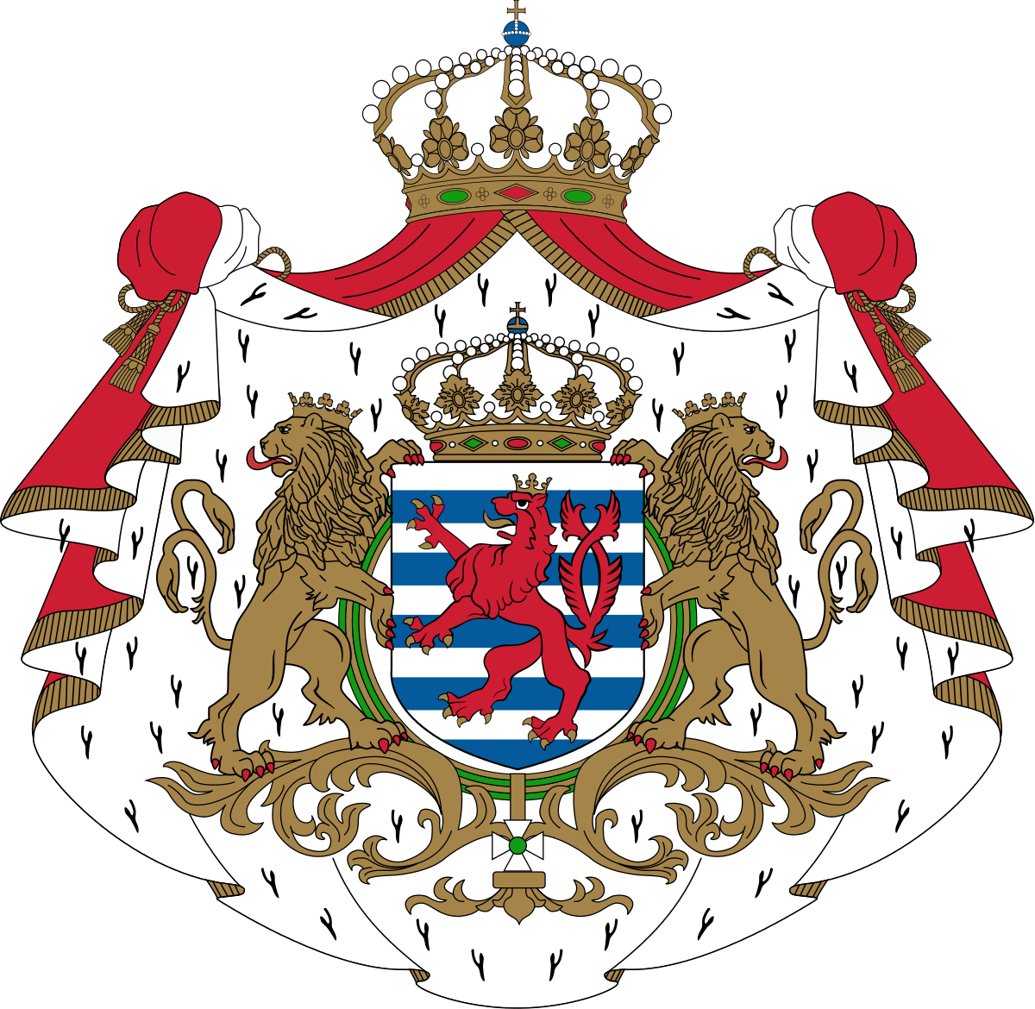
The Cities history

Slide 4
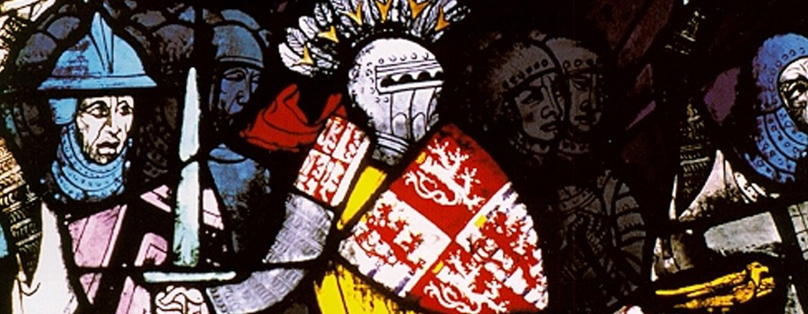
In the year 963 a Count by the name of Siegfried a rocky promontory overhanging the valley of the River Alzette.
a small stronghold called "Lucilinburhuc" was situated there at that time.
The name was later passed down to the city, that developed around the stronghold.
Nowadays the city and the country carry the same name.

Slide 5
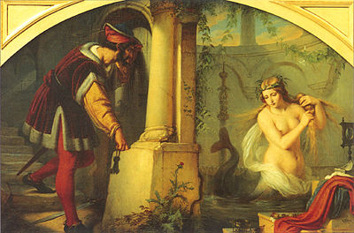
According to legend, Count Siegfried would be married to Melusina, a mermaid
The mermaid was to disappear beneath the waves of the Alzette.
Legend or not, Siegfried was present at the very birth of the House of Luxembourg

Slide 6
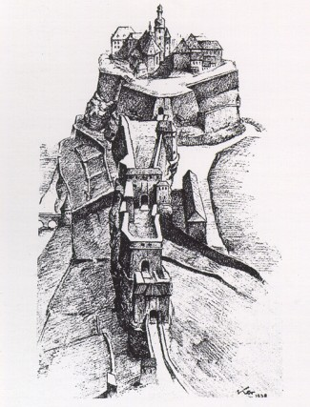
The word "Lucilinburhuc” means small fortress.
The city of Luxembourg was to be a fortress city for almost a thousand years.
Siegfried was to build a veritable fortress on the promontory.
While knights were billeted in the fortress, artisans and merchants settled around the fortress.

Slide 7
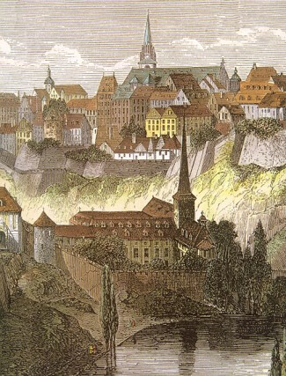
The first group settled on top of the rocky outcrop, the others beneath them.
Thus the distinction between the upper and the lower city was created.
Luxembourg owes its origins to its precipitous location and to the military interest which it thus provoked.

Slide 8
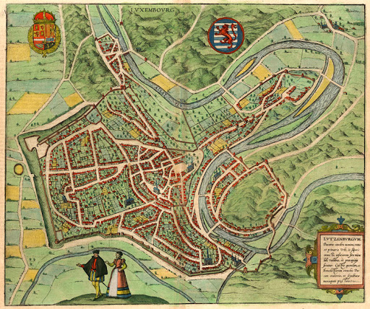
In the Middle Ages, Luxembourg was fortified on three sides.
to the South, to the East, and to the North-east it was surrounded by the deep valleys of the River Petrusse and the River Alzette.
On the side opening out to the plain, to the West and North-west, mighty remparts shielded the city.

Slide 9
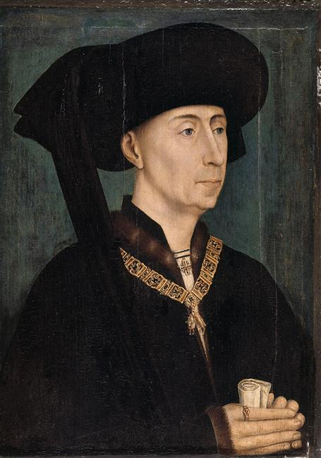
The city did not succumb to a siege, until in 1443 Philip the Good seized it by surprise.
It was integrated into the territory of the Netherlands and drawn with them into the duel which the Valois-Bourbons and the Habsburgs
In the strife which took place between Francis I and Charles V, the city changed hands four times before finally resting in those of the Habsburgs.

Slide 10
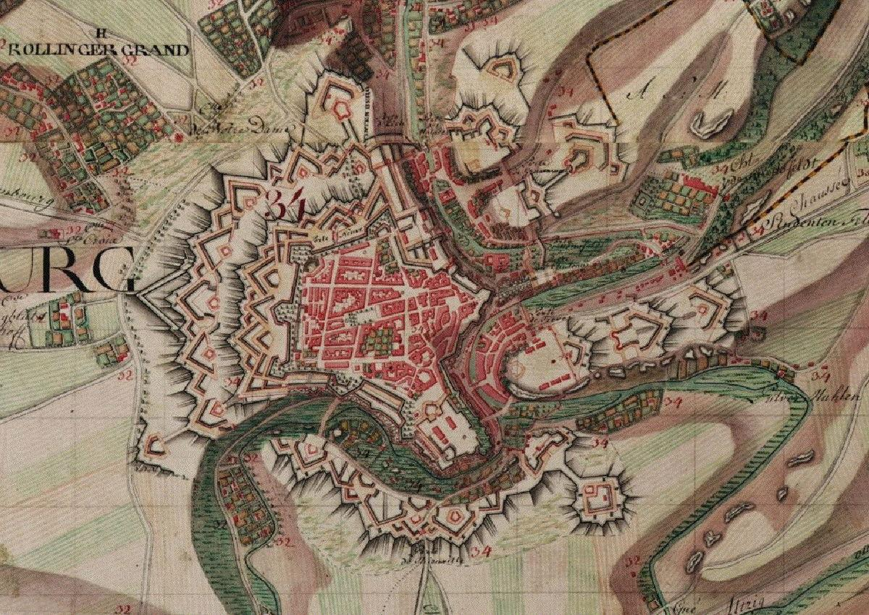
The Habsburgs decided to review he cities entire defensive system
After almost a century and half of hard work the fortified city had been transformed into a complete fortress.
At the end of a memorable siege, led by Vauban, the forces of the French King Louis XIV conquered Luxembourg in 1684.

Slide 11
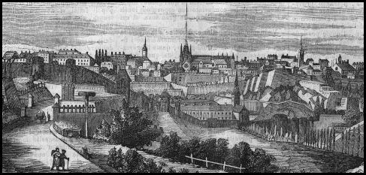
Luxembourg returned to the Habsburgs in 1697, the city took on the nickname of "Gibraltar of the North" during the 18th.Century.
After a long blockade, the city of Luxembourg was conquered, in 1795, by the French Revolutionary troops.
In 1815, after the creation of the Grand Duchy of Luxembourg, which became a member of the German Confederation.

Slide 12
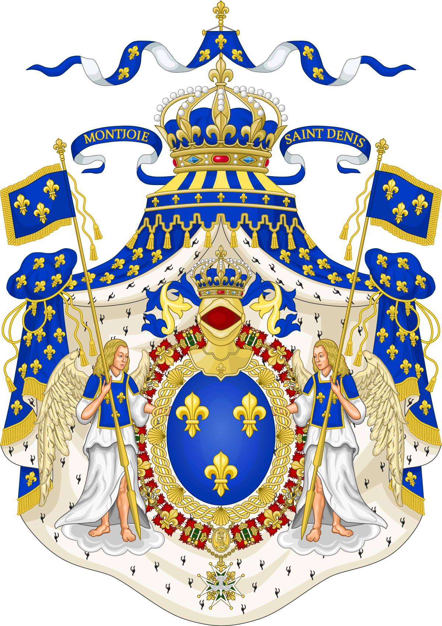
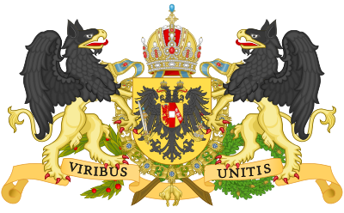
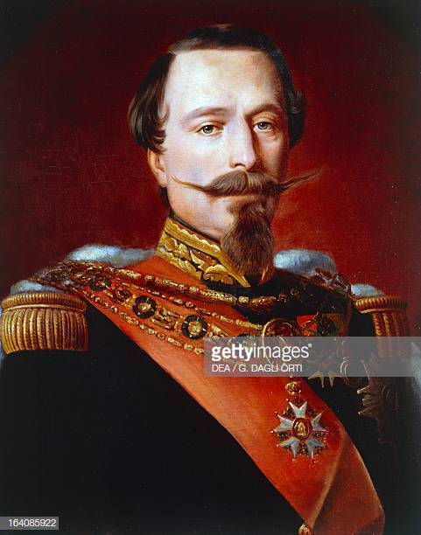
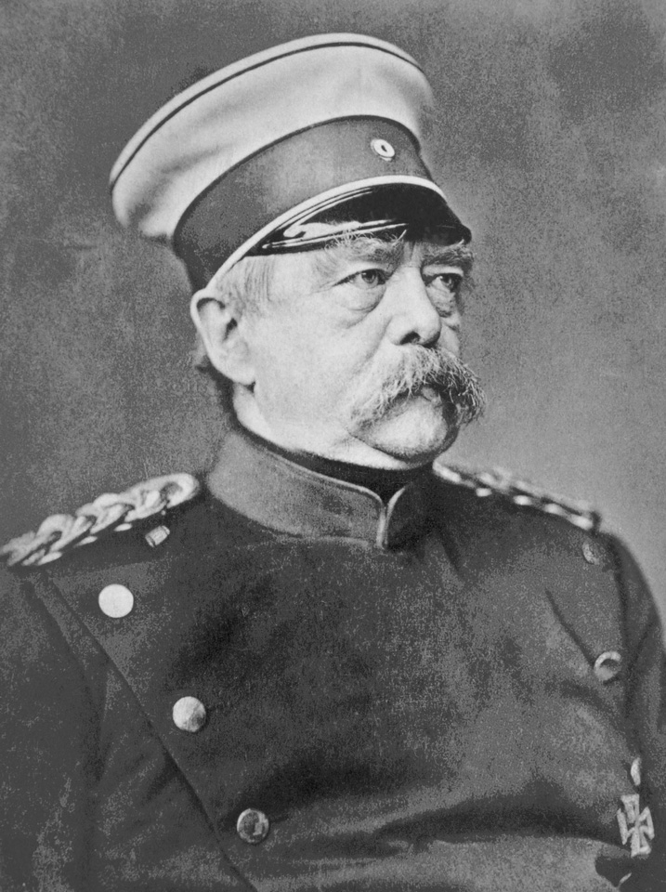
During the 19th century the conflict between the Bourbons and the Habsburgs had Luxembourg at the very front line between France and Germany.
In fact a war over it almost broke out between Napoleon III and Bismarck in 1867

Slide 13
A few places that you SHOULD visit

Slide 14
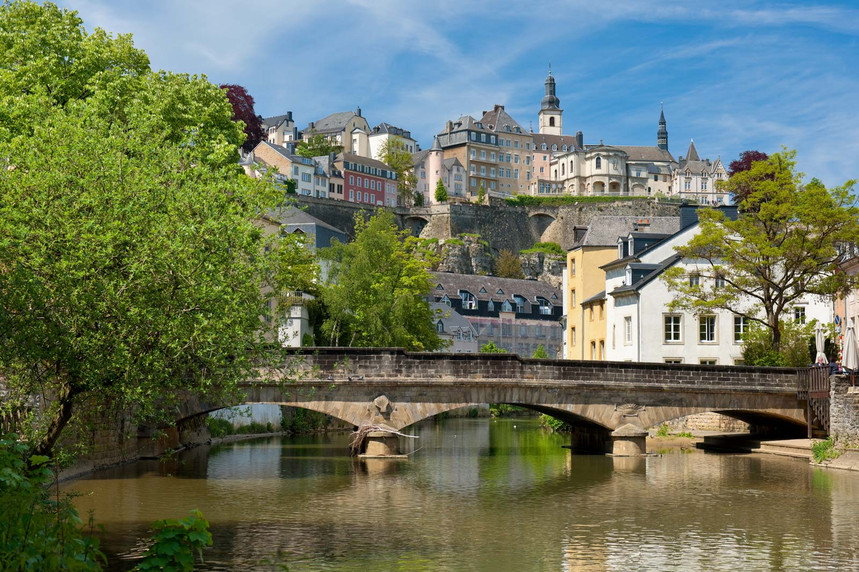
The Old Quarter of Luxembourg City
Designated a UNESCO World Heritage Site in 1994.
Today, the old fortifications have given way to beautifully laid out parks and gardens.
its cobbled streets are lined with charming old homes and buildings.
It has many bridges including the spectacular Adolphe Bridge, considered a city landmark

Slide 15
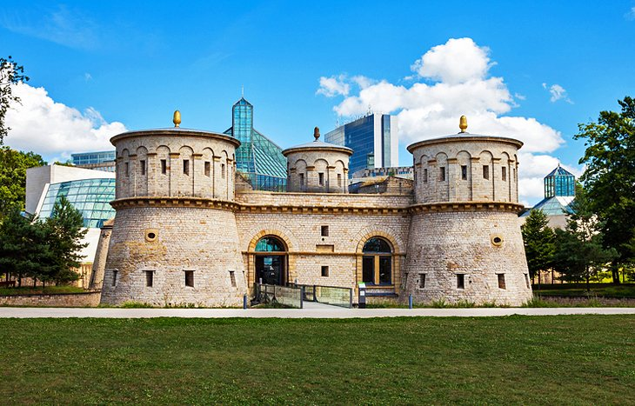
National Museum of History and Art, Luxembourg City
Located in the historic Fish Market area (the old town center)
There's a particular emphasis on the Gallo-Roman period with numerous fine displays illustrating the artistic, social, religious, and intellectual life of Luxembourgers
Also worthy of a visit is the Contemporary Art Gallery, with its first rate collection of visual arts.

Slide 16
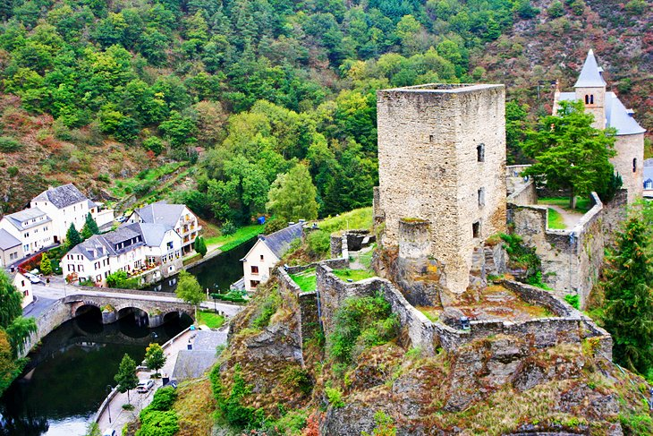
Upper Sûre Natural Park and Esch-sur-Sûre
Upper Sûre Natural Park consists of plateaus, narrow valleys with wooded slopes, and the lake of the Upper Sûre dam
The area also possesses a rich cultural heritage, and the Nature Park Centre - located in an old cloth mill
One of the largest events the is the biennial Water Art Festival, which attracts more than 200 musicians under a theme of "Rock meets Classic.„
A must-visit nearby is Esch-sur-Sûre, a spectacular small village set in the mountains and skirted by the river Sûre

Slide 17
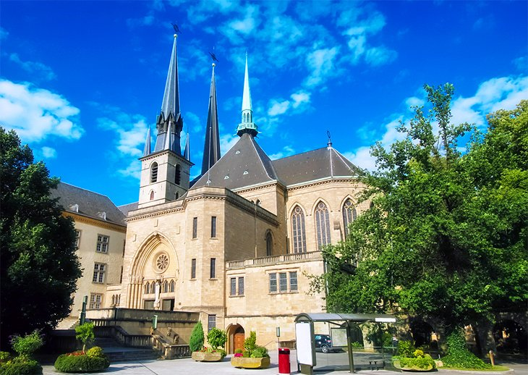
Notre-Dame Cathedral, Luxembourg City
The Roman Catholic Notre-Dame Cathedral in Luxembourg City - the country's only cathedral
as built in the early 17th century in late Gothic style, with a number of attractive Renaissance features added later.
Notable features include the two original choir bays, along with its three distinctive towers.
the cathedral's Sunday evening mass, is usually held by the Archbishop of Paris.

Slide 18
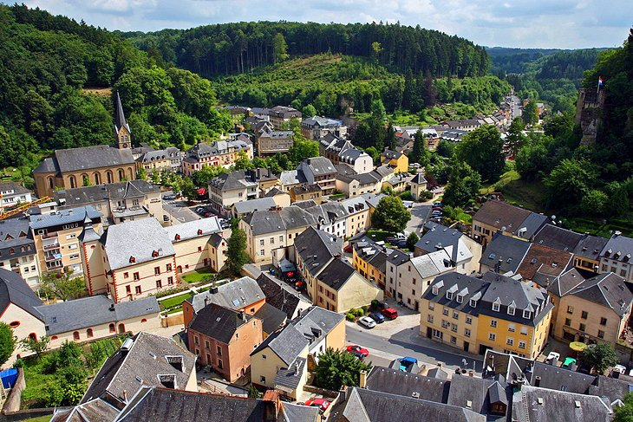
Larochette
Larochette is a quaint old market town that lies in a narrow, rocky valley surrounded by woods.
The town is dominated by two old and partially rebuilt castles that stand on a crag high above the valley of the White Ernz.

Slide 19
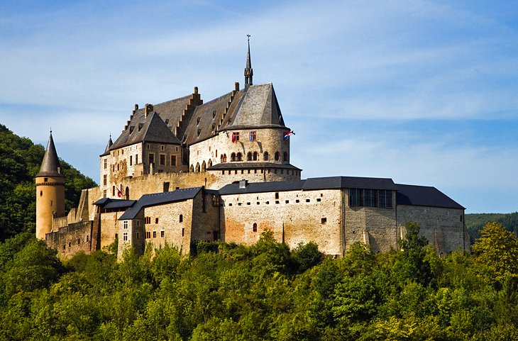
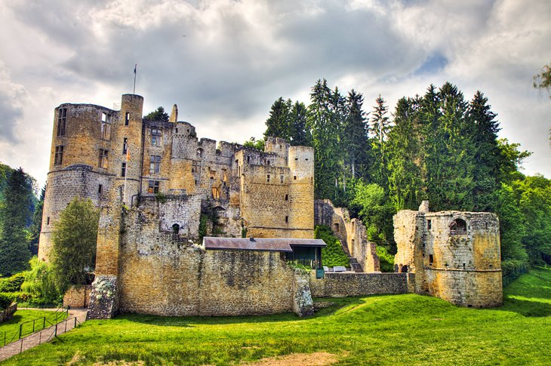
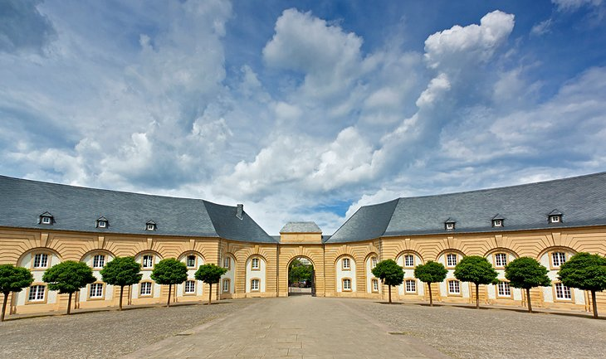
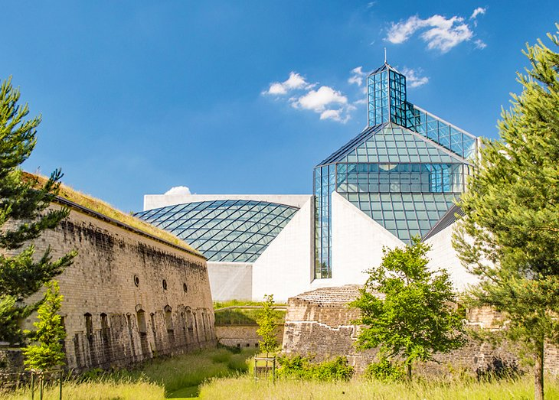
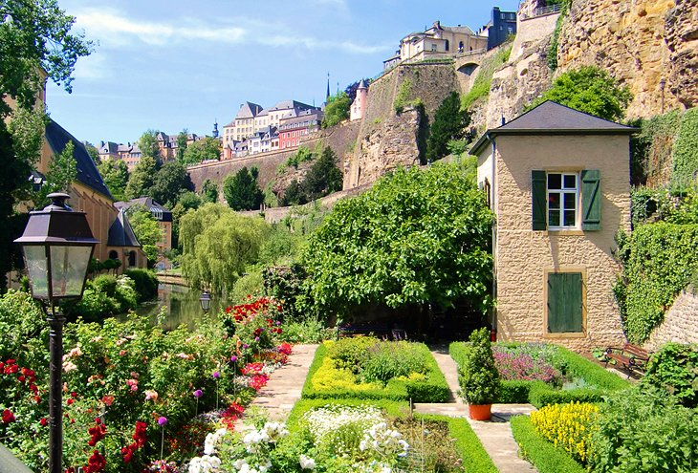
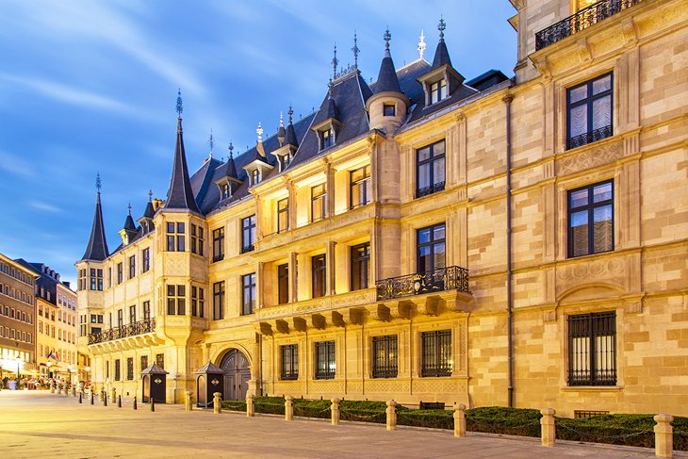
And many more !

Slide 20
Thank you for your attention !
☺

