Slide 1
CHRISTMAS
Zsidek Alexandra
Molnár Anna
2019
Slovakia

Slide 2
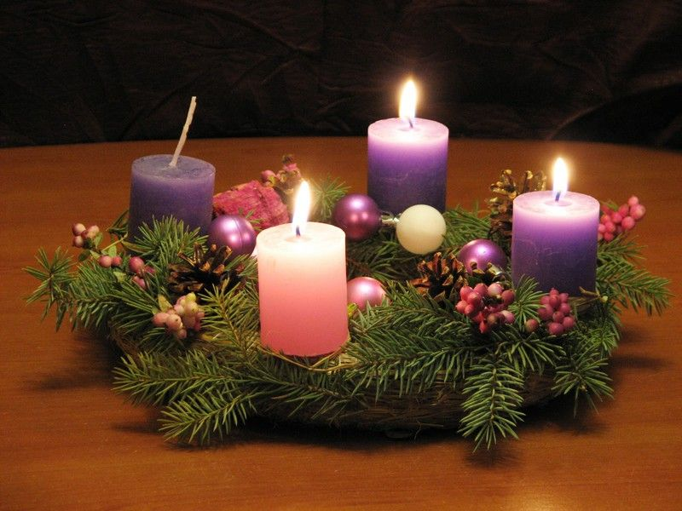
ADVENT
The time when we are preparing for the holidays
We usually make a wreath with candles in traditional colours:
3 purple and 1 pink= it symbolises the joy

Slide 3
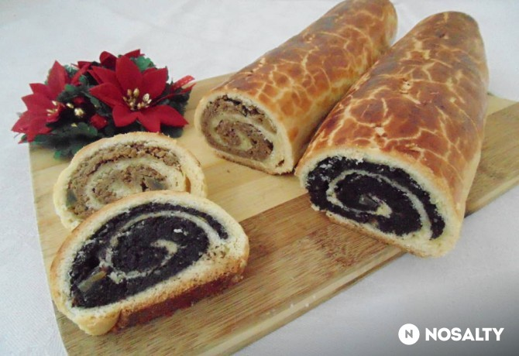
PREPARING
In our school there is a program called Soul Day
We have presentations, mass, we sing together
The wreath of classes are blessed by the „school priest”
Another program: „Kincskereső” = Treasure hunting
We make and sell handmade products
We bake waffles, cook punch (without alcohol :D)
We decorate gingerbreads
We listen to Christmas carols
At home we bake gingerbreads and beigli

Slide 4
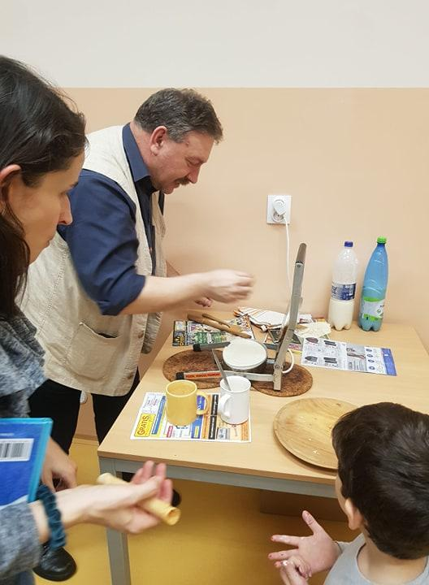
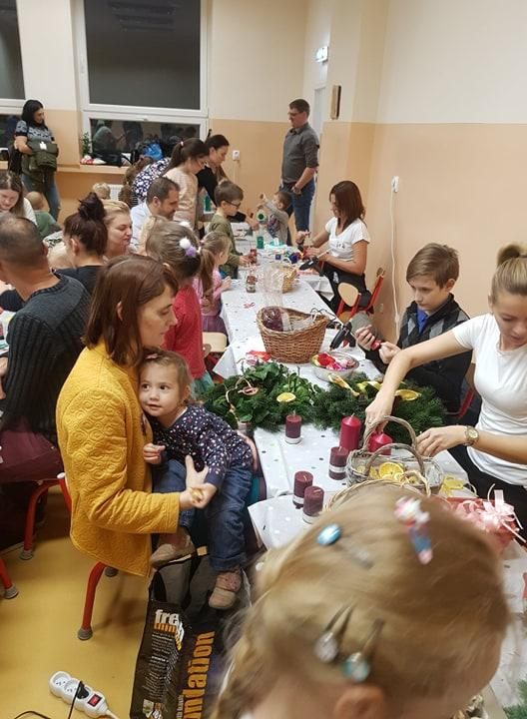
PREPARING
Soul Day

Slide 5
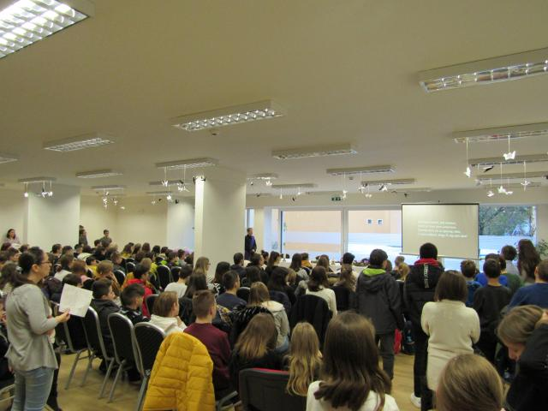

Slide 6
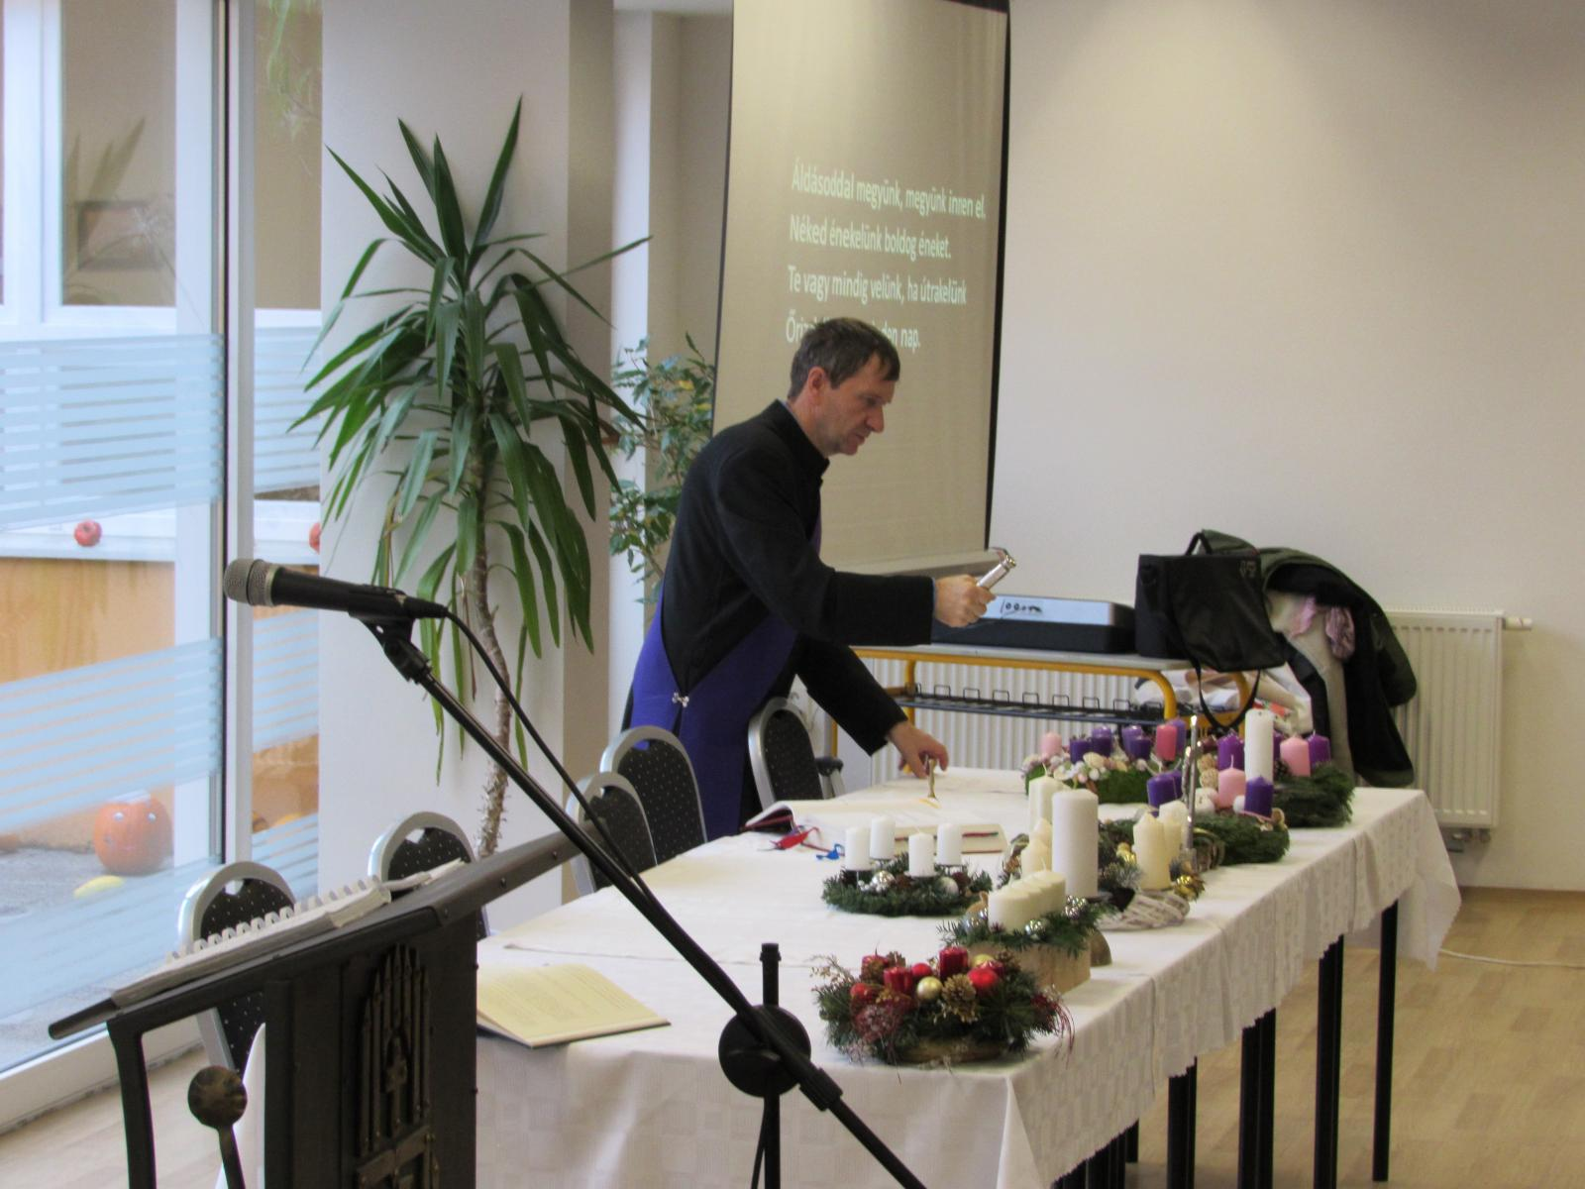

Slide 7
GINGERBREADS
Ingredients
honey
flour
sugar
butter
cinnamon
baking powder
And for the cream:
sugar
egg white

Slide 8
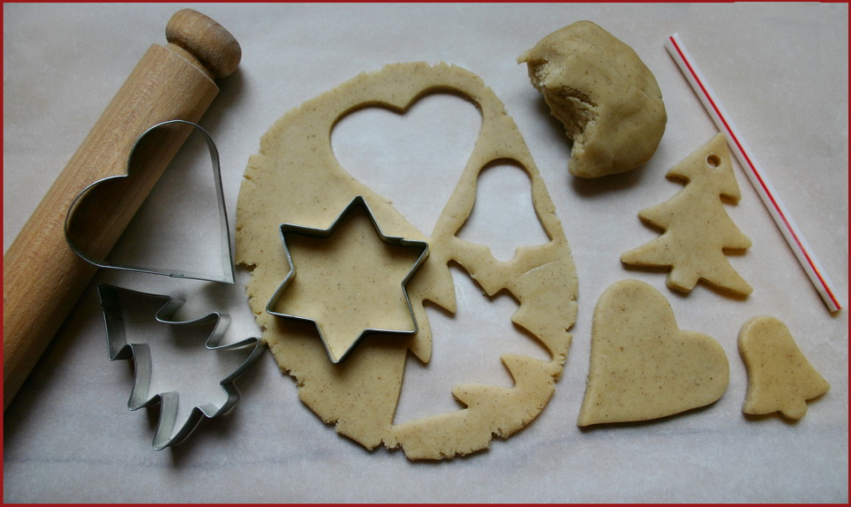
Traditional cookies

Slide 9
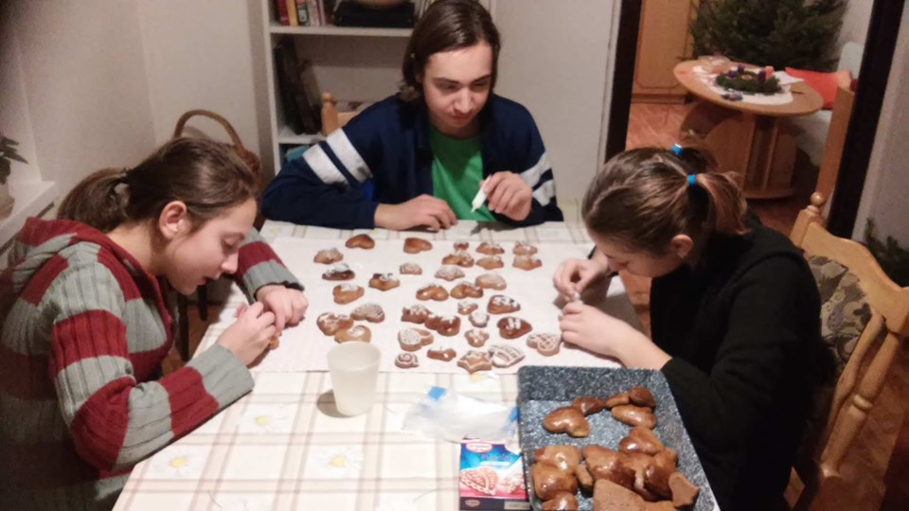
Connets the family

Slide 10
DECORATING we used to decorate our rooms (at the school dorm, too)

Slide 11
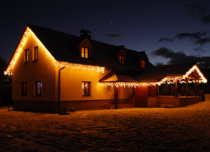
… also the whole house (interior-exterior)

Slide 12
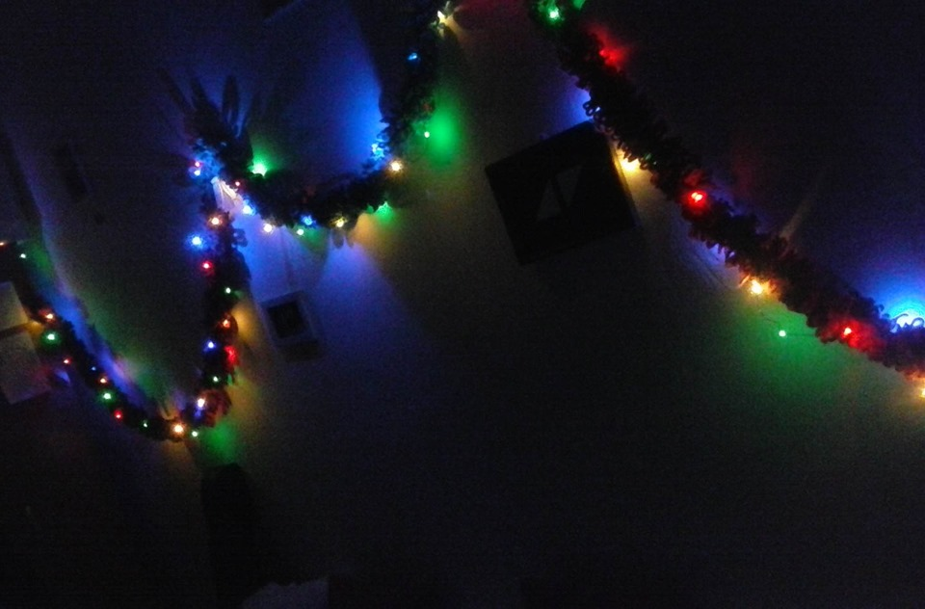

Slide 13
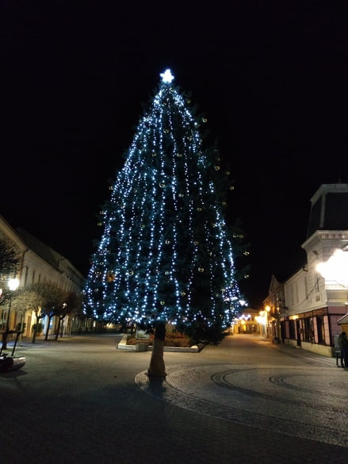
TOWN is in lights as well

Slide 14
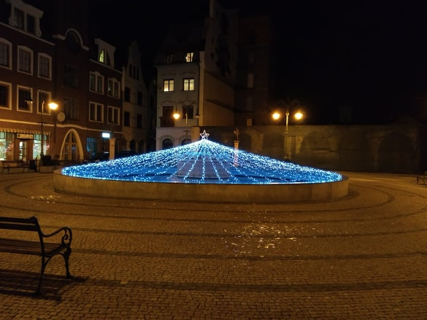
Komárom – Europa yard

Slide 15
HOLY NIGHT

Slide 16
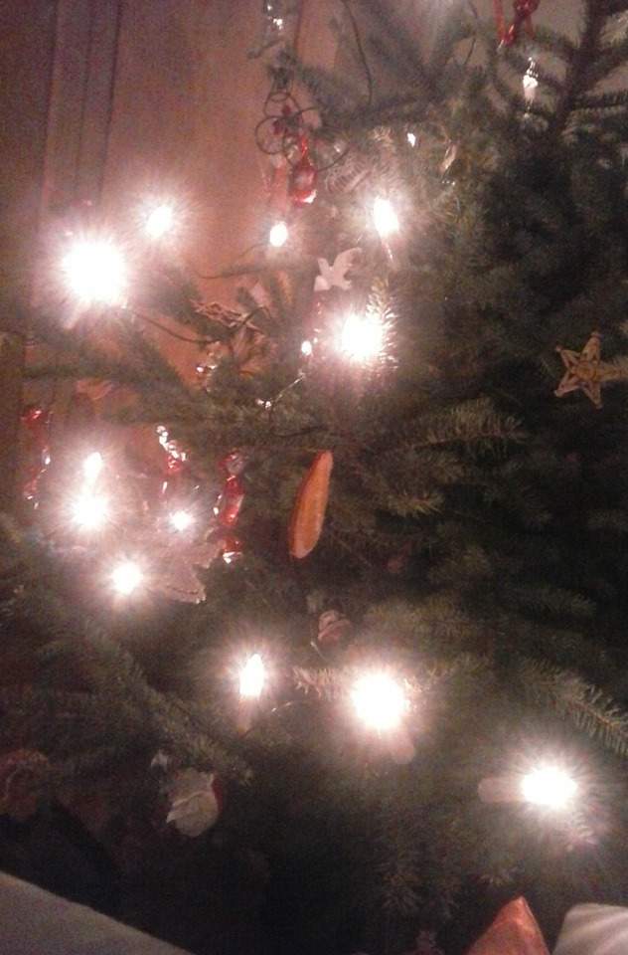
CHRISTMAS TREE

Slide 17
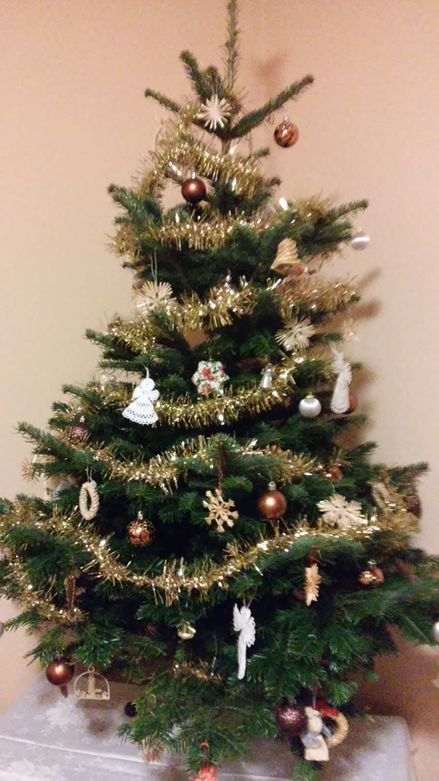
We love living trees
We decorate our tree on 24th December
We usually hang on it:
Handmade decorations, as: angels, gingerbreads, wooden ornaments
Christmas balls
Garlands
Lights
Dried oranges
On the top: a star
Fondants
Under the tree we place our gifts

Slide 18
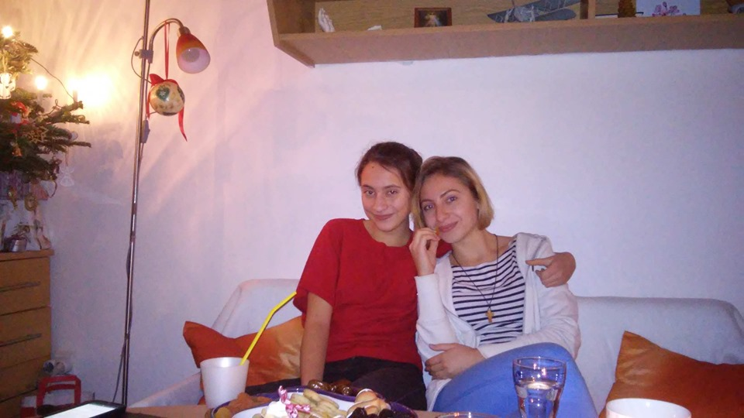
This is the tree ☺

Slide 19
TRADITIONAL DINNER
On the Christmas Eve (Holy Night) we eat together with our family
We used to slice an apple for every member of the family= we belong to each other
We used to eat walnuts as well.

Slide 20
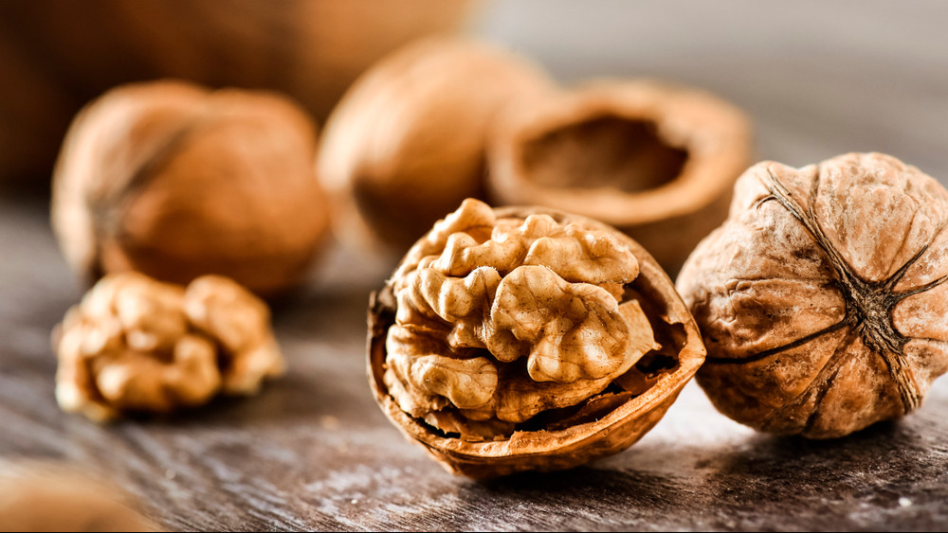

Slide 21
THE MENU
Traditinally fish soup

Slide 22
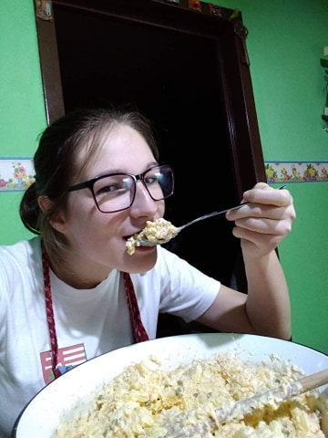
Potato salad with mayonnaise

Slide 23
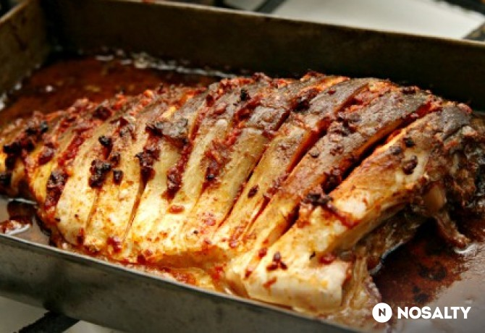
Roasted carp

Slide 24
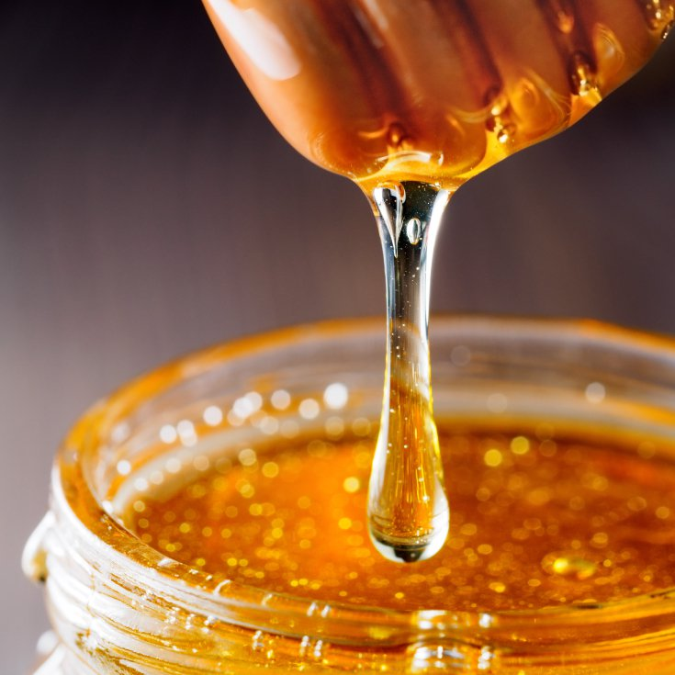
After the dinner we eat waffles as dessert with honey

Slide 25
PERFORMING
Our school choir „Schola Mariana” has a lot of performances during the time of preparing
We sing:
Christian, gregorian songs
Famous Christmas carols
Notes:
INCLUDES A VOICE FILE!

Slide 26
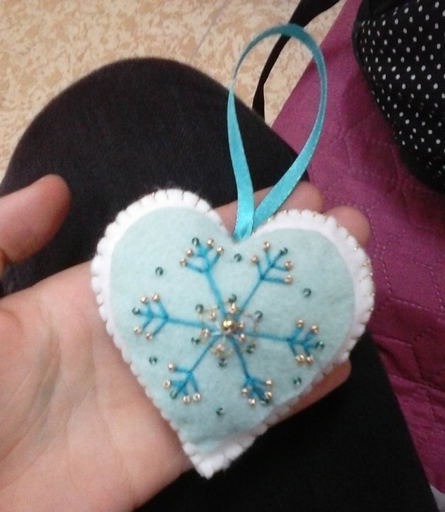
OPENING GIFTS

Slide 27
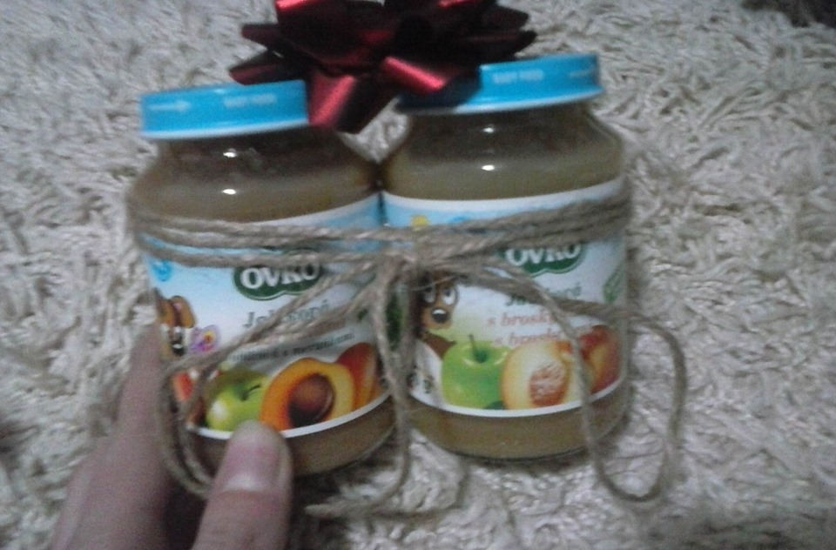
We love handmade gifts more, which are coming from heart
We usually buy only „experiences”
We open gifts at evening on 24th December

Slide 28
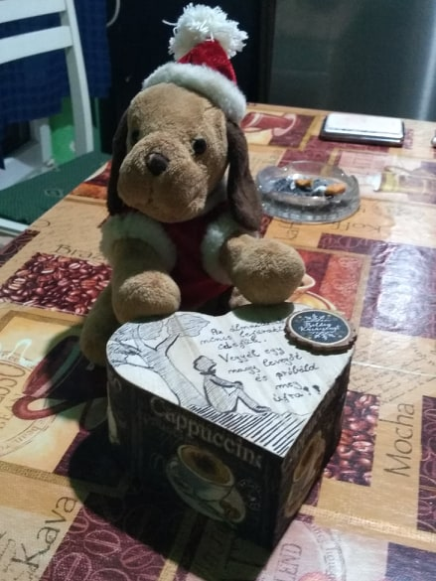

Slide 29
HOLY MASS at MIDNIGHT

Slide 30
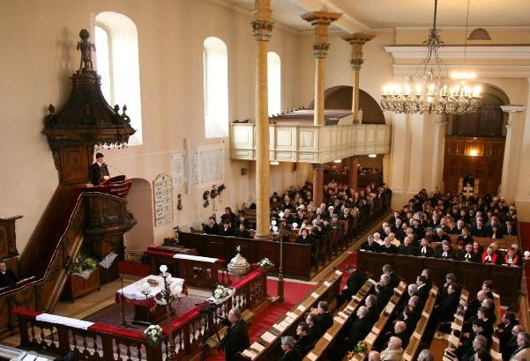
PROTESTANT WORSHIP

Slide 31
25th DECEMBER

Slide 32
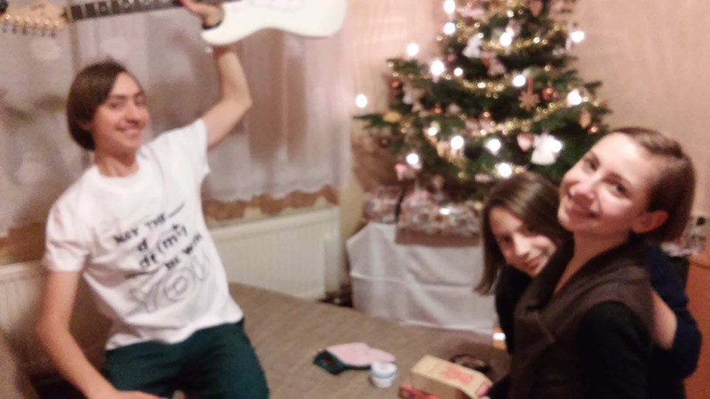
We spend this day visiting our relatives

Slide 33
THANK YOU FOR YOUR ATTENTION!

