Slide 1
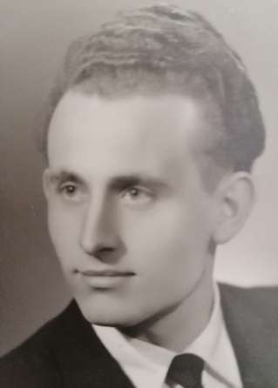
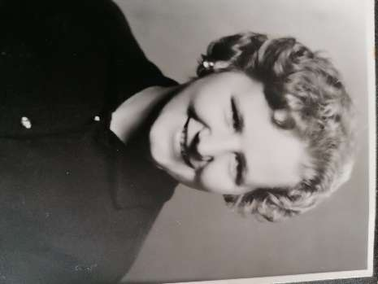
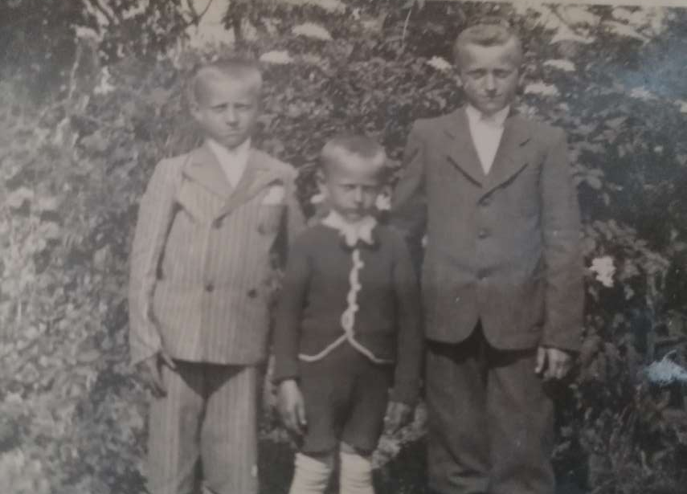
In this small presentation, I’d like to write about my grandparents from my mothers lineage. My grandfather´s name is Ferenc Kiss, he was born in 1936 on the 9th of April. My grandmother´s name is Kiss (born Gál) Matild, and she was born in 1944 on the 13th of September.
Both of my grandparents are from a small village called Egeg, as we like to say it in Hungarian, it’s somewhere behind the „God´s back”.
My grandfather was born into a poor peasant family as the youngest of 3 children. He always tells me, that he had a nice childhood, (even though it was rough because of the war about which he used to tell me stories when I was younger.)
He was 3 years old when WW II broke out. Many of his friends and acquaintances died during these times, and there was more than one case when he almost died too.

Slide 2
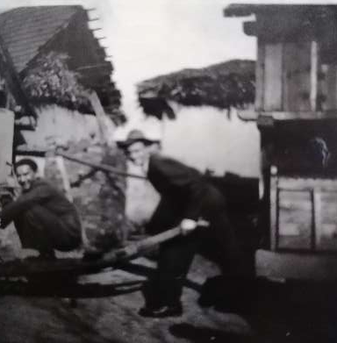
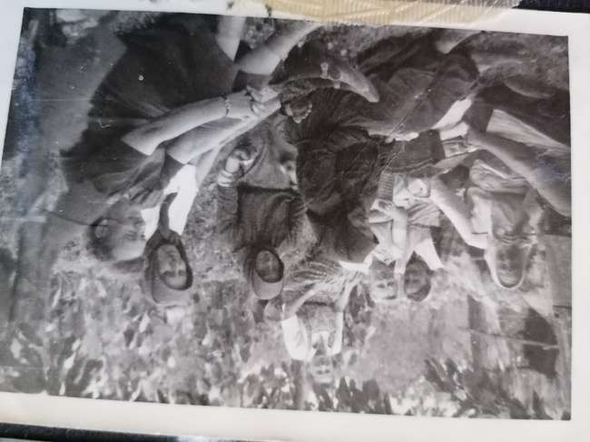
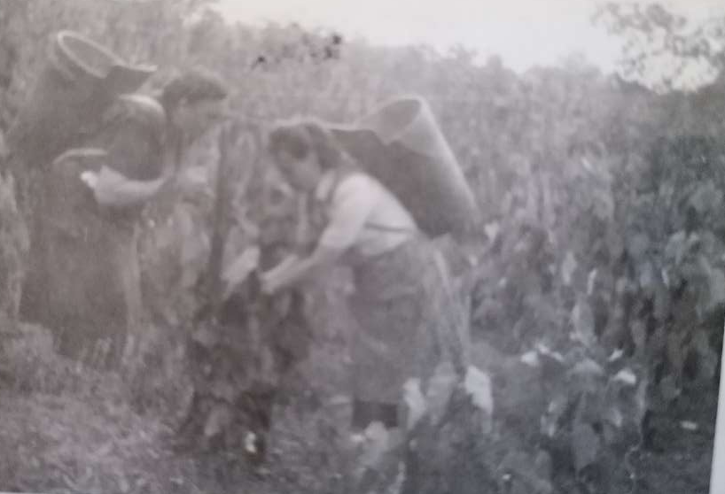
During the war the village was often „switched” between the Germans and the Soviets, depending on which army pushed back the other. These times were harsh, families broke apart, the villages were robbed, young maidens tried to appear old, so that they wouldn’t appeal to the soldiers. Sadly this didn’t work out many times and they got raped.
My great grandfather used to make brooms and candles for winter, however when the village was occupied by the Soviet forces, suddenly the brooms started to dissapear one-by-one. There was a Soviet tank in the garden of their house at that time. My grandfather couldn’t stand this, so he hid somewhere in the garden, and saw that one of the Soviet soldiers is stealing the brooms. The other day, he sneaked into the tank and tried to take back the brooms and the candles, but one of the soldiers grabbed him by the neck and threw him right into the fresh snow, he was lucky that he got away with that much.
Another time my grandfather got dressed up by the soldiers as one of their own, they put a rifle into his hands. In the other room Soviet officers were drinking, and having fun. The soldiers, who dressed up my grandfather, made him yell „Heil Hitler!” to the now drunk officers, one of them pointed his gun right at my grandfather, but luckily one of the soldiers quickly dragged him away from door, so the officer shot the wall.

Slide 3
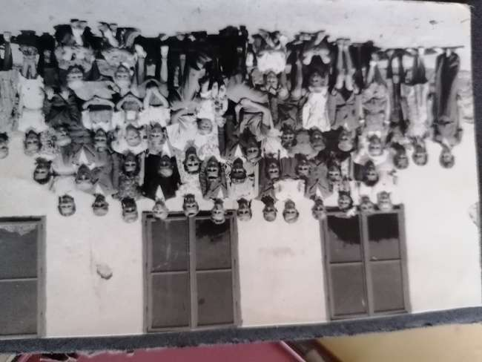
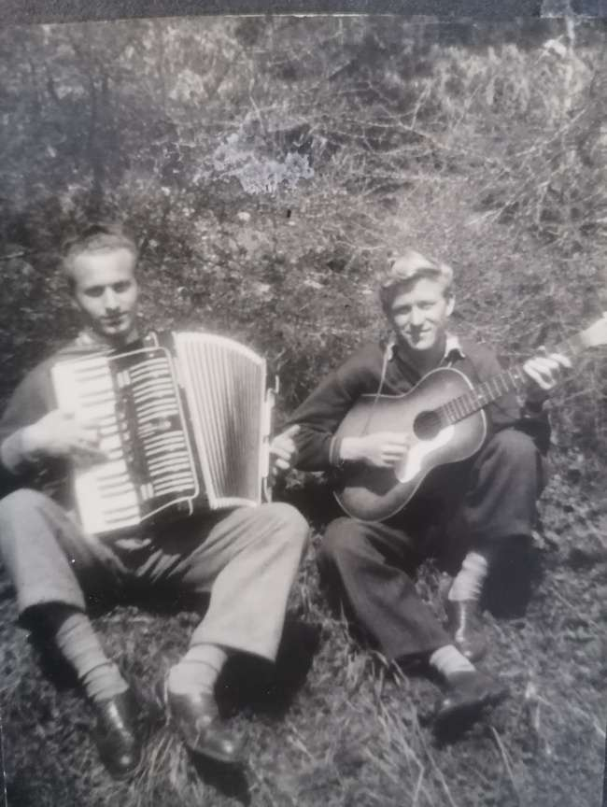
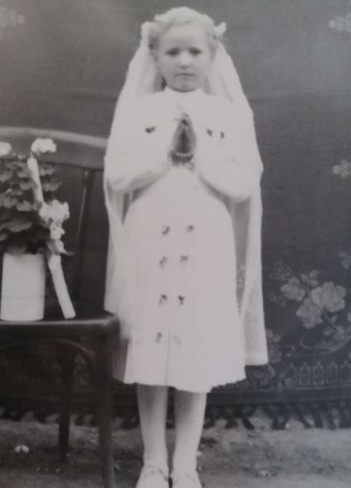
When the war ended, the horrors didn’t end there. Many people from the village (to my surprise mostly women) were deported to the Czech Republic. My grandfather´s family was deported as well, they had already packed their belongings, and were waiting for the train, but for some reason they didn’t have to go, so they stayed in the village. Even the deported women were brought home by one of the villagers, who spoke Czech.
My grandfather safely finished primary school in the village. Even though, he had a „happy” (kind of) childhood, he always wanted to get far away from home. He started to attend a teachers college in Rozsnyó at the age of 17 and this is the place where he was during the revolution of 1956. He said that one of their teachers came into the classroom - crying. The stundents asked him, if he was feeling sick or something, but the teacher replied : „ No my sons, the crimson blood of Hungarians is gushing. On that day the students marched up to the main square of Rozsnyó, however the police escorted them back to the school.
He set his eyes on my grandmother when she was only 15. Both of them were cheering for the local football team, that’s where he first saw her. That was the place, where he decided, that she’ll be his wife. He always told me, that he really liked, how she always smiled, and was very kind to everyone.

Slide 4
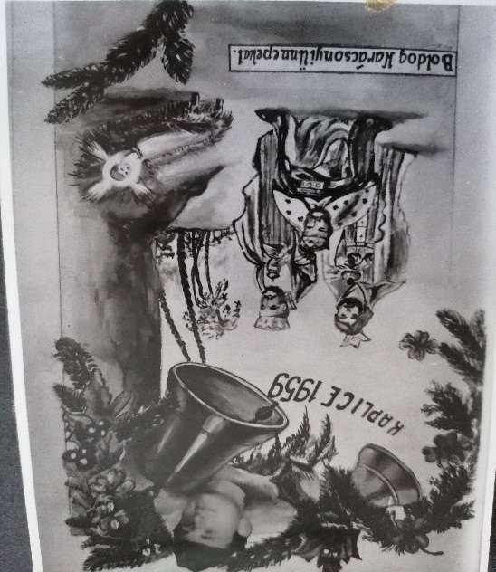
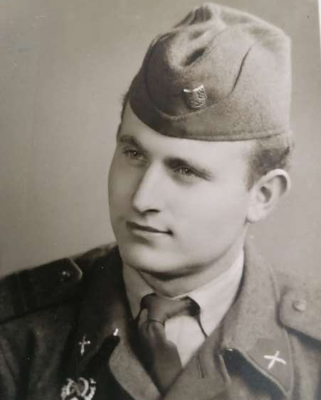
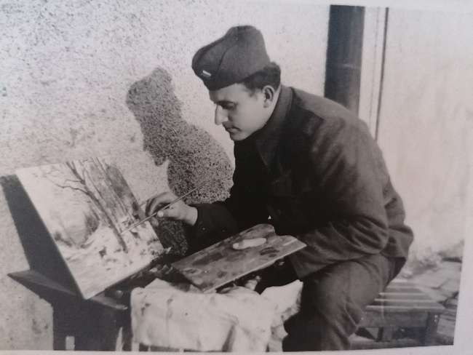
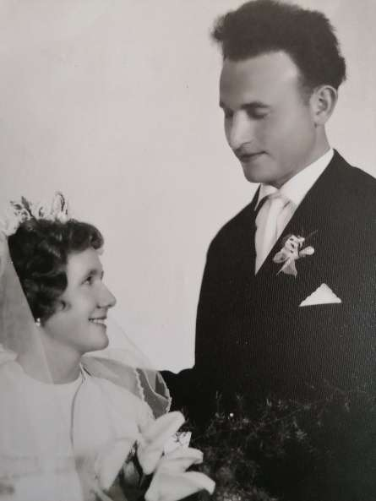
Even though my grandfather hates war, he loved being in the military, although it wasn’t easy either. He got enlisted when he was 22, he became a corporal. He had to watch over the soldiers, so that they wouldn’t desert or go stealing to the nearby villages. There was a soldier, who couldn’t pay in the inn. He told my grandfather, that he’d only go to the neighbouring village to get the money. My grandfather let him go, but the soldier tried to get to Austria (they were close to the border). Luckily they caught him in the forest, and my grandfather wasn’t punished.
My grandfather always loved music and art. He started painting at a very young age, however he really got into it, while he was serving in the military. He would paint 5-6 paintings a week. He usually painted our home village, or just the nature. He really loves to play the accordion as well. It’s one of his favourite musical instrument, however he can also play the organ, the piano and the violin.
He’s been wooing to my grandmother for 8 years. When he got back from the military, he had been waiting for 4 years for my grandmother, so she could finish school before getting married. Both of them were teachers, so they had to get married in secret, because at that time teachers couldn’t go to church, otherwise they could’ve lost their jobs. They got married in May in 1964.(interesting fact: They had to redo the photos the other day, because my grandmother didn’t like how my grandfather looked like in the first ones.)

Slide 5
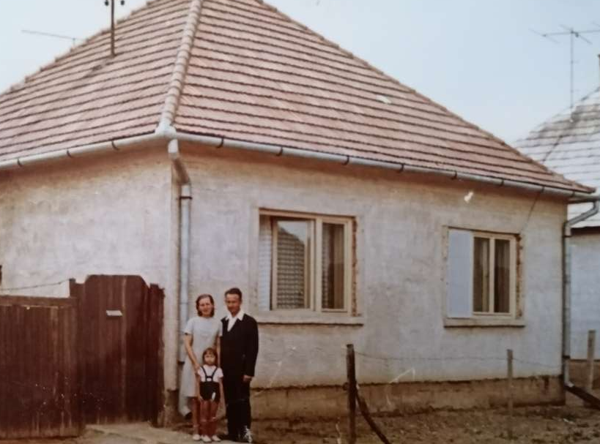
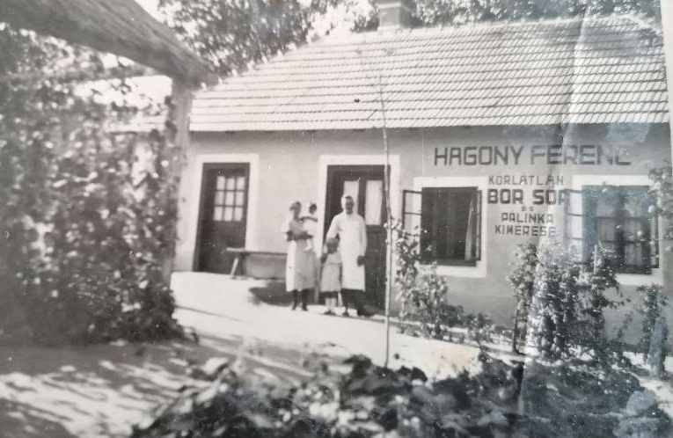
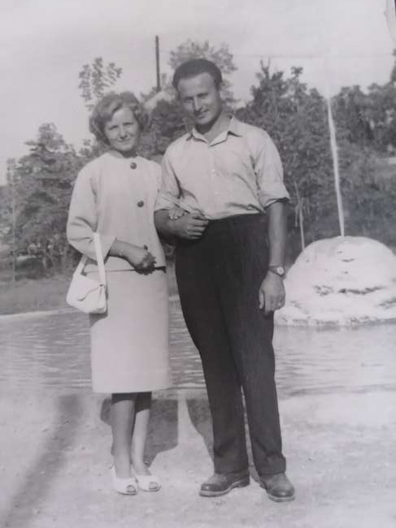
As I’ve mentioned earlier, both of them were teachers. My grandmother was a mathematician and physicist and my grandfather was the principal in a music school in Ság. He also worked as a cantor in the neighbourig city, and he also led multiple choirs!
They thought about moving to a bigger city next to our village (Ság) but they loved their home village so much that they settled there. First they didn’t live in their own house, but they were dreaming about building one, which they did. It was their dream home, just as they had imagined it, with a nice big garden.
My grandparents occasionaly visited our relatives in Hungary, who were deported during 45-48. They are living next to the Lake Balaton in Marcali. We’re still in touch with them. When I was younger, we visited them a few times.

Slide 6
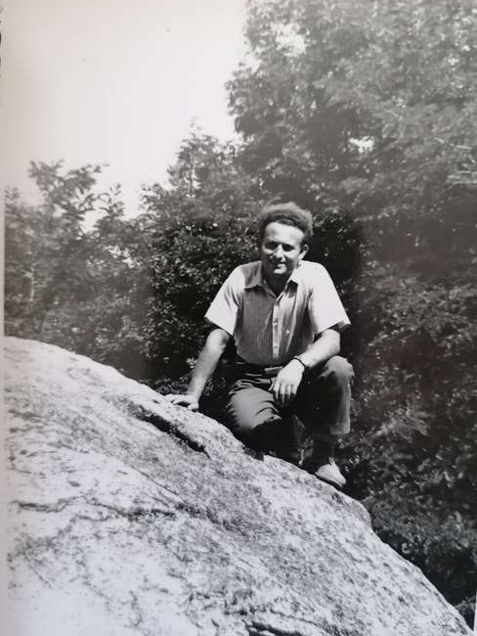
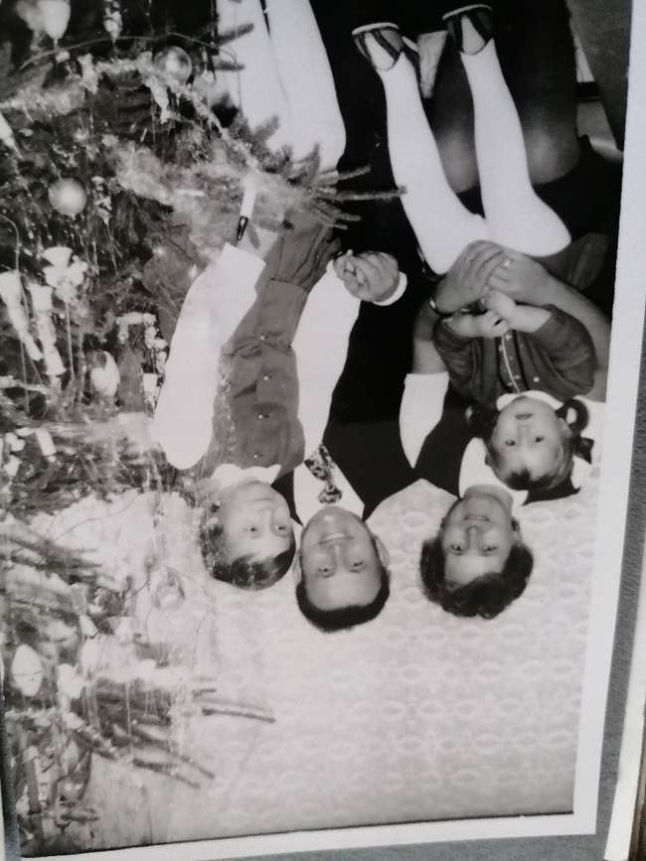
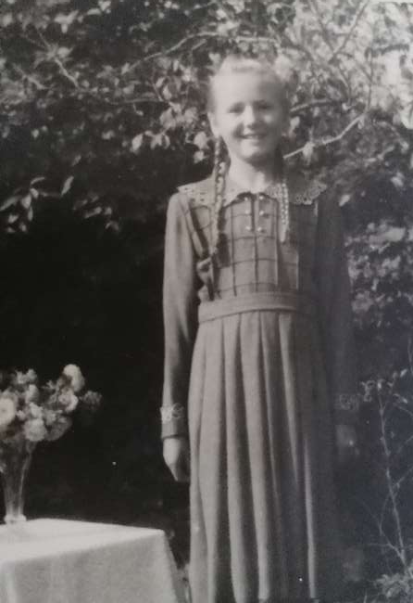
My grandmother gave birth to 2 beautiful girls (my mother and my aunt), and now they have 4 grandsons and 2 great-grandchildren as well. I can be thankful for them for so many things. When I was young, my grandmother was the one, who had taught me everything about religion, we would occasionaly pray together. I’m fond of cooking because of her. She would let me help her out in the kitchen since I was 1-2. (yes, I could walk from a very young age)
And thanks to my grandfather, each of his grandsons can play at least one musical instrument ( two even became musicians at a younger age). When I was little, he was the one, who taught me to respect and love nature, and the people around me.

Slide 7
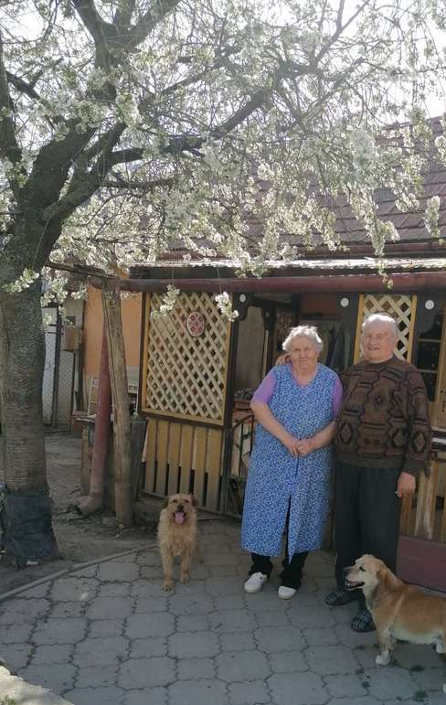
Now, my grandfather is 84 and my grandmother is 75 years old and with the God´s help, they are going to celebrate their 55th marriage anniversary !

