Slide 1
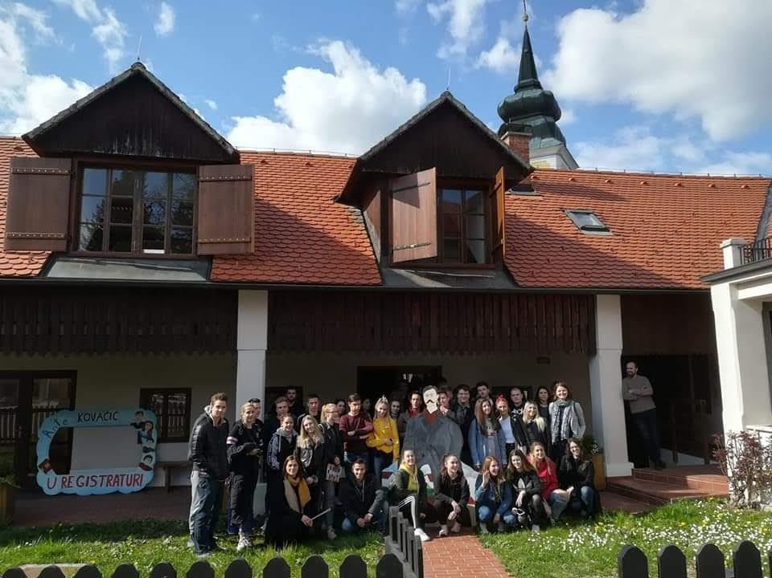
Ante Kovačić – Why He Should Be Remembered
Flipped and Outdoor Learning

Slide 2
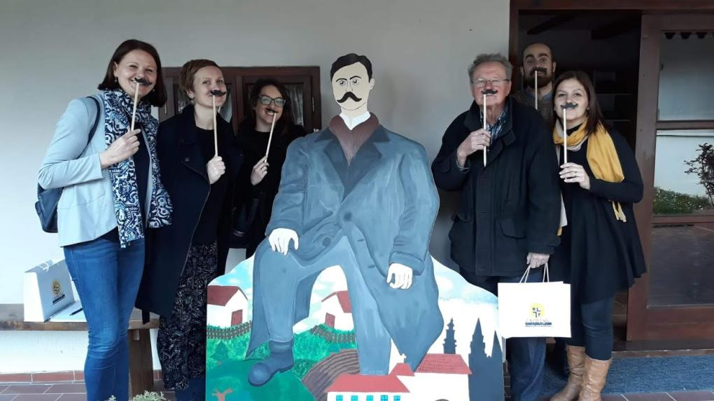
Who is Ante?
a famous Croatian writer from 19th century who lived and worked in our town

Slide 3
Participans
High School Ban Josip Jelačić, Zaprešić
Elementary School Ante Kovačić, Marija Gorica
Municipal Library Ante Kovačić, Marija Gorica
City Library Ante Kovačić, Zaprešić

Slide 4
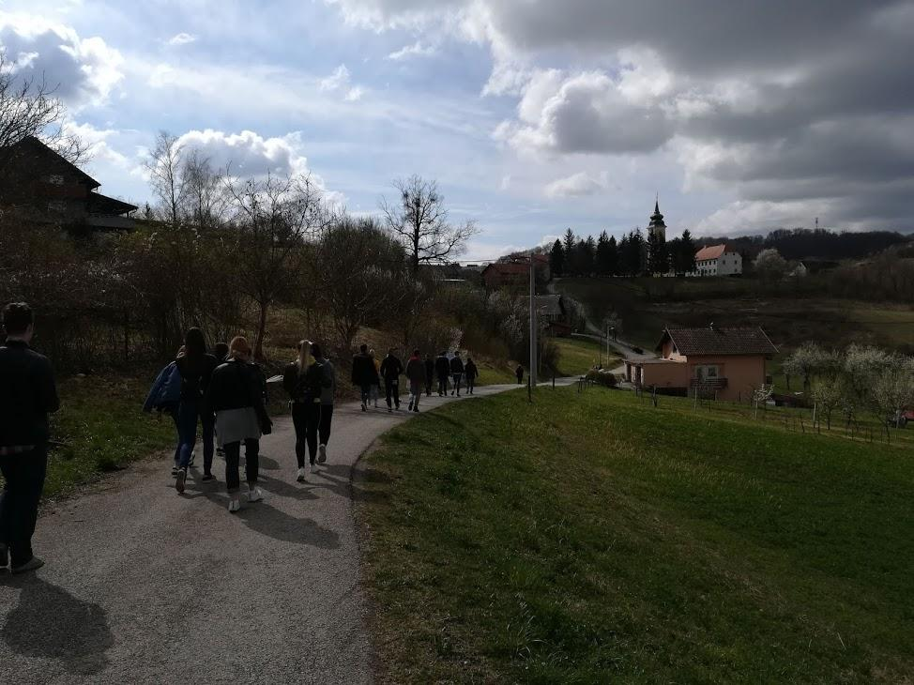
Why we did it this year?
130 years since the publication of the novel
Ante Kovačić U registraturi.
We love outdoor learning!

Slide 5
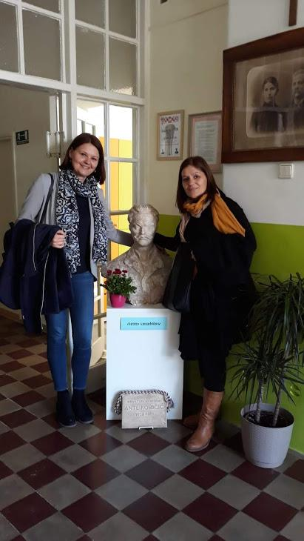
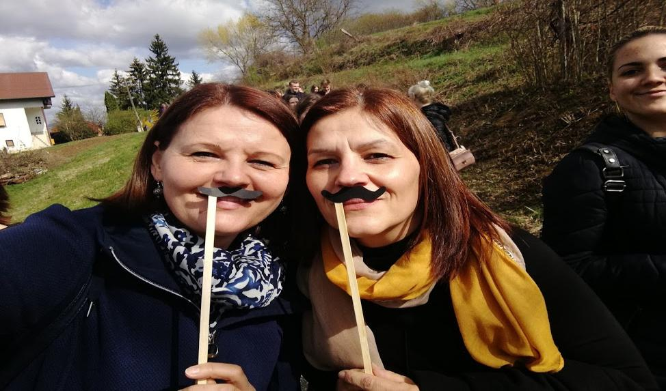
Subjects included in this project
Croatian Language and Literature
novel U registraturi
(In the registy Office)
TV series U registraturi
Politics and Economics
political parties in 19th Century
Notes:
Političke stranke u 19. st.

Slide 6
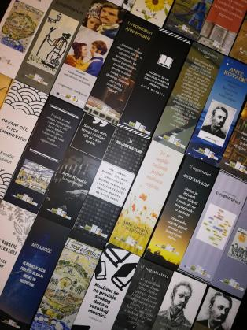
Activitis for outdoor learning of 3rd grade Gymnasium and Hotel-Tourism Technicians
H
posters and Bookmarks in aplication Canva
painted characters from the novel on wooden
boards
acting scenes from the novel
mental maps in aplication Mindomo
Comics
short movies: A Story from the registry office
Political confrotation
political speaches

Slide 7
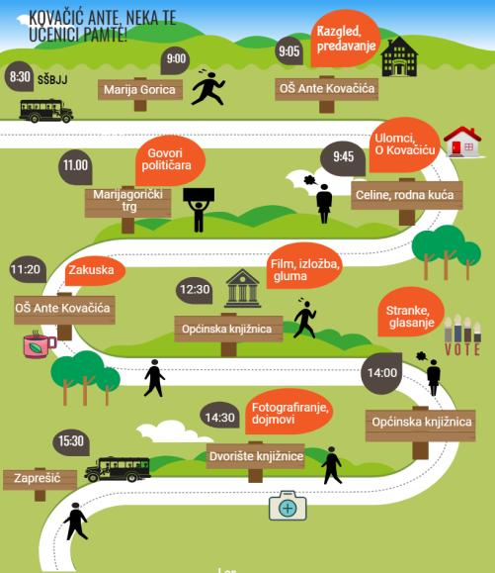
Where we were and what we were doing?
Notes:
Gdje smo bili i što smo radili?

Slide 8
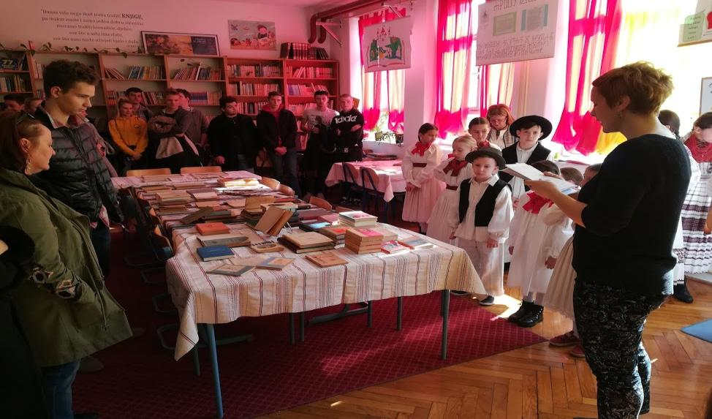
Elementary school where Kovačić worked - a brief lecture on Kovačić and a tour of his books
Notes:
kratko predavanje o Kovačiću i razgledavanje njegovih knjiga

Slide 9
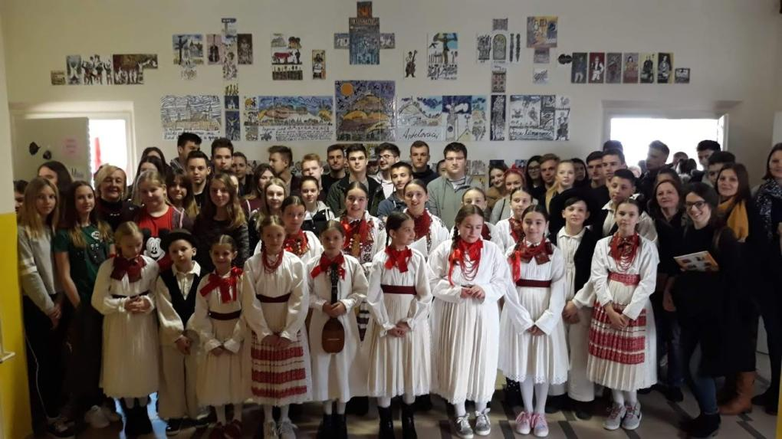
KUD Zgubidan – an orchestra which plays traditional music
Notes:
KUD - kako to prevesti?

Slide 10
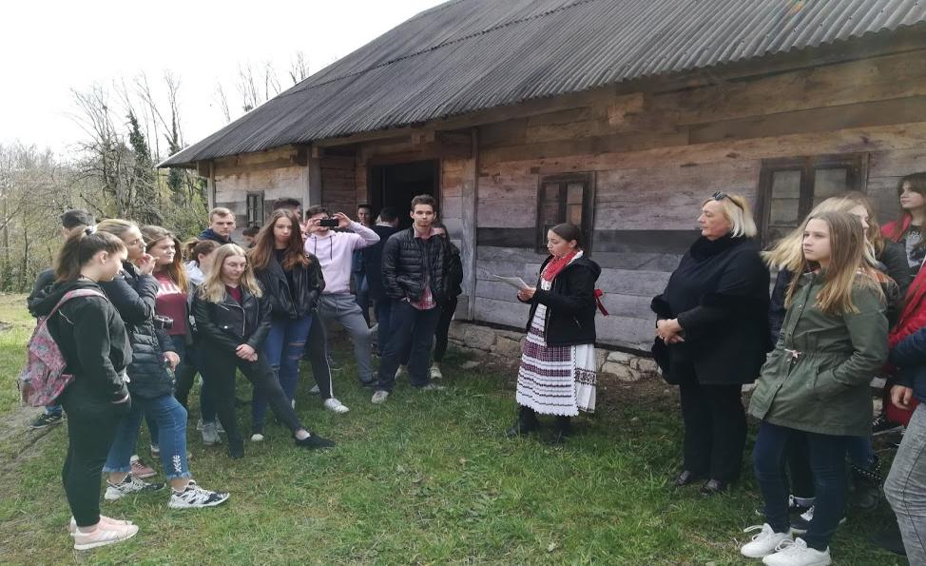
the birth house of Ante Kovačića
reading fragments from the novel
Notes:
Rodna kuća

Slide 11
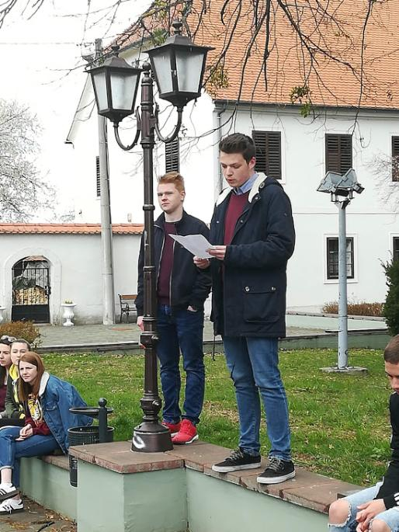
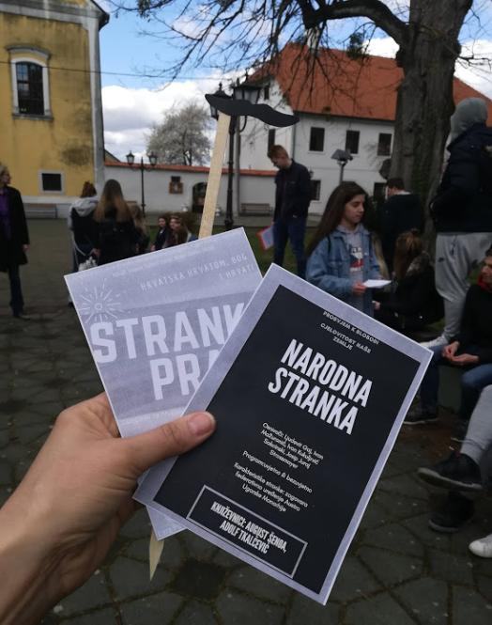
Political speaches
Notes:
politički govori

Slide 12
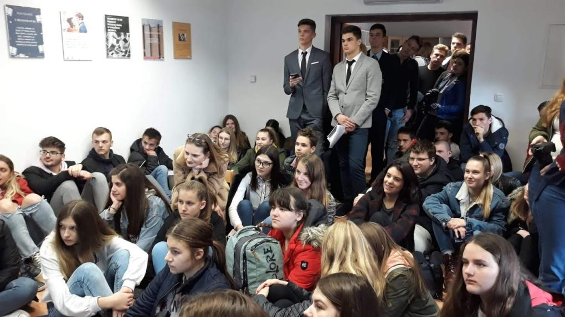
Town Library
Notes:
Općinska knjižnica

Slide 13
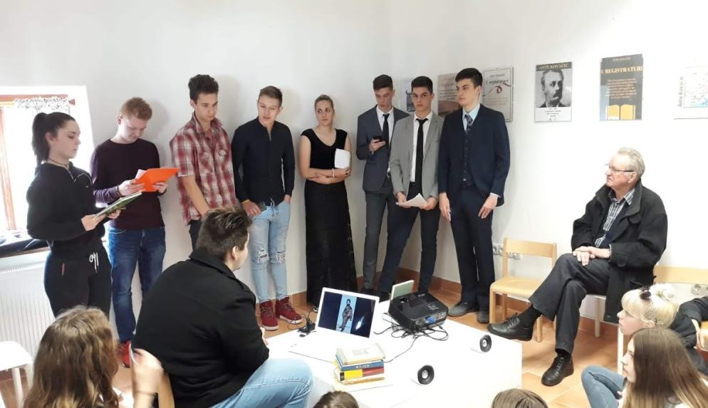
Students presented on their own

Slide 14
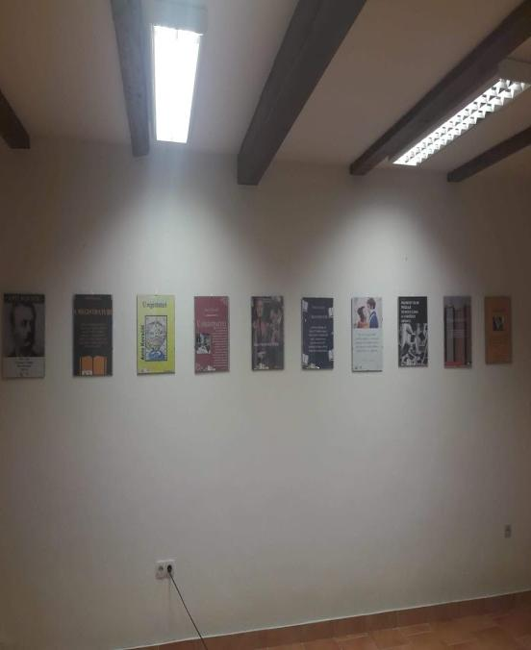
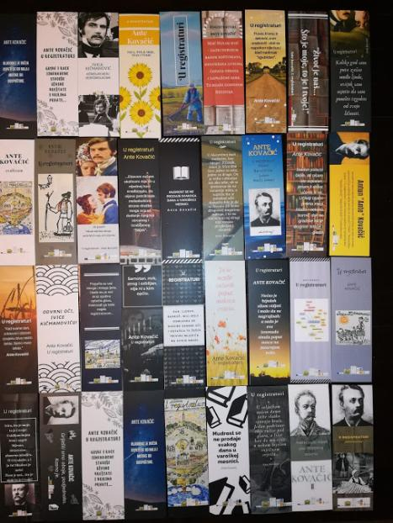
Exihibition of Posters and Bookmarks

Slide 15
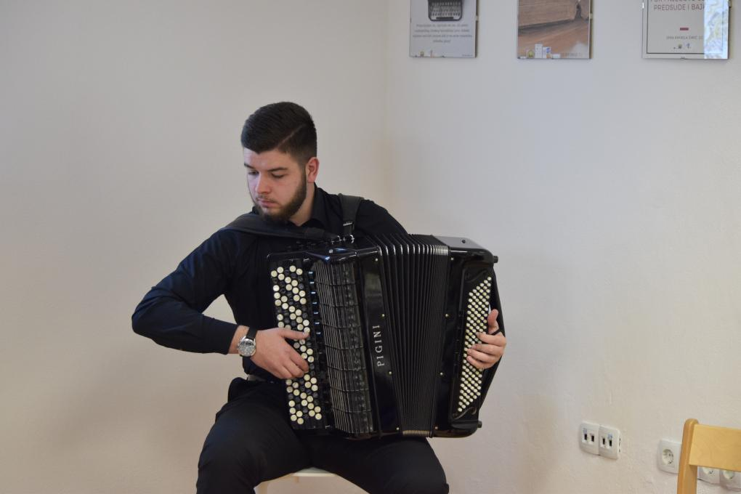
Musical intermezzo from the film
Notes:
Music from the film on harmonics

Slide 16
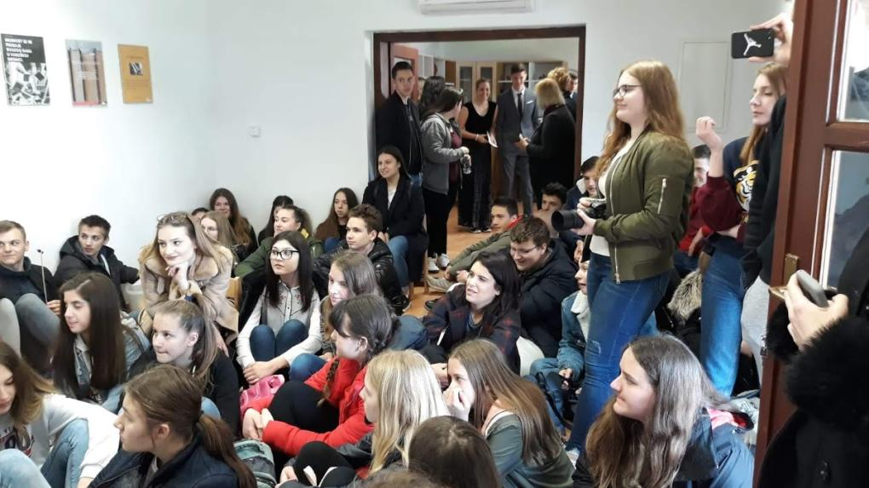
Movie presentation
Notes:
Movie Presentation

Slide 17
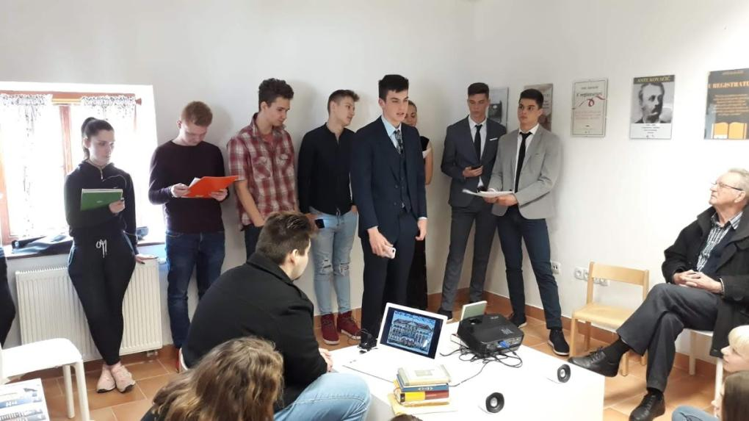
Acting
Notes:
Acting

Slide 18
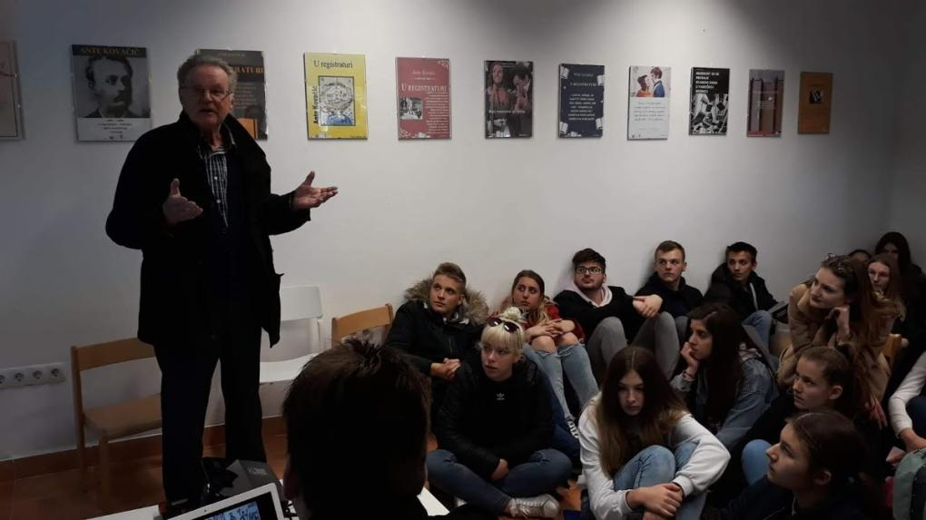
Interviewing the Guest

Slide 19
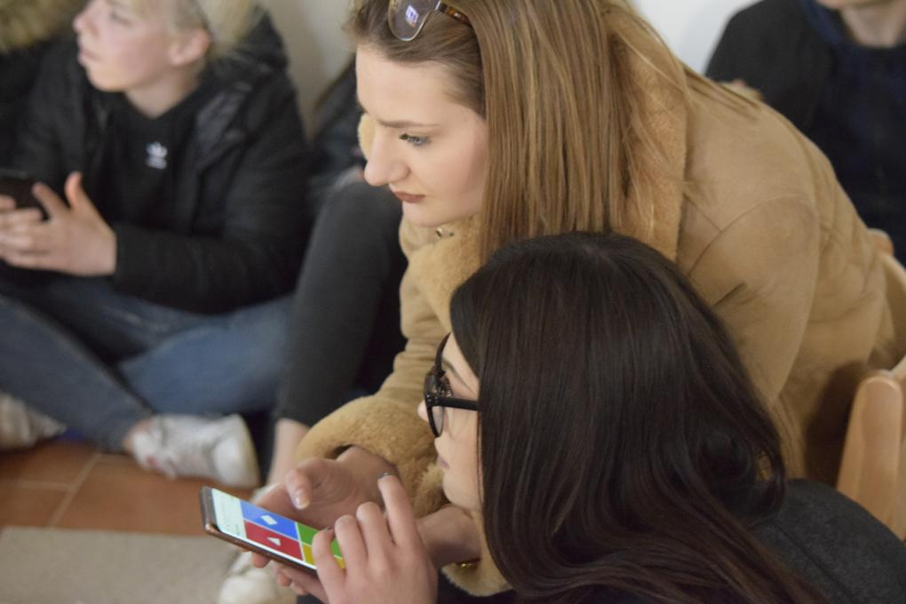
A quiz

Slide 20
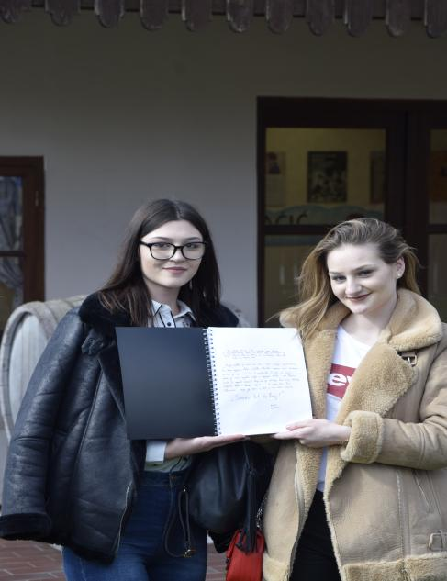
A book of Impressions
Notes:
A book of impresions

Slide 21
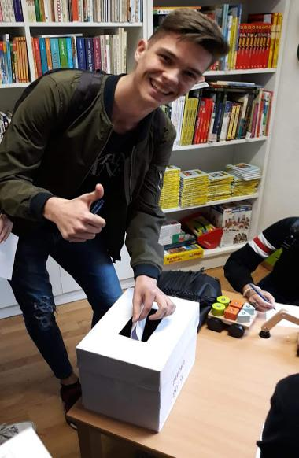
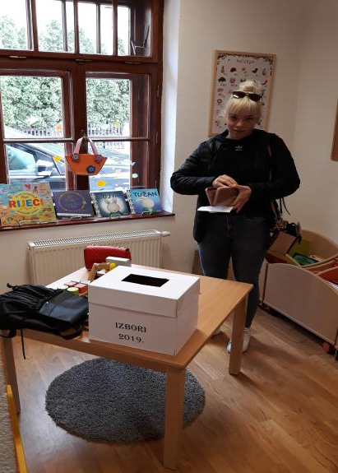
Voting
Notes:
glasanje

Slide 22
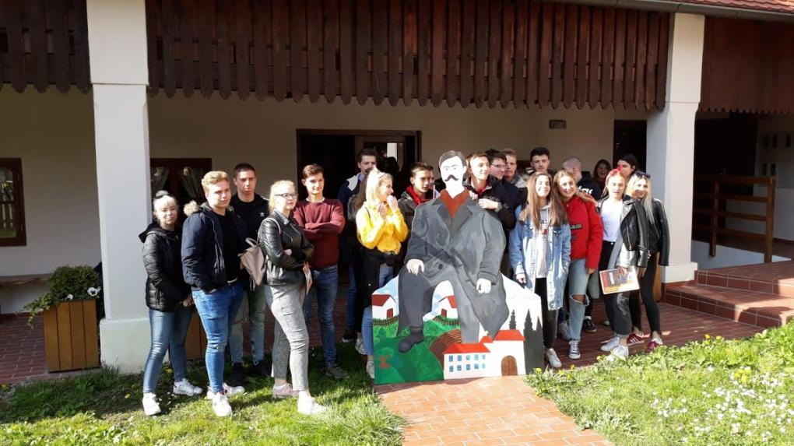
Making common pfotography
Notes:
Zajedničko fotografiranje

Slide 23
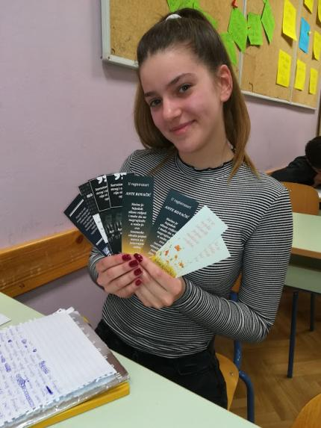
Outcomes
discover and connect the birthplace of Ante Kovacic with his way of life analyse the influence of A. Kovačić's birthplace on his life
Interpret part of a novel acting character role-play extracts from the novel
distinguish and critically reflect on the political parties of the 19th century
create movies, posters and bookmarks
use critical thinking when voting for the best party, the best bookmark, poster and the best actor

Slide 24
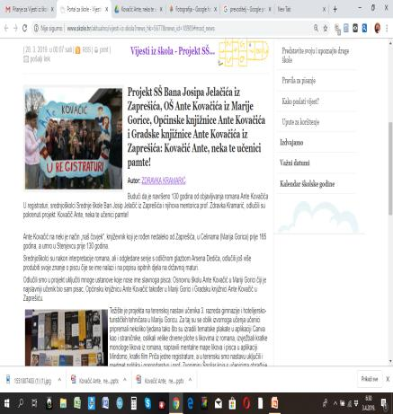
Disemination of the Project
Croatian School Portal
Facebook pages of Schools, museums…
Local Newspaperes
Notes:
Gdje se o projektu pisalo?

Slide 25
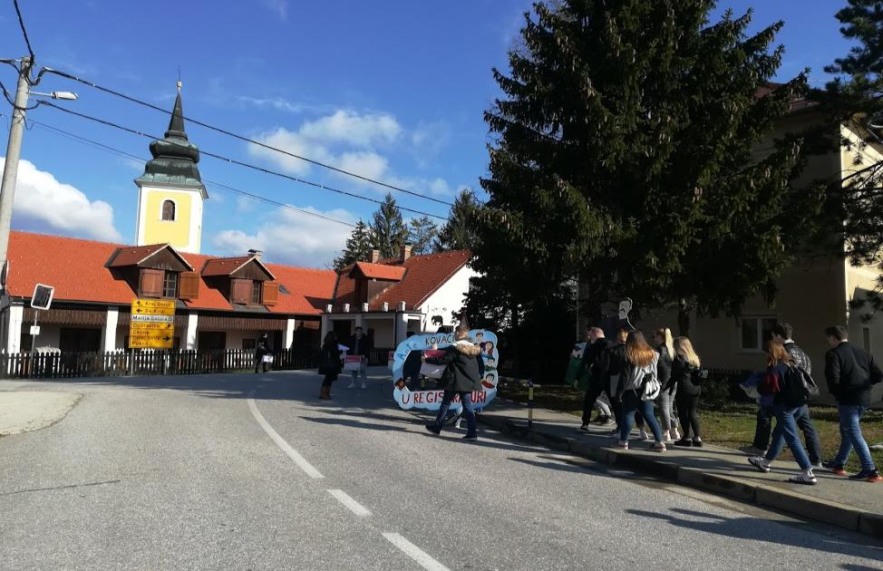
To understand and respect other cultures,
students must firs understand their own heritage!
Notes:
Da bismo razumjeli i poštovali druge kulture, učenici prvo moraju razumjeti svoju baštinu...

