Slide 1
FLIPPED CLASSROOM
Escola Básica e Secundária Dr. Ângelo Augusto da Silva
April 1st - 7th 2019

Slide 2
FLIPPED CLASSROOM
How to do it?

Slide 3
At home, students are introduced to content by using ict tools and practice working through it at school

Slide 4
In a flipped classroom – Marlene Ramos
Video lessons can be prepared by the teacher or third parties to deliver content although online collaborative discussions, digital research, and text readings may be also used.
In this situation, videos from YouTube were shared with students using a PADLET.

Slide 5
Out of the Class activities
- Watching Videos and PowerPoints at home
- Teacher/student online communication using PADLET

Slide 6
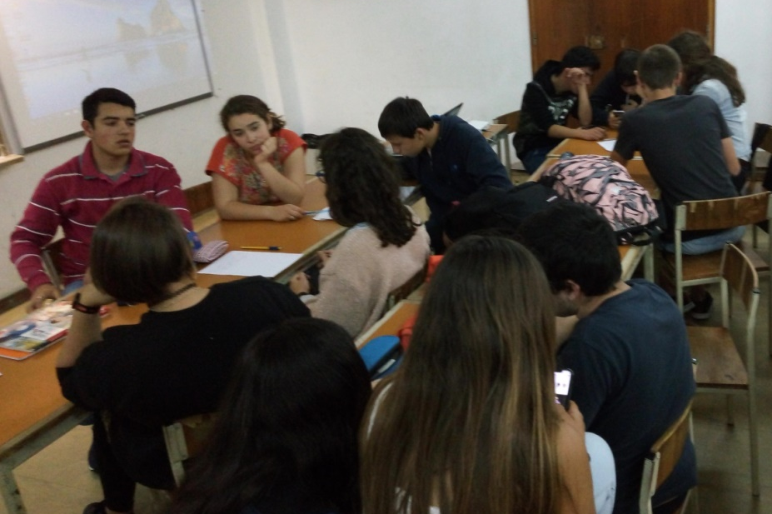
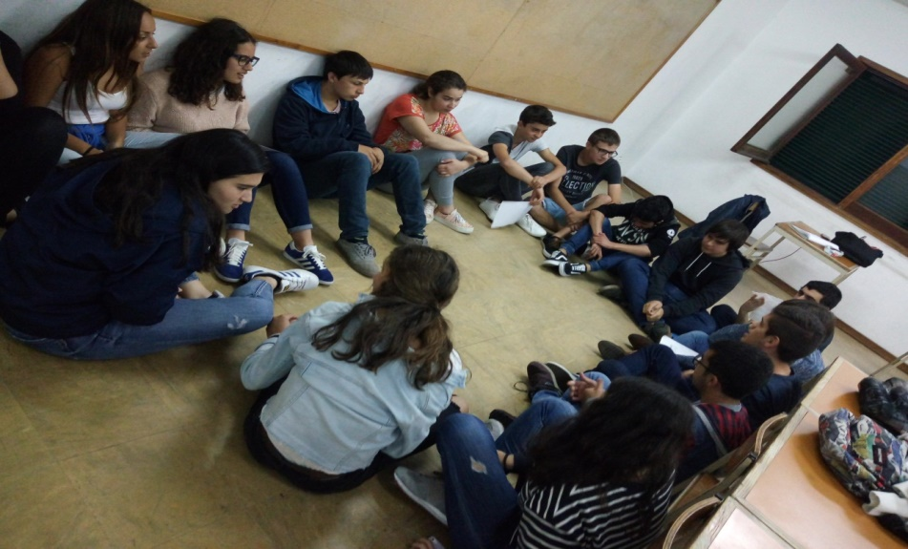
In Class activities
current event discussions – “Progress and environmental issues”
World-café - Participatory learning - Student discussion in the classroom –small groups interactions (student-student)
Big group discussion
Creating environmental slogans

Slide 7
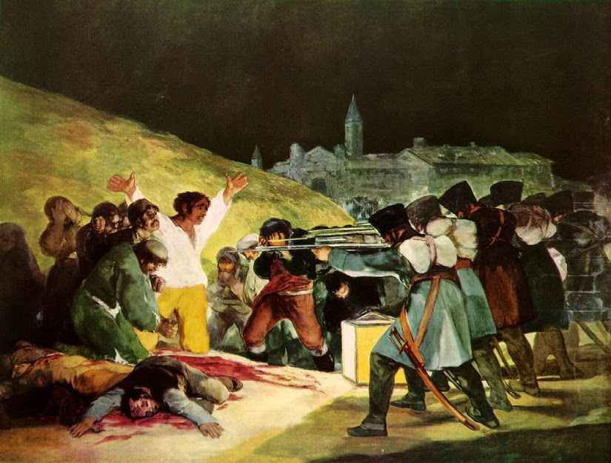
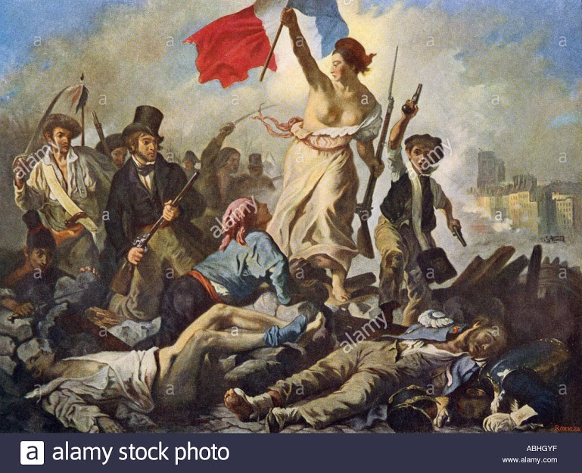
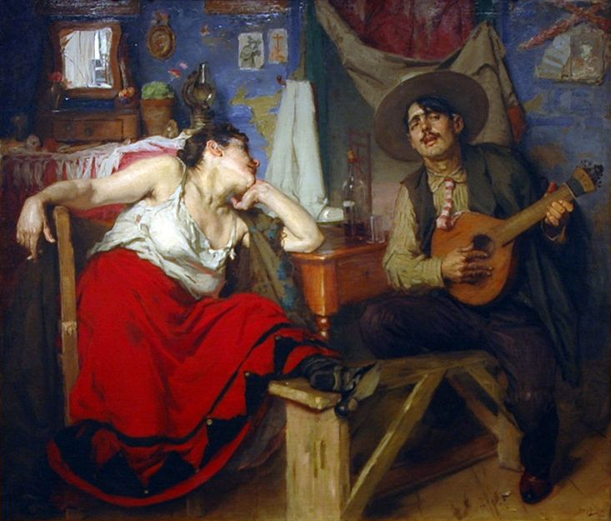
Research projects about Romanticism: A class of 11th grade students – History A – Laurinda Jardim
Romanticism was an artistic, literary, musical and intellectual movement that began in Europe towards the end of the 18th century,
Romanticism is one the contents of the subject of History A - Secondary Level, a specific subject to access university.
These and other inspiring documents were sent to the students by email:
Goya Delacroix Fado

Slide 8
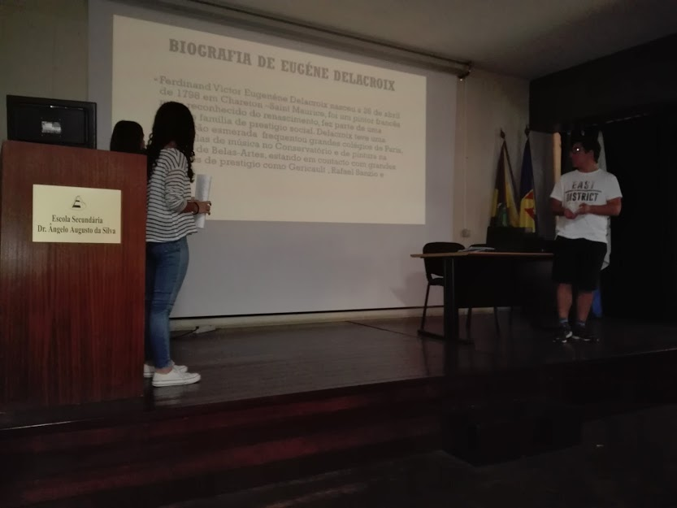
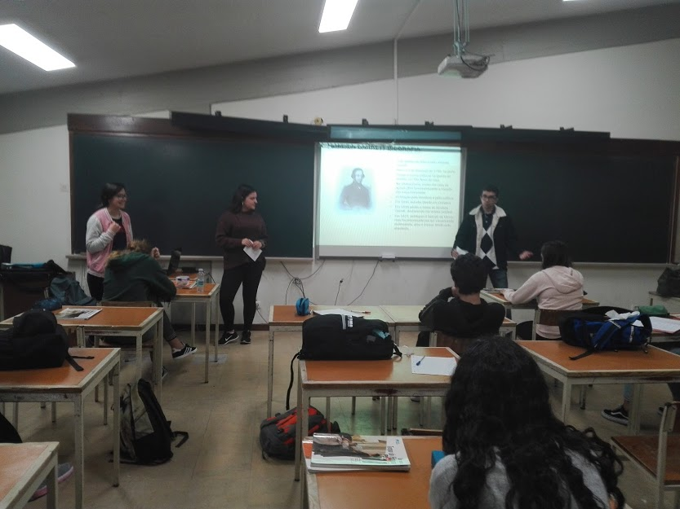
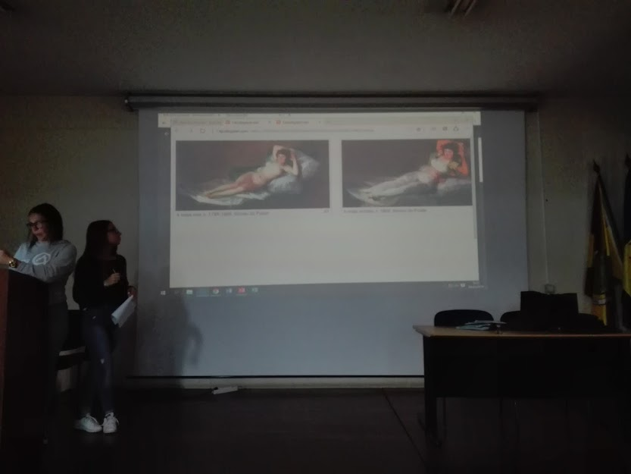
After a group research on the internet, students presented their assignment in classroom.
Using flipped classroom method, the students learned a lot about the theme and shared that knowledge with their colleagues. The teacher guided and evaluated their work.

Slide 9
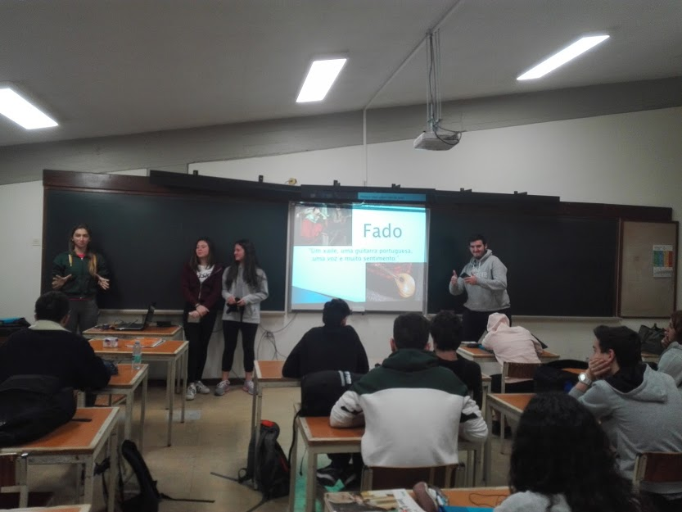
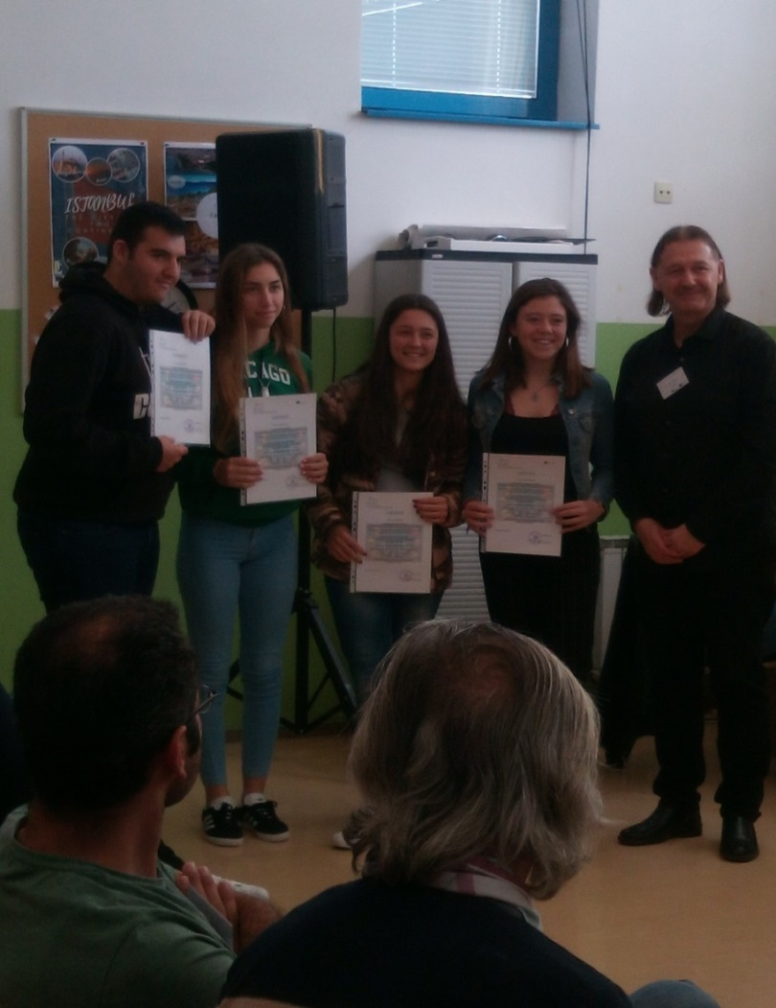
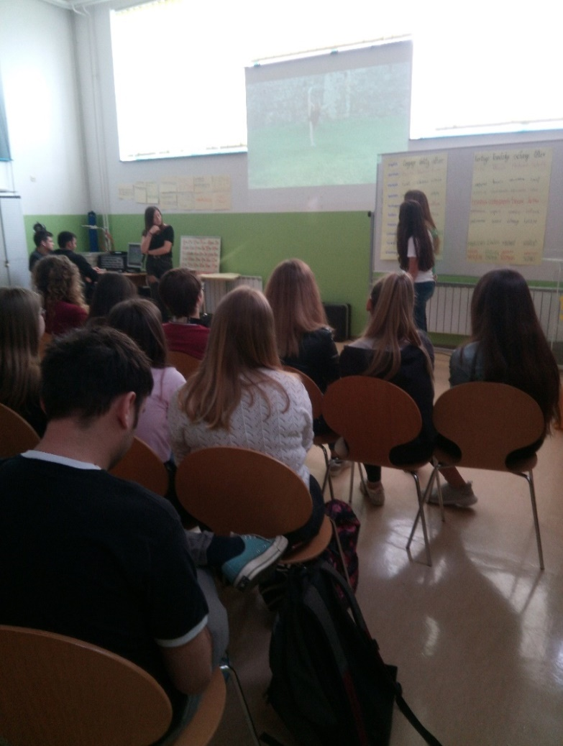
These works, specially the one about fado, which is related with Portuguese cultural heritage, aimed to prepare our presentation at this meeting in Zapresic.

Slide 10
Assessment:
Students - Self-assessment - Check lists.
Teacher – assessment – check lists:
students interventions – communication skills - speaking ;
Social skils: initiating conversation, understanding the listener, empathizing and problem-solving.

Slide 11
Does Flipped Classroom improve learning and teaching?
- Students access knowledge at their own rhythm and in different ways which provide them with new forms of learning .
- Students are more motivated to interact and participate in the teaching /learning process.
But
- Access to computers or video-viewing technology outside of the school environment is not yet possible for all students.

