Slide 1
My country My region My town

Slide 2
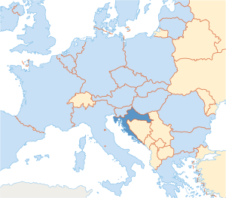
Croatia
at the crossroads of
Central and Southeast Europe
on the Adriatic Sea
Capital city: Zagreb
Anthem: ”Lijepa naša domovino”
President: Kolinda Grabar Kitarović

Slide 3
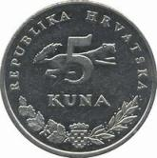
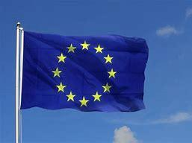
Currency: kuna
area: 56,594 km²
Population: 4.28 million
in the European Union since
1 July 2013

Slide 4
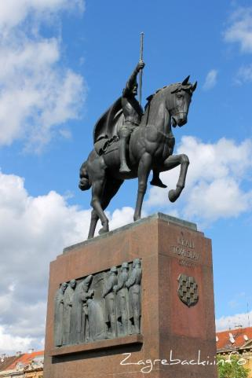
History
On this area since 7th century
First king: Tomislav (925)
In 1527 faced with Ottoman conquest
was part of the: Habsburg monarchy,
Austria-Hungary, Yugoslavia
declared independence on 8th of August 1991
Croatian War of Independence (1991-1995)

Slide 5
Geographical regions

Slide 6
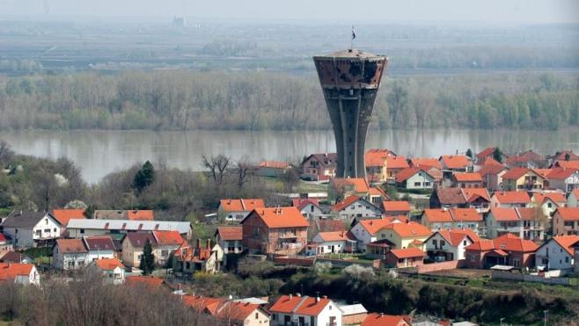
Vukovar

Slide 7
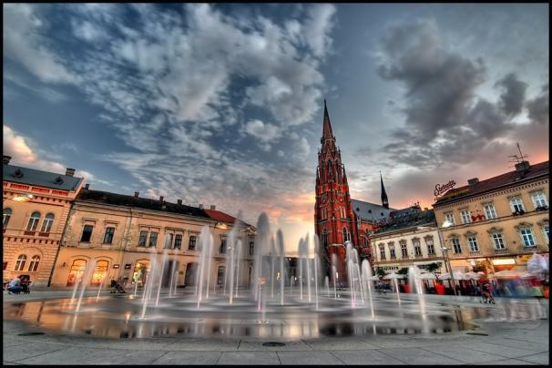
Osijek

Slide 8
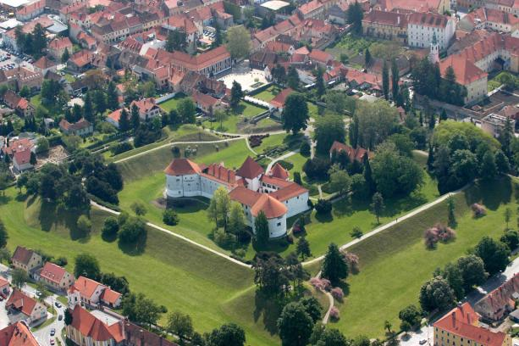
Varaždin

Slide 9
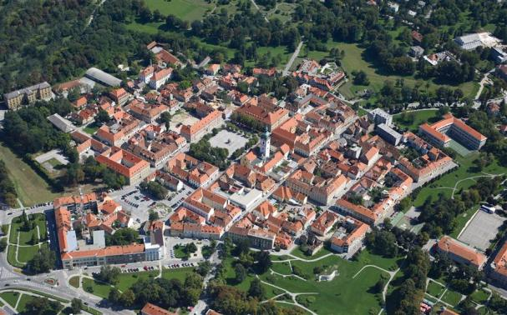
Karlovac

Slide 10
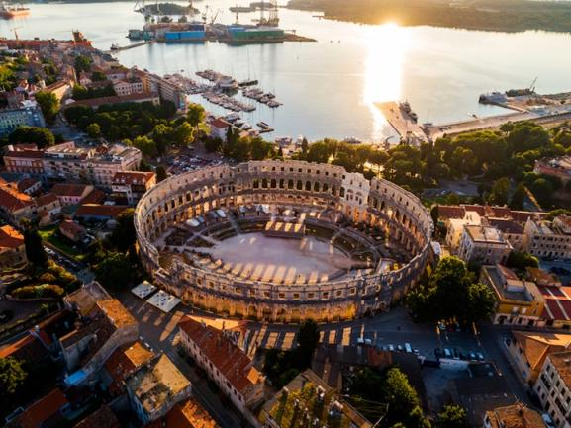
Pula

Slide 11
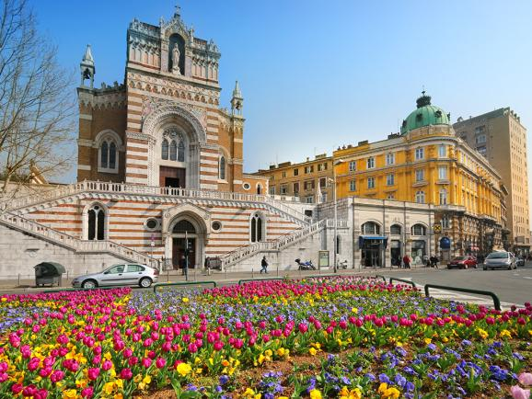
Rijeka

Slide 12
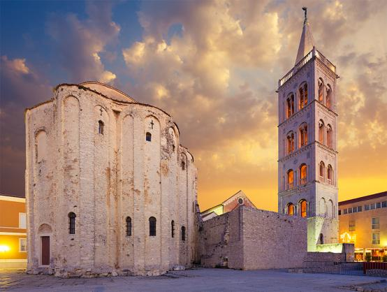
Zadar

Slide 13
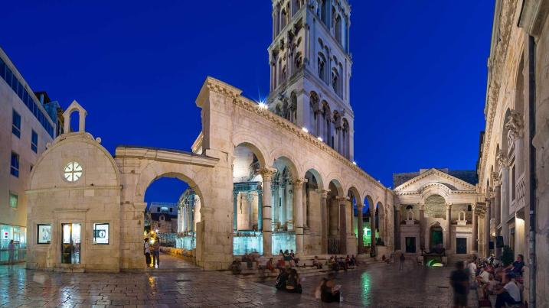
Split

Slide 14
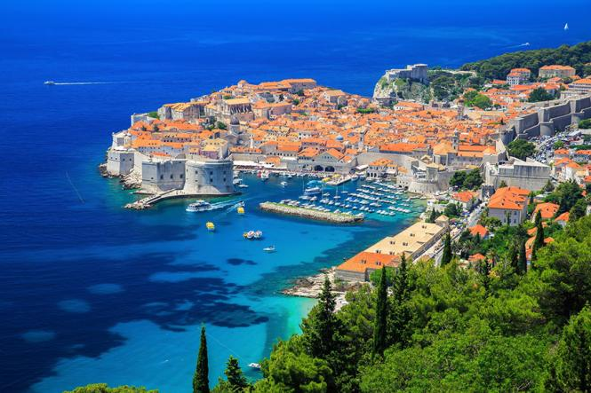
Dubrovnik

Slide 15
Adriatic sea
The coast is generally bold and rocky
Crystal clear sea water
Hundreds of islands, 66 inhabited
Some of the islands: Brijuni, Krk , Cres, Losinj, Rab, Pag,
Dugi Otok, Kornati, Brac, Hvar, Korcula, Mljet...
tourism

Slide 16
Protected areas National Parks
Plitvička jezera

Slide 17
Paklenica

Slide 18
Kornati

Slide 19
Nature Parks
Kopački rit

Slide 20
Žumberak-Samoborsko gorje

Slide 21
Biokovo

Slide 22
Eufrazijeva Bazilika Poreč

Slide 23
Stara gradska jezgra - Trogir

Slide 24
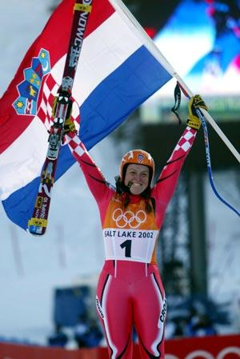
Sport
Dražen Petrović
Janica Kostelić

Slide 25
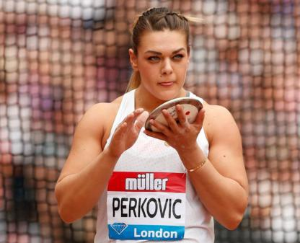
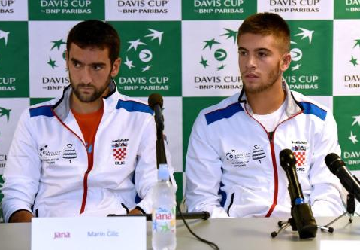
Marin Čilić and Borna Čorić

Slide 26
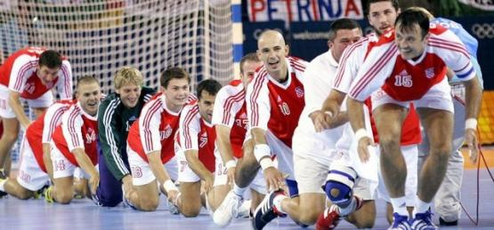
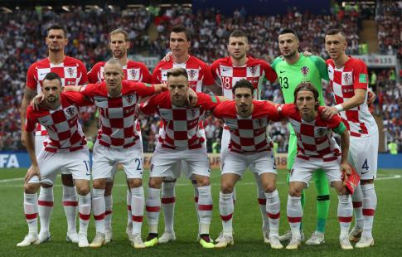

Slide 27
Zagrebačka županija

Slide 28
Zagreb
7th of September 1850 Kaptol and Gradec united in Zagreb
along the Sava river, beneath
Medvednica mountain
the largest city in Croatia
800.000 inhabitants
17 city districts
Main square
Ban Josip Jelčić Square

Slide 29
Zagreb Cathedral

Slide 30
St. Mark's Church

Slide 31
Croatian National Theater

Slide 32
Park Zrinjevac

Slide 33
Dolac Market

Slide 34
Advent in Zagreb

Slide 35
Zaprešić
bordered on the south by the Sava River,
on the east by Zagreb
30th of November 1995
26 000 inhabitants (wider area - 50 000 inhabitants)
two primary schools, a high school, a collelge

Slide 36
Dr. Franjo Tuđman Square

Slide 37
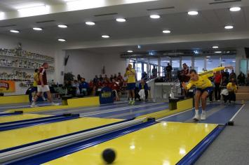
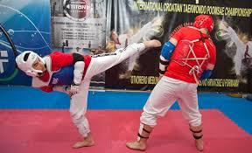
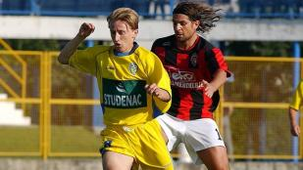
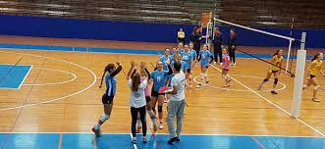
Sports
Bowling
Taekwondo
Football
Handball
Volleyball

Slide 38
Castle Lužnica

Slide 39
The Jelačić Novi Dvori

Slide 40
Ban josip jelačić

Slide 41
sš ban josip jelačić

Slide 42
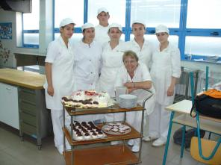
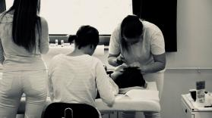
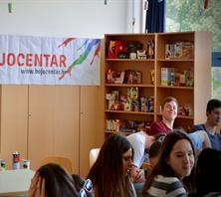
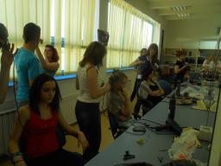
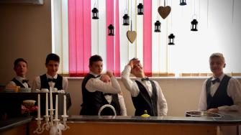
sš ban josip jelačić

Slide 43
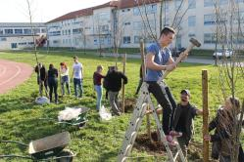
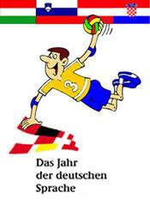
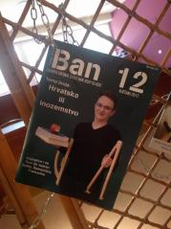
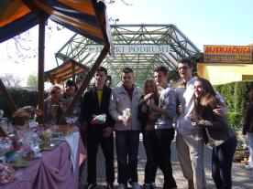
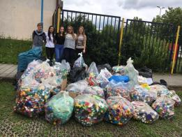
sš ban josip jelačić

Slide 44
ERASMUS+ PROJECTS
KA 101 The 21st Century Classroom
KA 101 The Growth Mindset
Ka 229 Raising Responsible Citizens
KA 229 New Teaching Methodologies

Slide 45
Thank you for your attention!

