Slide 1
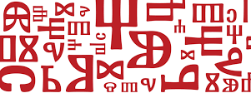
Glagolitic Script

Slide 2
Croatian scripts
Croatian Glagolitic Script
Croatian Cyrillic Script
Latin

Slide 3
Glagolitic Script – intangible cultural heritage
the oldwest known Slavic alphabet
9th to 19th century
St. Cyril and Methodius
used only in churches in Croatia

Slide 4
Glagolitic Script
The Croats – the only nation in Europe allowed to use its national language and script in liturgy

Slide 5
Glagolitic Monuments
a stone tablet – Baška Stone Tablet from the island of Krk
11th century

Slide 6
Glagolitic Monuments
The Vinodol Code- a legal document
moral protection and integrity of women

Slide 7
Glagolitic Monuments
The Missal of Hrvoje – a liturgical book
colourful illustrations

Slide 8
Fun Facts about Glagolitic Script
more liturgies than in any other script in the world
glagolitic script is still use in some churches
the last Croatian Glagolitic book was printed in Rome in 1905

Slide 9
Glagolitic Script
using Glagolitic Script write a message to a friend and sign

