Slide 1
ICT Learning
Escola Básica e Secundária Dr. Ângelo Augusto da Silva
April 1st - 7th 2019
Laurinda Jardim & MarleneRamos

Slide 2
Information and Communication Technology in Education
How can it improve learning and teaching at school?

Slide 3
School is a place for innovation and where students should experiment.
By using ICT tools, they can learn to:
Relate to each other;
Question;
Build and develop knowledge;
Communicate assertively.

Slide 4
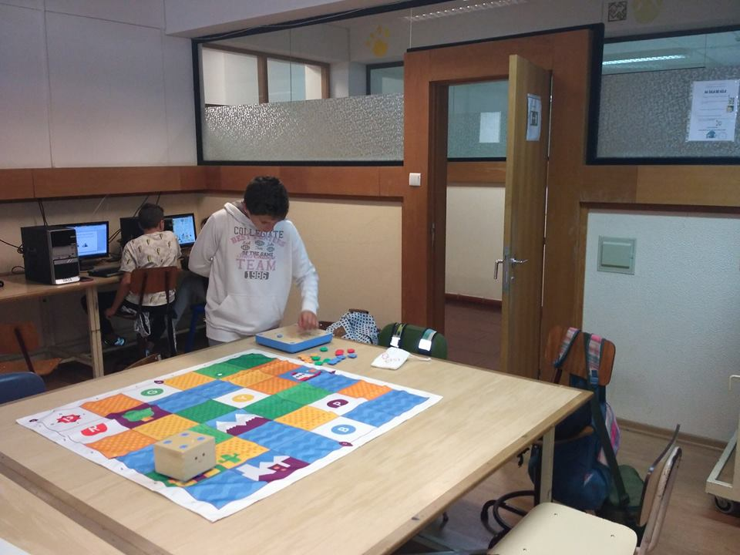
Some practical examples
5th grade – Class Project – “The life of a little seed” – based on a mandatory reading, students will replicate the stages of the development of a seed on a robot device (Robot CUBETTO) – prized project.
Final product: storyboard with Robot Cubetto to learn concepts from Science, Maths, Portuguese, ICT, History … based on several researches.

Slide 5
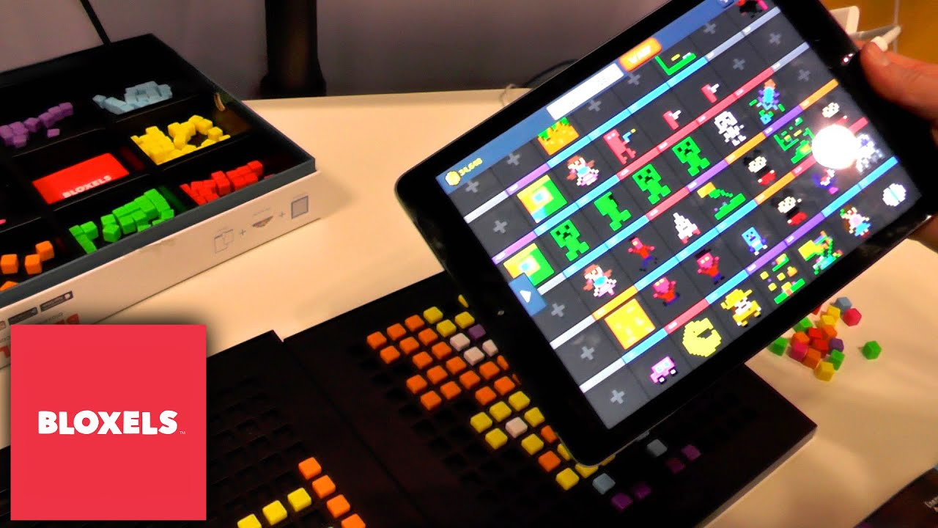
Some practical examples
7th grade – Class Project – “The Danish Knight” – based on a mandatory reading, students will create an interactive game using Bloxels and replicating different challenges on different levels - prized project.
Stages
Creating the characters and surroundings/background according to what they have studied in Portuguese class;
Arts- the design;
Sports – different types of jumps;
Physics – velocity ;
English – translation;
Math – score, coordinates.

Slide 6
DAC – Maths /ICT – 5th and 6th grades
Combination of two subjects - interdisciplinary approaches
teachers develope interdisciplinary and cross-classroom activities combining topics and subjects in meaningful and purposeful ways by using ICT tools.

Slide 7
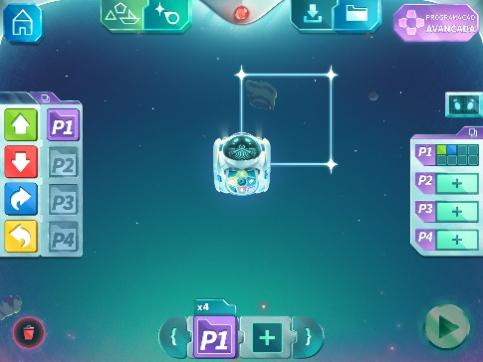
Aplicações

Slide 8
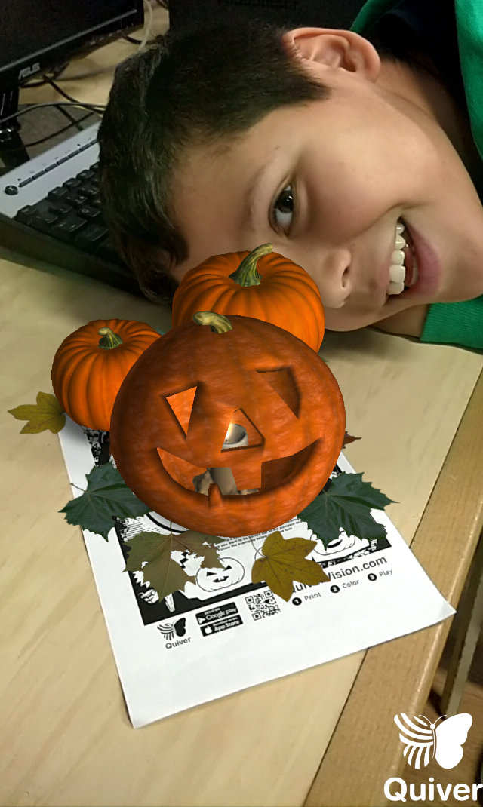
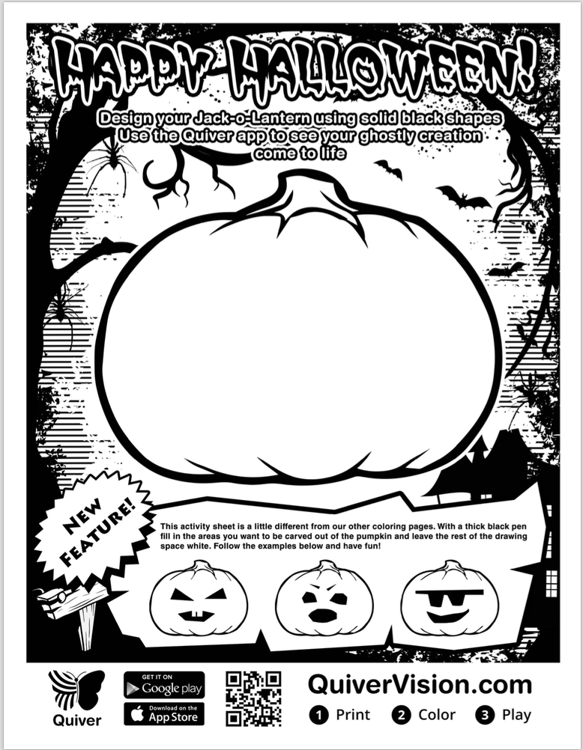
QUIVER VISION

Slide 9
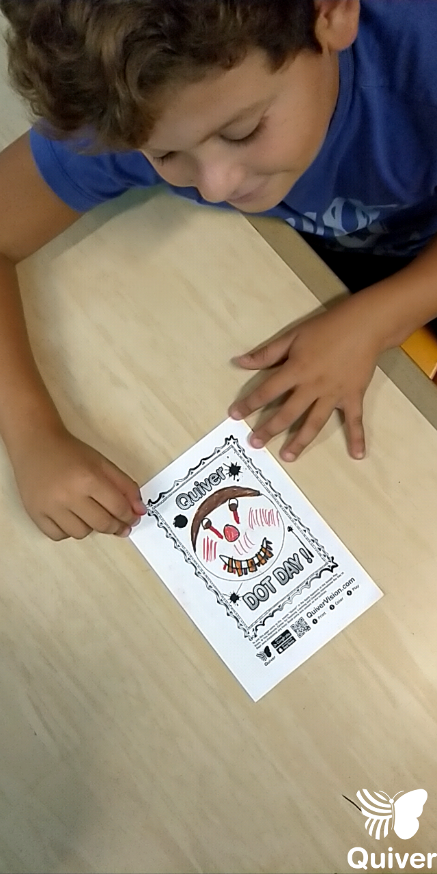
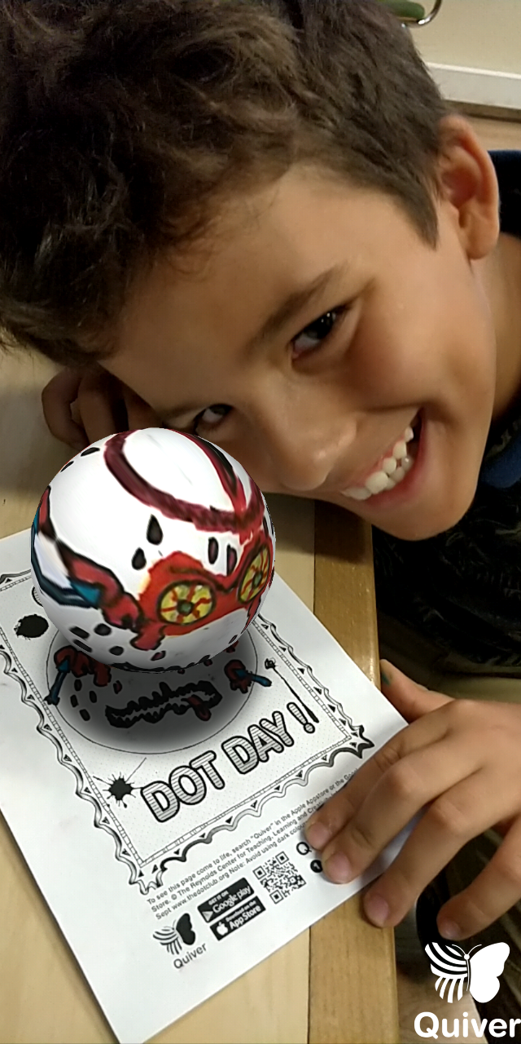

Slide 10
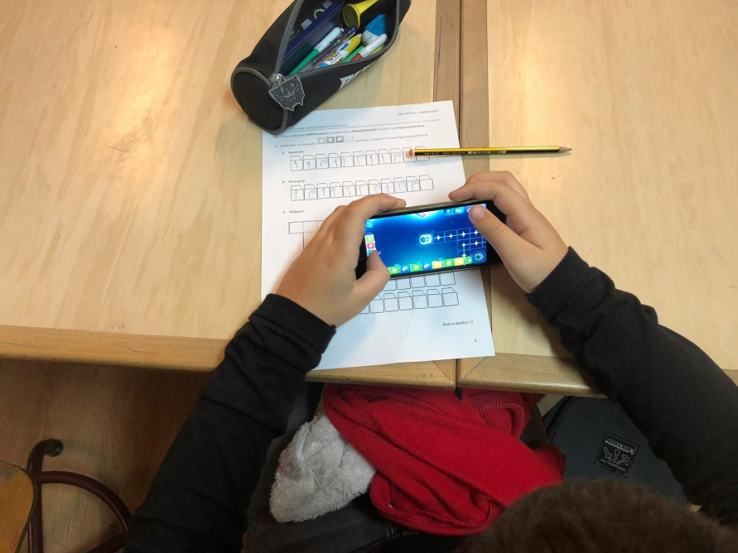
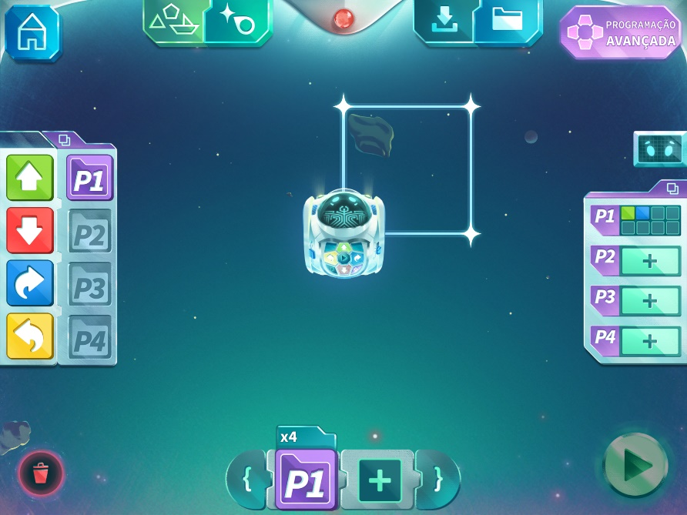
MIND DESIGNER

Slide 11
MIND DESIGNER

