Slide 1
3D Zaprešić Ivana Imbrija
Ivana Imbrija
Erasmus+, KA2, April 2nd, 2019, Zaprešić, Croatia
Ta fotografija korisnika Nepoznat autor: licenca CC BY-SA-NC

Slide 2
3D Zaprešić project
Maths project
last theme in the 2nd grade – 3D shapes
IT tehnicans

Slide 3
Main objectives
identify the 3D objects and classify the items
calculate the realistic measurements
develop higher cognitive and ICT skills
develop self-confidence, leadership, time management and collaborative skills as well as tolerance and responsibility
developing awareness of the importance of Zaprešić cultural heritage
evaluate the work of the peers

Slide 4
Contents
list of public buildings in Zaprešić
each student chooses one of them and application for the modeling
duration: one month
share the final model over an e-mail
a video with a translation in English

Slide 5
Methodology
student centered
content-focused (geometry, volume, cultural heritage..)and process-focused (applications, videos, presentations…)
students’ interaction, collaboration and active participation
transversal skills - organisational, collaboration and communication skills

Slide 6
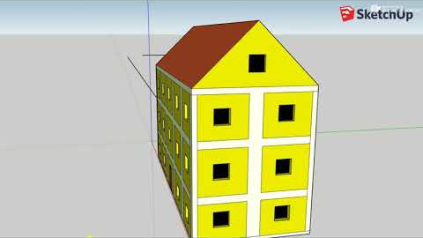

Slide 7
Questions?

Slide 8
Thank you!

