Slide 1
school for all
Ankica šarić

Slide 2
Inclusion
Special education needs students
Immigrants and national minorities

Slide 3
Special Education Needs
students with learning difficulties
Gifted students
Education act about primary and secondary education for students with special needs ( 23 February, 2015)

Slide 4
Individualized program
For students with dyslexia, dysgraphia, dyscalculia, language difficulties, ADHD, vision and hearing difficulties, physically disabled, children with combined disabilities

Slide 5
Special needs students in sš bjj
Individualized program – 36 students
Special (adjusted) education program – 28 students
2 down syndrome; 1 cerebral paralysis; 1 highly functional autism teaching assisstant

Slide 6
Individualized program

Slide 7
Special education program / adjusted program
Setting achievable goals
planning activities which will help achieve those goals
appropriate evaluation

Slide 9
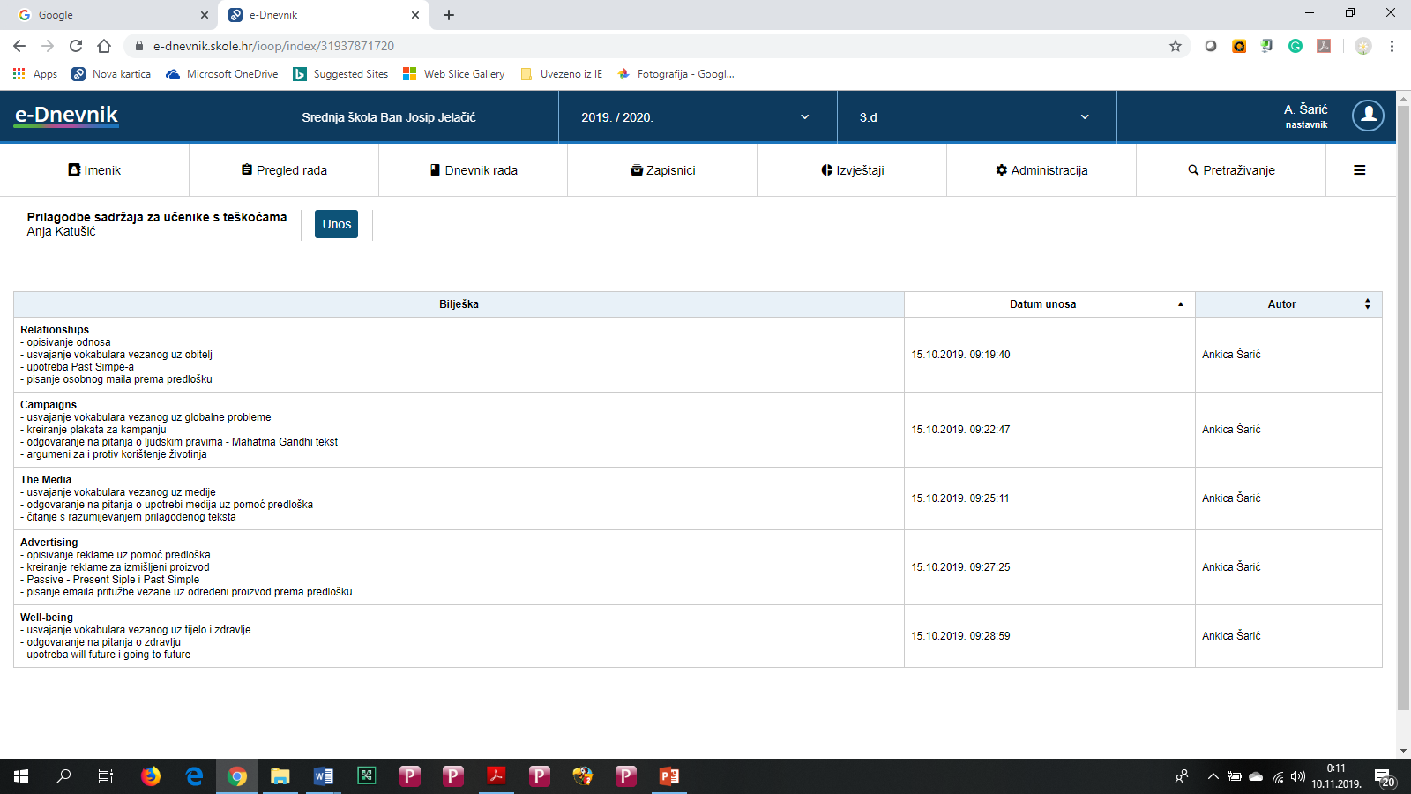

Slide 10
Special education program / adjusted program
For students with intellectual disabilities
graphic, language, content adjustment

Slide 11
Graphic, language, content adjustment

Slide 12
Social inclusion - Exhibition

Slide 13
Social inclusion - Exhibition

