Slide 1
Why Should I Visit Novi Dvori?

Slide 2
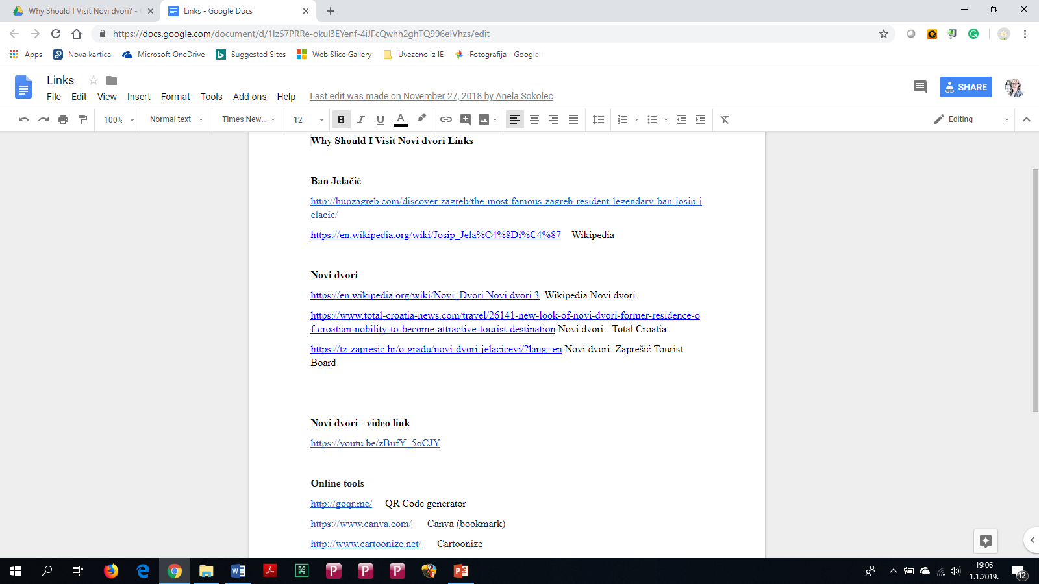

Slide 3
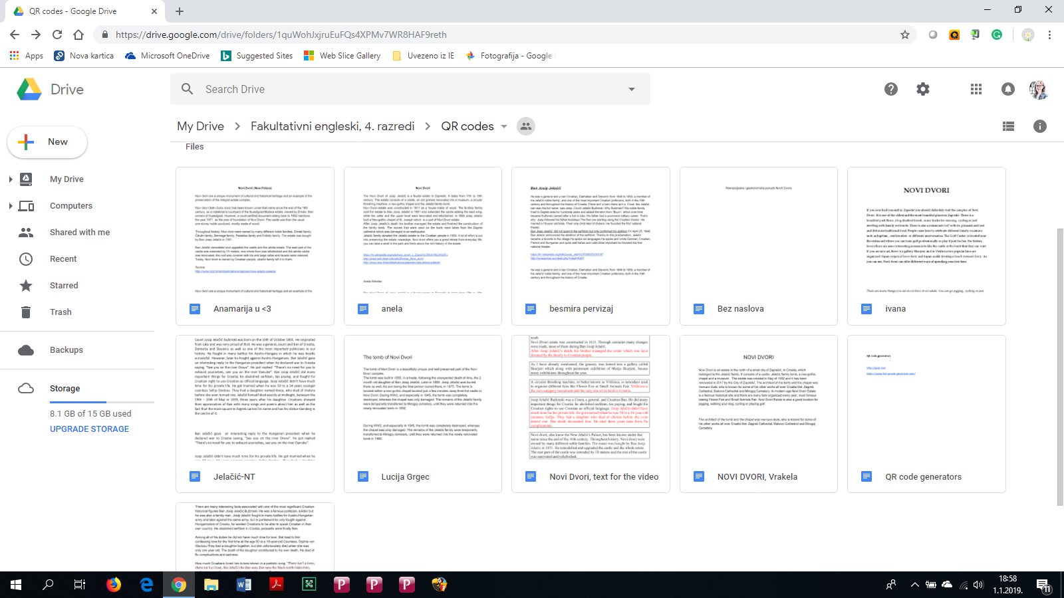

Slide 4
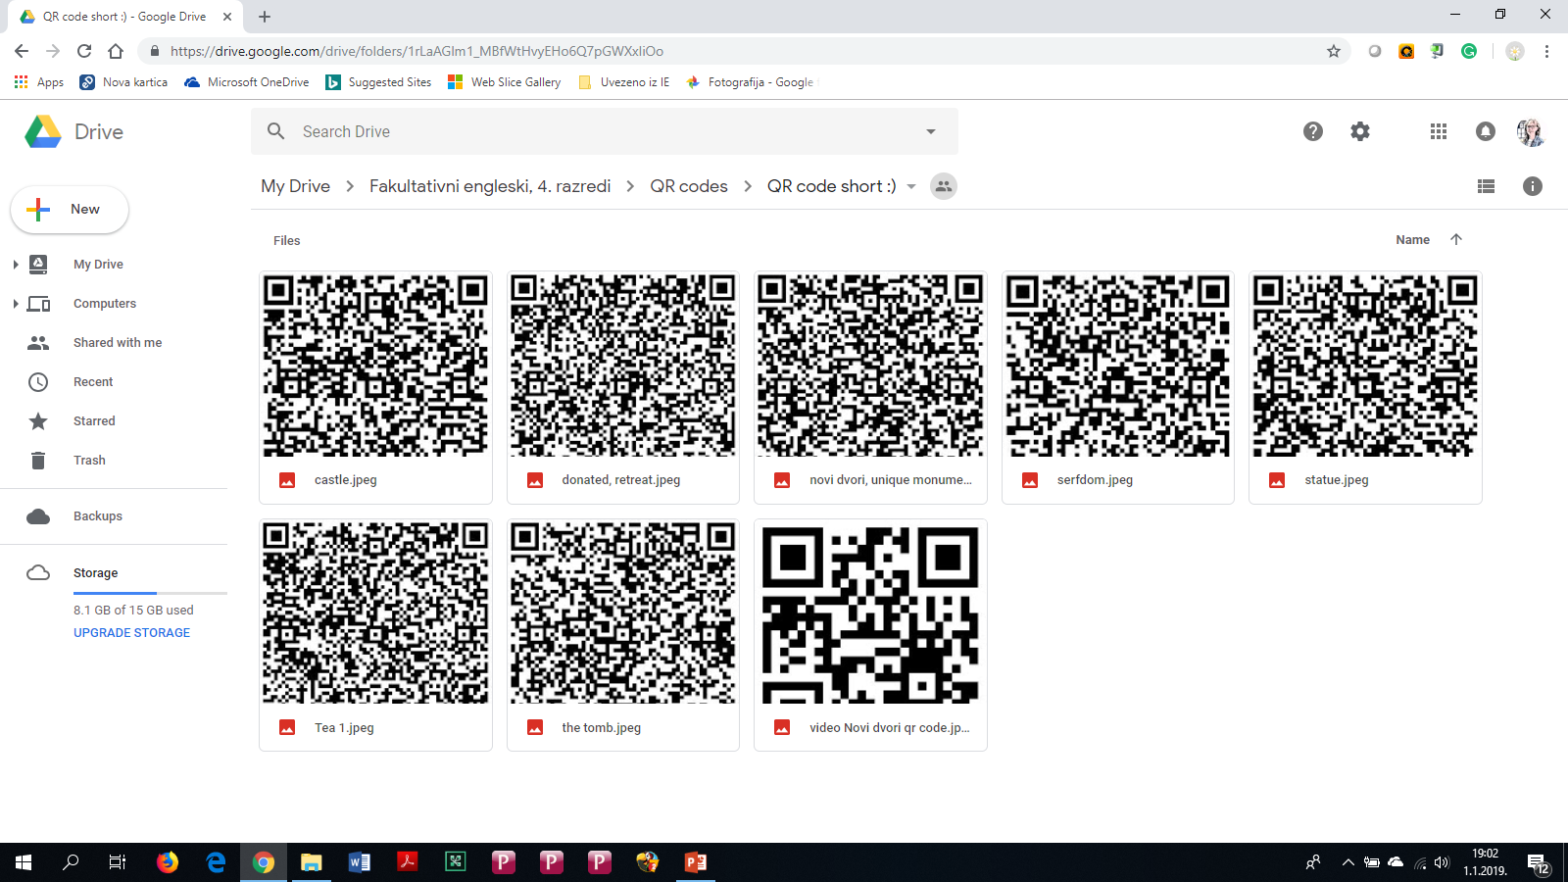

Slide 5
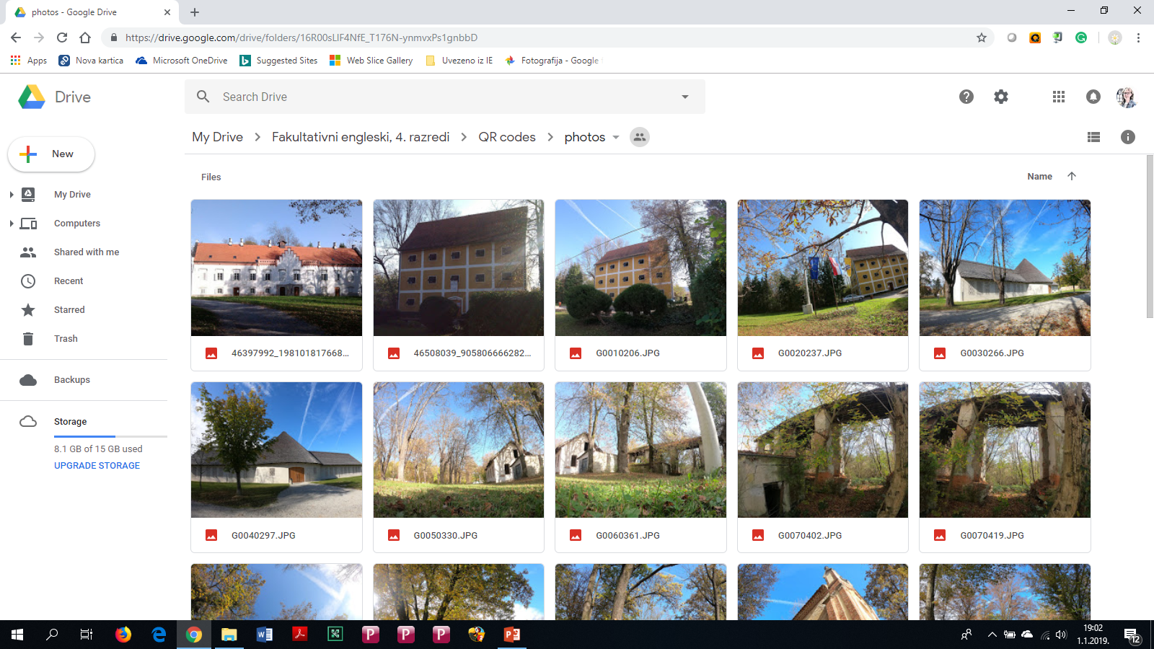

Slide 6
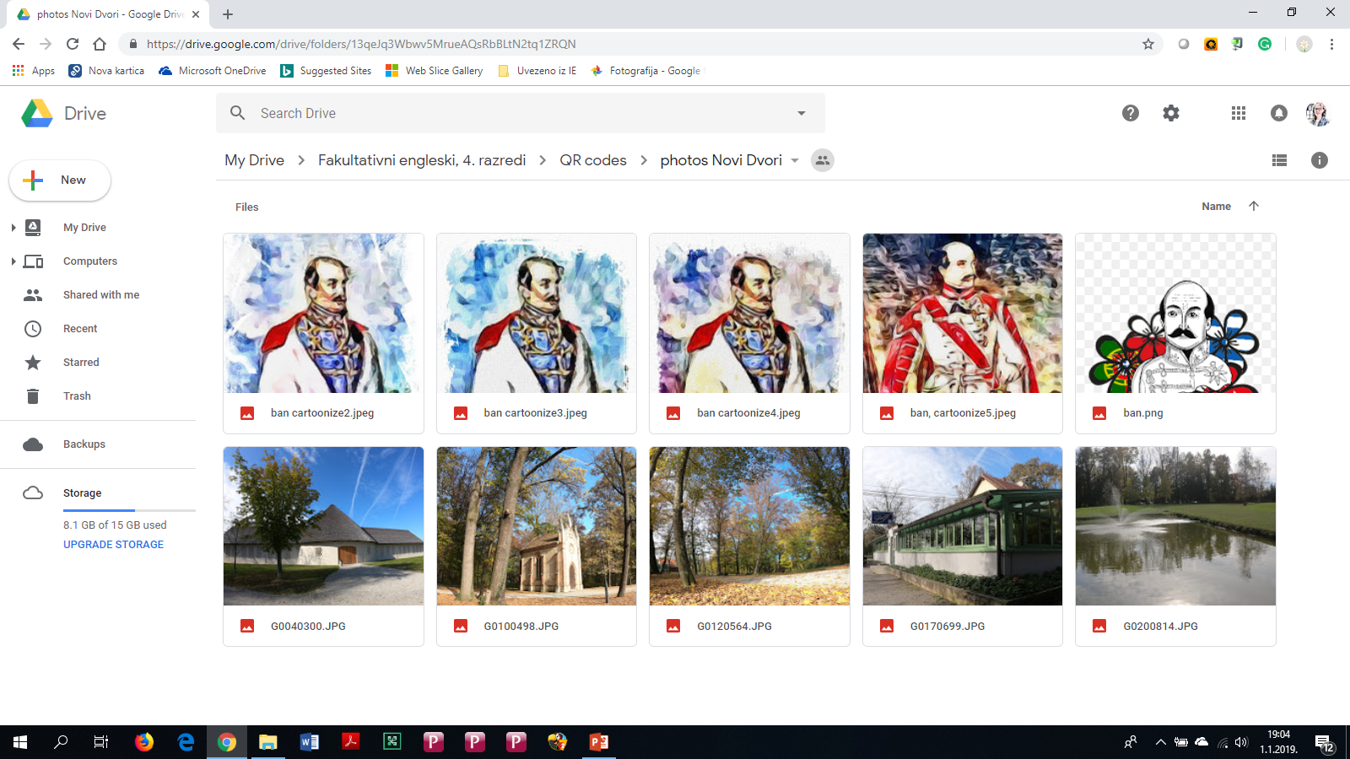

Slide 7
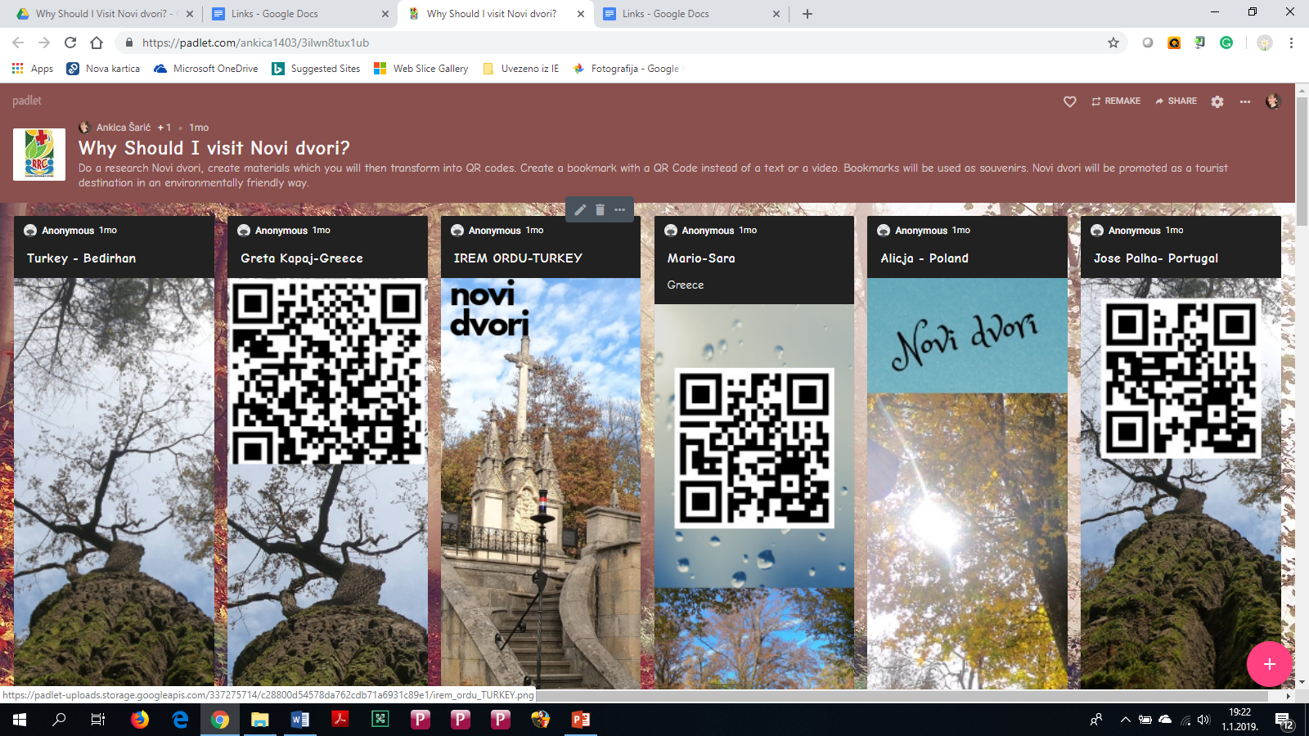

Slide 8
Bookmarks with QR Codes about Novi Dvori

Slide 9
Bookmarks with QR Codes about Ban Josip Jelačić

Slide 10
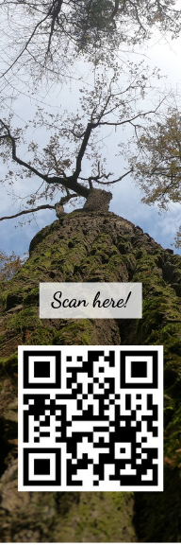
Bookmarks with QR Code of a video about Novi Dvori estate

