Slide 1
ICT Learning
Escola Básica e Secundária Dr. Ângelo Augusto da Silva
April 1st - 7th 2019
Laurinda Jardim & MarleneRamos

Slide 2
CODE CLUB
This project aims to develop the knowledge of ICT tools amongst our youngest students.
In Portugal, schools are experimenting more autonomy and flexibility in the curriculum. Therefore this project is now being put in practice with small groups of students.
It aims to:
- Enjoy learning through technological means and ICT tools .
- Make learning more participatory.
- Improve interpersonal relationships.
- Increase teamwork.
Tools: Scratch; Lego Mindstorms EV3; MakeyMakey
Clube de Código Ebsaas
Computer code/programming
Robotics

Slide 3
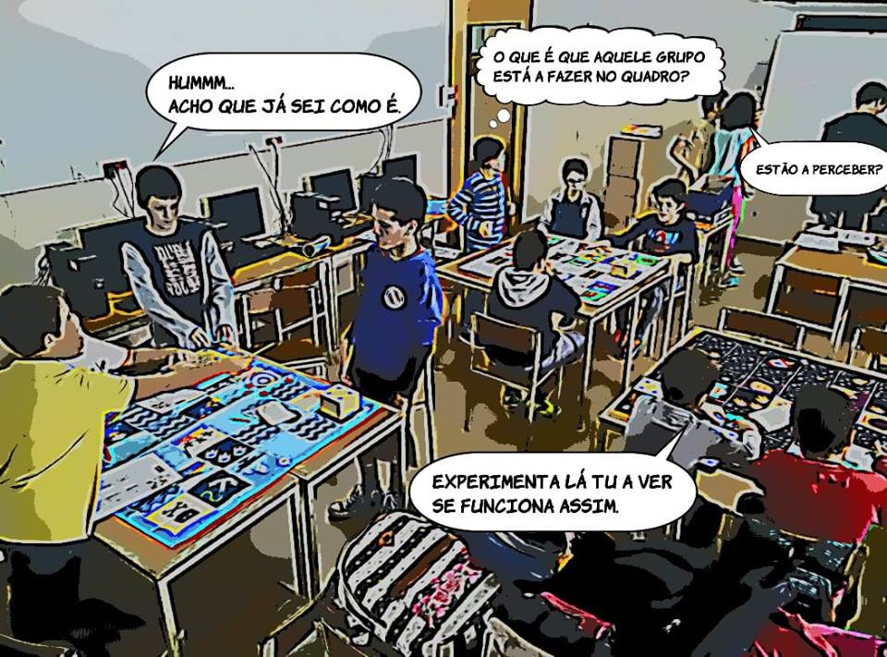
CODE CLUB

Slide 4
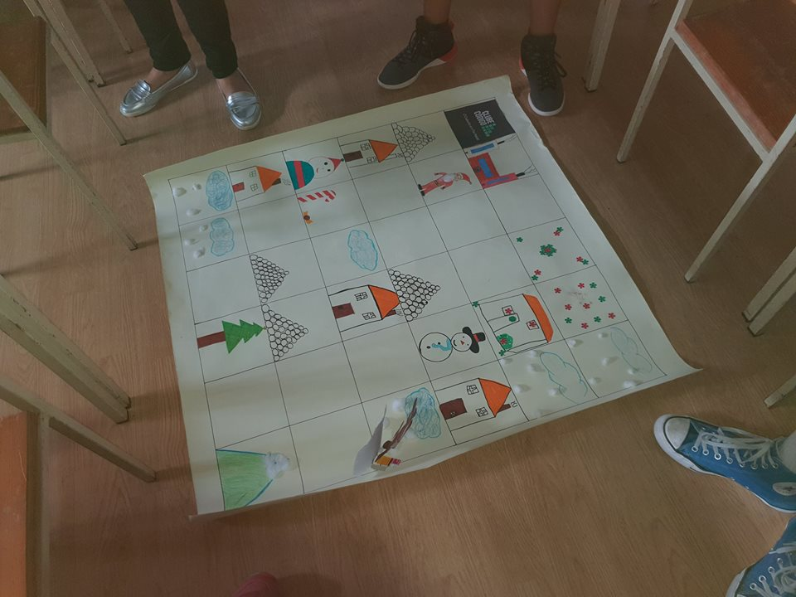
CODE CLUB @clubecodigoebsaas

